Slide 1
4
Deep Learning

Slide 2
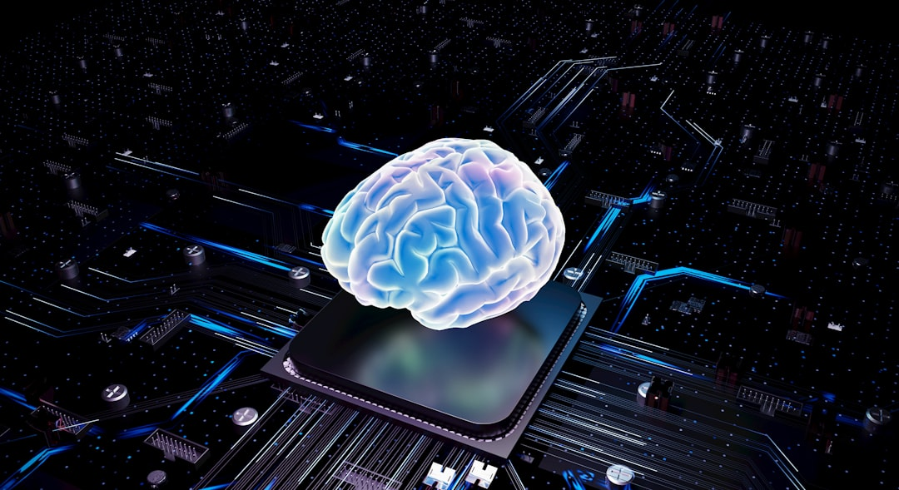
Introduction
Deep learning is a subset of machine learning techniques inspired by neural networks.
It uses multiple layers of artificial neural networks to analyze data and make decisions.
Deep learning models can learn complex patterns in large datasets automatically.
The backpropagation algorithm is commonly used to train deep learning models efficiently.
h_t = tanh(Wx_t + Uh_{t-1}) represents a basic recurrent neural network equation.
Deep learning has many applications in computer vision, natural language processing, and robotics.
Notes:
Explain Introduction in the context of 4.

Slide 3
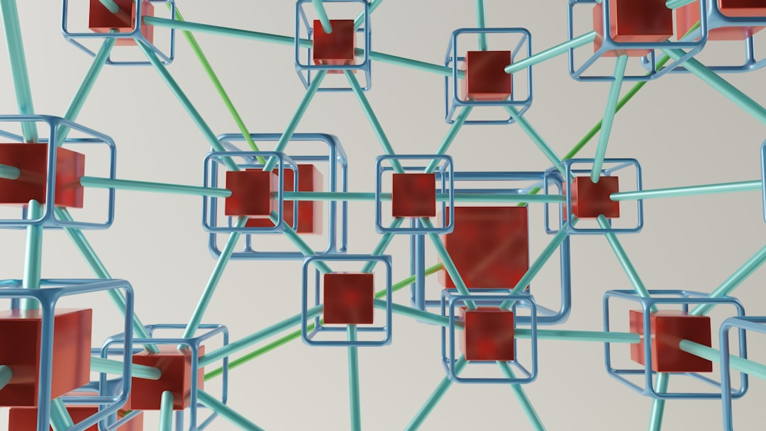
Core Concept / Architecture
Deep learning models are composed of multiple layers of artificial neural networks.
The architecture of deep learning models is designed to mimic the human brain's structure.
Convolutional neural networks are a type of deep learning model used for image recognition.
Recurrent neural networks are suitable for sequential data such as speech or text.
The backpropagation algorithm is used to train deep learning models by minimizing errors.
h_t = tanh(Wx_t + Uh_{t-1}) represents the hidden state in a recurrent neural network.
Notes:
Explain Core Concept / Architecture in the context of 4.

Slide 4
Mathematical / Logical Explanation
Deep learning models rely on neural networks with multiple layers of processing units.
The activation function introduces non-linearity to the model's predictions and outputs.
h_t = tanh(Wx_t + Uh_{t-1}) represents the hidden state in a recurrent neural network.
Backpropagation is used to train the model by minimizing the error and adjusting weights.
Gradient descent optimizes the model's parameters to reduce the loss function's value.
Regularization techniques prevent overfitting by adding a penalty term to the loss function.
The choice of optimizer and hyperparameters significantly affects the model's performance.
Notes:
Explain Mathematical / Logical Explanation in the context of 4.

Slide 5
Applications / Use Cases
Deep learning is used for image recognition and object detection purposes.
Natural language processing relies heavily on deep learning algorithms.
Speech recognition systems are built using deep learning techniques.
Deep learning is applied in recommender systems for personalized suggestions.
Self-driving cars utilize deep learning for navigation and control.
Medical diagnosis uses deep learning for disease detection and analysis.
Time series forecasting is another significant application of deep learning.
Notes:
Explain Applications / Use Cases in the context of 4.

Slide 6
Thank You

