Slide 1
RNNS
Deep Learning

Slide 2
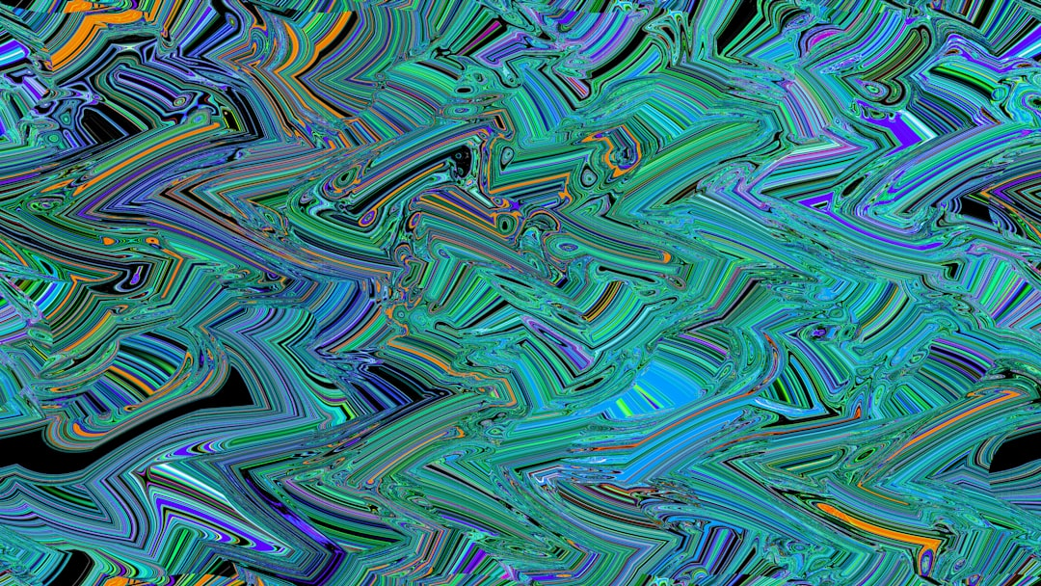
Introduction
Recurrent Neural Networks are a type of deep learning model.
RNNS are designed to handle sequential data and time series forecasting.
They have feedback connections that allow information to loop back.
This looping back of information allows the model to keep track of state.
The architecture of RNNS consists of an input layer and hidden layers.
The hidden layers are where the sequential data is processed and patterns learned.
Notes:
Explain Introduction in the context of RNNS.

Slide 3
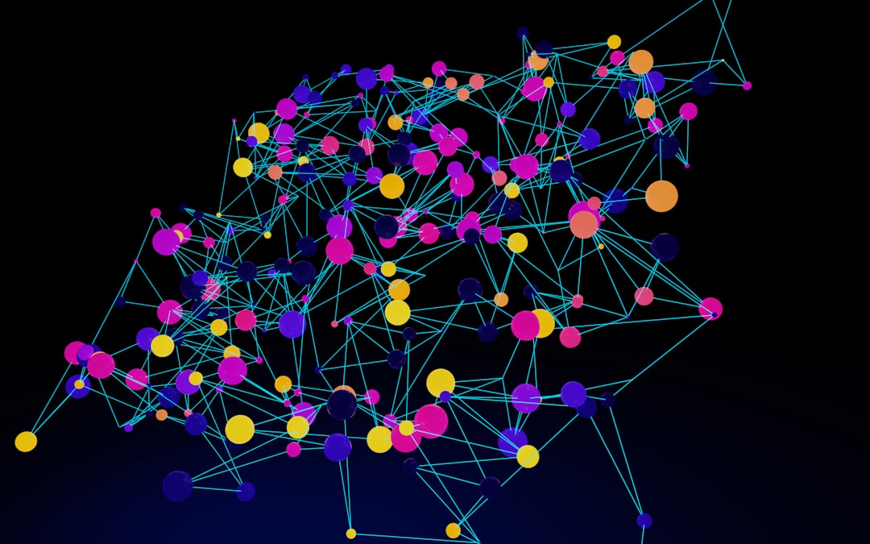
Core Concept / Architecture
Recurrent Neural Networks (RNNs) are a type of neural network designed for sequential data processing.
The core concept of RNNs involves recursive feedback connections that enable information retention.
RNNs consist of an input layer, a hidden layer, and an output layer with interconnected nodes.
The hidden layer retains internal state, allowing the network to keep track of context and make predictions.
h_t = tanh(Wx_t + Uh_{t-1}) represents the mathematical formulation of the hidden state update process.
RNNs can be further divided into subcategories, including Simple RNNs, LSTMs, and GRUs, each with unique strengths.
Notes:
Explain Core Concept / Architecture in the context of RNNS.

Slide 4
Mathematical / Logical Explanation
Recurrent Neural Networks utilize sequential data to predict outcomes.
The mathematical formulation of RNNs involves recursive equations.
h_t = tanh(Wx_t + Uh_{t-1}) represents the hidden state calculation.
RNNs can learn long-term patterns and dependencies in data sequences.
Backpropagation through time is used for training RNN models effectively.
Vanishing gradients are a common issue in deep RNN architectures.
Gated Recurrent Units and Long Short-Term Memory solve this problem.
Notes:
Explain Mathematical / Logical Explanation in the context of RNNS.

Slide 5
Applications / Use Cases
Recurrent Neural Networks are used in language modeling tasks.
RNNS are applied in speech recognition systems effectively.
They are utilized in time series forecasting and prediction.
RNNS are also used in machine translation tasks successfully.
Sentiment analysis and text classification use RNNS extensively.
Handwriting recognition systems rely on RNNS for accuracy.
Natural Language Processing uses RNNS for intent detection.
Notes:
Explain Applications / Use Cases in the context of RNNS.

Slide 6
Thank You

