Slide 1
RNNs
Deep Learning

Slide 2
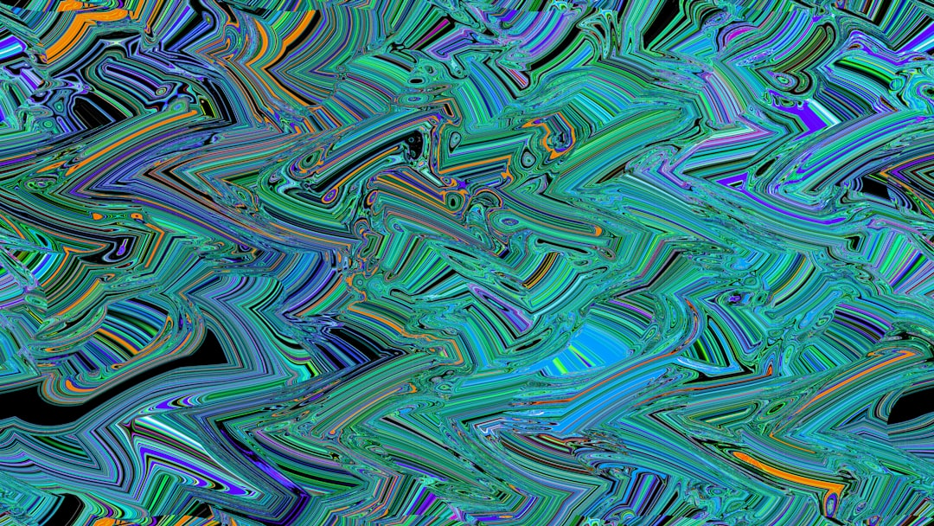
Introduction
The primary focus of Introduction involves understanding the foundational mechanics of RNNs within the broader context of Deep Learning.
A mathematical or structural approach to Introduction helps illustrate how various components interact and influence the overall outcome.
Engineers and researchers utilize these concepts extensively to build robust systems that account for dynamic changes in the environment.
One critical piece of this subject is recognizing the limitations and assumptions that bound standard models and equations.
To effectively apply Introduction, one must first evaluate baseline metrics and then execute iterative improvements.
Historically, advancements in this area of RNNs have relied heavily on both empirical validation and rigorous theoretical frameworks.
Notes:
Explain Introduction in the context of RNNs.

Slide 3
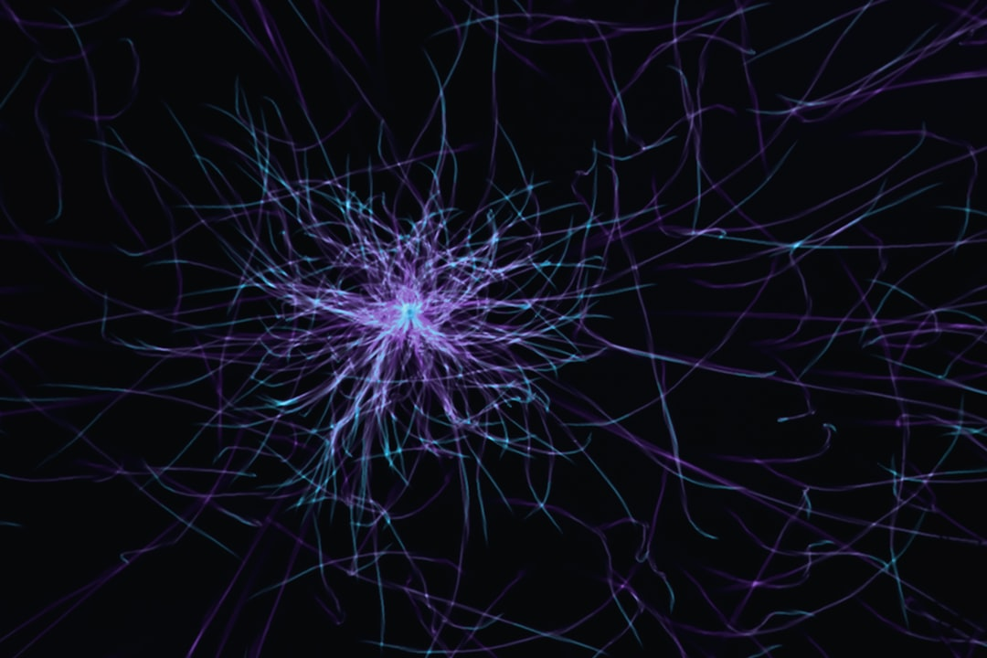
Core Concept / Architecture
The core concept of Recurrent Neural Networks (RNNs) revolves around their ability to capture sequential relationships in data, such as t...
RNNs typically consist of an input layer, a hidden layer, and an output layer, with the hidden layer being where the recurrent connection...
The activation function, such as sigmoid or tanh, is crucial in RNNs as it introduces non-linearity into the model, enabling the network...
Backpropagation Through Time (BPTT) is a key algorithm used for training RNNs, which involves unrolling the network in time, allowing the...
To mitigate the vanishing gradient problem in RNNs, techniques such as gradient clipping, where the gradient is scaled to have a maximum...
The choice of activation function and initialization of the recurrent weight matrix can significantly impact the performance of an RNN, w...
RNNs can be further extended to more complex architectures, such as bidirectional RNNs, which process the input sequence in both forward...
In terms of training RNNs, stochastic gradient descent (SGD) with momentum is often used, where the update rule for the model parameters...
Regularization techniques, such as dropout, where a fraction of the neurons are randomly dropped during training, or L1 and L2 regulariza...
Notes:
Explain Core Concept / Architecture in the context of RNNs.

Slide 4
Mathematical / Logical Explanation
A Recurrent Neural Network (RNN) is a type of neural network where the output from the previous step is fed as input to the current step,...
The activation function, typically a sigmoid or tanh function, introduces non-linearity into the model, enabling the RNN to learn and rep...
The RNN's ability to maintain a hidden state over time allows it to capture temporal relationships in sequential data, such as speech, te...
Training an RNN involves optimizing the model's parameters to minimize the difference between the predicted output and the actual output,...
To mitigate the vanishing gradient problem, which can occur when training RNNs using BPTT, techniques such as gradient clipping, weight r...
RNNs can also be used for generative modeling, where the goal is to learn a probability distribution over a sequence of data, such as tex...
In addition to LSTMs, other variants of RNNs include Gated Recurrent Units (GRUs) and Bidirectional RNNs, which can be used to model more...
The choice of activation function and optimization algorithm can significantly impact the performance of an RNN, with popular choices inc...
Notes:
Explain Mathematical / Logical Explanation in the context of RNNs.

Slide 5
Applications / Use Cases
Recurrent Neural Networks (RNNs) are widely used in Natural Language Processing (NLP) tasks, such as language modeling, where the goal is...
RNNs are also applied in speech recognition systems, where they are used to model the temporal relationships between acoustic features, s...
In addition, RNNs are used in machine translation tasks, where they are employed to model the sequential relationships between words in t...
Another application of RNNs is in time series forecasting, where they are used to predict future values in a sequence, such as stock pric...
RNNs are also used in sentiment analysis tasks, where they are employed to model the sequential relationships between words in a sentence...
Furthermore, RNNs are applied in chatbots and dialogue systems, where they are used to model the sequential relationships between user in...
RNNs are also used in music generation tasks, where they are employed to model the sequential relationships between musical notes, to gen...
In addition, RNNs are applied in video analysis tasks, such as action recognition and object detection, where they are used to model the...
RNNs are also used in recommender systems, where they are employed to model the sequential relationships between user interactions, such...
Notes:
Explain Applications / Use Cases in the context of RNNs.

Slide 6
Summary & Key Takeaways
Recurrent Neural Networks (RNNs) are a type of deep learning model that is particularly well-suited for sequential data, such as time ser...
The primary component of an RNN is the recurrent layer, which consists of a set of recurrently connected nodes or neurons, where each nod...
One of the key challenges in training RNNs is the vanishing gradient problem, which occurs when the gradients of the loss function with r...
RNNs can be further categorized into different types, including Simple RNNs, LSTM (Long Short-Term Memory) networks, and GRU (Gated Recur...
LSTM networks, in particular, are designed to handle the vanishing gradient problem by introducing a set of gates, including the input ga...
GRU networks, on the other hand, are a simpler alternative to LSTM networks, and consist of a reset gate and an update gate, which contro...
In terms of applications, RNNs have been widely used in a variety of tasks, including language modeling, speech recognition, and machine...
The choice of optimization algorithm and hyperparameters, such as the learning rate and batch size, can have a significant impact on the...
Finally, RNNs can be evaluated using a variety of metrics, including perplexity, accuracy, and F1 score, which provide a measure of the m...
Notes:
Explain Summary & Key Takeaways in the context of RNNs.

Slide 7
Thank You

