Slide 1
RNNs
Deep Learning

Slide 2
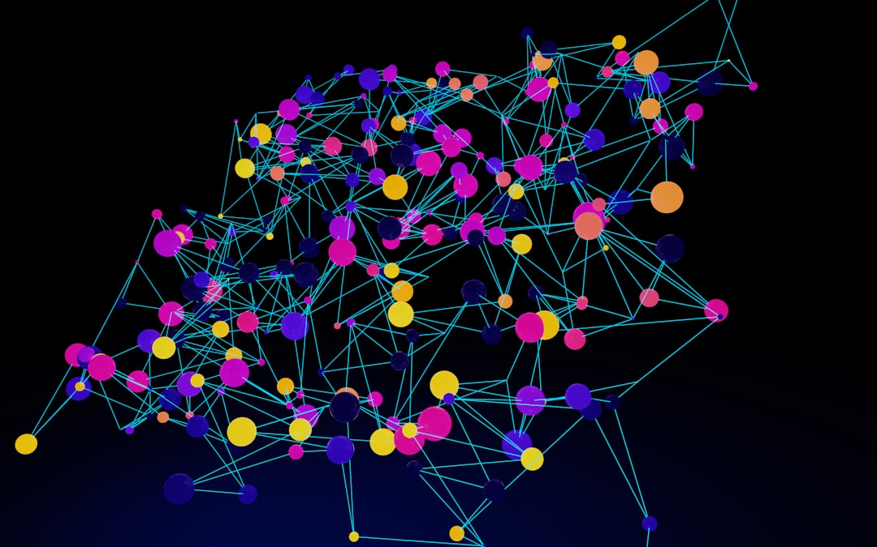
Introduction
Recurrent Neural Networks, or RNNs, are a type of deep learning model that is particularly well-suited for sequential data, such as time series data or natural language processing tasks, where the order of the data matters.
The basic structure of an RNN includes an input gate, a hidden state, and an output gate, which can be represented by the equation h_t = tanh(Wx_t + Uh_{t-1}), where h_t is the hidden state at time t, x_t is the input at time t, and W and U are learnable weights.
RNNs can be trained using backpropagation through time, which involves unrolling the network in time and applying the backpropagation algorithm to compute the gradients of the loss function with respect to the model's parameters.
One of the key benefits of RNNs is their ability to capture long-term dependencies in data, which is achieved through the use of a recurrent connection that allows the model to maintain a hidden state over time, as represented by the equation o_t = softmax(Vh_t), where o_t is the output at time t an
RNNs have been widely used in a variety of applications, including language modeling, speech recognition, and machine translation, where they have achieved state-of-the-art results, and the Long Short-Term Memory, or LSTM, network is a type of RNN that is particularly well-suited for these tasks.
The LSTM network includes a memory cell that allows the model to store information over long periods of time, and the forget gate, input gate, and output gate of the LSTM network can be represented by the equations c_t = f_t * c_{t-1} + i_t * tanh(Wx_t + Uh_{t-1}), h_t = o_t * tanh(c_t), where c_t i
Notes:
Explain Introduction in the context of RNNs.

Slide 3
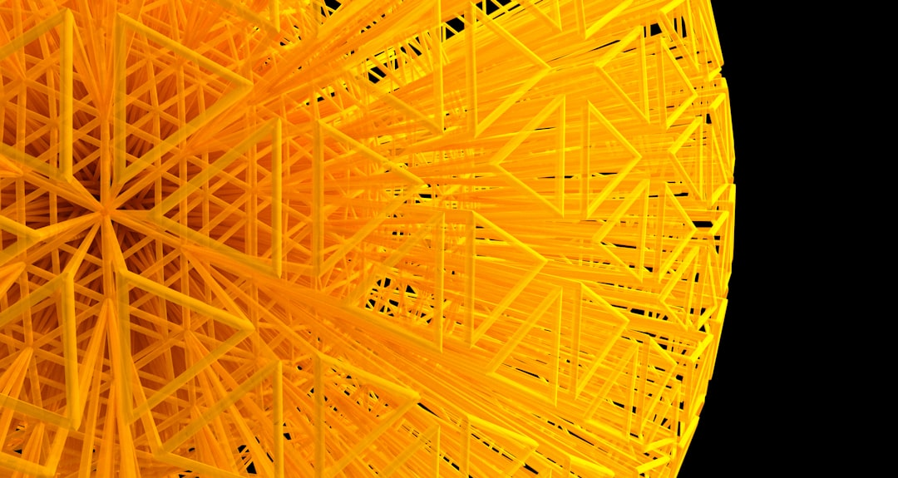
Core Concept / Architecture
The core concept of Recurrent Neural Networks (RNNs) is to capture sequential information by maintaining an internal state, which is updated at each time step using the formula h_t = tanh(Wx_t + Uh_{t-1}), where h_t is the hidden state at time t, W and U are weight matrices, and x_t is the input at
RNNs consist of three main components: the input gate, the hidden state, and the output gate, which work together to process sequential data and generate predictions based on the patterns learned from the data.
The architecture of RNNs can be unfolded in time, allowing the network to keep track of information over long sequences, and the backpropagation through time (BPTT) algorithm is used to train the network by computing the gradient of the loss function with respect to the model's parameters.
The vanilla RNN architecture is simple and effective, but it can suffer from vanishing gradients, which can be addressed using techniques such as gradient clipping or long short-term memory (LSTM) units, which use the formula c_t = f_t * c_{t-1} + i_t * tanh(Wx_t + Uh_{t-1}) to update the cell state
RNNs can be further extended to more complex architectures, such as bidirectional RNNs, which process the input sequence in both forward and backward directions, or encoder-decoder RNNs, which use separate RNNs for encoding and decoding the input and output sequences.
The training process of RNNs involves optimizing the model's parameters to minimize the loss function, which can be done using stochastic gradient descent (SGD) or other optimization algorithms, and the performance of the model is typically evaluated using metrics such as accuracy, precision, and re
Notes:
Explain Core Concept / Architecture in the context of RNNs.

Slide 4
Mathematical / Logical Explanation
The mathematical foundation of Recurrent Neural Networks (RNNs) is based on the concept of recurrence, where the hidden state at time t, denoted as h_t, is computed using the current input x_t and the previous hidden state h_{t-1}, as given by the equation h_t = tanh(Wx_t + Uh_{t-1}).
The activation function, typically tanh or sigmoid, introduces non-linearity into the model, allowing it to learn complex patterns in sequential data, such as time series or natural language processing tasks.
RNNs can be trained using backpropagation through time (BPTT), which computes the gradients of the loss function with respect to the model's parameters by unfolding the network in time and applying the chain rule, as expressed by the equation dL/dW = dL/dh_t * dh_t/dW.
To mitigate the vanishing gradient problem in RNNs, techniques such as gradient clipping and weight regularization can be employed, which help to stabilize the training process and prevent exploding gradients, ensuring that the model learns effectively.
The use of Long Short-Term Memory (LSTM) units or Gated Recurrent Units (GRUs) can also help to alleviate the vanishing gradient issue, as these architectures introduce additional gates that control the flow of information and allow the model to capture long-range dependencies, with the LSTM update
RNNs can be further extended to more complex architectures, such as bidirectional RNNs or encoder-decoder models, which enable the model to capture contextual relationships and generate sequential output, such as machine translation or text summarization tasks.
The choice of optimization algorithm and hyperparameters, such as learning rate and batch size, plays a crucial role in the training process of RNNs, as it affects the convergence rate and stability of the model, with the Adam optimizer being a popular choice due to its adaptive learning rate, given
Notes:
Explain Mathematical / Logical Explanation in the context of RNNs.

Slide 5
Applications / Use Cases
Recurrent Neural Networks (RNNs) are widely used in natural language processing tasks, such as language modeling, where the probability of a word is predicted based on the context of the previous words, using the formula p(w_t | w_1, w_2, ..., w_{t-1}).
RNNs are also applied in speech recognition systems, where the acoustic features of speech are modeled using the equation h_t = tanh(Wx_t + Uh_{t-1}), to predict the spoken words.
In time series forecasting, RNNs are used to predict future values based on past patterns, using the concept of backpropagation through time, which unfolds the RNN into a feedforward network with shared weights.
Another significant application of RNNs is in machine translation, where the sequence-to-sequence model is used, consisting of an encoder RNN and a decoder RNN, to translate text from one language to another.
RNNs are also used in sentiment analysis, where the goal is to classify text as positive, negative, or neutral, using the output of the RNN, which is often computed as o_t = softmax(Vh_t), where V is the output weight matrix.
Additionally, RNNs are applied in chatbots and virtual assistants, where they are used to generate human-like responses to user input, using a combination of natural language understanding and generation techniques.
RNNs can also be used for image captioning, where the RNN is used to generate a sequence of words that describe the content of an image, using a combination of convolutional neural networks (CNNs) and RNNs.
Notes:
Explain Applications / Use Cases in the context of RNNs.

Slide 6
Thank You

