Slide 1
RNNs
Deep Learning

Slide 2
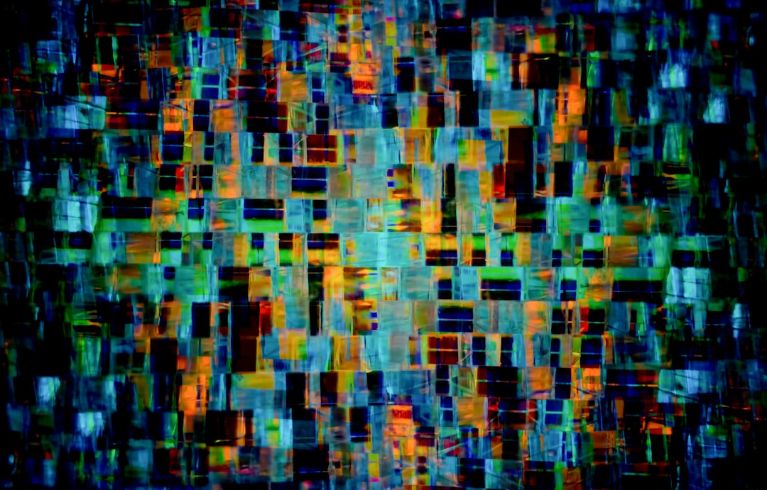
Introduction
RNNs are neural networks
Used for sequential data
Time series prediction possible
h_t = tanh(Wx_t + Uh_{t-1})
Trained using backpropagation
Can learn patterns
Notes:
Explain Introduction in the context of RNNs.

Slide 3
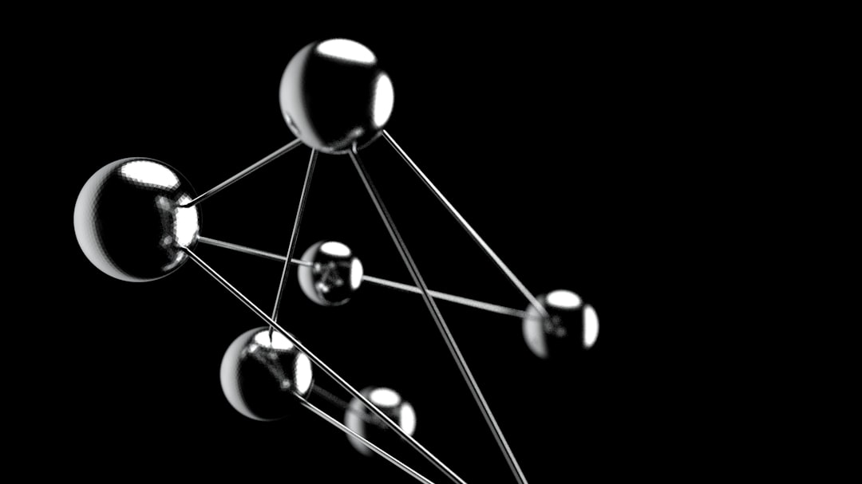
Core Concept / Architecture
Recurrent Neural Networks process sequences
Feedback connections allow information recall
Hidden state captures sequence context
Input gate controls new information
Output gate generates predictions
Cell state retains internal memory
Notes:
Explain Core Concept / Architecture in the context of RNNs.

Slide 4
Mathematical / Logical Explanation
RNNs use recurrent connections
Feedback loops for sequential data
h_t = tanh(Wx_t + Uh_{t-1})
Cell state captures information
Gates control data flow
Simple RNNs have vanishing gradients
LSTMs resolve vanishing gradients
GRUs are another variant
Notes:
Explain Mathematical / Logical Explanation in the context of RNNs.

Slide 5
Applications / Use Cases
Language Translation
Text Summarization
Chatbots
Speech Recognition
Time Series Forecasting
Sentiment Analysis
Image Captioning
Machine Translation
Notes:
Explain Applications / Use Cases in the context of RNNs.

Slide 6
Thank You

