Slide 1
RNNs
Deep Learning

Slide 2
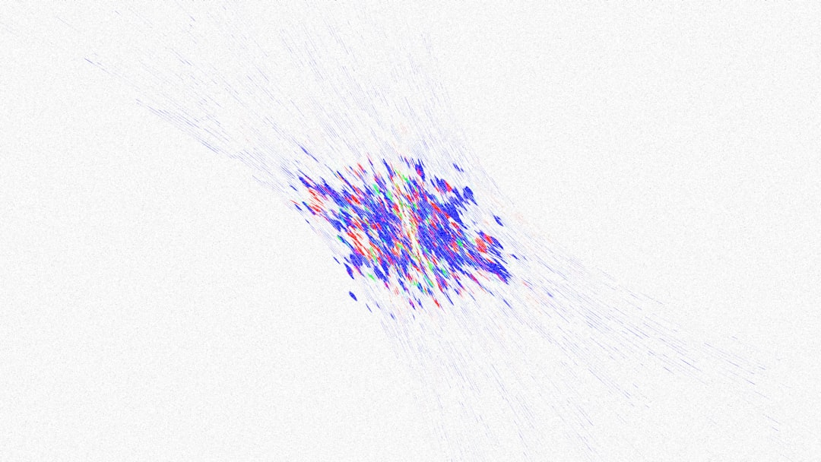
Introduction
Recurrent Neural Networks are designed for sequential data processing.
RNNs have feedback connections that allow information to loop back.
This looping back of information enables the network to keep track.
RNNs are trained using backpropagation through time algorithms primarily.
The architecture of RNNs consists of input, hidden, and output layers.
h_t = tanh(Wx_t + Uh_{t-1}) represents the hidden state calculation.
RNNs can learn patterns in data that vary over time naturally.
They are commonly used for language modeling and speech recognition.
Notes:
Explain Introduction in the context of RNNs.

Slide 3
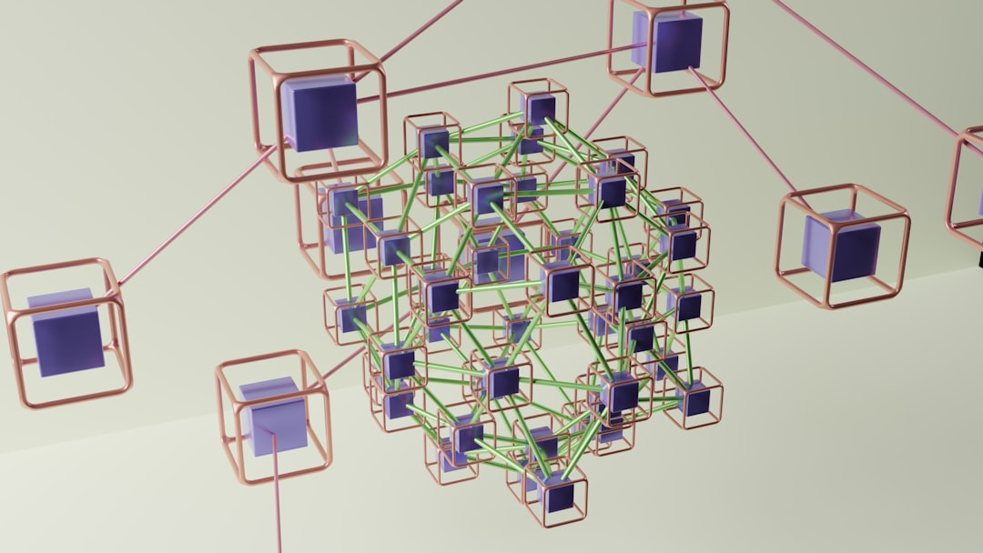
Core Concept / Architecture
Recurrent Neural Networks have feedback connections that allow information to loop back
RNNs are designed to handle sequential data such as time series or speech
The architecture of RNNs consists of input, hidden, and output layers
Each layer in the RNN has a specific function and set of weights
h_t = tanh(Wx_t + Uh_{t-1}) is a key equation in RNN architecture
The hidden layer maintains internal state that captures sequence dependencies
RNNs can be trained using backpropagation through time algorithm
Training RNNs can be computationally expensive due to sequential nature
Notes:
Explain Core Concept / Architecture in the context of RNNs.

Slide 4
Mathematical / Logical Explanation
Recurrent Neural Networks utilize sequential data to predict outcomes.
The RNN architecture consists of three main components: input, hidden, and output layers.
The hidden layer retains information from previous time steps to inform future predictions.
Backpropagation through time is used to train RNNs on sequential data.
RNNs can be further divided into two subcategories: one-to-one and many-to-one models.
The many-to-one model is particularly useful for tasks such as sentiment analysis and text classification.
h_t = tanh(Wx_t + Uh_{t-1}) represents the mathematical formula for calculating the hidden state.
RNNs are well-suited for modeling temporal relationships in data, such as speech or time series data.
The vanishing gradient problem can occur during RNN training, requiring careful optimization techniques.
Notes:
Explain Mathematical / Logical Explanation in the context of RNNs.

Slide 5
Applications / Use Cases
Recurrent Neural Networks are used for speech recognition systems.
RNNs are applied in natural language processing tasks effectively.
They are utilized in machine translation applications daily.
RNNs are used for time series forecasting and prediction models.
They are implemented in chatbots and virtual assistants commonly.
RNNs are used for sentiment analysis and text classification tasks.
They are applied in recommender systems for personalized feedback.
RNNs are utilized in image captioning and video description generation.
They are used for handwriting recognition and gesture recognition systems.
Notes:
Explain Applications / Use Cases in the context of RNNs.

Slide 6
Thank You

