Slide 1
RNNs
Deep Learning

Slide 2
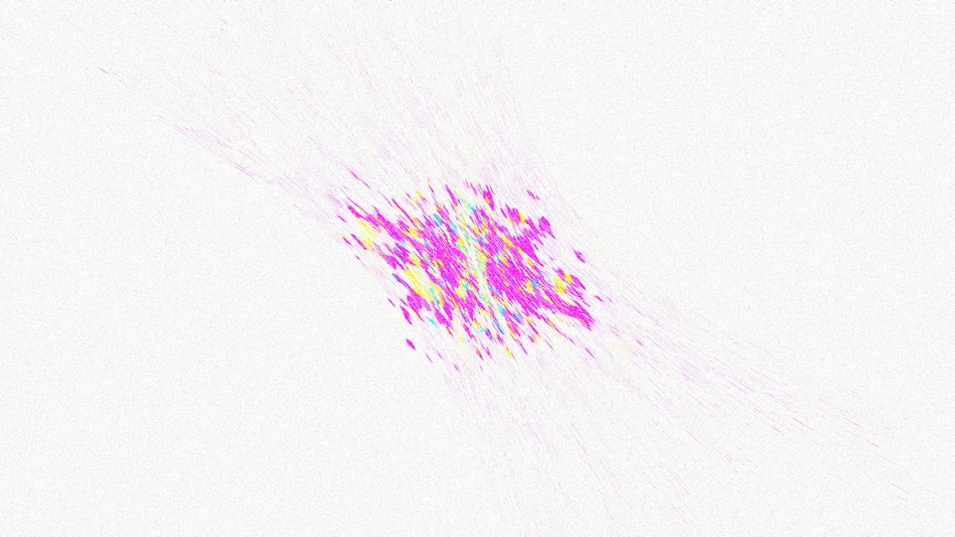
Introduction
Recurrent Neural Networks are a type of deep learning model.
RNNs are designed to handle sequential data and time series forecasting.
They have feedback connections that allow information to loop back.
This looping back of information allows the model to keep track of state.
RNNs can be used for natural language processing and speech recognition.
The architecture of RNNs includes an input layer and an output layer.
Notes:
Explain Introduction in the context of RNNs.

Slide 3
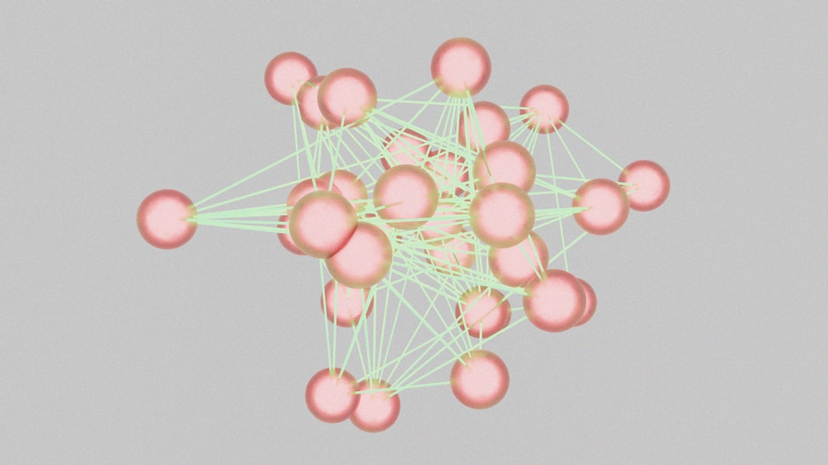
Core Concept / Architecture
Recurrent Neural Networks are designed to handle sequential data effectively always.
The core concept of RNNs involves recursive feedback connections in the network.
RNNs have a unique architecture that allows them to maintain internal state.
This internal state is used to capture temporal relationships in data sequences.
The architecture of RNNs includes input, output, and hidden layers typically.
h_t = tanh(Wx_t + Uh_{t-1}) represents the basic mathematical equation for RNNs.
Notes:
Explain Core Concept / Architecture in the context of RNNs.

Slide 4
Mathematical / Logical Explanation
Recurrent Neural Networks utilize sequential data to predict outcomes effectively.
The architecture of RNNs consists of feedback connections to process sequences.
RNNs are trained using backpropagation through time to optimize weights.
The hidden state is updated at each time step using previous information.
h_t = tanh(Wx_t + Uh_{t-1}) represents the mathematical formulation of RNNs.
RNNs can learn long-term dependencies in sequential data through training.
The vanishing gradient problem is a major challenge in training RNNs.
Gated Recurrent Units and Long Short-Term Memory networks mitigate this issue.
RNNs have applications in natural language processing and speech recognition.
Notes:
Explain Mathematical / Logical Explanation in the context of RNNs.

Slide 5
Applications / Use Cases
Recurrent Neural Networks are used for natural language processing tasks effectively.
RNNs can learn sequential patterns in time series data analysis applications.
Speech recognition systems rely heavily on RNN architectures and designs.
Language translation models often utilize RNNs for sequence-to-sequence learning.
RNNs are applied in sentiment analysis to understand text-based user feedback.
Chatbots and virtual assistants use RNNs to generate human-like responses.
h_t = tanh(Wx_t + Uh_{t-1}) represents the basic RNN cell equation.
Text summarization and question answering systems also employ RNN techniques.
RNNs are used in music and video generation to create sequential content.
Notes:
Explain Applications / Use Cases in the context of RNNs.

Slide 6
Thank You

