Slide 1
CNNs
Educational Presentation
Notes:
Introduce the topic: CNNs. Explain its importance and relevance.

Slide 2
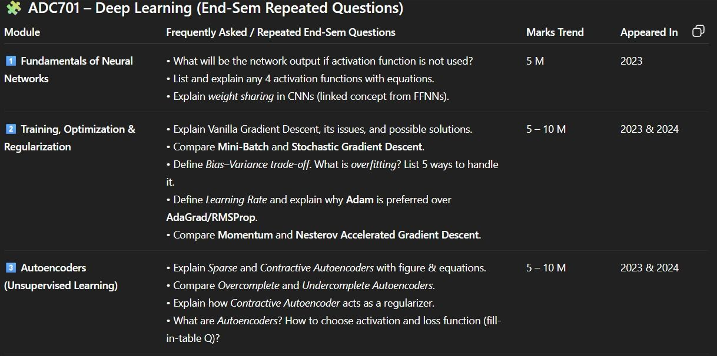
Key Concept 1
Important point 1 for concept 1
Important point 2 for concept 1
Important point 3 for concept 1
Notes:
Explain key concept 1 in detail. Provide examples and engage students.

Slide 3
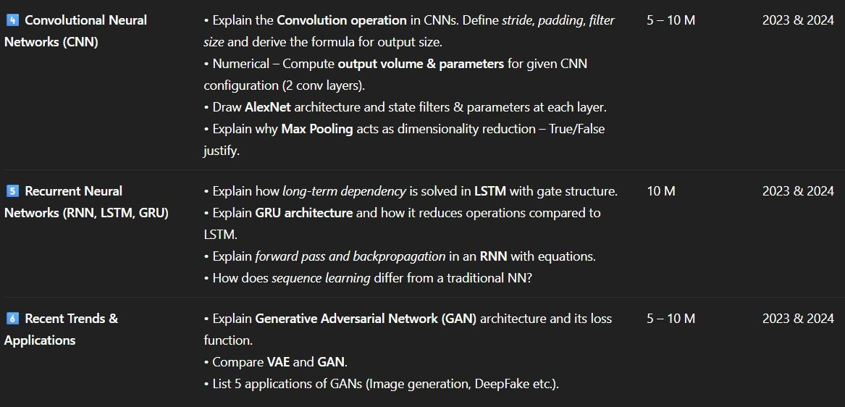
Key Concept 2
Important point 1 for concept 2
Important point 2 for concept 2
Important point 3 for concept 2
Notes:
Explain key concept 2 in detail. Provide examples and engage students.

Slide 4

Key Concept 3
Important point 1 for concept 3
Important point 2 for concept 3
Important point 3 for concept 3
Notes:
Explain key concept 3 in detail. Provide examples and engage students.

Slide 5
Summary
Key takeaways from the presentation
Important points to remember
Next steps or further reading
Notes:
Summarize the key points. Emphasize important takeaways and encourage questions.

