Slide 1
Indexing
Database Management System
Notes:
Introduction to the presentation on Indexing.

Slide 2

Introduction
Indexing enhances database query performance greatly
Database indexing is a data structure technique
Indexing speeds up data retrieval operations
Indexing is used for fast data access methods
Database indexing has several types available
Indexing improves query optimization greatly always
Database systems use indexing for efficiency
Indexing supports quick data retrieval always
Indexing is crucial for database management systems
Indexing enhances overall system performance greatly
Notes:
When introducing the concept of indexing, emphasize its importance in enhancing database query performance and speeding up data retrieval operations. Provide examples of how indexing is used in real-world database systems and ask students to consider how indexing would improve the efficiency of a database. Ask questions like 'What are the benefits of using indexing in a database?' to encourage discussion and understanding of the concept.

Slide 3
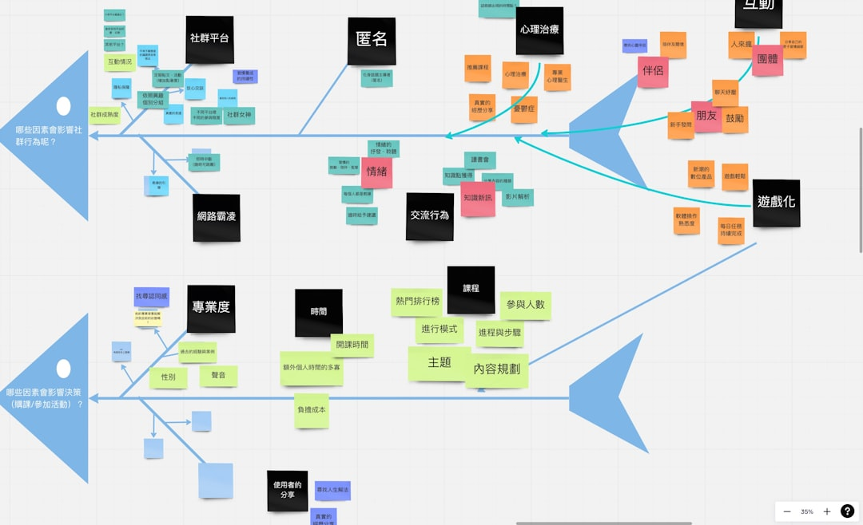
Core Concept / Architecture
Overview of Core Concept / Architecture
Key concepts related to Core Concept / Architecture
Important aspects of Core Concept / Architecture
Applications and examples of Core Concept / Architecture
Notes:
Explain Core Concept / Architecture in detail, covering key concepts and applications.

Slide 4
Mathematical / Logical Explanation
Indexing uses mathematical formulas to optimize data retrieval
Logical explanations involve data distribution and storage
Mathematical models predict query performance and indexing
Indexing algorithms use logical operators for data filtering
Data indexing uses mathematical techniques for sorting
Logical indexing explains data relationships and patterns
Mathematical indexing optimizes data storage and retrieval
Indexing uses logical rules for data consistency and integrity
Mathematical explanations of indexing involve statistical models
Logical indexing ensures data accuracy and reliability
Notes:
When explaining the mathematical and logical explanation of indexing, emphasize the use of mathematical formulas and logical operators to optimize data retrieval and storage. Provide examples of how indexing algorithms use mathematical models to predict query performance and explain how logical indexing ensures data consistency and integrity. Ask students to consider how mathematical and logical explanations can be applied to real-world database management systems.

Slide 5
Applications / Use Cases
Database query optimization using indexing techniques
Improving data retrieval speed in web applications
Enhancing performance in data warehousing systems
Supporting efficient data analysis and reporting
Accelerating data processing in big data environments
Optimizing database storage and memory usage
Facilitating fast data search and retrieval operations
Enabling efficient handling of large datasets
Streamlining database maintenance and updates
Supporting real-time data processing and analytics
Notes:
When discussing the applications and use cases of indexing, emphasize how it improves database query performance and supports efficient data analysis. Provide examples of real-world scenarios where indexing is crucial, such as e-commerce websites or social media platforms. Ask students to consider how indexing can be applied to various industries and domains, and what benefits it can bring to different types of applications.

Slide 6
Summary & Key Takeaways
Overview of Summary & Key Takeaways
Key concepts related to Summary & Key Takeaways
Important aspects of Summary & Key Takeaways
Applications and examples of Summary & Key Takeaways
Notes:
Explain Summary & Key Takeaways in detail, covering key concepts and applications.

