Slide 1
RNNs
Deep Learning
Notes:
Introduction to the presentation on RNNs.

Slide 2
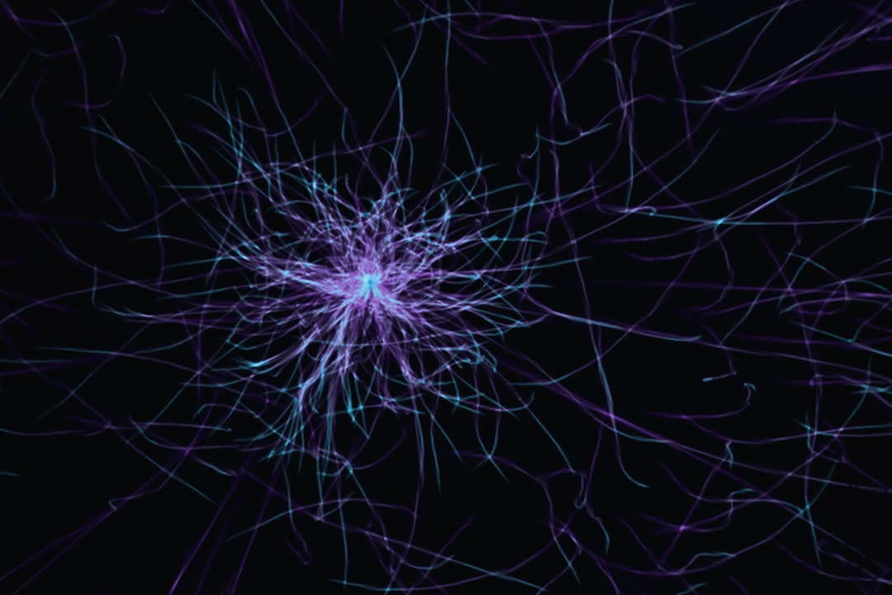
Introduction
Recurrent Neural Networks (RNNs) introduction
RNNs used for sequential data processing
Time-series forecasting and language modeling
RNNs have feedback connections, allowing information retention
Simple to complex RNN architectures exist
RNNs are a type of deep learning model
Used in natural language processing and speech recognition
Can learn long-term dependencies in data
Have been used in many applications, including text generation
Notes:
Introduce the concept of RNNs, explaining their use in sequential data processing. Provide examples of time-series forecasting and language modeling. Ask students if they have any experience with RNNs or deep learning models.

Slide 3

Simple RNN Architecture
A simple RNN processes sequences step by step, sharing weights across time
Hidden state captures previous context and is updated at each time step
Output at each step depends on current input and previous hidden state
Notes:
Explain the basic components of a simple RNN architecture, including the input layer, hidden layer, and output layer. Describe the feedback connections and activation functions used. Ask students to consider the limitations of simple RNNs and how they can be improved upon.

Slide 4
Mathematical Formulation
RNNs can be represented mathematically as a recursive function
Hidden state updated at each time step
Output calculated based on hidden state and input
Backpropagation through time (BPTT) used for training
BPTT can be computationally expensive
RNNs can be trained using stochastic gradient descent
Regularization techniques can be used to prevent overfitting
Mathematical formulation is important for understanding RNNs
Helps to identify potential issues and limitations
Notes:
Provide a mathematical formulation of RNNs, explaining the recursive function and how the hidden state is updated. Describe the backpropagation through time (BPTT) algorithm and its computational expense. Ask students to consider the importance of regularization techniques in preventing overfitting.

Slide 5
Vanishing Gradient Problem
Gradients used to update weights during backpropagation
Vanishing gradients occur when gradients are very small
Prevents weights from being updated effectively
Can lead to slow or no learning
Exploding gradients can also occur
Gradient clipping and normalization can help
Vanishing gradients are a common issue in deep learning
Can be mitigated using different activation functions
Residual connections can also help to alleviate the issue
Notes:
Explain the vanishing gradient problem, describing how gradients are used to update weights during backpropagation. Discuss the effects of vanishing gradients on learning and provide potential solutions, such as gradient clipping and normalization. Ask students to consider the importance of mitigating vanishing gradients in deep learning models.

Slide 6
Applications of RNNs
Notes:
This slide will be replaced with user-provided content. Please insert the content for this slide.

Slide 7
Summary and Takeaways
RNNs are a type of deep learning model
Used for sequential data processing and time-series forecasting
Simple RNNs have limitations, including vanishing gradients
More complex RNN architectures can learn long-term dependencies
RNNs have many applications, including natural language processing
Mathematical formulation is important for understanding RNNs
Vanishing gradients can be mitigated using different techniques
RNNs are a powerful tool for modeling sequential data
Can be used in a variety of fields, including speech recognition
Notes:
Summarize the key takeaways from the presentation, including the basics of RNNs, their limitations, and their applications. Ask students to consider the importance of RNNs in deep learning and their potential uses in real-world problems. Provide examples of how RNNs can be used in different fields, such as speech recognition and natural language processing.

