Slide 1
RNNs
Deep Learning
Notes:
Introduction to the presentation on RNNs.

Slide 2
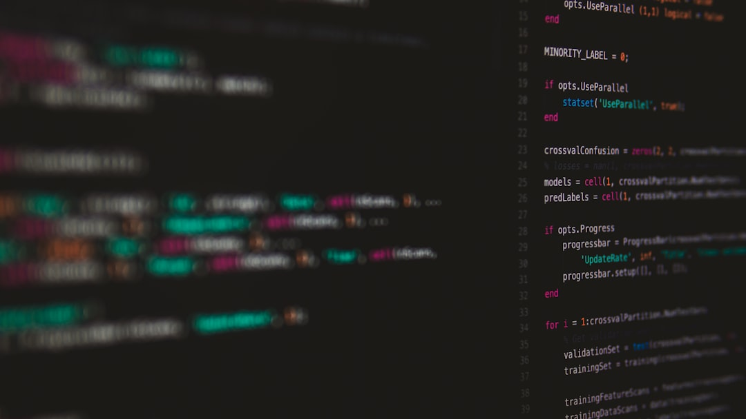
Introduction
Introduction to Introduction
Key concepts related to Introduction
Important aspects of Introduction
Applications and examples of Introduction
Notes:
Explain Introduction in detail, covering key concepts and applications.

Slide 3
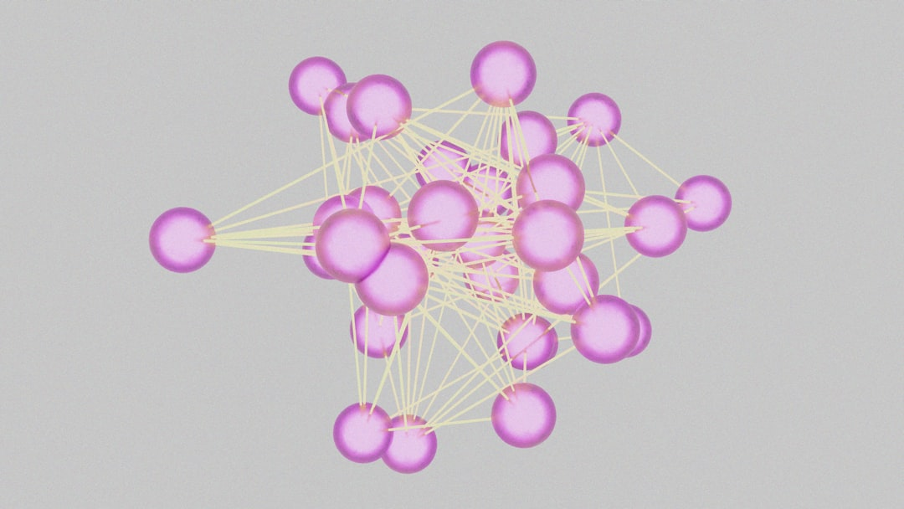
Core Concept / Architecture
Recurrent Neural Networks process sequential data
Feedback connections allow information retention
Hidden state captures sequential context
Input gate controls new information
Output gate generates predictions
Cell state retains long-term information
Activation functions introduce non-linearity
Architecture varies for different RNN types
Simple RNNs have basic feedback loops
LSTM and GRU have gated feedback mechanisms
Notes:
When discussing the Core Concept / Architecture of RNNs, emphasize the importance of feedback connections and hidden states in processing sequential data. Provide examples of simple RNNs and more complex architectures like LSTM and GRU, asking students to consider how these differences impact performance. Ask students to think about how these architectural elements contribute to the ability of RNNs to learn from sequential data.

Slide 4
Mathematical / Logical Explanation
Recurrent Neural Networks use mathematical functions
Logical gates control data flow in RNNs
Activation functions introduce non-linearity
Backpropagation calculates error gradients
Optimization algorithms update weights
Matrix multiplications perform computations
Vectorized operations speed up calculations
Derivatives measure function sensitivity
Chain rule applies to nested functions
Gradient descent minimizes loss functions
Notes:
When explaining the mathematical and logical explanation of RNNs, emphasize the role of activation functions and backpropagation in training the network. Provide examples of how matrix multiplications and vectorized operations are used in RNN computations. Ask students to consider how the chain rule is applied in nested functions and how gradient descent is used to minimize loss functions.

Slide 5
Applications / Use Cases
Introduction to Applications / Use Cases
Key concepts related to Applications / Use Cases
Important aspects of Applications / Use Cases
Applications and examples of Applications / Use Cases
Notes:
Explain Applications / Use Cases in detail, covering key concepts and applications.

Slide 6
Summary & Key Takeaways
RNNs process sequential data with temporal relationships
Key applications include language modeling and text generation
Recurrent connections enable feedback and memory
Training RNNs involves backpropagation through time
Vanishing gradients affect RNN training and stability
LSTM and GRU architectures mitigate gradient issues
RNNs are suitable for time-series forecasting and prediction
Regularization techniques improve RNN generalization
Hyperparameter tuning is crucial for RNN performance
Notes:
When discussing this slide, emphasize the importance of understanding RNN architectures and their applications. Provide examples of how RNNs are used in language modeling and text generation. Ask students to consider the challenges of training RNNs and how techniques like backpropagation through time and regularization can address these issues.

