Slide 1
RNNs
Deep Learning
Notes:
Introduction to the presentation on RNNs.

Slide 2

Introduction
Recurrent Neural Networks utilize sequential data to make predictions and decisions effectively
RNNs are designed to handle temporal relationships in data, such as time series forecasting
Basic RNNs consist of input, hidden, and output layers, processing sequential data
RNNs can learn patterns and relationships in sequential data, like speech or text
Long Short-Term Memory networks are a type of RNN, addressing vanishing gradients
Gated Recurrent Units are another type of RNN, simplifying LSTM architecture
RNNs are commonly used in natural language processing, speech recognition tasks
RNNs can be trained using backpropagation through time, optimizing weights and biases
RNNs have applications in machine translation, sentiment analysis, and text classification
Notes:
Explain Introduction in the context of RNNs.

Slide 3
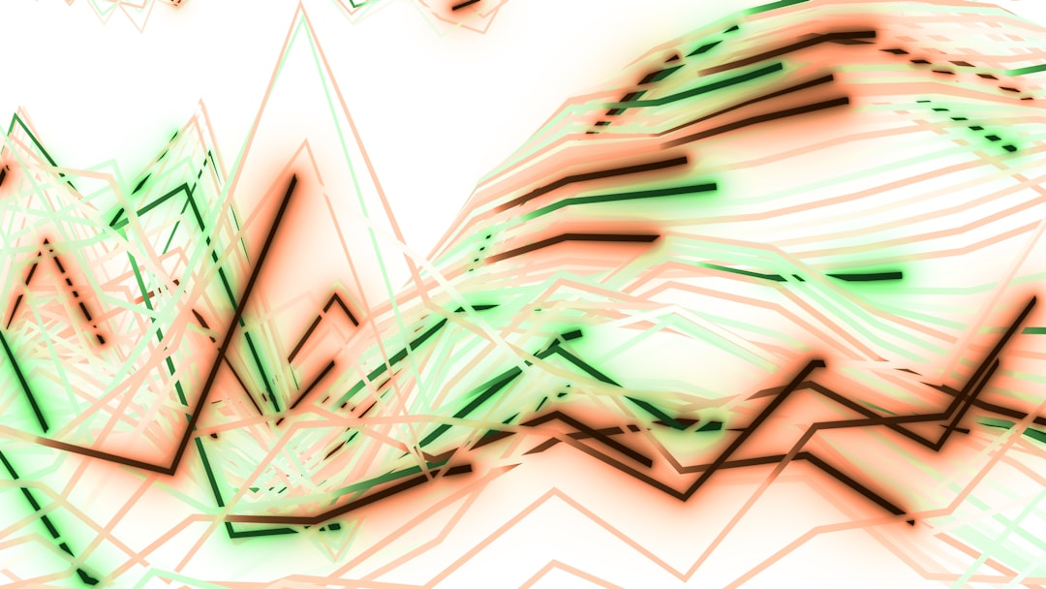
Core Concept / Architecture
Recurrent Neural Networks utilize sequential data to predict outcomes effectively
RNNs consist of input gate, output gate, and forget gate components
Feedback connections enable RNNs to retain information over time sequences
Cell state and hidden state are crucial components in RNN architecture
RNNs can be trained using backpropagation through time algorithms effectively
Simple RNNs are vulnerable to vanishing gradient problems during training
Long Short-Term Memory networks are advanced RNN variants with improved performance
Gated Recurrent Units are another type of RNN with fewer parameters required
Bidirectional RNNs process input sequences in both forward and backward directions
RNNs are widely applied in natural language processing and speech recognition tasks
Notes:
Explain Core Concept / Architecture in the context of RNNs.

Slide 4
Mathematical / Logical Explanation
Recurrent Neural Networks utilize sequential data through feedback connections and nonlinear activation functions.
RNNs process input sequences one element at a time, maintaining internal state for context.
Backpropagation Through Time is used for training RNNs, adjusting weights and biases.
The vanishing gradient problem is a common issue in RNNs, impacting learning and stability.
Long Short-Term Memory networks address this issue with memory cells and gates.
Gated Recurrent Units simplify LSTMs, using update and reset gates for state management.
RNNs can be further extended with attention mechanisms, focusing on relevant input sequences.
Mathematical formulations of RNNs involve recursive equations, capturing dynamic system behavior.
Training RNNs requires careful initialization and regularization to prevent overfitting and instability.
Notes:
Explain Mathematical / Logical Explanation in the context of RNNs.

