Slide 1
Rnn
Deep Learning.
Notes:
Introduction to the presentation on Rnn.

Slide 2
Introduction to Rnn
Key concept about Introduction to Rnn in the context of Rnn
Important aspect of Introduction to Rnn relevant to Deep Learning.
Fundamental principle related to Introduction to Rnn
Practical application of Introduction to Rnn in Rnn
Core understanding of Introduction to Rnn
Essential knowledge about Introduction to Rnn
Significant detail regarding Introduction to Rnn
Critical point about Introduction to Rnn in Deep Learning.
Notes:
Explain Introduction to Rnn in the context of Rnn.

Slide 3
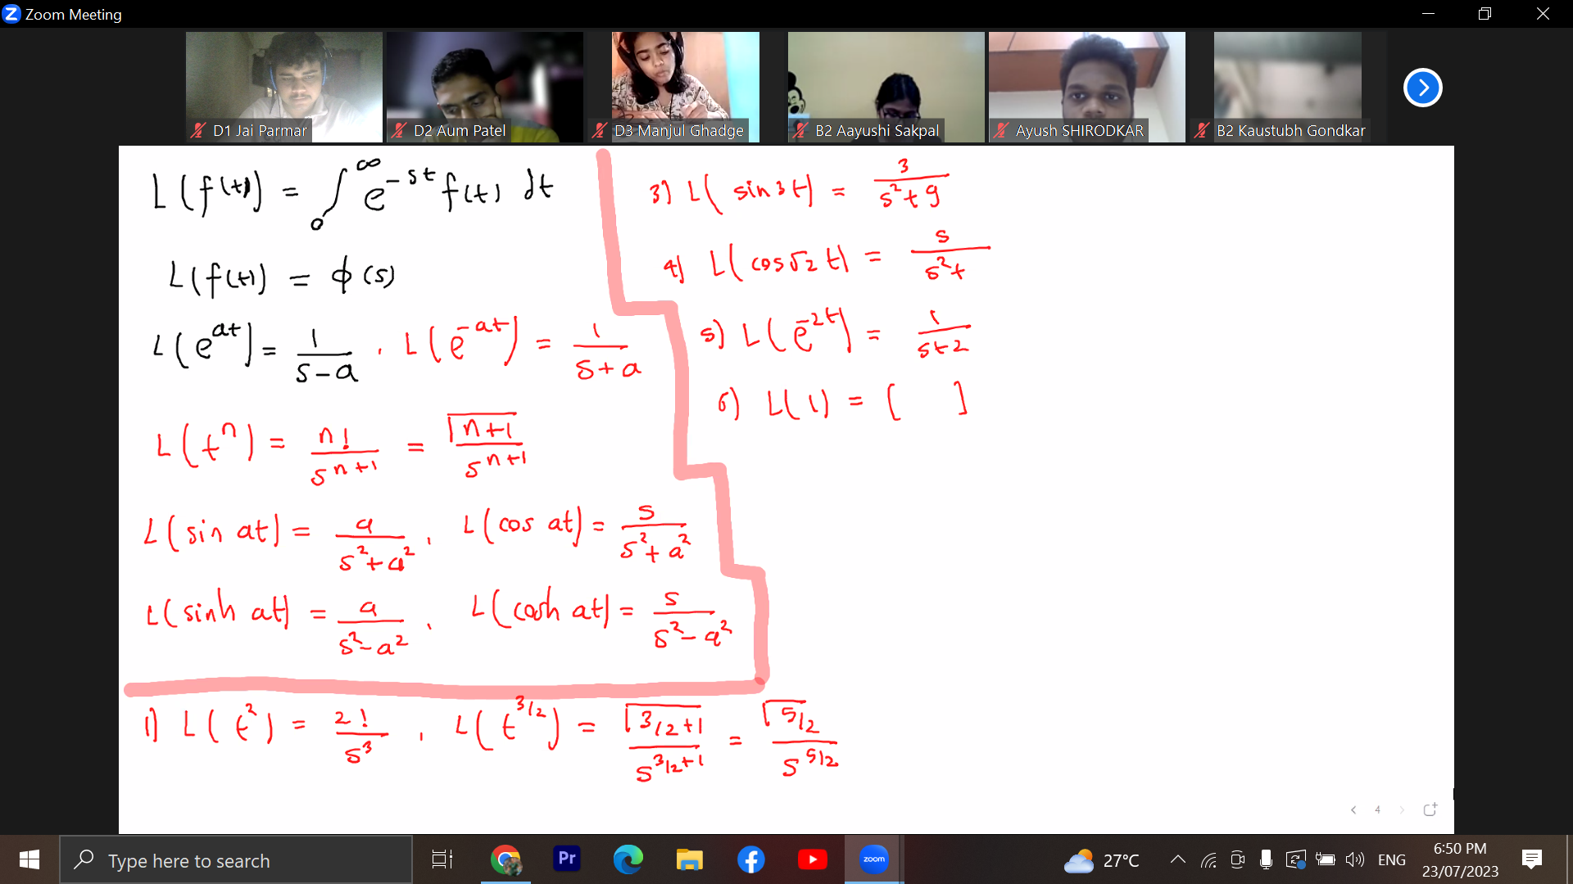
Architecture
Key concept about Architecture in the context of Rnn
Important aspect of Architecture relevant to Deep Learning.
Fundamental principle related to Architecture
Practical application of Architecture in Rnn
Core understanding of Architecture
Essential knowledge about Architecture
Significant detail regarding Architecture
Critical point about Architecture in Deep Learning.
Notes:
Explain Architecture in the context of Rnn.

Slide 4
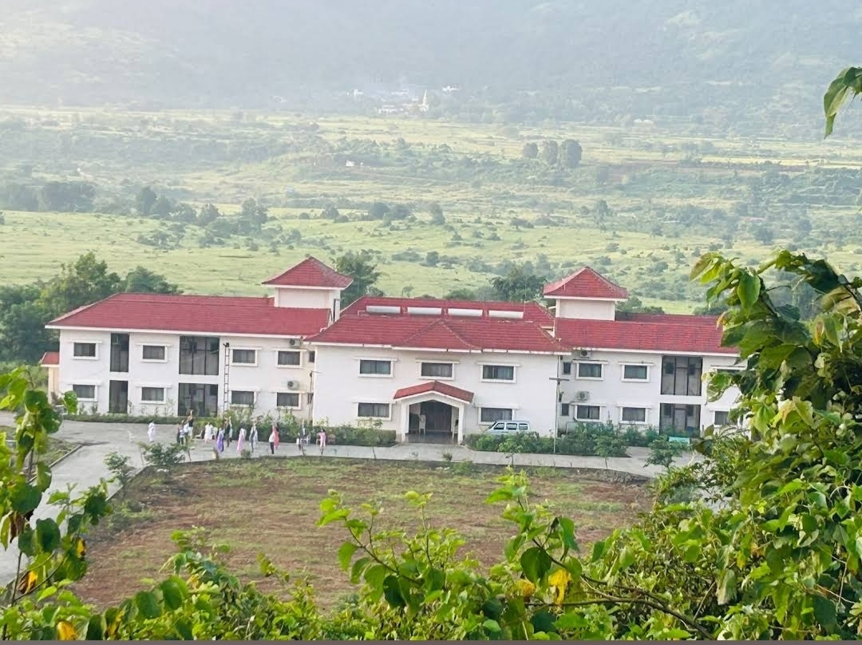
Applications
Key concept about Applications in the context of Rnn
Important aspect of Applications relevant to Deep Learning.
Fundamental principle related to Applications
Practical application of Applications in Rnn
Core understanding of Applications
Essential knowledge about Applications
Significant detail regarding Applications
Critical point about Applications in Deep Learning.
Notes:
Explain Applications in the context of Rnn.

Slide 5
Summary
Key concept about Summary in the context of Rnn
Important aspect of Summary relevant to Deep Learning.
Fundamental principle related to Summary
Practical application of Summary in Rnn
Core understanding of Summary
Essential knowledge about Summary
Significant detail regarding Summary
Critical point about Summary in Deep Learning.
Notes:
Explain Summary in the context of Rnn.

