Slide 1


SMART INDIA HACKATHON 2024
Problem Statement ID – 1638
Problem Statement Title- AI-Driven Crop Disease Prediction and Management System
Theme- Agriculture, FoodTech & Rural Development
PS Category- Software
Team ID-54
Team Name – Field AI

Slide 2
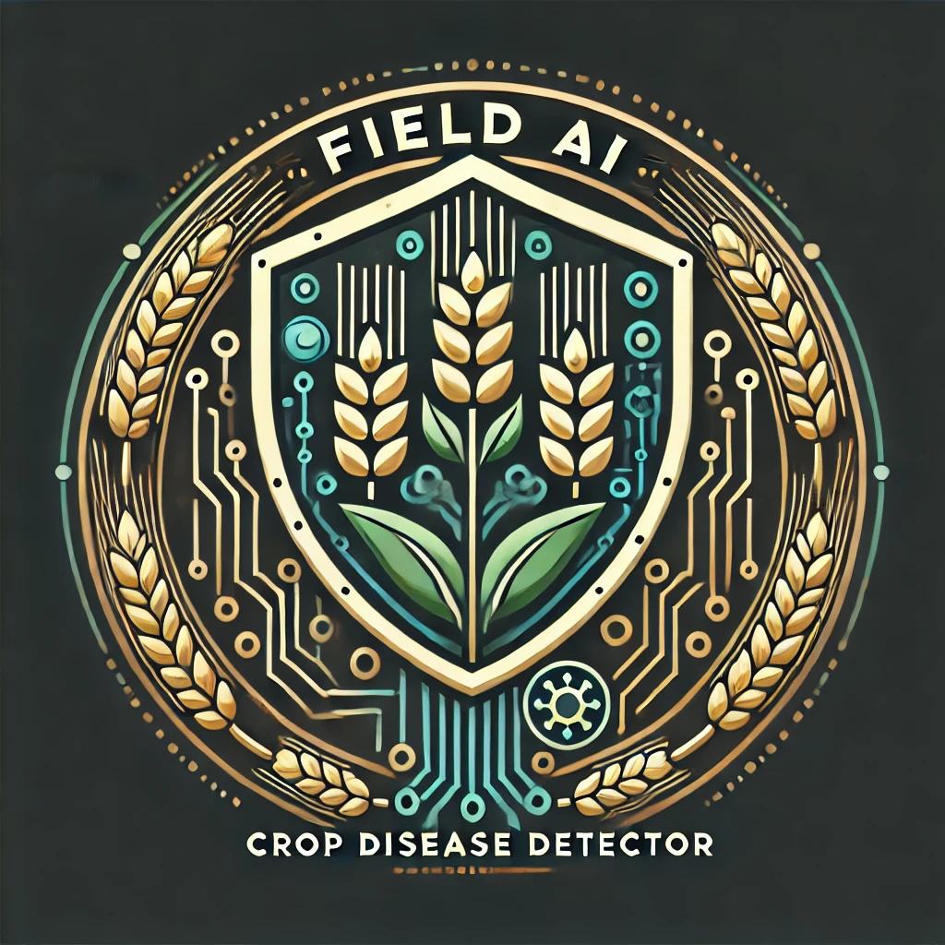
AI-Driven Crop Disease Prediction and Management System
Proposed Solution:
1. Problem Addressed:
Automation: Replaces manual methods with fast, accurate detection.
Early Intervention: CNNs spot disease patterns from images, reducing crop losses.
2. Solution:
Deep Learning: Uses CNNs for automated disease detection from images.
Process: Includes data collection, preprocessing, model training, and detection.
3. Innovation:
Farmer Support: Identifies diseases and provides solutions.
Integration: Links with local pesticide stores for easy access.
Voice Chatbot: Offers direct communication about crop issues.
Field
A.I

Slide 3
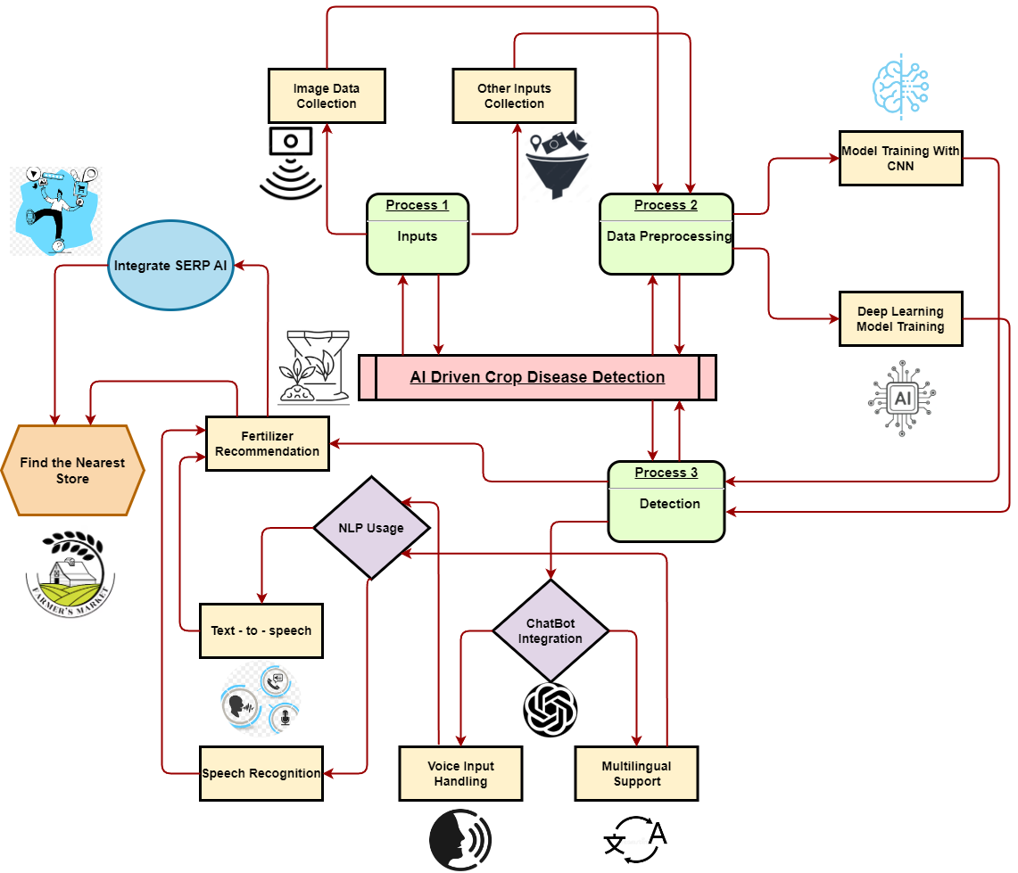
Field
A.I
LANGUAGES-
Python
Xml
java
FRAMEWORKS-​
Tensorflow​
Sklearn​
OS​
SEQUENTIAL​
KERAS.LAYERS​
to_categorical​
zipfile

Slide 4
FEASIBILITY AND VIABILITY
Viability
Ad's
Data collection
Local store advertisement
sponsorships
Technological Feasibility
AI & Machine Learning
Existing Datasets
Real-time Data Collection
Cloud & Edge Computing
Market Feasibility
Growing Demand for AgriTech
Government Support
AgriTech Investments

Slide 5
IMPACT AND BENEFITS
Impact on Farmers, Agronomists, Agricultural Industry
Increased Crop Yields
Reduced Crop Losses
Localized Recommendations
Social benefits:
Knowledge Transfer
Food Security
Economic benefits:
Cost Savings
Higher Profitability
Support for Sustainable Agriculture
Environmental benefits:
Reduced Chemical Usage
Sustainable Farming
Biodiversity Preservation

Slide 6
RESEARCH AND REFERENCES
Plant Disease Detection and Classification by Deep Learning
Author: Muhammad Hammad Saleem,¹ Johan Potgieter,² and Khalid Mahmood Arif^{1,*}
^{Published online 2019 Oct 31}
^{doi: 10.3390/plants8110468}
Research paper Link

