Slide 1


MULTI PURPOSE AGRICULTURE MACHINE
Group Number: 03
Group Member:
217022 Atharva Joshi
2107006 Manashri Atkar
2107015 Gargi Gamote
2107059 Abhishek Shukla
2107034 Mohit Nagarkar
Under the Guidance of : L.D. Vilhekar Sir
Co- Guide: Priti Saktel Ma’am

Slide 2
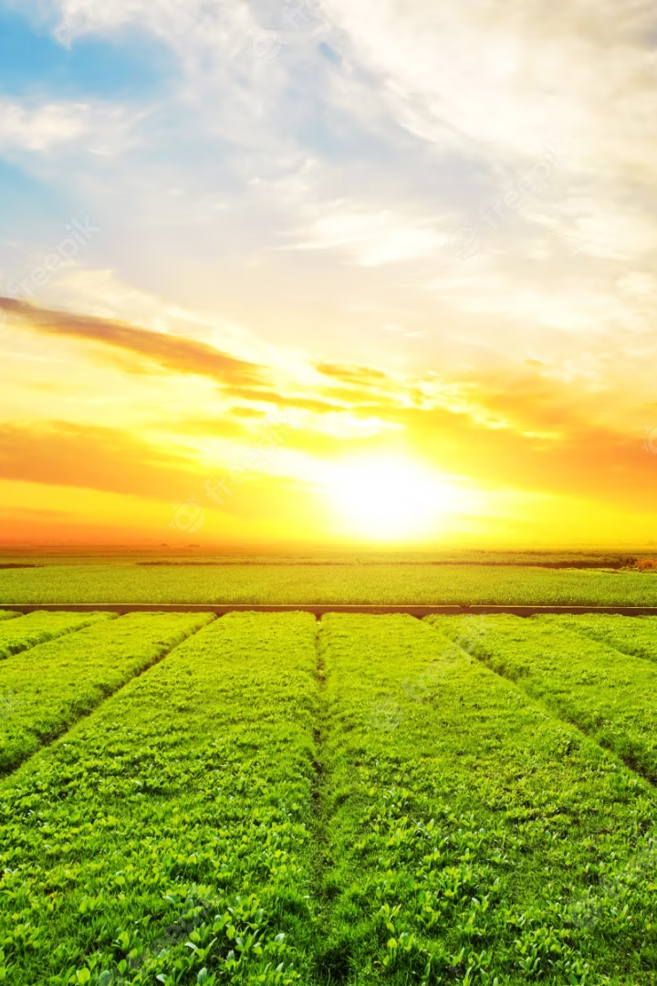
Revolutionizing Agriculture with Multipurpose Machines
Discover the ultimate solution to automate agriculture with our multipurpose machine. Advanced features and software applications make farming quicker and more efficient.

Slide 3
Multipurpose Agriculture Machine: An Overview
What is it?
Our machine is designed to perform multiple tasks in
a single run.
It can sow seeds, fertilize the land, and even sprinkle water while minimizing human intervention.

Slide 4

The Need of a Multipurpose Agriculture Machine
A step toward Agriculture automation.
Self navigation machine
Referred from ADAS system
Reduction of manual labour work
Multipurpose

Slide 5
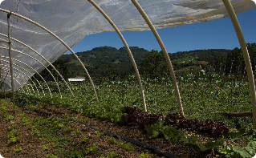


Features of the Software Application
Customizable
User-friendly
Remote Control
The software applications are customizable based on the farm's needs, ensuring optimal performance and output.
The interfaces are designed to be user-friendly, allowing the farmer to control the machine with ease.
The machine can even be controlled remotely, allowing the farmer to monitor its activities from a distance using the software application.

Slide 6
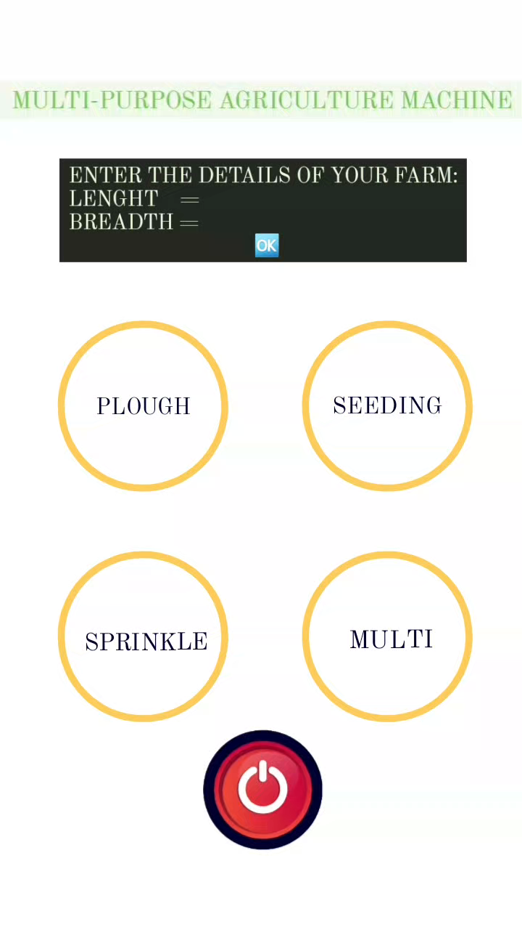
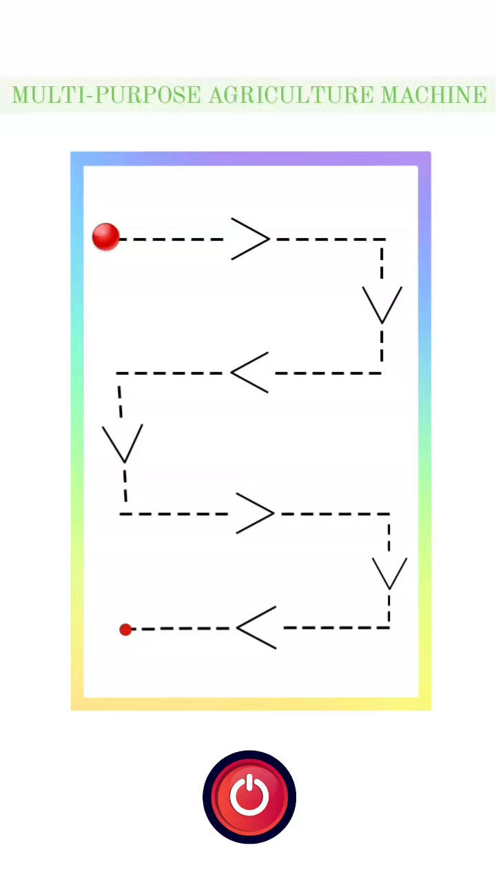
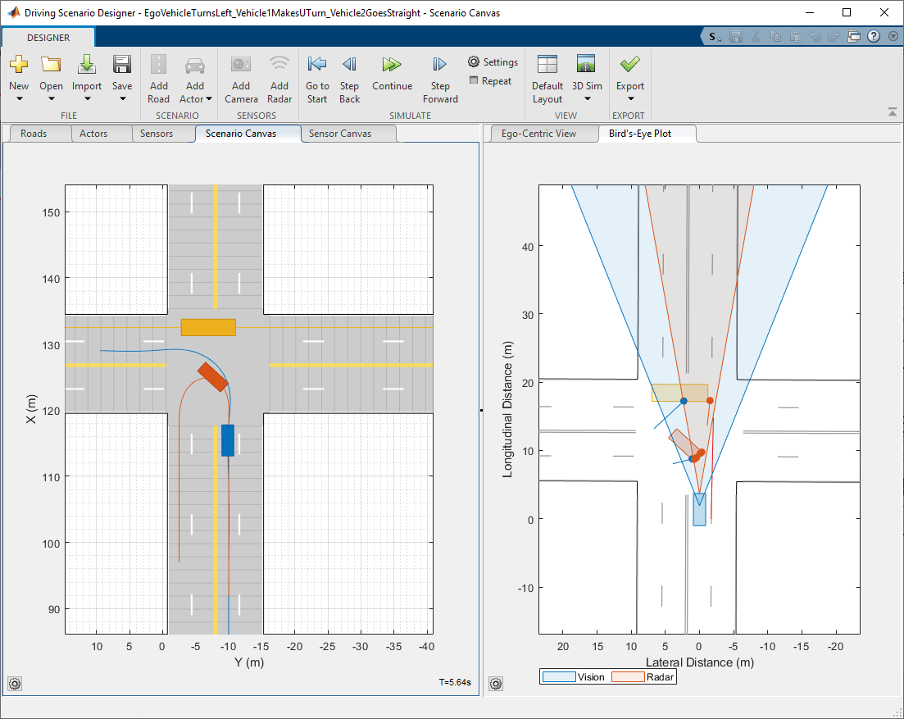
How the SOFTWARE will work?

Slide 7
Lane Navigation
What is it?
How does it work?
Why is it important?
A concept allowing the machine to navigate its way around the farm in a pre-defined lane.
The machine uses GPS systems and sensors to identify the lane and follow it.
It increases efficiency by making sure the machine follows the same path, minimizing errors and optimizing output.

Slide 8
Benefits for Farmers
1
Save Time and Money
Improved Accuracy
2
3
Eco-Friendly
Increased Yield
4
5
Diminishes labour work

Slide 9

Potential Impact on Agriculture Industry
Sustainable solution to increase agricultural output
Diminishes manual labour
Reduces environmental impact
Makes farming more efficient, cost-effective, and sustainable

Slide 10
Working of Multipurpose Agriculture Machine in Hardware
Sensors and Navigation
The machine is equipped with various sensors that detect soil moisture, temperature, and other important parameters. These sensors are used to generate a map of the farm that guides the machine's navigation.
Actuators and Implements
The machine is fitted with a range of implements that perform different tasks, such as plowing, seeding, and fertilizer application. These implements are controlled by actuators that are driven by hydraulic or electric power.
Power and Control
The machine is powered by an internal combustion engine or an electric motor, depending on the model. The engine or motor is connected to a set of hydraulics that provide power to the various actuators. The machine is controlled by a computer that receives input from the various sensors and implements.

Slide 11

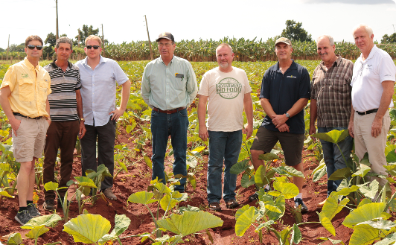

Conclusion and Future Developments
Staying Ahead in Innovation
Farmers Partnership
A Greener Future
We aim to constantly upgrade our software and machine to stay ahead in the innovation game.
Our goal is to work closely with farmers and incorporate their feedback to create a more customized solution for their unique needs.
We envision sustainable and cost-efficient agriculture that can feed the world without harming the planet. Our machine and software solutions are the first steps of many towards a greener future.

