Slide 1
Amazon Sales Analytics
SQL
MySQL project report and executive dashboard: revenue, customers, inventory, payments and returns across 21,629 sales records
Presented by Atharva Madure | Built with MySQL Workbench
Notes:
Combined deck: project overview, executive dashboard, ten query walkthroughs, insights and recommendations.

Slide 2
Agenda
01
02
03
04
Project and data model
Executive dashboard
Query walkthrough
Insights and next steps
Scope, 8-table schema and ERD
Headline KPIs and charts
Ten business questions, Q1 to Q10
Findings, SQL toolkit and actions

Slide 3
Project overview
Analysed an Amazon-style e-commerce dataset using MySQL Workbench.
Covered revenue analysis, customer segmentation, inventory, payments and returns.
Used joins, aggregates, CTEs, subqueries, window functions, COALESCE() and NULLIF().
Included data cleaning, NULL handling and real-world business questions.
21,629
8
Sales records
Tables in schema
10
$12.64M
Business queries
Total revenue
Customers place orders with sellers, orders generate order items linked to products, products belong to categories and are tracked in inventory, and orders connect to payments and shippings.

Slide 4
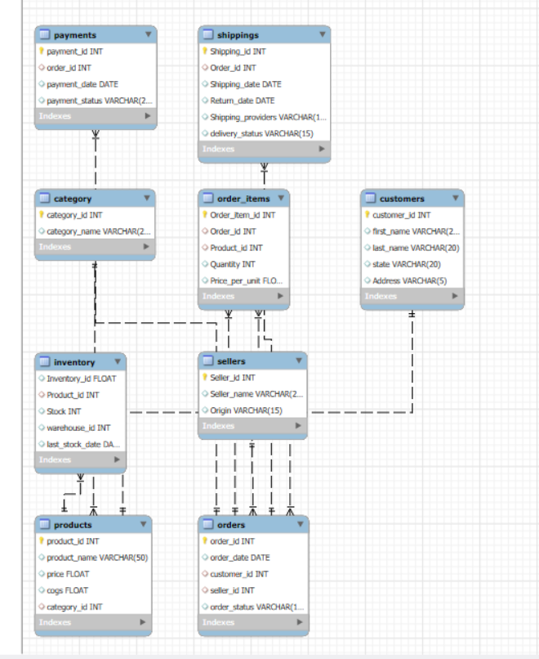
Database schema (ERD)
Table | References | Key
orders | customers | customer_id
orders | sellers | seller_id
order_items | orders | order_id
order_items | products | product_id
inventory | products | product_id
products | category | category_id
payments | orders | order_id
shippings | orders | order_id
Core chain: Customers, Orders, Order_Items, Products. Payments and Shippings both depend on Orders.

Slide 5
Executive dashboard
$12.64M
21,629
84.61%
89.7%
Total revenue
Payments / orders
Payment success
Electronics share

Slide 6
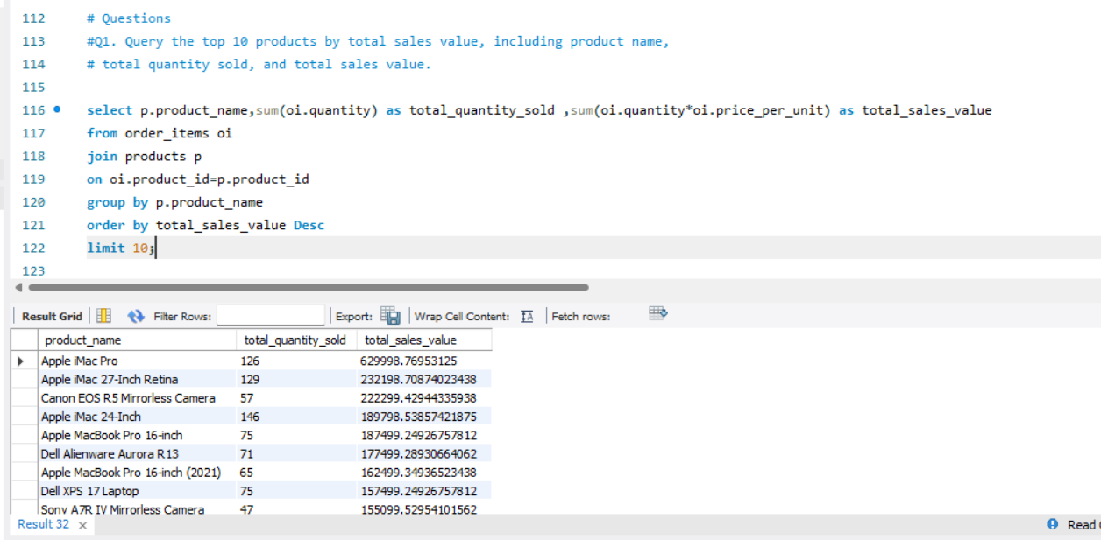
Top products by total sales value
Q1
WHAT THE QUERY DOES
Joins order_items with products, totals quantity and sales value (quantity x price) per product, and sorts by sales so the highest-revenue products come first.
$630K
Apple iMac Pro leads, about 2.7x the next product (iMac 27-Inch Retina, $232K).

Slide 7
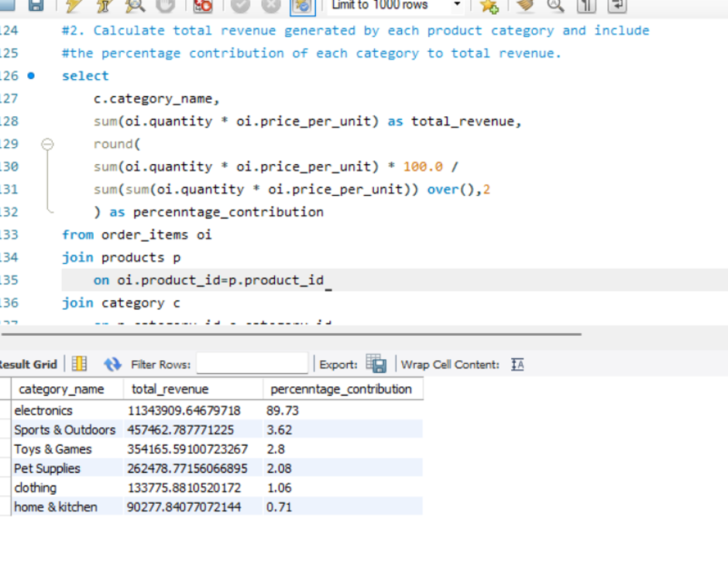
Revenue by category and contribution
Q2
WHAT THE QUERY DOES
Multiplies quantity by price per unit for each category, divides by total revenue for the percentage share (rounded to 2 decimals) and sorts in descending order.
89.73%
Electronics drives nearly 90% of revenue, a strong concentration risk. Every other category is under 4%.

Slide 8
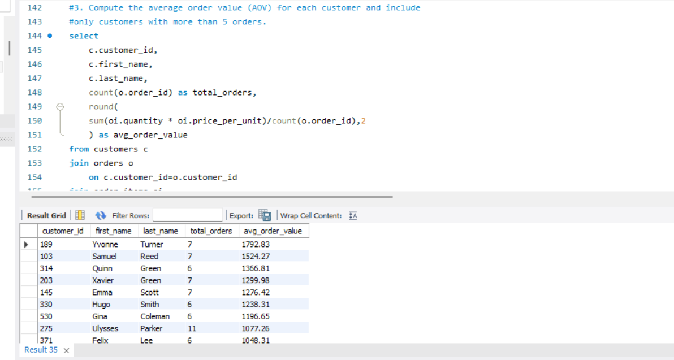
Average order value (customers with 5+ orders)
Q3
WHAT THE QUERY DOES
Joins customers, orders and order_items, keeps customers with more than five orders, and divides total sales by order count to get each customer's AOV.
$1,792.83
Highest AOV: Yvonne Turner. Ulysses Parker orders most often (11 orders) but at a lower average value.

Slide 9
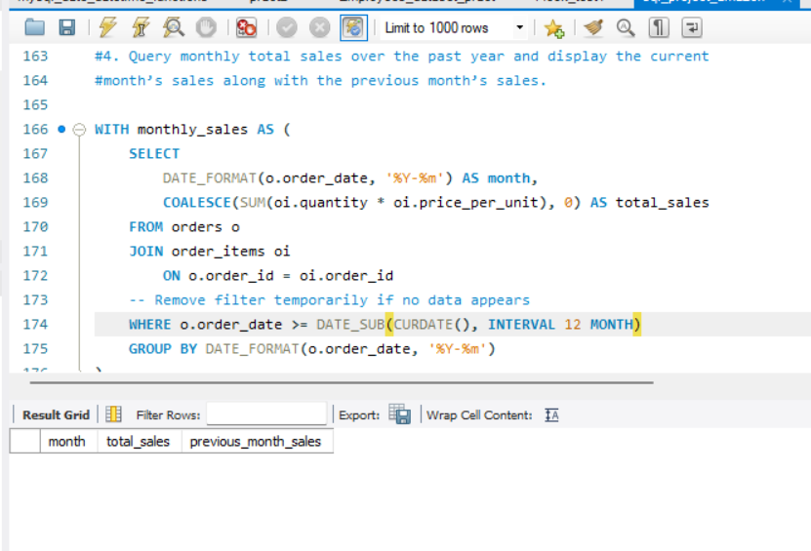
Monthly sales trend with previous month
Q4
WHAT THE QUERY DOES
Totals quantity x price by month and uses the LAG() window function to show the previous month's sales next to the current month.
No rows
The filter uses CURDATE() minus 12 months, but the order dates are older. Fix: anchor on MAX(order_date) instead.

Slide 10
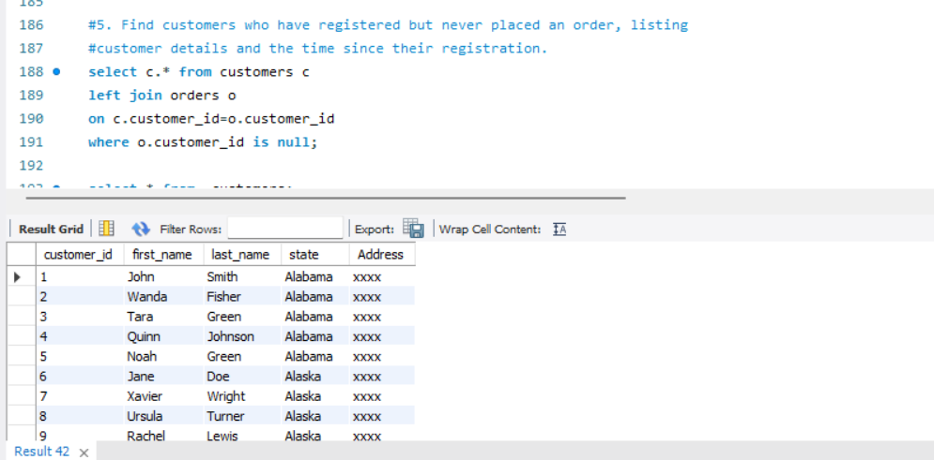
Customers who registered but never ordered
Q5
WHAT THE QUERY DOES
LEFT JOINs customers to orders and filters for NULL in o.customer_id, which means no matching order exists for that customer.
Never ordered
Sample: John Smith, Wanda Fisher, Tara Green (Alabama). A registration-date column is needed to show time since registration.

Slide 11
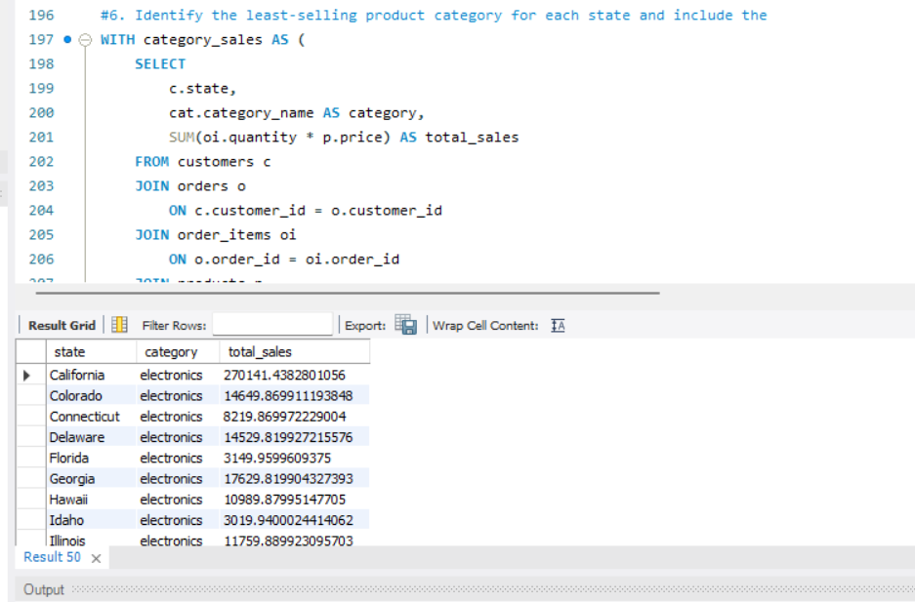
Least-selling category by state
Q6
WHAT THE QUERY DOES
CTE category_sales totals sales per category in each state. CTE ranked_categories applies RANK() within each state. Filtering on rnk = 1 returns one category per state.
Electronics
Every visible state returns Electronics, so recheck the ranking direction (ASC vs DESC) for a true least-selling result.

Slide 12
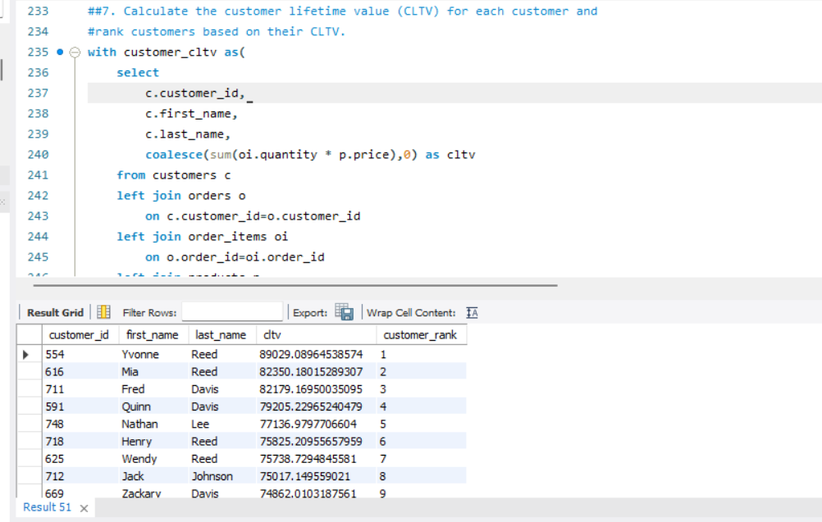
Customer lifetime value (CLTV) ranking
Q7
WHAT THE QUERY DOES
CTE customer_cltv sums each customer's spend, with COALESCE() giving customers with no purchases a CLTV of 0. RANK() then orders customers from highest to lowest.
$89.0K
Top CLTV: Yvonne Reed. Four of the top nine spenders share the surname Reed.

Slide 13
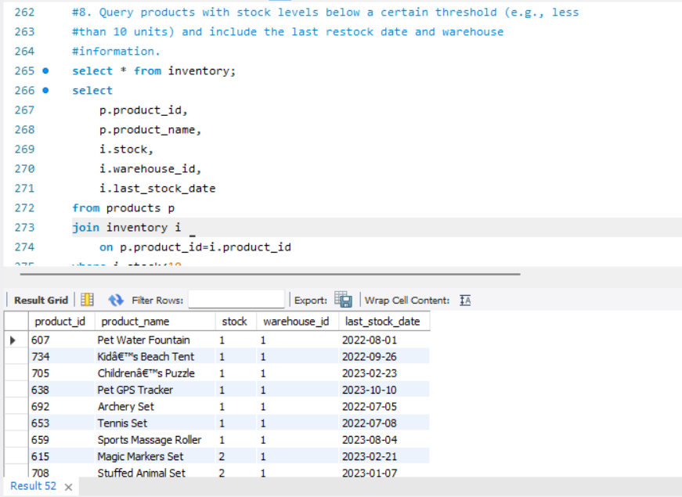
Low stock alert (under 10 units)
Q8
WHAT THE QUERY DOES
Joins products with inventory on product_id, keeps items under 10 units and shows ID, name, stock, warehouse and last restock date, lowest stock first.
1 unit
Stock is down to 1 unit on 7 of 9 listed items, all in Warehouse 1, mostly last restocked in 2022 to 2023. Reorder these first.

Slide 14
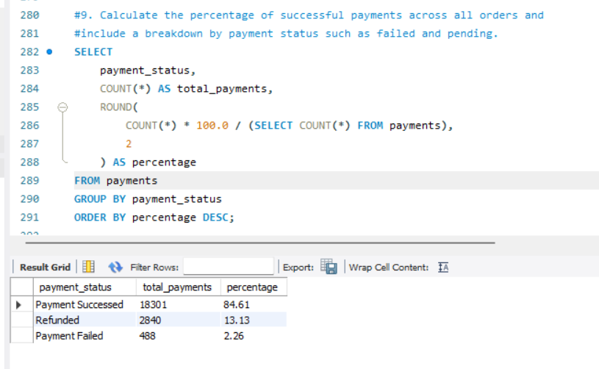
Payment status breakdown
Q9
WHAT THE QUERY DOES
Groups payments by status, counts each with COUNT(*), calculates each share of the total with a subquery, rounds to 2 decimals and sorts by percentage.
84.61%
18,301 payments succeeded. 2,840 (13.13%) were refunded and 488 (2.26%) failed, so about 15.4% did not complete.

Slide 15
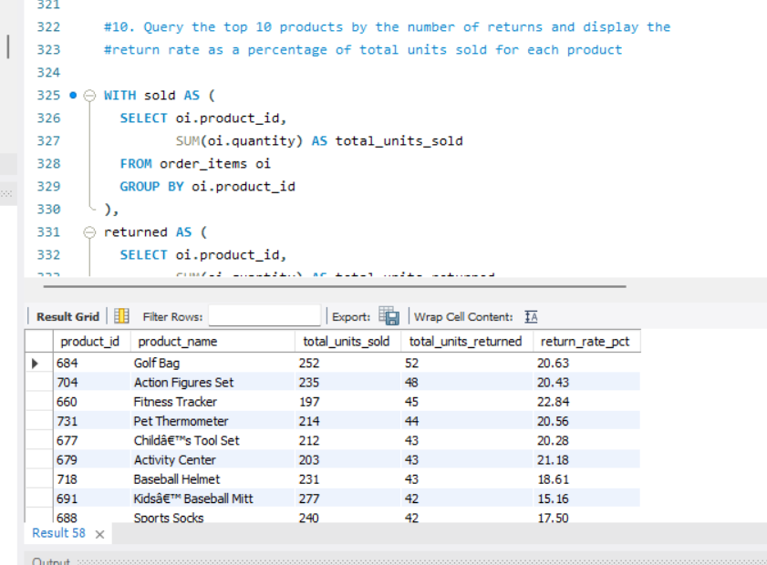
Products with the most returns
Q10
WHAT THE QUERY DOES
CTEs count units sold and units returned (return_date not NULL). COALESCE() fills gaps, NULLIF() prevents division by zero, and the top 10 by returns are shown with their return rate.
22.84%
Fitness Tracker has the highest return rate. Golf Bag has the most returned units (52).

Slide 16
Sales performance at a glance
Electronics generates $11.34M of $12.64M in revenue. Diversifying the catalogue lowers concentration risk.

Slide 17
Customer value: AOV and CLTV
Top spenders are worth $75K to $89K each. They are the natural audience for a loyalty tier.

Slide 18
Payments and returns
About 15.4% of payments are refunded or failed, and return rates on these products run from 15% to 23%.

Slide 19
SQL toolkit used across the project
Technique | Why it was used | Queries
JOIN / LEFT JOIN | Link orders, items, products, customers, payments and inventory | Q1 to Q10
SUM, COUNT, AVG + GROUP BY | Totals, counts and averages per product, category or customer | Q1 to Q3, Q9
HAVING | Keep only customers with more than 5 orders | Q3
CTE (WITH) | Break complex logic into readable, reusable steps | Q4, Q6, Q7, Q10
Window functions: RANK(), LAG() | Rank customers and categories; compare with the previous month | Q4, Q6, Q7
Subquery | Compute the grand total for percentage shares | Q2, Q9
COALESCE() / NULLIF() | Handle NULLs and avoid division by zero | Q7, Q10
ROUND() | Display percentages to two decimal places | Q2, Q9, Q10

Slide 20
Key insights
Revenue concentration
Payment leakage
Returns hotspots
Electronics = 89.7% of revenue; iMac Pro alone brings in about $630K.
15.4% of payments are refunded or failed.
Return rates of 15% to 23% on sports, kids and pet items.
Stock risk
Data quality
Customer value
Several products have 1 to 2 units left in Warehouse 1.
Q4 returned no rows, Q6 shows Electronics everywhere, and product names show encoding artefacts.
Top CLTV customers are worth $75K to $89K, while some signups never ordered.

Slide 21
Recommended next steps
Fix now
Act next
Grow
Data quality
Operations
Customers and catalogue
Rewrite Q4 with MAX(order_date) as the anchor
Recheck Q6 ranking direction (ASC vs DESC)
Add a registration-date column for Q5
Switch to utf8mb4 to remove encoding artefacts
Reorder single-unit products in Warehouse 1
Investigate failed and refunded payments
Review quality and listings for high-return items
Diversify beyond Electronics
Launch a loyalty tier for top CLTV customers
Win back signups who never ordered

Slide 22
Conclusion
These MySQL queries analyse revenue, customers, inventory, payments and returns. Joins, aggregates, CTEs, window functions and NULL-handling functions turn raw data into insights that support inventory planning, payment monitoring and product performance evaluation.
Thank you | Atharva Madure

