Slide 1

EXL-Capstone Project
A Dashboard visualization interface to predict the uber service data
Guided by : Prof. Dadasaheb Hinge

Slide 2

Group Members
Atharva Bharambe
BE Comp, NBNSTIC
Bhagyashri Yerawar
BE Comp, JSPM

Slide 3
Objectives
Primary Objectives
The main goal of this project is to develop a dynamic and interactive dashboard that provides valuable insights into Uber service data. The dashboard will aim to showcase trends, patterns, and key metrics related to Uber's performance, helping users understand the business and make informed decisions.
Secondary Objectives
In addition to the primary objectives, the dashboard will feature several secondary functionalities that enhance its usefulness and flexibility for a broader range of users.
Technical Objectives
The technical implementation of the dashboard will involve several considerations to ensure scalability, security, and efficient data handling.

Slide 4

Technologies used:
Pyspark(Python):
PySpark is the Python API for Apache Spark
Azure Databricks:
Azure Databricks is a unified analytics IDE
MySQL:
MSQL is used to view and cross-verify the data
Dataset:
Uber service dataset is required for this project

Slide 5
Step-by-Step Process
Data Collection
Creating dataframe
Data Cleaning
Data Visualization
Dashboard Creation
Gather Uber service data and ensure it is accessible for analysis.
Store the data in Bronze Layer inorder to keep a backup.
Data is Cleaned in SIlver Layer Table and appended to the Gold Layer Table.
With the help of Gold Layer Table data visualization takes place.
After every visualization of data a customizable Dashboard is created.

Slide 6
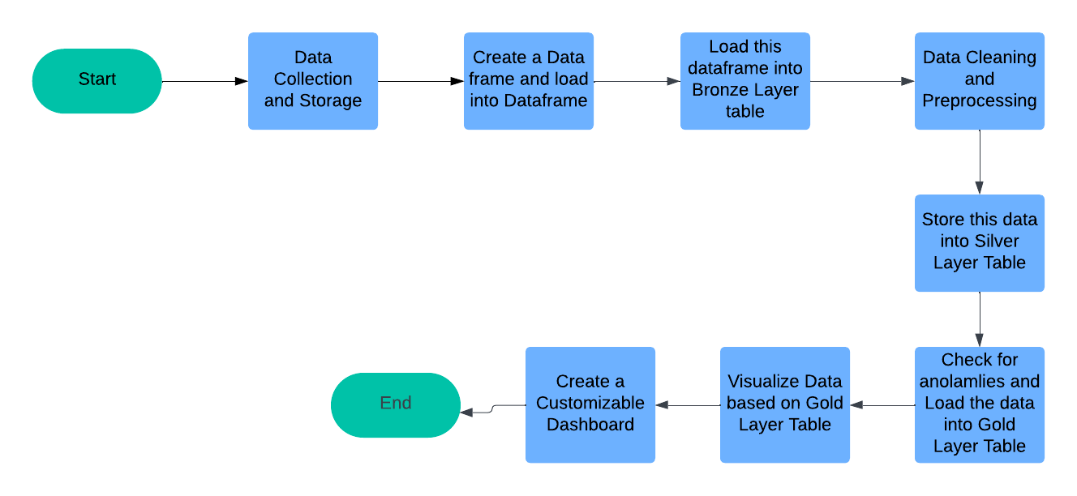
Data Flow Diagram

Slide 7
Challenges
Cost Management and Budgeting:
Managing the cost associated with creating and maintaining an Azure account for the project. Azure services, including Databricks, require careful cost planning due to factors like storage, compute resources, and data processing.
Data Aggregation and Transformation:
Aggregating and transforming large datasets from Uber to derive meaningful insights (e.g., ride demand by region, peak hours, and customer satisfaction) can be computationally intensive. The transformation logic may need to be complex to produce accurate results for visualization.
Complexity in Designing Visualizations:
Designing effective, intuitive, and actionable visualizations for a wide range of metrics (e.g., ride frequency, trip duration, demand patterns) can be complex. Balancing user-friendly design with insightful data representation while avoiding information overload requires expertise in both data visualization and user experience design.

Slide 8
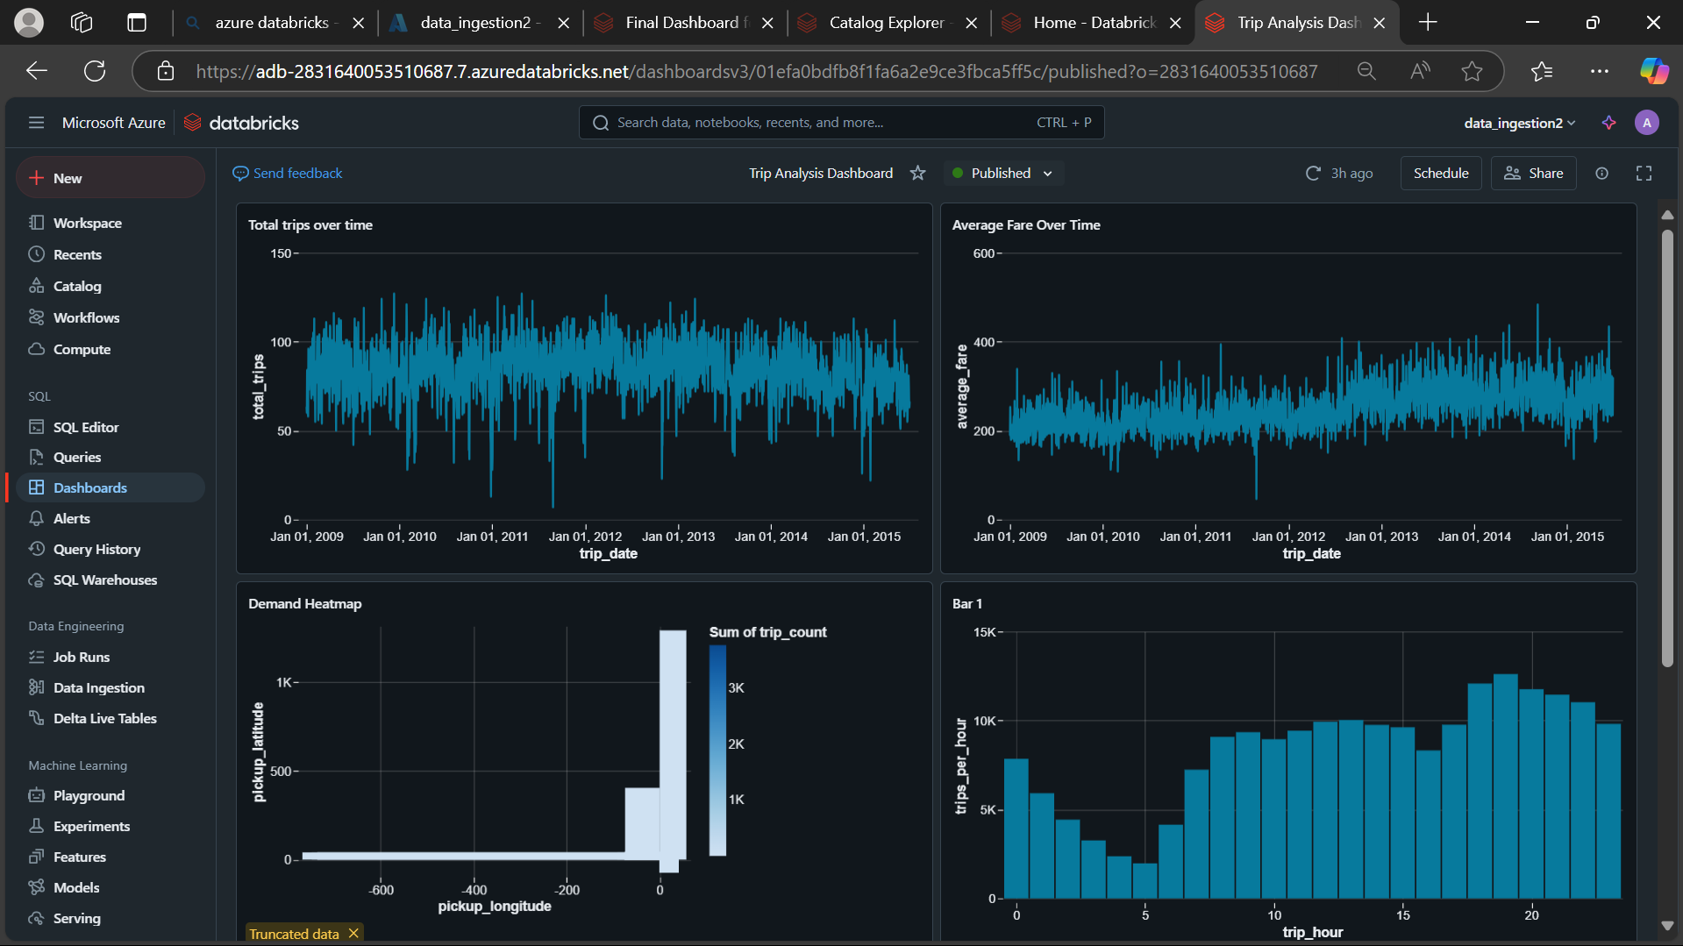
Outputs Snapshots:

Slide 9
Conclusion
The creation of a dashboard visualization interface for Uber service data highlights the transformative power of data analytics in the transportation sector. By converting raw trip data into meaningful insights, the project showcases how organizations can harness data to optimize operations, enhance user experience, and support strategic decision-making. From cleaning and preprocessing the dataset to designing interactive visualizations, each step was carefully executed to ensure the accuracy and relevance of the insights.
This project underscores the importance of integrating scalable and user-friendly tools for data analysis and visualization. The methodology used is not only applicable to Uber but can also be extended to other sectors that require actionable insights from large datasets. Future enhancements, such as incorporating real-time data and predictive analytics using machine learning, can further expand the dashboard’s capabilities. These additions would enable proactive decision-making, making the dashboard a critical tool for optimizing transportation services and improving customer satisfaction.

Slide 10

THANK YOU

