Slide 1
Judges

Slide 2
What do Judges do?
Make decisions about whether or not to admit evidence into trials
Judges preside over trials, and they make decisions about what kinds of evidence go in
Have to decide on whether the expert evidence is reliable and valid

Slide 3
Who can be a Judge?
To become a judge, an individual must be an Attorney
Oregon Supreme Court
a U.S. citizen
a state resident for at least three years
state bar member
under the age of 75
Oregon Court of Appeals
a U.S. citizen
a qualified elector of his or her county of residence
state bar member
under the age of 75

Slide 4
How are Judges chosen in Oregon?
As of April 2023, state court judges in Oregon were selected exclusively through nonpartisan elections.
The nonpartisan election of judges is a selection method where judges are chosen through elections where they are listed on the ballot without an indication of their political affiliation.
If a primary election is held, it is not to narrow the candidates to one from each party. Instead, these primary elections typically narrow the field to two candidates for the general election.

Slide 5
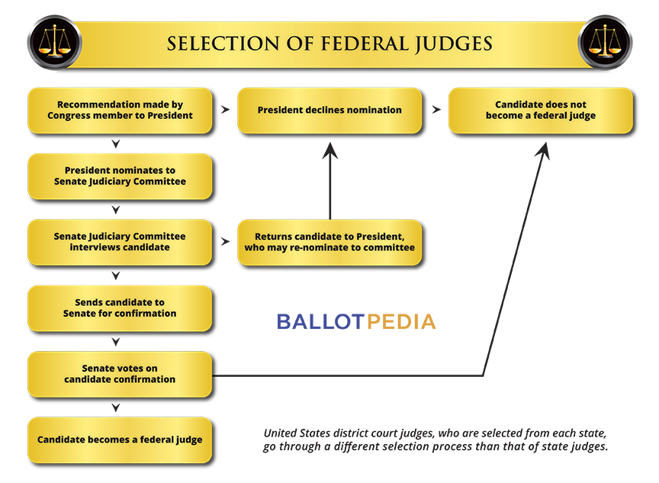

Slide 6
Can be Judges be removed?
Judges can be disciplined or reprimanded for reasons including ethical violations, criminal conduct or incapacity to perform their duties.
Hearing, investigations, and other forms of inquiry.
Oregon Judges are subject to retention elections.
Overall, judges can be removed through a process overseen by the Oregon Commission on Judicial Fitness and Disability.

