Slide 1

Basic Details of the Team and Problem Statement
Ministry/Organization Name/Student Innovation:
Ministry Of AYUSH
PS Code: 1347
Problem Statement Title: A software that suggests drugs and formulations for a disease/pharmacological property based on the Ayurvedic classical books/Repositories.
Team Name: DevRishi
Team Leader Name: Atharva Deopujari
Institute Code (AISHE):
Institute Name: Indian Institute of Information Technology, Nagpur
Theme Name:

Slide 2
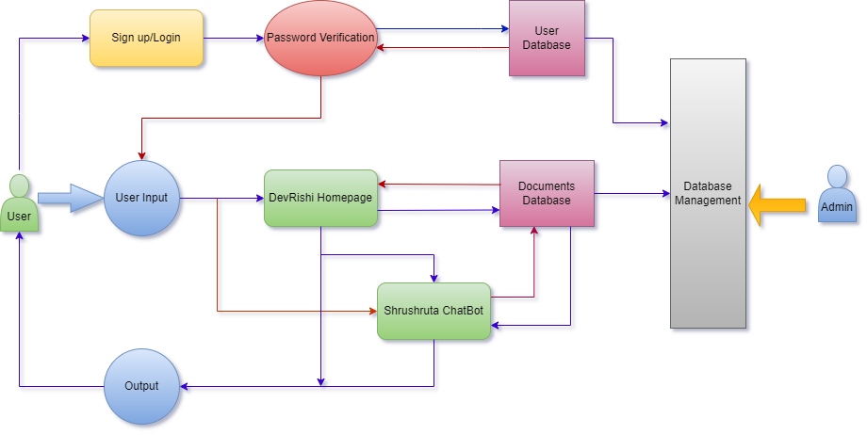




















Idea/Approach Details
We are looking for a solution by creating a web system that suggests drugs and formulations for a disease based on the Ayurvedic classical books. It will help the common people, practitioners and students to access the Ayurvedic knowledge of herbs, minerals and formulations from its 150 diverse texts. Prototype will work as follows:
The user will use the Sushruta chat-bot to access the knowledge about Ayurveda. This chat-bot will suggest the drug and dosage and formulations using Artificial Intelligence(AI) and Machine Learning(ML) when the user mentions theirs symptoms to this chat-bot by its huge database on Ayurvedic texts.
After Sushruta suggests the drug to the user, it will also give the necessary drug details to the user like price, nearby shop via GPS system.
We have complete control over data by which we monitor the information that is fed into our chat-bot and to check whether this data aligns with our ethical and quality standards.
Sushruta will also take speech input in with Multilingual Support by which people from rural could also get to know about the Ayurvedic cure about their medicine.
This Sushruta chat-bot will be integrated to the primary website DevRishi. This website will contain the information about each medicines in Ayurveda till date divided into its sub sections.
This website will also contain a contribution page where the students and doctors will share information gathered by them on their specific domains on our website.
This website will contain E-books and pdf links of some important books used by the students and also some online tutorials
This website will also provide multilingual support to its users, this will turn the whole page to the language the user wants.
Later, patients can use AR and VR to interact with Ayurvedic practitioners alongside the chatbot for valuable feedback.
Describe your Technology stack here:

Slide 3
Idea/Approach Details
Describe your Dependencies / Show stopper here
Our chatbot not only offers specific suggestions for Ayurvedic recipes to enhance your balanced diet and well-being but also provides recommendations for specific ailments.
By selecting their preferred language, this feature transforms the website to cater to the user's linguistic preferences.
A dedicated page for practitioners and students to generously share their knowledge, contributing to the collective knowledge that enriches our website and also increase the database.
Access a vast repository of Ayurvedic literature, Research papers, and Educational materials.
Our website will not only act as a platform for gaining knowledge but also a platform for all like minded individuals to interact with each other.
This web app will provide essential information about Ayurvedic medicines, categorizing them into specific sections for the convenience of students and practitioners.
Easily create an account, enabling them to seamlessly resume their studies from where they left off. All their valuable data is securely saved under their account name.
Website will be integrated with a user-friendly search bar, designed to enhance your travel experience on our website.
Business Strategies-
Freemium Model:The chatbot offers free basics to attract users and monetizes premium features like personalized health plans and consultations.
Affiliate Marketing: By partnering with Ayurvedic product suppliers, the chatbot recommends herbal products and earns income through affiliate marketing.
Data-driven Insights: The chatbot anonymizes and aggregates user data, with consent, to identify health trends. This data can be sold to research institutions, Ayurvedic product firms, or pharmaceutical companies for natural remedy development.
Describe your Use Cases here
Visit DevRishi's website, ask your health questions easily, and our AI chatbot will give you personalized Ayurvedic advice based on your needs and Ayurvedic knowledge.
DevRishi prescribe medicines and its formulations backed by reliable Ayurvedic data, guided by AI. This ensures prescriptions are based on trusted Ayurvedic knowledge.
To build an Ayurveda web-app for students and practitioners, use Node.js for development, MySQL for data storage, and OAuth for user authentication, WebSocket for real-time communication, monitor performance and user activity, and make content delivery faster with CDNs.
Implement security best practices to protect user data, including encryption, data validation, and protection against common web application vulnerabilities like SQL injection and Cross-Site Scripting (XSS).
NLP facilitates multilingual conversations in AI chatbots by enabling them to understand and respond in various languages, breaking down language barriers for global users.
Through an Automation System the model tracks the user location and can give address of nearest Medical store to buy the prescribed Ayurvedic Medicines.

Slide 4
Team Member Details
Team Leader Name: Atharva Deopujari
Branch: Btech, Stream: ECE, Year: II
Team Member 1 Name: Vansh Bhavsar
Branch: Btech, Stream: ECE, Year: II
Team Member 2 Name: Kirtan Bhavsar
Branch: Btech, Stream: ECE, Year: II
Team Member 3 Name: Vipin Mishra
Branch: Btech, Stream: ECE, Year: II
Team Member 4 Name: Kushagra Srivastav
Branch: Btech, Stream: CSE, Year: II
Team Member 5 Name: Akshaya Mudragada
Branch: Btech, Stream: CSE, Year: II
Team Mentor 1 Name: Dr.Aatish Daryapurkar
Category: Academic, Expertise: Nano Science and Nanotechnology ,Domain Experience (in years):
Team Mentor 2 Name:
Category: Academic, Expertise: ,Domain Experience (in years):

Slide 5
Important Pointers
Please ensure below pointers are met while
Kindly keep the maximum slides limit to 4 pages
All the topics should be utilized for description of your idea
Try to avoid paragraphs and post your idea in points
Keep your explanation precisely and easy to understand
Idea should be unique and novel. If it has a business potential more weightage will be given.
Apart from this PPT abstract of your idea will be asked separately while submitting
You need to save the file in PDF and upload the same on portal. No PPT, Word Doc or any other format will be supported
You can delete this slide (Important Pointers) when you upload the details of your idea on SIH portal.

