Slide 1

Basic Details of the Team and Problem Statement
Ministry/Organization Name/Student Innovation: Ministry Of AYUSH
PS Code: 1347
Problem Statement Title: A software that suggests drugs and formulations for a disease/pharmacological property based on the Ayurvedic classical books/Repositories.
Team Name: DevRishi
Team Leader Name: Atharva Deopujari
Institute Code (AISHE): U-0841
Institute Name: Indian Institute of Information Technology, Nagpur
Theme Name: MedTech / BioTech / HealthTech
1

Slide 2
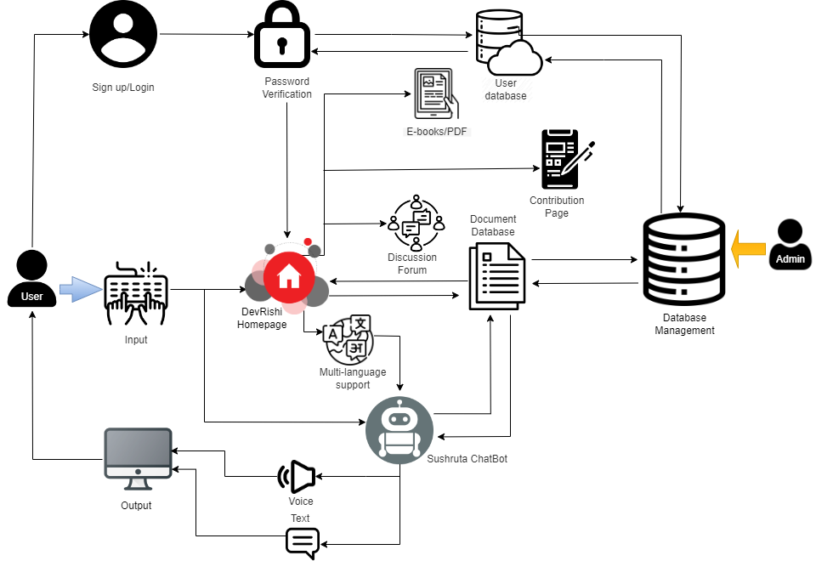




















Idea/Approach Details
We are looking for a solution by creating a web-app system that suggests drugs and formulations for a disease based on the Ayurvedic classical books. It will help the common people, practitioners and students to access the Ayurvedic knowledge of herbs, minerals and formulations from its 150 diverse texts. Prototype will work as follows:
Users can access Ayurvedic knowledge via Sushruta chat-bot, which suggests AI/ML-driven drug recommendations and its formulations based on symptoms using a vast Ayurvedic database.
Can maintain complete data control, ensuring ethical and quality standards along with accuracy for chat-bot provided information.
The website and chatbot has multilingual support and speech input for user-preferred languages.
Integration with the DevRishi website, offering comprehensive Ayurvedic medicine information divided into sections and sub-sections.
A contribution page for students and doctors to share domain-specific knowledge. Important E-books, PDFs, and online tutorials will be made available on the website.
Future integration of Augmented Reality(AR) and Virtual Reality(VR) for interaction of Ayurvedic practitioners with Sushruta chatbot.
Website includes Discussion Forums for community interaction of like minded individuals.
Describe your Technology stack here:

Slide 3
Idea/Approach Details
Describe your Dependencies / Show stopper here
Users can create accounts to access personalized features. Manage their profiles, preferences, and security settings.
Website is integrated with a user-friendly search bar, designed to enhance your travel experience on our website.
After Sushruta suggests the drug to the user, it will also give the necessary drug details to the user like price, nearby manufacturer via GPS system.
NLP facilitates multilingual conversations in AI chatbots by enabling them to understand and respond in various languages, breaking down language barriers for global users.
At basic stage the chatbot depends on OpenAi API to function. Later with help of proper resources, dataset and faster cpu, our own models can be trained.
Used Node.js for development, MySQL for data storage, and OAuth for user authentication, WebSocket for real-time communication, monitor performance and user activity, and made content delivery faster with CDNs.
Given is the link for short demo of what we have implemented till now. Note-It is still under development and is the initial version https://drive.google.com/file/d/15nrn5wiAdAxIbalvCHskZ16A6QF8d75D/view?usp=drive_link
Describe your Use Cases here
Visit DevRishi's website, ask questions, and get tailored Ayurvedic guidance from our AI chatbot. Receive dietary recommendations and specific remedies for various health concerns.
DevRishi provides reliable ayurvedic formulations based on AI and trustworthy datasets according to the person.
Access to vast repository of Ayurvedic literature, Research papers, and Educational materials.
The chatbot offers free basics to attract users and monetizes premium features like personalized health plans and consultations following freemium model.
By partnering with Ayurvedic product suppliers, the chatbot recommends herbal products and earns income through affiliate marketing.
The chatbot anonymizes and aggregates user data, with consent, to identify health trends. This data can be sold to research institutions, Ayurvedic product firms, or pharmaceutical companies for natural remedy development.

Slide 4
Team Member Details
Team Leader Name: Atharva Deopujari
Branch: Btech, Stream: ECE, Year: II
Team Member 1 Name: Vansh Bhavsar
Branch: Btech, Stream: ECE, Year: II
Team Member 2 Name: Kirtan Bhavsar
Branch: Btech, Stream: ECE, Year: II
Team Member 3 Name: Vipin Mishra
Branch: Btech, Stream: ECE, Year: II
Team Member 4 Name: Kushagra Srivastava
Branch: Btech, Stream: CSE, Year: II
Team Member 5 Name: Akshaya Mudragada
Branch: Btech, Stream: CSE, Year: II
Team Mentor 1 Name: Dr.Aatish Daryapurkar
Category: Academic, Expertise: Effective problem-solving strategies, Nanoscience and Nanotechnology ,Domain Experience (in years): 10
Team Mentor 2 Name: Dr.Amol Bhopale
Category: Academic, Expertise: NLP and Machine Learning , Domain Experience (in years): 6

