Slide 1

Healthcare Analytics for Doctor Visits_TIRTC
Exploratory Data Analysis & Data Preprocessing
Done By : Atharva Abhay Deshpande
AICTE ID : STU6a5e292a5d1bd1784555818

Slide 2


PROBLEM STATEMENT
Doctor visits vary a lot from one patient to another. In this dataset, 79.8% of patients made no visit, while a small group made several. Understanding which patient characteristics are linked to more visits is non-trivial without structured analysis.
Key variables under investigation:
Gender and age
Income
Illness, reduced and health values
Insurance type (private, freepoor, freerepat) and chronic conditions (nchronic, lchronic)
Doctor visits vary depending on factors such as gender, age, income, illness, insurance type and chronic conditions. This project aims to analyze the 5,190-record doctor visits dataset to understand these relationships and derive meaningful insights that can help understand doctor-visit patterns.

Slide 3
Project Description
Dataset at a Glance
Project Workflow
Source: Healthcare Analytics for Doctor Visits dataset (CSV file)
Size: 5,190 rows x 12 columns
Type: Structured tabular data
1
Load & Understand
Identify and load the dataset; inspect structure, data types, and statistical summary
2
Data Quality Checks
12 Dataset Columns
Check for missing values (none found) and duplicate records (1,320 repeated rows,
kept because there is no patient ID)
visits (whole number)
gender (female / male)
age (numeric)
income (numeric)
illness (whole number)
reduced (whole number)
health (whole number)
private (yes / no)
freepoor (yes / no)
freerepat (yes / no)
nchronic (yes / no)
lchronic (yes / no)
3
Question-Based Analysis
Answer 13 questions using filtering, grouping, counts and sorting
4
Further Analytics & Insights
Study distributions, age, income and illness bands and correlations;
derive evidence-based findings

Slide 4






WHO ARE THE END USERS?
Healthcare Administrators
Health Insurance Analysts
Public Health Researchers / Policy Makers
Can understand how often patients visit and which patient groups visit more, before discussing planning.
Can compare average visits across private, freepoor and freerepat groups to see how insurance type relates to visits.
Can study how age, income and illness relate to doctor visits across 5,190 patient records.
Healthcare Data Analysts
Data Analysts / Students
Can use the analyzed data to understand trends and relationships in doctor visits.
Can use the project as an example of data cleaning, exploratory data analysis and visualization.

Slide 5
Technology Used
Python
Pandas & NumPy
Core programming language for all data loading, manipulation, analysis, and scripting tasks throughout the project.
Pandas for dataset loading, cleaning, grouping, and aggregation. NumPy for efficient numerical operations and array computations.
Matplotlib & Seaborn
Jupyter / Google Colab
Matplotlib for scatter plots and boxplots; Seaborn for higher-level EDA visualizations and exploratory statistical graphics.
Interactive notebook environment for writing, executing, and documenting the analysis in a reproducible, step-by-step format.

Slide 6
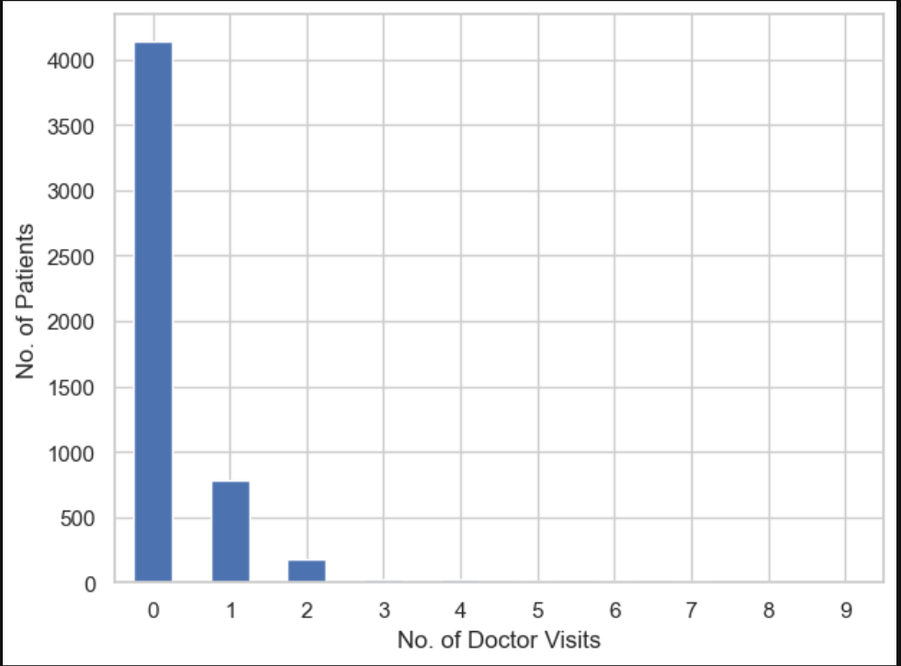
RESULTS
8 in 10 patients made no doctor visit
DISTRIBUTION FINDINGS
4,141 patients (79.8%) had 0 visits; 1,049 (20.2%) had at least one.
The maximum is 9 visits, in just one record: a male patient with illness 5, reduced 14, health 10, freerepat yes and lchronic yes.
Five records have 8 visits. Sorting by visits puts the 9-visit record first, and three of the top five records have reduced = 14.
Number of patients by number of visits · Most patients made zero visits
Demo Link : Click Here

Slide 7
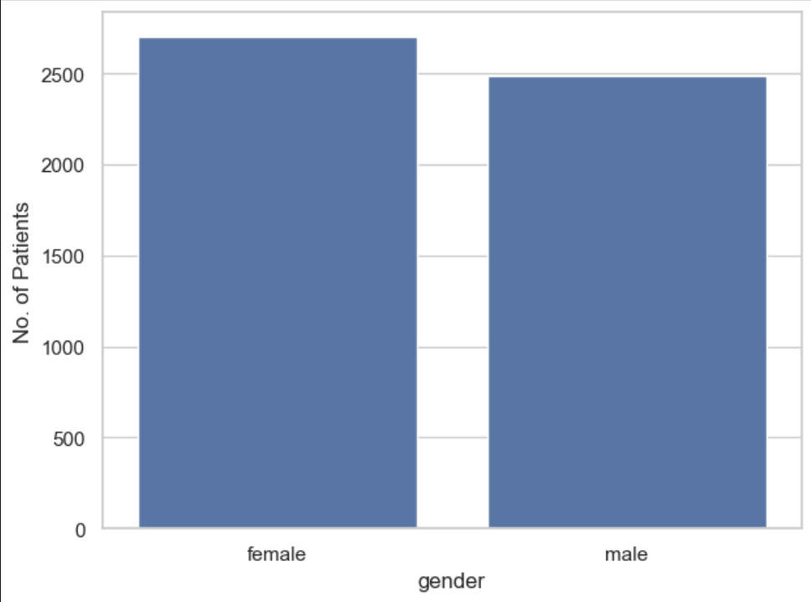
RESULTS
Female patients visit more often than male patients
SEX COMPARISON
2,702 female records and 2,488 male records.
660 female patients (24.4% of female records) visited at least once, compared with 389 male patients (15.6% of male records).
292 female patients with private insurance visited at least once.
Average visits by sex · Female records have the higher average visits
Demo Link : Click Here

Slide 8
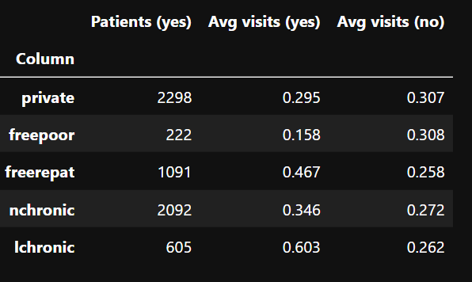
RESULTS
Free-insurance groups differ sharply; private insurance makes almost no difference
INSURANCE & CHRONIC COHORTS
231 patients have private insurance and lchronic = yes.
1,251 records are male with private insurance, or have freepoor = yes.
Average visits for yes vs no
Demo Link : Click Here

Slide 9
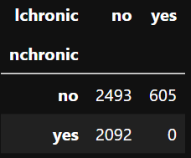
RESULTS
The two chronic flags never overlap, and lchronic carries the highest visit rate
CHRONIC CONDITION COHORTS
No record has both flags set to yes.
340 female patients have lchronic = yes and 807 male patients have nchronic = yes, together 1,147 records.
Average visits: lchronic = yes 0.603 vs 0.262 for the rest.
nchronic by lchronic contingency table · Zero overlap observed
Demo Link : Click Here

Slide 10
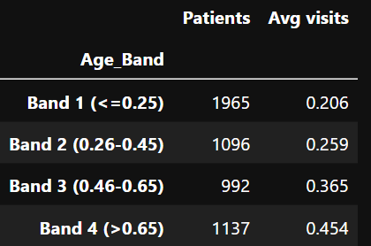
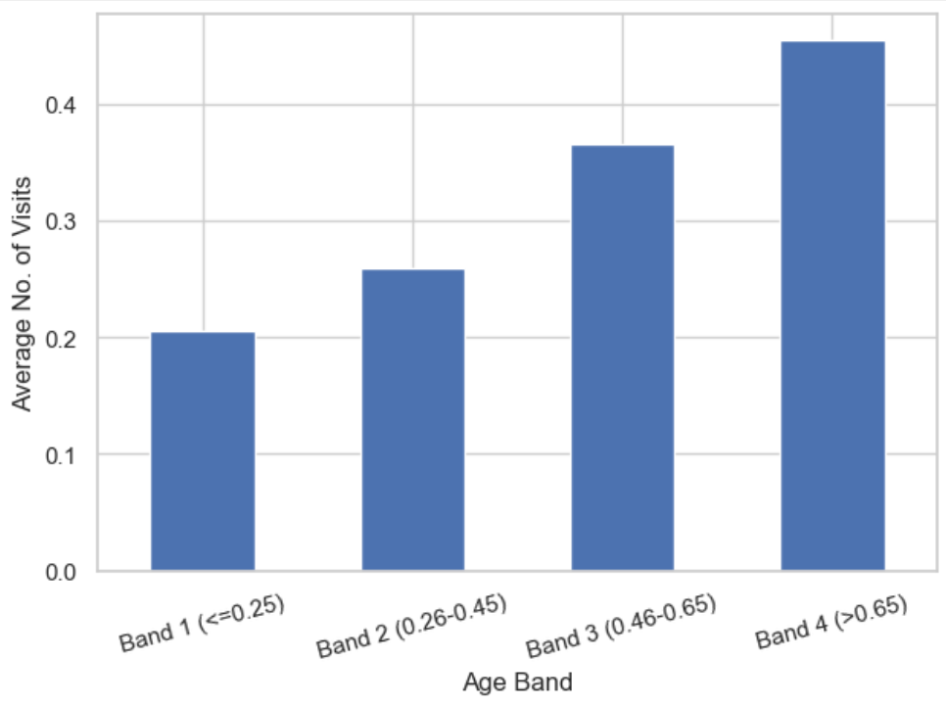
RESULTS
Visits rise with age values and fall with income values
Average visits by age and income bands
Age bands (units of age are not given in the data): Band 1 (0.25 or less) 0.206 with 1,965 patients; Band 2 (0.26 to 0.45) 0.259 with 1,096; Band 3 (0.46 to 0.65) 0.365 with 992; Band 4 (above 0.65) 0.454 with 1,137.
Income bands (units of income are not given in the data): Band 1 (0.25 or less) 0.398 with 1,638 patients; Band 2 (0.26 to 0.55) 0.305 with 1,329; Band 3 (0.56 to 0.90) 0.230 with 1,485; Band 4 (above 0.90) 0.225 with 738.
Most common income values (patients): 0.25 = 1,195; 0.90 = 589; 0.55 = 467; 0.35 = 462; 0.65 = 455; 0.75 = 441; 0.45 = 400; 1.10 = 361; 0.15 = 249; 1.50 = 215.
Demo Link : Click Here

Slide 11
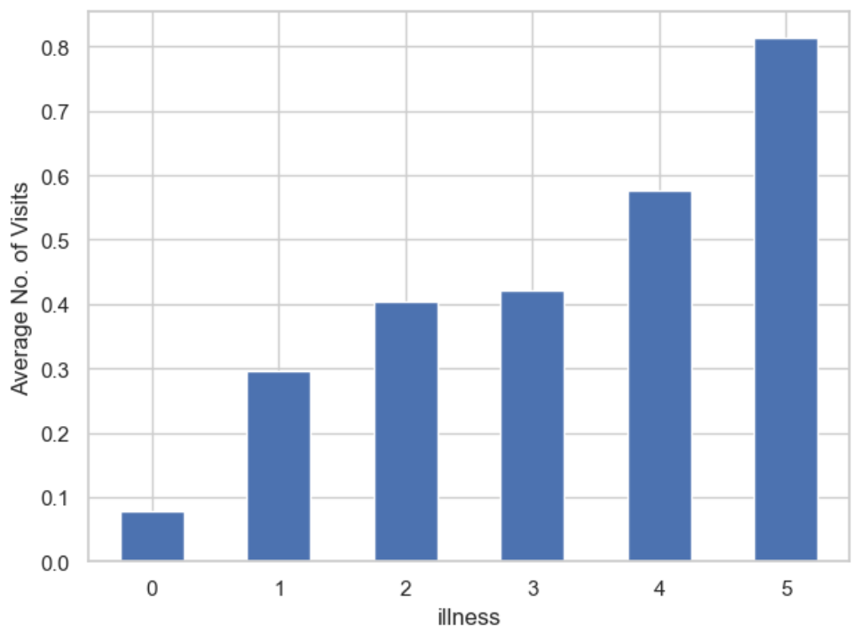
RESULTS
More illnesses, more visits
ILLNESS PROGRESSION
illness has 6 distinct values, from 0 to 5.
Average visits increase at every step of illness, from 0.08 to 0.81.
92 patients with lchronic = yes have a health value above 5.
Average visits by illness value · Average visits increase at every step of illness
Demo Link : Click Here

Slide 12
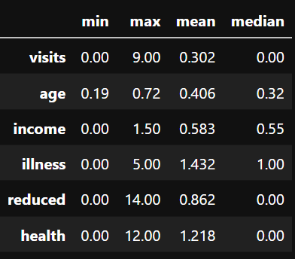
RESULTS
Most count columns are heavily concentrated at zero
Records at 0: visits 4,141; reduced 4,454; health 3,026.
reduced has a second spike at its maximum of 14 (188 records).
37.9% of records sit at the two lowest age values (0.19 and 0.22), and 822 at the highest (0.72).
Count-column distribution
Demo Link : Click Here

Slide 13
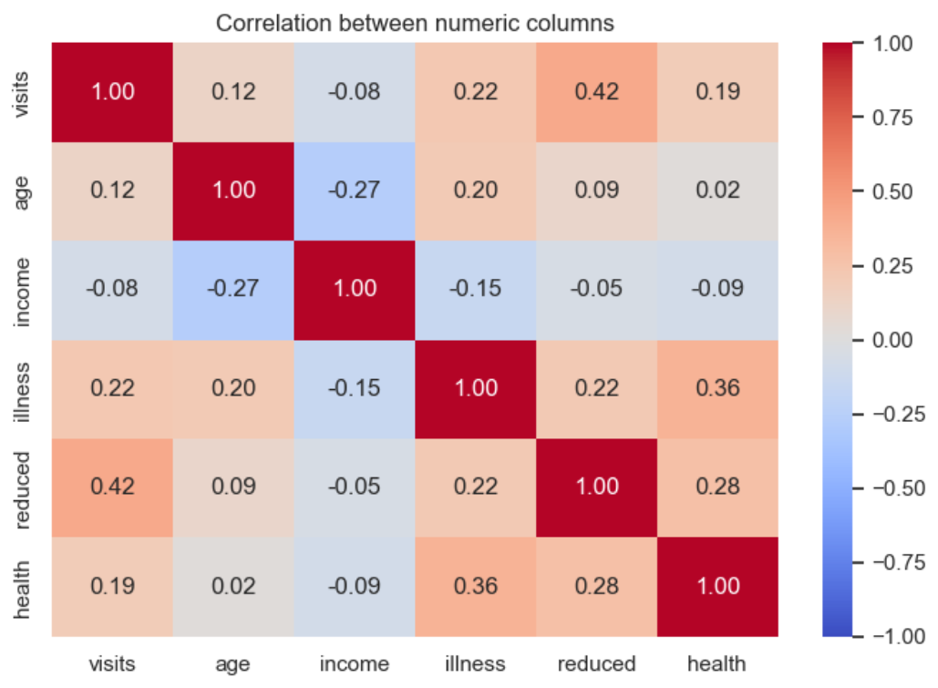
RESULTS
Reduced is the strongest link with visits
CORRELATION ANALYSIS
Other notable pairs: illness and health 0.36; reduced and health 0.28; age and income -0.27.
No single column explains visits on its own.
Correlation with visits · reduced has the strongest positive correlation with visits
Demo Link : Click Here

Slide 14

.
.

