Slide 1

Project Title – Seasonal Agriculture performance Analysis
Student Name : Atharva Abhay Deshpande
College Name : Sanjivani College of Engineering
AICTE STU ID : STU6a5e292a5d1bd1784555818

Slide 2

PROBLEM STATEMENT
Agricultural activities are influenced by seasonal variations in environmental conditions, farming practices, resource availability and market conditions. As a result, agricultural performance may differ from one season to another.
However, raw agricultural data does not clearly explain how agricultural performance changes across seasons or what patterns can be observed in different seasonal conditions.
The problem is to analyze the given agricultural dataset and investigate seasonal differences in agricultural performance by identifying meaningful patterns, trends, relationships and variations within the available data.

Slide 3
Project Description
Project Description :
  This project analyzes seasonal patterns in agricultural performance using a dataset of 4,000 farm records across 28 attributes, covering farms across multiple states, districts, and crops during the Kharif, Rabi, and Zaid seasons.
About the Dataset :
The dataset combines four types of information for each farm record:
  Farm & Location Details – Farm ID, State, District, Crop, Season, Farm Area (Hectares)
  Environmental Conditions – Rainfall (mm), Average Temperature (°C), Humidity (%), Sunlight Hours/Day, Soil pH, Soil Moisture (%)
  Farming Inputs & Practices – Nitrogen, Phosphorus & Potassium (kg/ha), Irrigation Method, Fertilizer (kg/ha), Pesticide (Litre/ha), Seed Quality Score, Water Used (m³)
  Production & Economic Outcomes – Yield (Tonnes/ha), Production (Tonnes), Market Price (INR/Tonne), Total Cost, Revenue, Profit (INR), Water Efficiency
What the Project Does :
Using this data, the project cleans and prepares the dataset, then studies how environmental conditions, resource usage, and economic performance change across seasons. Statistical tests (ANOVA, Chi-square) validate whether these seasonal differences are significant, while correlation analysis and regional/crop-wise comparisons uncover deeper relationships. The result is a set of evidence-based insights and recommendations to support smarter, season-specific agricultural planning.

Slide 4

WHO ARE THE END USERS?
Farmers & Cooperatives
State Agricultural Departments
Agri-Fintech & Insurers
Planning crop selection and resource allocation by season to maximize yield and profitability.
Policy makers using seasonal performance data to design targeted agricultural support programs.
Crop insurance companies assessing seasonal risk exposure and pricing coverage accurately.
Agronomists & Researchers
Input Suppliers
Studying seasonal yield patterns to advance agricultural science and best practices.
Fertilizer, seed, and irrigation equipment suppliers using seasonal demand forecasting for inventory planning.

Slide 5
Technology Used
Python
Pandas & NumPy
Core programming language for all data loading, manipulation, analysis, and scripting tasks throughout the project.
Pandas for dataset loading, cleaning, grouping, and aggregation. NumPy for efficient numerical operations and array computations.
Matplotlib & Seaborn
Jupyter / Google Colab
Matplotlib for scatter plots and boxplots; Seaborn for higher-level EDA visualizations and exploratory statistical graphics.
Interactive notebook environment for writing, executing, and documenting the analysis in a reproducible, step-by-step format.

Slide 6
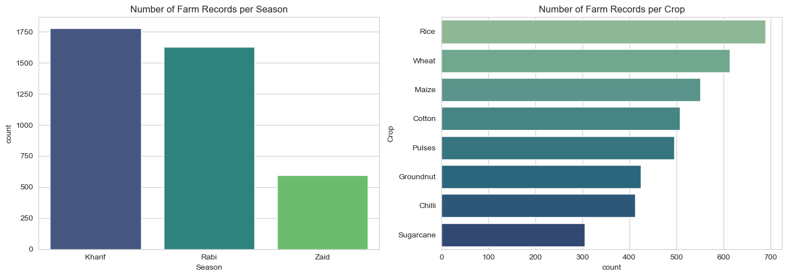
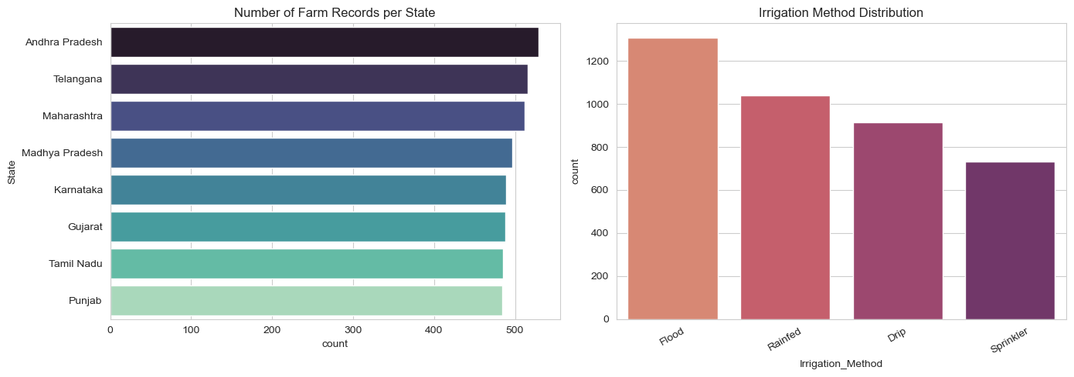
RESULTS
PROJECT BRIEF · EXPLORE, UNDERSTAND AND PREPARE THE DATA
4,000 × 28 farm records × attributes
3 · 8 · 8 seasons · crops · states
4 irrigation methods (Drip, Flood, Rainfed, Sprinkler)
~1% missing values — imputed with season-wise medians
6–10% outliers in economic columns — capped at 1st/99th percentile
0 duplicate rows

Slide 7
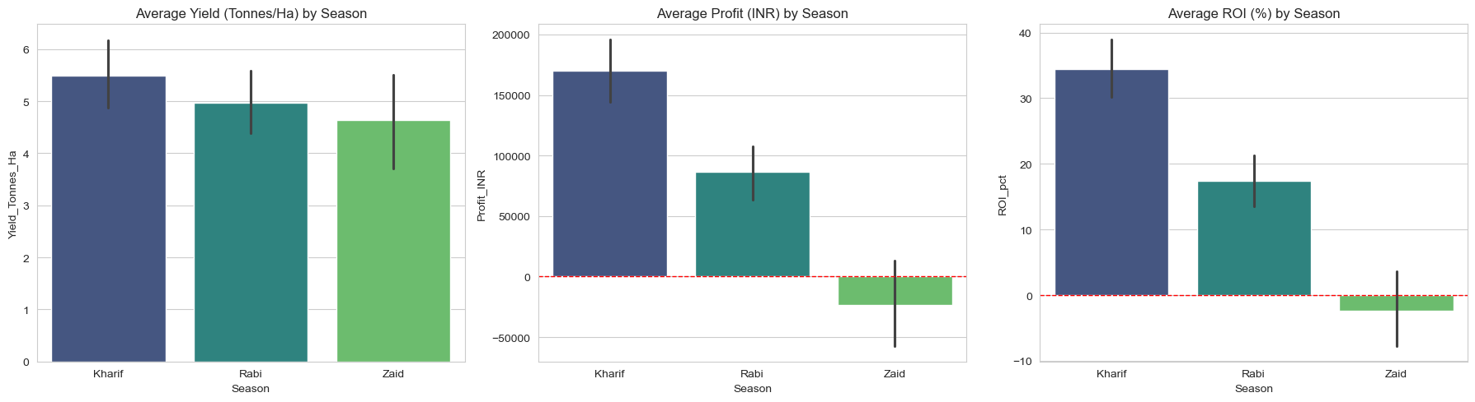
RESULTS
KEY QUESTION 1 · HOW DOES AGRICULTURAL PERFORMANCE VARY ACROSS SEASONS?
KHARIF
Yield 5.50 t/ha
Profit ₹1.70 L
ROI 34.4%
RABI
Yield 4.98 t/ha
Profit ₹0.86 L
ROI 17.4%
ZAID
Yield 4.64 t/ha
Profit −₹0.23 L
ROI −2.3%

Slide 8
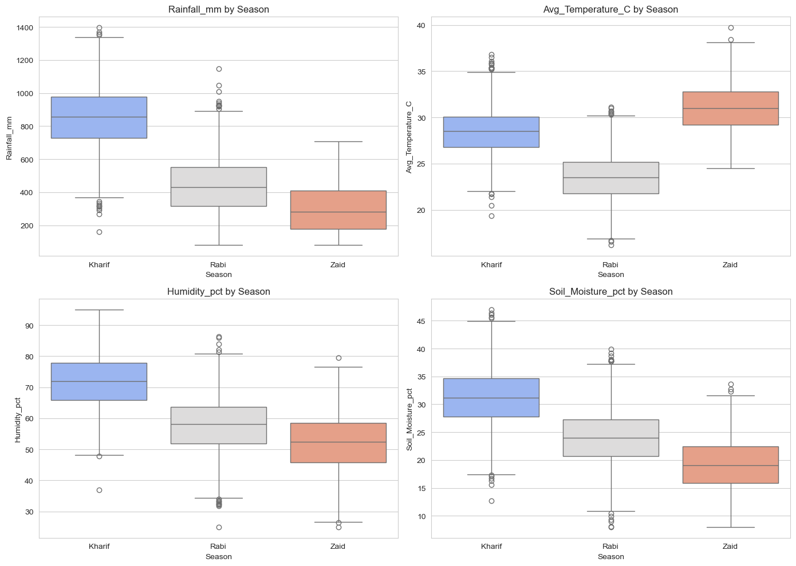
RESULTS
KEY QUESTIONS 2–3 · WHAT MAJOR PATTERNS APPEAR, WHICH CHARACTERISTICS CHANGE?
Metric | Kharif | Rabi | Zaid
Rainfall (mm) | 852 | 436 | 299
Temp (°C) | 28.5 | 23.5 | 31.0
Humidity (%) | 71.8 | 57.9 | 52.0
Soil moisture (%) | 31.2 | 24.1 | 19.2
Kharif = monsoon: wettest, most humid.
Rabi = cool, dry winter window.
Zaid = hot, dry summer — harshest.

Slide 9
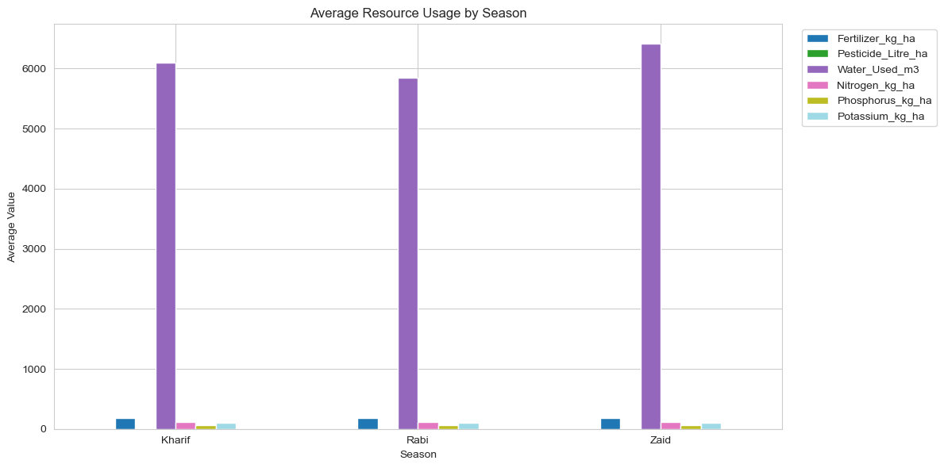
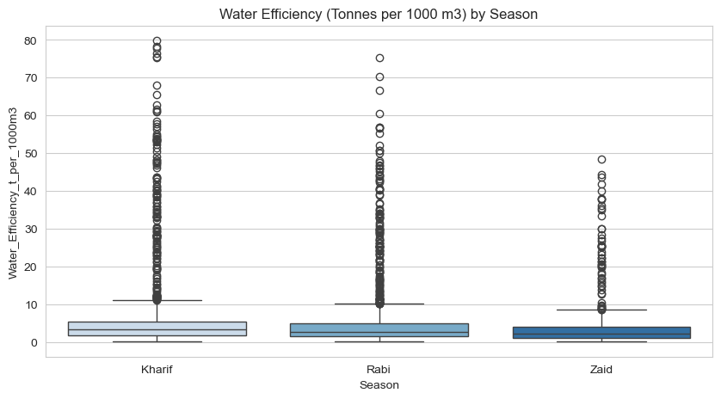
RESULTS
KEY QUESTIONS 4–5 · DO ACTIVITIES AND RESOURCE USAGE VARY ACROSS SEASONS?
Inputs are flat: fertilizer (184.6–187.1 kg/ha), pesticide and NPK use barely change across seasons — inputs don't explain the performance gap.
Water is the outlier: Zaid draws the most water (6,420 m³) yet has the lowest efficiency (4.41 t/1,000 m³); Kharif is most efficient (5.89).

Slide 10
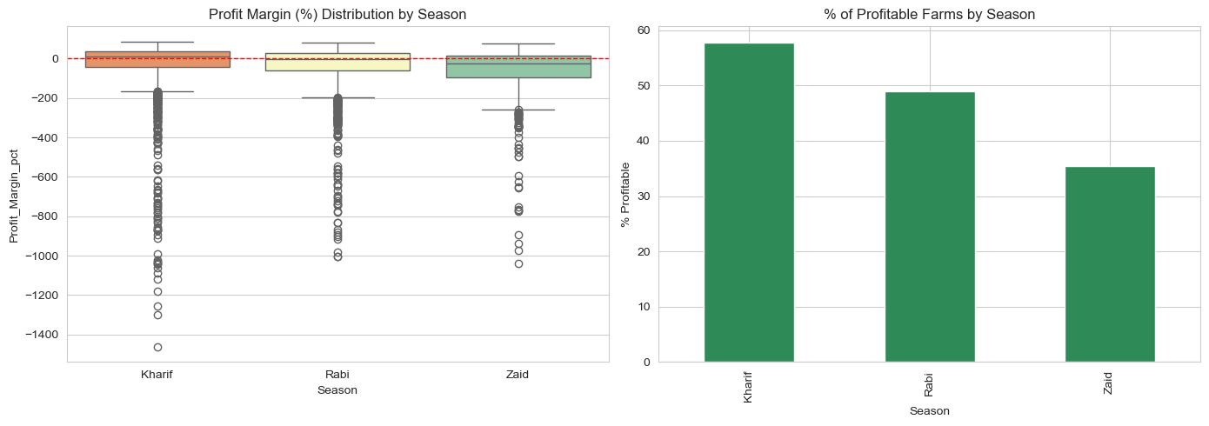
RESULTS
KEY QUESTION 6 · HOW DO ECONOMIC OUTCOMES VARY ACROSS SEASONS?
57.8%
Kharif farms profitable
48.9%
Rabi farms profitable
35.5%
Zaid farms profitable
22-point profitability gap: 57.8% of Kharif farms make money versus only 35.5% in Zaid.
Average profit falls ₹1.93 L from +₹1.70 L (Kharif) to −₹0.23 L (Zaid) — Rabi sits between at ₹0.86 L.

Slide 11
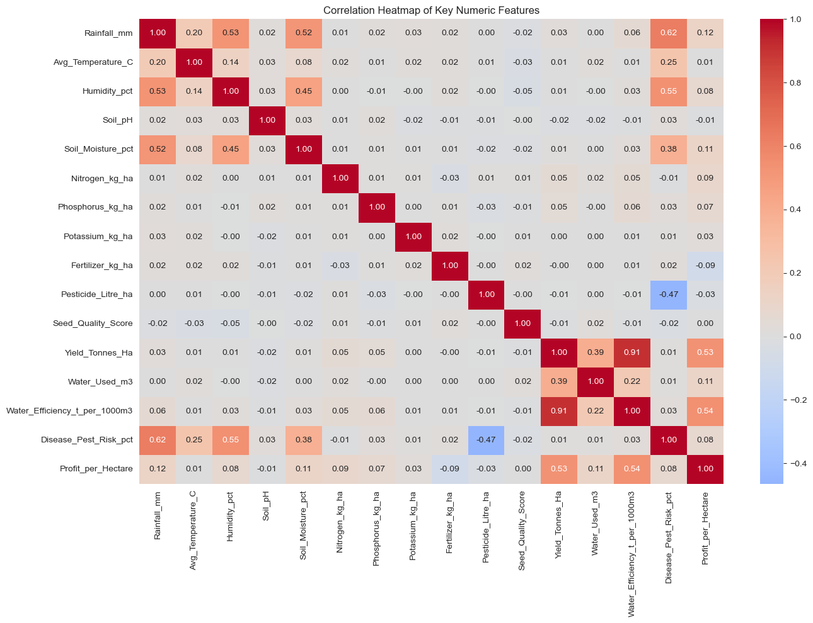
RESULTS
KEY QUESTION 7 · ARE ENVIRONMENTAL CONDITIONS RELATED TO PERFORMANCE?
Correlations are weak (mostly |r| < 0.3) — no single environmental or input variable dominates yield or profit.
Scale clusters together: farm area, production and water use correlate with each other, as expected.
Season acts through groups, not through one linear driver — performance is multivariate.

Slide 12
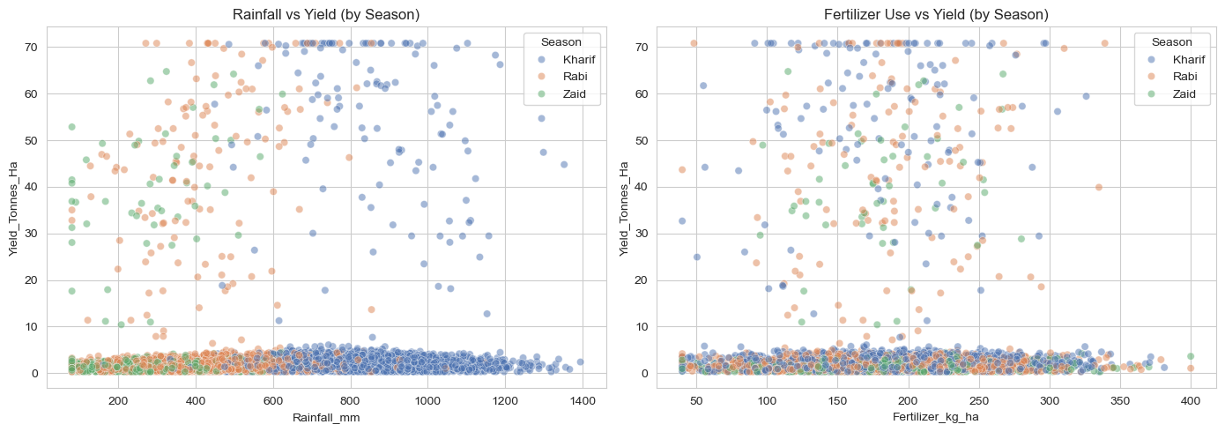
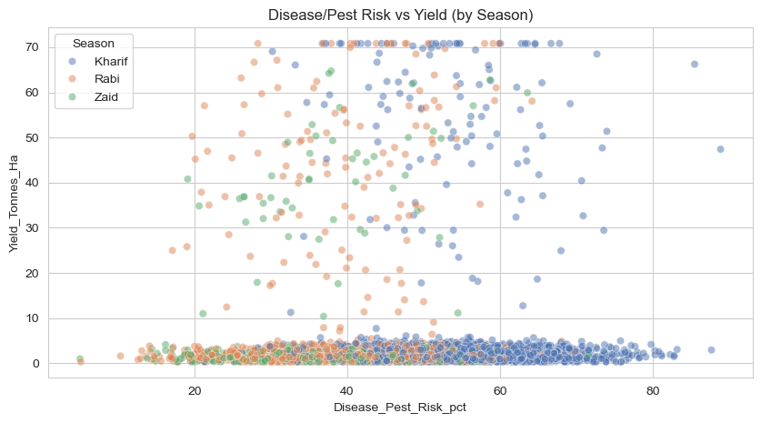
RESULTS
KEY QUESTION 7 (CONTINUED) · RELATIONSHIPS IN DETAIL
Rainfall → yield: wide clouds, no trend within any season — more rain alone doesn't raise yield.
Fertilizer → yield: flat relationship — input level is not a proxy for productivity.
Disease risk → yield: no clear gradient at field level, despite Kharif's higher average risk.

Slide 13
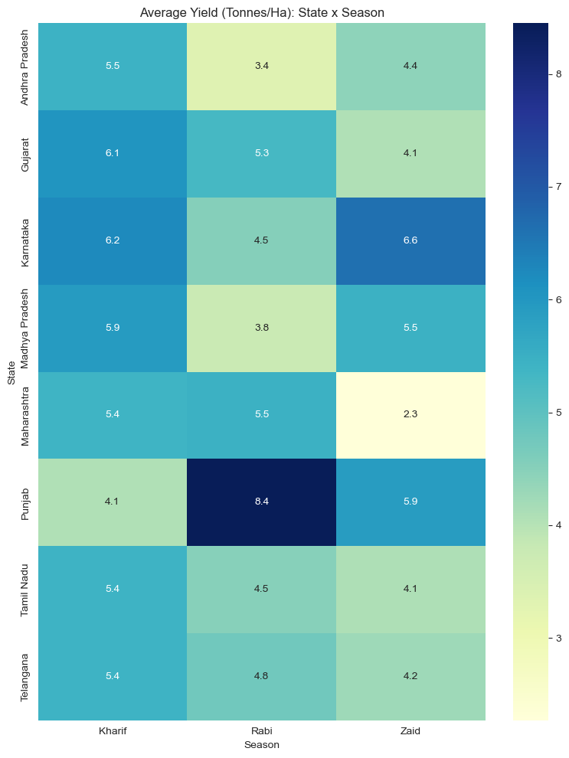
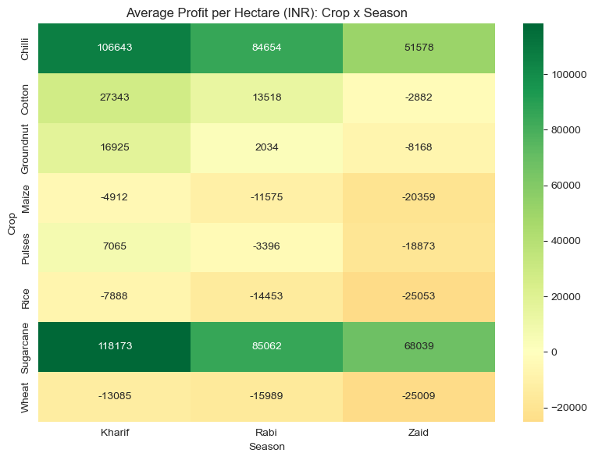
RESULTS
KEY QUESTION 8 · ARE PATTERNS CONSISTENT ACROSS REGIONS AND CATEGORIES?
No state leads in every season.
Sugarcane & Chilli stay profitable across seasons.
Where + when matter as much as what.

Slide 14
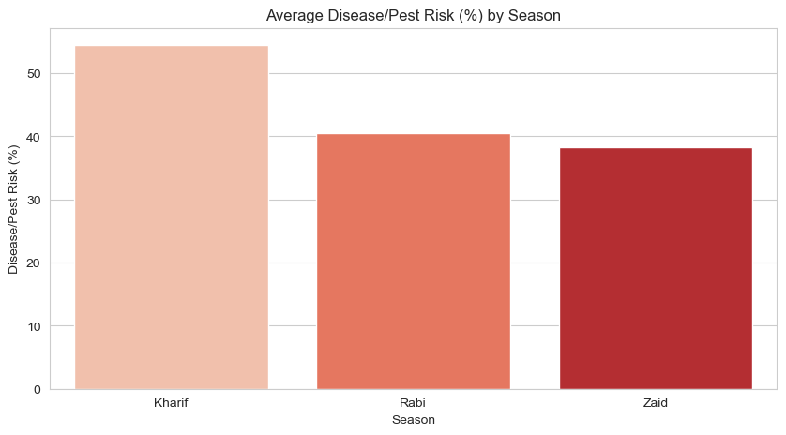
RESULTS
KEY QUESTION 9 · ARE THERE UNUSUAL OR UNEXPECTED PATTERNS?
209 farms (5.2%)
with top-quartile yield still lost money. 8 of the 10 biggest loss cases are Sugarcane — costs up to ₹9.9 L against revenue as low as ₹1.8 L.
Kharif risk spike: disease/pest risk averages 54.5% in Kharif — about 14 points above Rabi (40.5%) and Zaid (38.2%).
Cost, not output, drives losses in the high-yield loss group — cost control matters as much as growing more.

Slide 15
Statistical Validation — Are the Differences Real?
RESULTS
HYPOTHESIS TESTS ON SEASONAL DIFFERENCES (Α = 0.05)
ANOVA · Yield by Season
F = 1.269 p = 0.281
NOT SIGNIFICANT
ANOVA · Profit by Season
F = 33.978 p < 0.001
SIGNIFICANT
Chi-square · Irrigation × Season
χ² = 3.513 p = 0.742
NO ASSOCIATION
Read: seasons differ in profitability, not in average yield — profit gaps are real; apparent yield gaps sit within random variation.
Post-hoc: Tukey HSD skipped because the yield ANOVA was not significant.

Slide 16
RESULTS
KEY QUESTION 10 · WHAT INSIGHTS FOLLOW FROM THE SEASONAL DIFFERENCES?
KHARIF SWEEPS ALL FOUR HEADLINE METRICS
5.50 t/ha
yield
₹1.70 L
avg profit
34.4%
ROI
5.89
water eff.
Profit, not yield, separates seasons: profit differs significantly (p < 0.001); yield does not (p = 0.28).
₹1.93 L profit gap between Kharif (+₹1.70 L) and Zaid (−₹0.23 L) per average farm.
Zaid is structurally hard: negative ROI (−2.3%) and only 35.5% profitable farms.
Yield ≠ success: 5.2% of farms lose money despite top-quartile yield.
Source: notebook §15 — auto-generated key insights

Slide 17
RESULTS
KEY QUESTIONS 11–12 · CONCLUSIONS AND BETTER SEASONAL PLANNING
RECOMMENDATIONS
1. Prioritise Kharif acreage and profitable crops (Sugarcane, Chilli) in seasonal plans.
2. Audit high-cost farms — especially Sugarcane — for avoidable overruns.
3. Target pest management at Kharif, where risk peaks at 54.5%.
4. Transfer Kharif's water-efficient practices to Zaid.
5. Plan with the State × Season and Crop × Season matrices — no one-size-fits-all advice.
CONCLUSIONS
Seasonal environments differ sharply — and it carries into farm economics.
Profitability, not yield, is what separates the seasons.
Inputs are flat across seasons, so the gap is environmental and crop-mix driven.
Source: notebook §16 — conclusions & recommendations

Slide 18
Future scope
Predictive modelling: forecast yield and profit by season, crop and region with machine learning.
Multi-year data: add year-on-year records to separate seasonal effects from long-term trends.
Weather & remote sensing: integrate satellite vegetation indices and live weather feeds.
Farmer-facing dashboard: district-level, season-aware decision support for crop planning.
Cost optimisation: recommend input levels that maximise ROI, not just output.

Slide 19
GitHub Link
https://github.com/atharvadeshpande547-hub/seasonal-agriculture-performance-analysis

Slide 20

VOIS Course completion certificate -
Course name- Data Visualization

Slide 21

.
.

