Slide 1






WEB FRAMEWORKS

Slide 2
Division: B Group_ID: B_02
Department of Artificial Intelligence and Data Science
Vishwakarma Institute of Technology, Pune
SEM I A.Y.(2024-2025)
Presented by:
Atharva Kavade (12310269)
Shripad Kanakdande (12310844)
Hardik Khade (12310224)
Vivek kendre (12311430)
Sushant Katare(12311416)
Vishwakarma Institute of Technology

Slide 3

INTRODUCTION
DEFINITION OF WEB FRAMEWORKS:
SOFTWARE LIBRARIES THAT SUPPORT WEB APPLICATION DEVELOPMENT.
PROVIDE A STRUCTURED FOUNDATION TO SIMPLIFY COMPLEX AND REPETITIVE TASKS.
ENABLE DEVELOPERS TO FOCUS ON UNIQUE APPLICATION FEATURES BY REUSING PRE-BUILT COMPONENTS.
IMPORTANCE OF WEB FRAMEWORKS:
EFFICIENCY AND SPEED
CONSISTENCY AND MAINTAINABILITY
SECURITY
Notes:
A web framework is a crucial tool in modern web development, acting as a software library that supports the creation of web applications. It provides a structured foundation, which simplifies complex and repetitive tasks, allowing developers to work more efficiently.There are many pre-built components so developers can focus on the unique features and functionality of their applications rather than doing repetative coding tasks. The importance of web frameworks lies in their ability to enhance development speed, maintain code quality, and significantly improve security. These frameworks streamline the development process, making it easier to build robust, scalable, and secure web applications, which is why they are widely used in the industry today.

Slide 4


OVERVIEW OF WEB TECHNOLOGIES
FLOW OF INTERACTION:
USER ACTION: A USER INTERACTS WITH THE CLIENT-SIDE INTERFACE (E.G., SUBMITS A FORM).
CLIENT-SIDE REQUEST: JAVASCRIPT CAPTURES THE USER ACTION AND SENDS A REQUEST TO THE SERVER USING AN API (RESTFUL API OR GRAPHQL).
SERVER-SIDE PROCESSING:THE SERVER-SIDE FRAMEWORK (NODE.JS/EXPRESS.JS, FLASK/DJANGO) RECEIVES THE REQUEST, PROCESSES IT (E.G., QUERYING THE DATABASE), AND PREPARES A RESPONSE.
RESPONSE TO CLIENT-SIDE:THE SERVER SENDS THE PROCESSED DATA BACK TO THE CLIENT-SIDE IN THE FORM OF A JSON RESPONSE.
CLIENT-SIDE UPDATE:JAVASCRIPT UPDATES THE USER INTERFACE BASED ON THE DATA RECEIVED FROM THE SERVER, PROVIDING THE USER WITH REAL-TIME FEEDBACK OR NEW CONTENT.

Slide 5
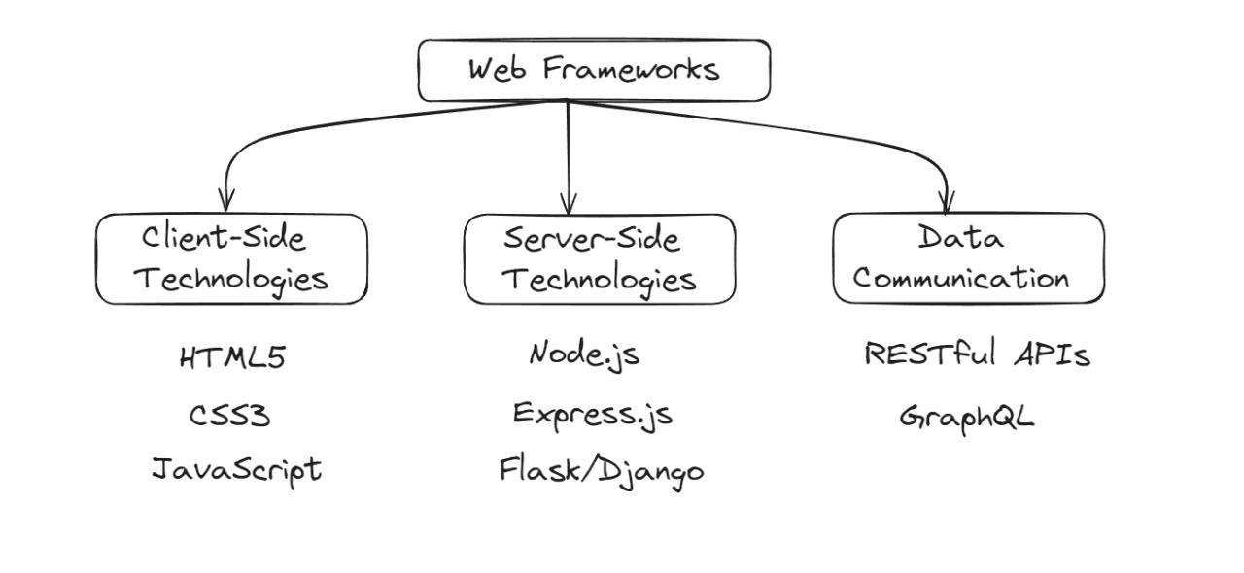
OVERVIEW OF WEB TECHNOLOGIES

Slide 6
ADVANTAGES OF WEB FRAMEWORKS
RAPID DEVELOPMENT: PRE-BUILT COMPONENTS REDUCE DEVELOPMENT TIME.
CONSISTENCY: ENFORCES BEST PRACTICES FOR MAINTAINABLE CODE.
SECURITY: BUILT-IN SECURITY FEATURES.
COMMUNITY AND ECOSYSTEM: ACCESS TO EXTENSIVE LIBRARIES AND ACTIVE COMMUNITIES.
SCALABILITY: SUPPORTS SCALABLE ARCHITECTURES.

Slide 7
DISADVANTAGES OF WEB FRAMEWORKS
LEARNING CURVE: TIME NEEDED TO LEARN FRAMEWORK-SPECIFIC PRACTICES.
Flexibility: Potential limitations on design choices.
Performance Overhead: Abstraction layers may introduce performance issues.
Compatibility and Updates: Challenges in keeping up with updates.
Resource Consumption: May consume more resources than custom-coded solutions.

Slide 8
OVERCOMING OF DISADVANTAGES
Flexibility: Potential Limitations on Design Choices
Use features like pluggable apps to allow modularity and flexibility in the design.
Performance Overhead: Abstraction Layers May Introduce Performance Issues
Implement lazy loading techniques to reduce initial load times and improve overall performance.
Compatibility and Updates: Challenges in Keeping Up with Updates
Leverage containerization tools like Docker to isolate dependencies, ensuring that updates do not interfere with the application’s environment.
Monitoring and Tuning
Continuously monitor resource usage with tools like New Relic or Prometheus, and fine-tune the application’s performance based on the collected data.
Project-Based Learning: Emphasizing Practical Application
Encourage project-based learning to deepen understanding through hands-on experiences, allowing learners to apply theoretical knowledge to real-world challenges. This approach enhances problem-solving skills and adaptability in handling technology limitations.

Slide 9




OBJECTIVES
Server-side programming: Learn server-side programming features like PHP and JSP
Database applications: Learn about database applications
Web services: Learn about the usefulness of web services
Web publishing tools and applications: Learn the basic tools and applications used in web publishing
File organization and access: Learn about the organization and access of files, including directories and URLs

Slide 10


EXAMPLES

Slide 11






DJANGO
FEATURES:
Batteries Included: Built-in authentication, admin panel, ORM.
MVC Architecture: Follows the Model-View-Controller pattern.
Django REST Framework: Ideal for building RESTful APIs.
Security: security best practices.
BENEFITS:
DRAWBACKS:
Fast Development
Robust Security
Versatility
Strong Documentation
Monolithic structure
Complexity for small projects

Slide 12
EXPRESS.JS
FEATURES:
Minimalistic and flexible Node.js framework.
Middleware support.
Robust routing system.
Scalable for real-time apps.
BENEFITS:
DRAWBACKS:
High performance
Lightweight, suitable for microservices
Large and active community
Minimalistic: Requires additional libraries for complex apps.
Steep learning curve: Requires strong knowledge of Node.js and JavaScript.
Notes:
Express.js is a lightweight and flexible web application framework built on top of Node.js, designed to streamline the development of web and mobile applications. It has become particularly popular in full-stack development, especially within the MEAN and MERN stacks, where it plays a critical role in building server-side applications. Express.js stands out for its key features, including simplified routing, which allows developers to easily define routes for different HTTP methods. Additionally, Express.js offers a standardized approach to error handling. It allows developers to scale their applications effectively, while its simple API and extensive documentation make it easy to use. With its lightweight and efficient nature, Express.js enables fast development, making it a preferred choice for building high-performance applications.

Slide 13

THANK YOU!

