Slide 1
TOPIC : BOOK RECOMMENDATION SYSTEM
A recommendation engine is a class of machine learning which offers relevant suggestions to the customer. Before the recommendation system, the major tendency to buy was to take a suggestion from friends. But Now Google knows what news you will read, Youtube knows what type of videos you will watch based on your search history, watch history, or purchase history.
A book recommendation system is a type of recommendation system where we have to recommend similar books to the reader based on his interest. The books recommendation system is used by online websites which provide ebooks like google play books, open library, good Read’s, etc.

Slide 2
A recommendation system is usually built using 3 techniques which are content-based filtering, collaborative filtering, and a combination of both.
Content-based Filtering
Content-based filtering uses item features to recommend other items similar to what the user likes , based on their previous actions or explicit feedback.
Collaborative-based Filtering
Collaborative based filtering recommender systems are based on past interactions of users and target items.
Hybrid Filtering Method
It is basically a combination of both the above methods. It is a too complex model which recommends product based on your history as well based on similar users like you.

Slide 3
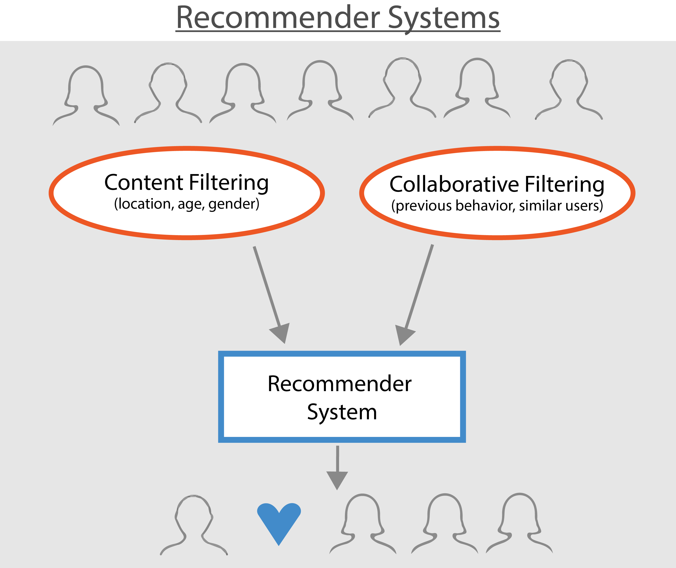

Slide 4
Process :
1. Data Collection
2. Data Pre-Processing
3. Gather recommendations on user data
4. Displaying recommendations on user's web-page

Slide 5
Output Expected :
Personalized recommendations will be based on :
1. User's Profile
2. User's Past Reads
3. User's Favourites
4. User's Genre interests

Slide 6
Future Scope :
We can perform data analysis based on user data that we will collect which will help in further recommendations.

Slide 7
Guide : Prof. Jaya Gupta Team Members :
1) Atharva Dumbre 2) Shreyas Gosavi 3) Shrenik Jangada

