Slide 1
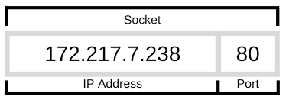
Inter process communication (IPC)
mechanism that allows processes to communicate with each other.
Same or across machines
socket module — Low-level networking interface
Sockets : most popular form of IPC for cross-platform communication.
an end-point of a two-way communication link.
identified by IP address and the port number.
Initiate a connection, listen for incoming messages and send responses at either ends of a client-server environment.

Slide 2

