Slide 1


Impact of AI on Jobs: Automation Risk and Trends Across Industries
AI is rapidly transforming work processes—improving efficiency but potentially displacing routine tasks.
This analysis examines which industries and occupations face automation risks and where growth opportunities exist, guiding stakeholders on reskilling needs.
by Atharva Jagtap

Slide 2




Project Motivation
Technological Transformation
AI is revolutionizing work processes, driving efficiency while
potentially displacing routine tasks.
Global Perspective
Dataset includes diverse locations like New York, London, and San Francisco, revealing how regional factors shape job trends.
Strategic Planning
Findings will inform proactive reskilling and workforce development
initiatives.

Slide 3





Research Methods
Data Collection
Utilized the “AI-Powered Job Market Insights” dataset with 500 pre-cleaned job listings.
Preparation
Verified data types and encoded features (e.g., mapping automation risk to numerical scores).
Analysis
Employed Python libraries: pandas, matplotlib, and seaborn for Exploratory Data Analysis (EDA).
Documentation
Documented the process in a Jupyter Notebook to ensure transparency and reproducibility.

Slide 4
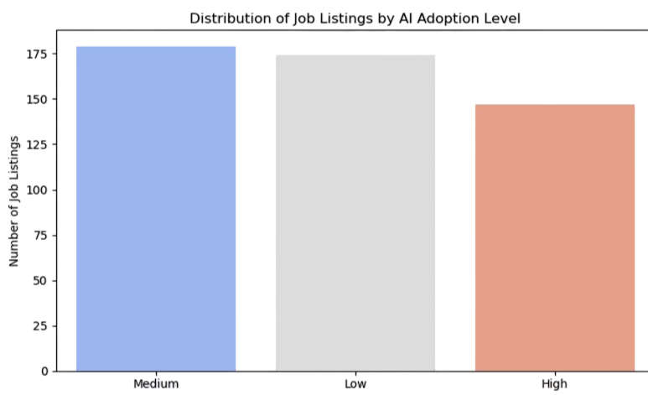
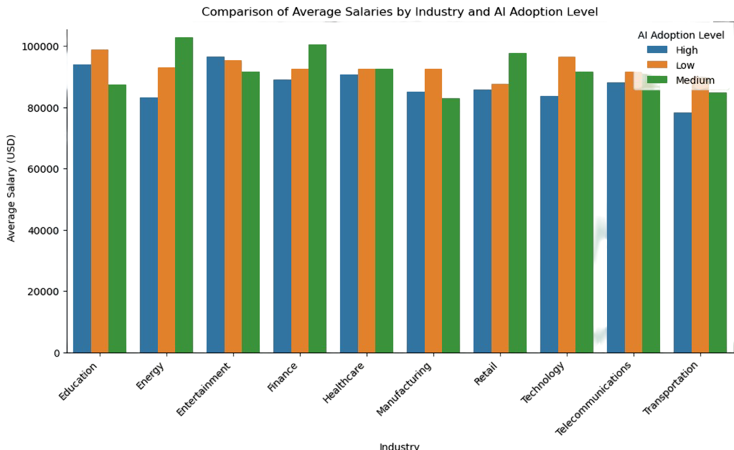
AI Adoption Trends
Transitional Phase
Most companies show "Medium" AI adoption levels, indicating a transitional market phase.
Salary Variations
Higher AI adoption can correlate with higher salaries in certain industries, but the effect is not uniform.
Other Factors
Elements such as market demand and specific job responsibilities also contribute to salary levels.

Slide 5
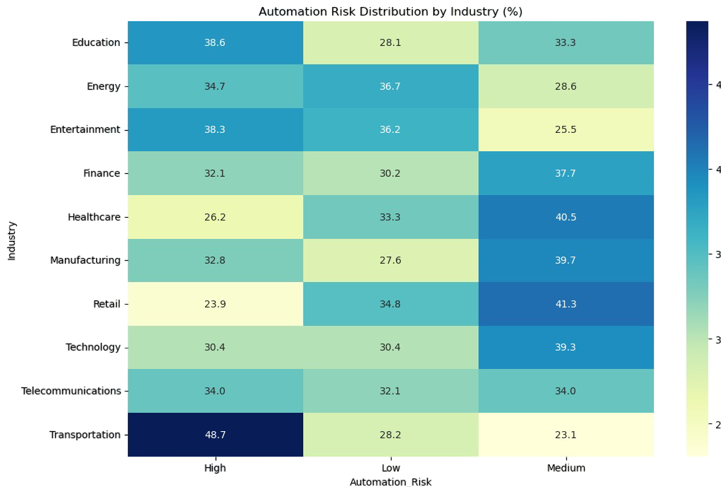
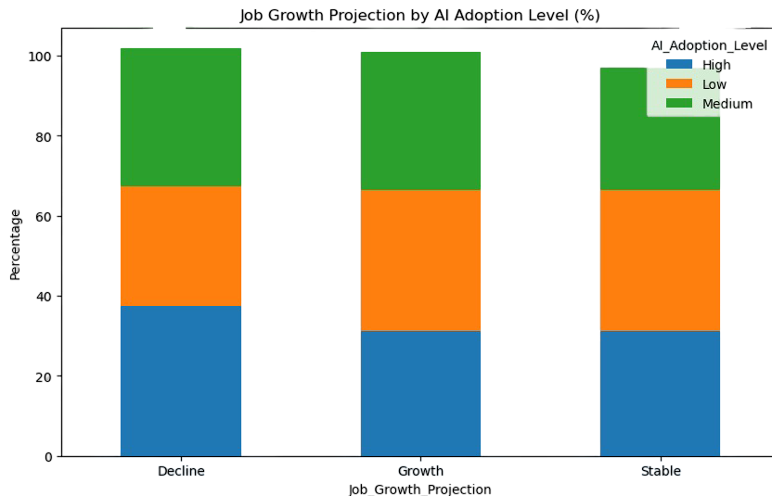
Automation Risk
Routine task-based jobs in Transportation face higher automation risks.
Growth Projections
Mixed growth projections across all AI adoption levels. It is one of several factors influencing job growth.

Slide 6
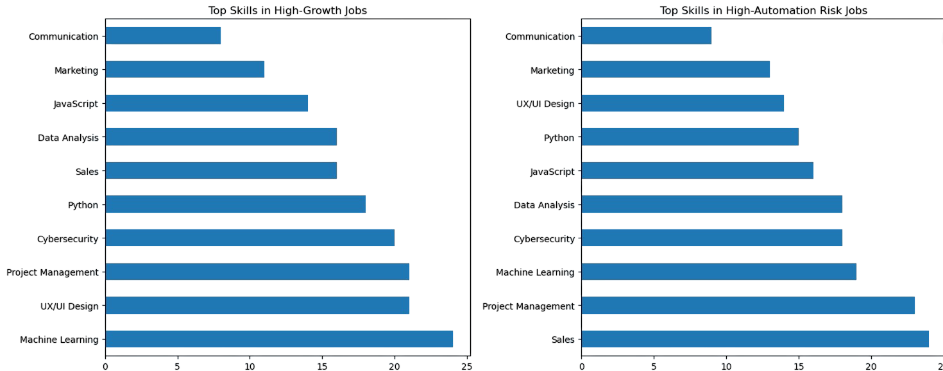
Top Skills
Companies are investing heavily in these skill sets because they’re critical to leveraging AI effectively (hence the growth). Yet the very nature of AI also means certain tasks can be standardized or replaced.

Slide 7
Critical Skills for Future Jobs
High-Growth Jobs
Automation-Resistant Skills
Machine Learning
Creative Problem Solving
Data Analysis
Emotional Intelligence
Project Management
Complex Communication
UI/UX Design
Adaptability
AI’s influence on the job market is multifaceted. The same skills driving innovation and commanding higher salaries can also face automation. This duality highlights the need for ongoing learning, adaptability, and a blend of technical and soft skills to stay resilient in an AI-transformed workforce.

Slide 8






Key Takeaways & Implications
Strategic Action
Emphasis on proactive reskilling programs and policy interventions to mitigate risks.
Balancing Act
AI drives innovation but also poses automation risks in specific industries.
Continuous Adaptation
Continuous monitoring of AI trends is necessary for workforce planning.
This reveals that while AI offers immense potential for growth and innovation, its impact is not uniform across industries or geographies. Stakeholders must balance the opportunities of AI-driven transformation with the risks of automation, employing targeted reskilling programs, adaptive policy measures, and a continual emphasis on both technical and soft skill development. This balanced and informed approach will be essential for navigating the evolving landscape of the future job market.

