Slide 1
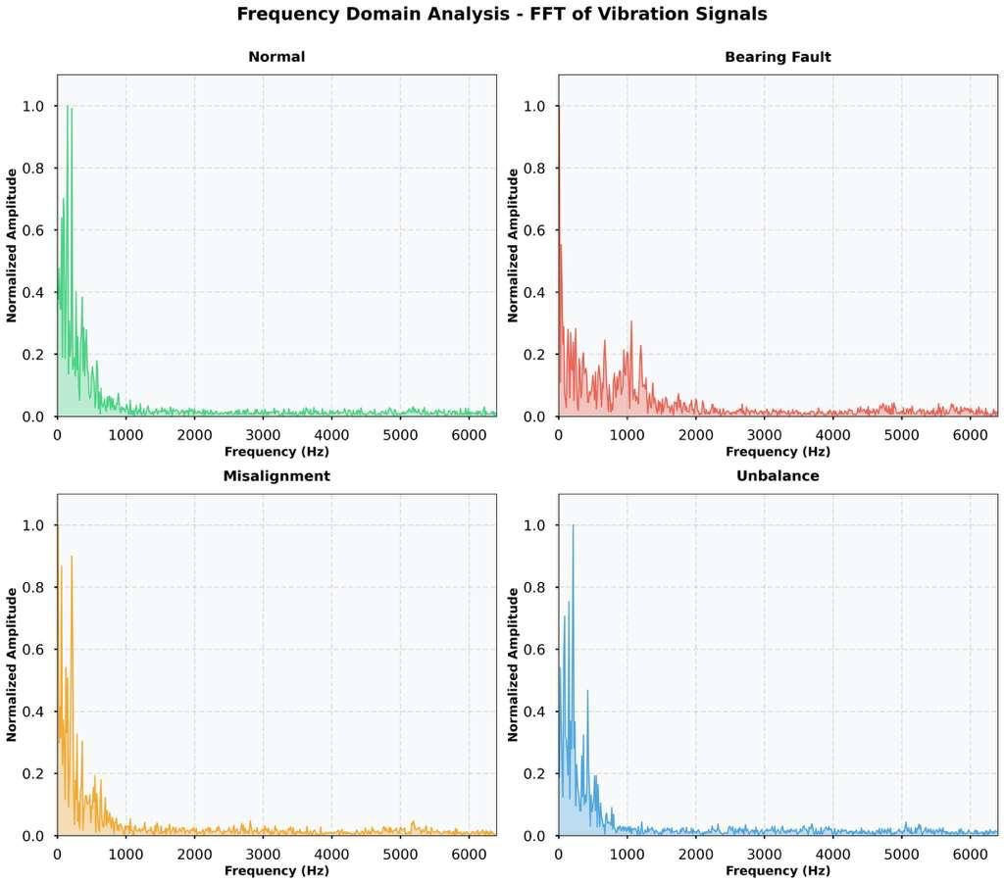
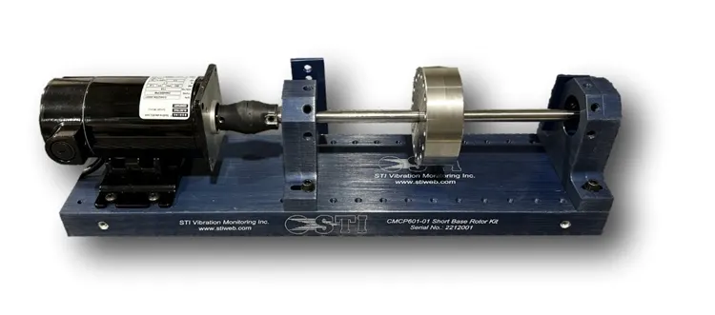
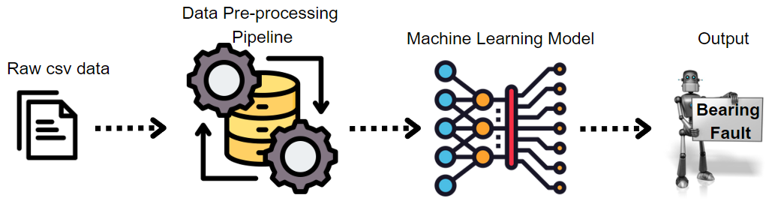
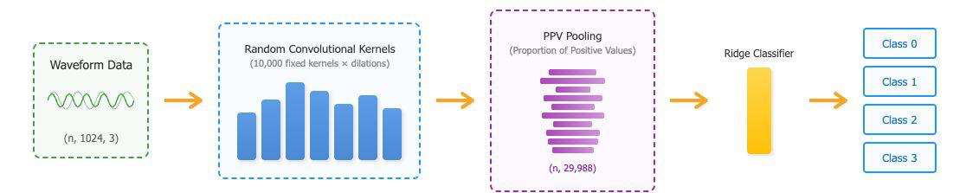
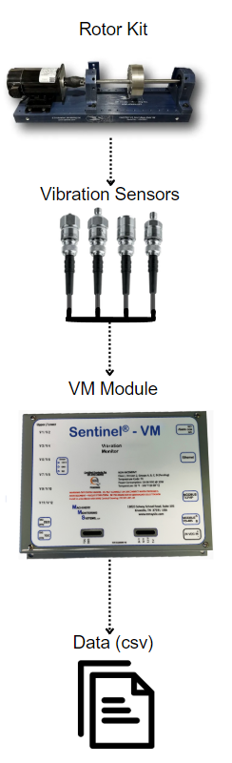
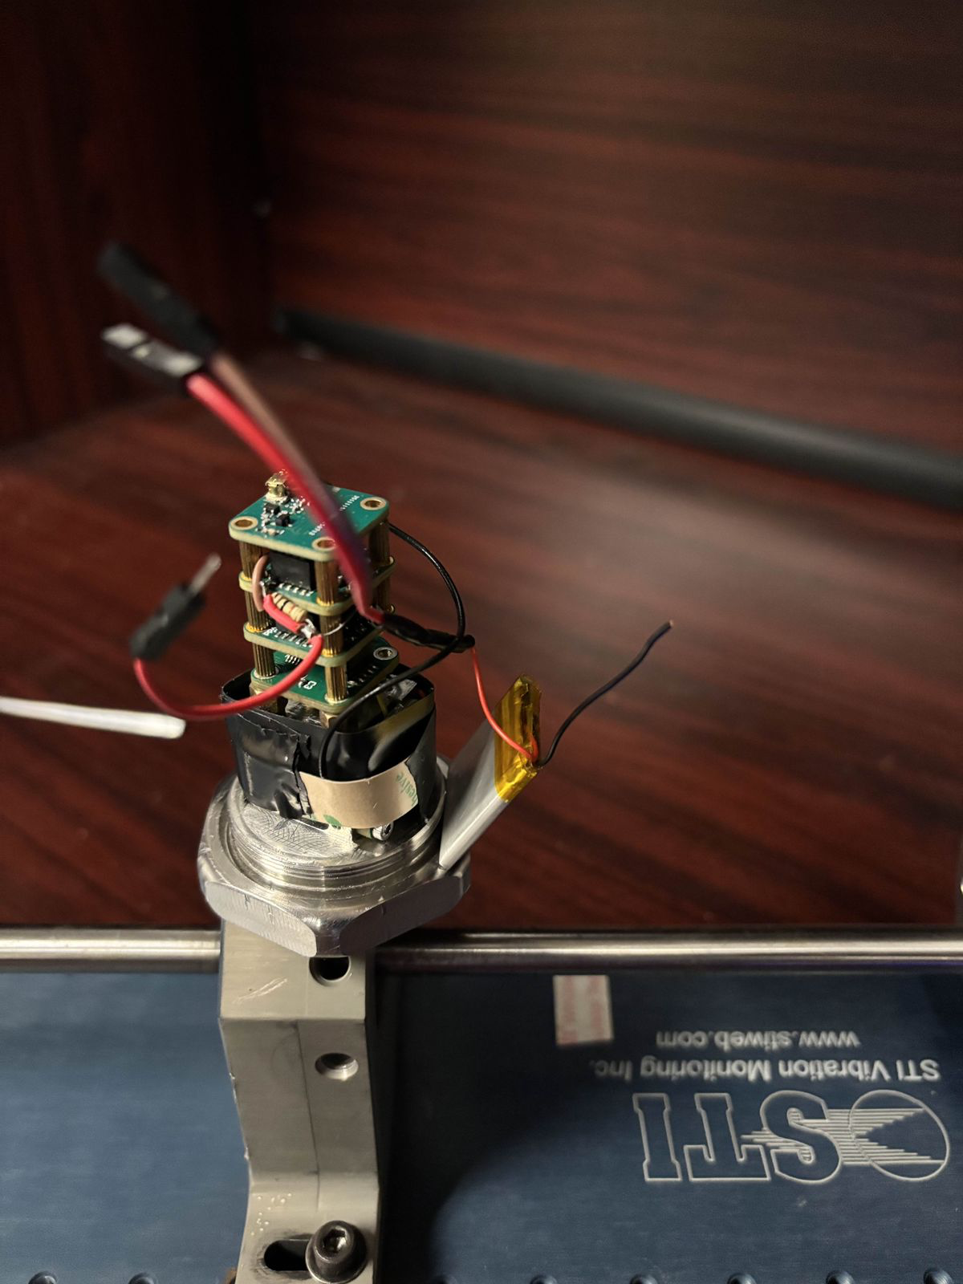
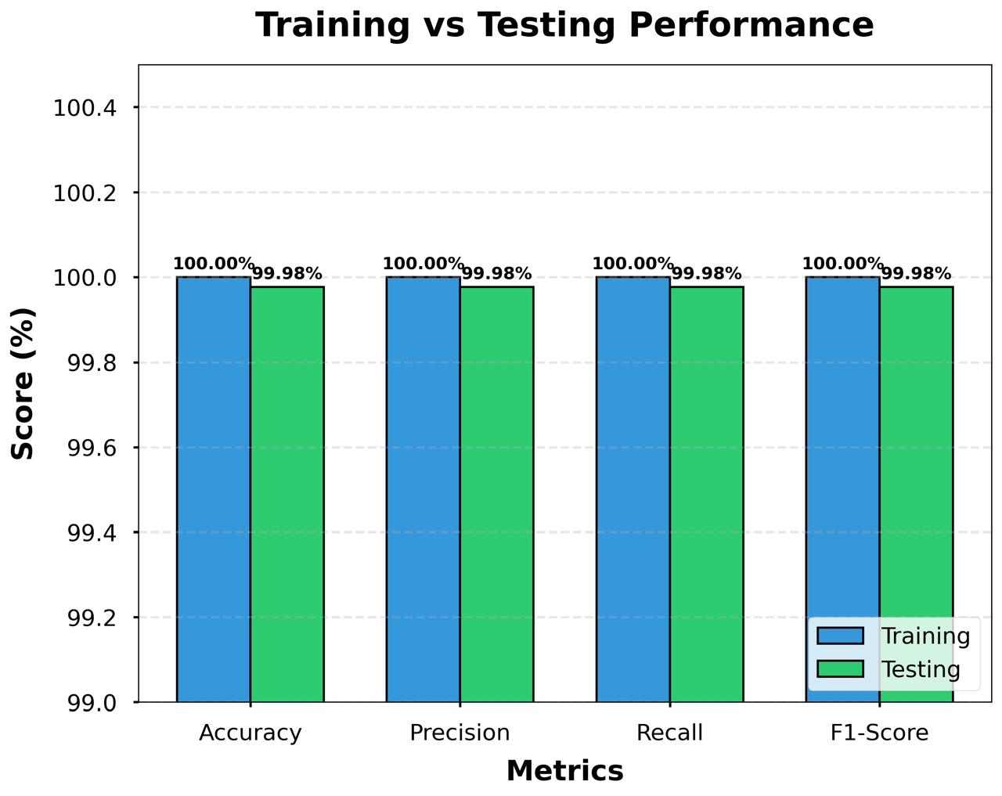
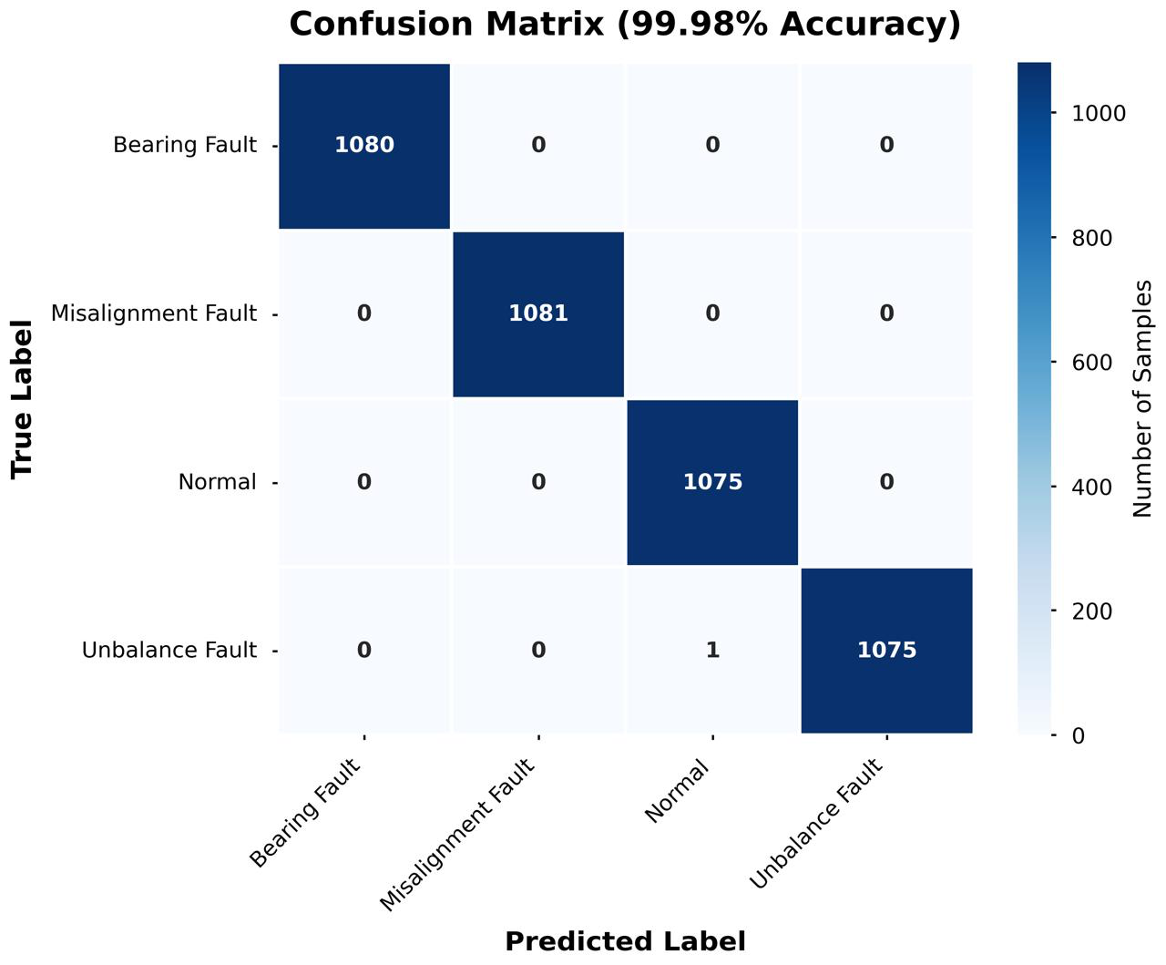
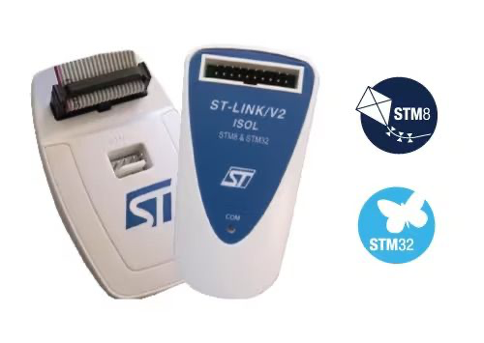
Predictive Maintenance for Rotating Machinery
In Partnership with Machinery Monitoring Systems, LLC
Team –SpectraForge | Sravanthi Polneni | Abhinaya Ragipani | Atharva Ganesh Joshi | Vardhan Vivek Burande
Professors – Sam Marrazzo | Adithya Lakshmi Narayanan
Problem Statement
Rotating machinery in industries operates continuously, and even small faults like imbalance, misalignment, or bearing wear can quickly escalate into major failures. These issues lead to costly downtime, unreliable equipment performance, and safety risks. Traditional scheduled maintenance often misses early warning signs. Our project aims to detect these faults early by analyzing vibration patterns from a controlled rotor-kit system, enabling predictive maintenance that prevents mechanical damage and avoids production interruptions.
Frequency Analysis of Fault Conditions Using FFT
Equipment Overview
Our Approach
1. Data Pre-processing
A small-scale rotor kit was used to simulate real machinery behavior.
We introduced: Imbalance: added weights | Misalignment: bearing offset | Bearing Fault: damaged bearing installed | Normal Condition
Data Collection Workflow
Set rotor kit to specific speed
Introduce a fault
Collect vibration signals
Export CSV files
Preprocess waveforms (filtering + normalization)
Build labeled dataset for ML training
Our MiniRocket ML Model
Rotor kit
Business Impact
Vibration sensor
Enables early, data-driven fault detection that minimizes unplanned downtime, reduces maintenance costs, and extends machinery lifespan through timely, targeted interventions.
Enhances overall operational reliability and safety by preventing high-risk mechanical failures before they escalate into critical disruptions.
Results
STM32
Data (csv)
Achieved 99.98% accuracy with near-perfect precision across all fault types, demonstrating the model’s ability to reliably distinguish each machinery condition through its unique vibration signature.
Provides a highly dependable early-fault detection system that helps prevent downtime, optimizes maintenance, and enhances overall operational safety.
Institute for Artificial Intelligence and Data Science School of Engineering and Applied Science
https://www.buffalo.edu/ai-data-science.html

