Slide 1
Mini-Project Finger Knuckle Based Biometric Identification of person

Slide 2
Project TEAM:
Sagar Mhantati 2016BTECS00031
Atharva Kango 2016BTECS00044
Nikita Aware 2016BTECS00107
Project Guide:
Swapnil Mahadeshwar

Slide 3
Introduction
Finger knuckle print can be incredibly beneficial for person identity. FKP as a new biometric modality supplying huge scope for researchers in few years.
In this system we present a finger knuckle identification method.

Slide 4
Problem Statement
Finger Knuckle Based Biometric Identification of person

Slide 5
Literature Review
In ancient days, traditional modes consisting of password gadget, PIN range system and identification playing cards device are used for the authentication cause. Biometric device is notably utilized in man or woman authentication gadget than traditional methods. The genetic developments like fingerprint, face, iris, palm print, hand geometry, finger vein and hand vein are used as biometric systems. Biometric behaviors like palm print, fingerprint, hand vein and hand geometry are extensively used because of excessive person acceptance. The image sample of membrane wrinkles and creases, the outside finger knuckle region is greatly distinctive. Consequently this biometric characteristic is used as a distinctive biometric device . The inner surface of the finger knuckle print is extensively used in conserving of objects. Consequently, it isn't always effortlessly damaged by intruder. The criminal sports are not associated with finger knuckle print and as a result it has higher consumer recognition . The strains of the knuckle surface aren't seemed on the sensor tool and hence it cannot be cast without difficulty. It's far prosperous in texture and used as great biometric gadget. On this paintings, a nearby–worldwide feature fusion approach is proposed for finger knuckle-print biometric scheme.
Later, Kumar and Ravikanth proposed some other approach to personal authentication via the usage of 2-D finger-returned floor imaging. They evolved a tool to seize hand-back pictures after which extracted the finger knuckle regions with the aid of some preprocessing steps. The sub-area evaluation strategies together with PCA, LDA and ICA were blended to do feature extraction and matching. With Kumar et al.’s design, the purchase tool is doomed to have a
big length because almost the whole hand returned area needs to be captured, notwithstanding the fact that the finger knuckle area handiest occupies a small part of the received photo. Furthermore, subspace evaluation strategies may additionally be effective for face reputation however they will not be capable of effectively extract the exclusive line features from the finger knuckle.

Slide 6
Objective
The main Objective of this project is to design system which will use finger knuckle data for identification of the person.

Slide 7
Proposed techniques
GABOR FILTER
PCA
LDA

Slide 8
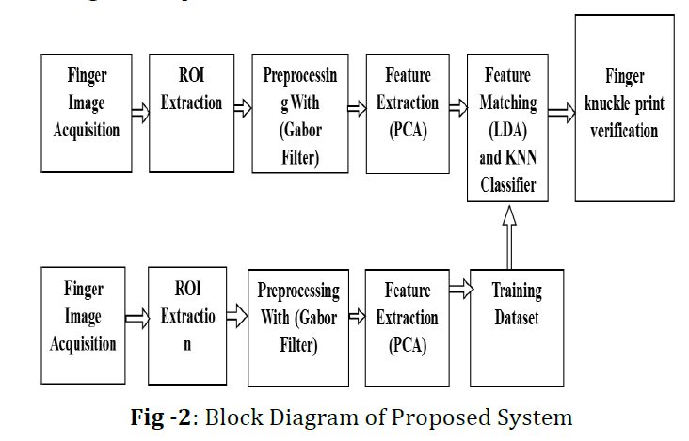
Methodology
BLOCK DIAGRAM OF PROPOSED SYSTEM

Slide 9
Conclusion
This project has presented a new approach of subspace technique for personal authentication using finger knuckle back surface. This system compares the user knuckle with the database knuckle from the captured knuckle by using web camera, the contour part of two images.

Slide 10
References
Kyi Pyar Zaw, Aung Soe Khaing, “Implementation of Contactless Finger Knuckle Identification System,” IJSETR, vol. 3, Issue 6,June 2014. (references)
Shubhanda Sonawane, Verifying Human Identities Using Major and Minor Finger Knuckle Pattern, vol.5, Issue2, Feb 2016.
D. L. Woodard, P. J. Flynn, “Finger surface as a biometric identifier”, Computer Vision and Image Understanding, pp. 357-384, vol. 100, Aug. 2005.

