Slide 1




Rash Driving Detection System
Under The Guidance of:
Prof. S. L. Mahadeshwar
Presented By:
Atharva A. Kango
Sagar S. Mhantati
Nikita D. Aware

Slide 2

CONTENTS
Problem Statement
Objectives
Implementation
Result
Significance
Conclusion
References
2
Third National RSC 2018 (20-22 December, 2018)
2
2

Slide 3
PROBLEM STATEMENT
Transportation by road is one of the major factors that have been affecting the commercial development of our country. With the increasing vehicular population and their movement on the roads, accidents are also steadily increasing. It has become a nightmare for the authorities to prevent or reduce such fatal accidents on the road and all their efforts are in vain.

Slide 4
OBJECTIVES
To Make a Fully Functional System, capable of detecting whether a driver is rash or not.
To help the owners of the vehicles & the government as well and make them, aware of such bad drivers.
4

Slide 5
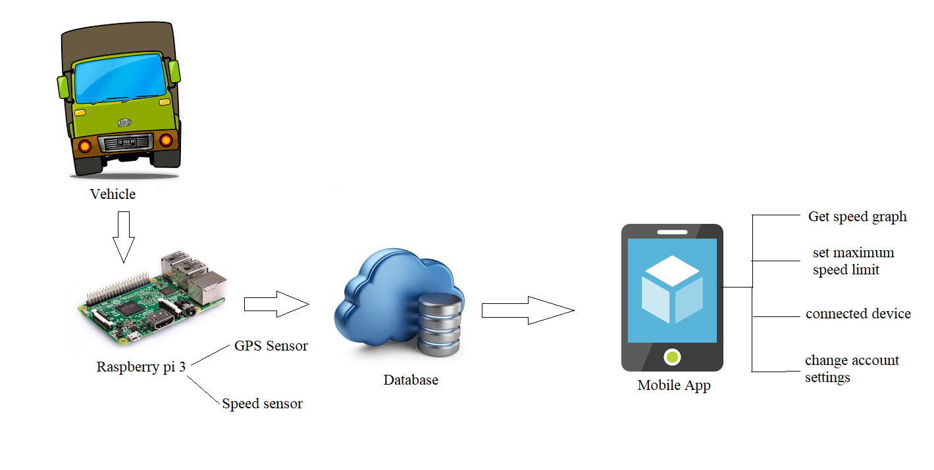
WORK FLOW
5
5
Third National RSC 2018 (20-22 December, 2018)

Slide 6
IMPLEMENTATION
6

Slide 7
Modules implemented
1. Configuration of Raspberry Pi and sending data to the server
2. Processing the data on the server, and
3. Visualization on an Android App and website ( Whether the driver is Rash Driver or not )
7
Third National RSC 2018 (20-22 December, 2018)
7

Slide 8
IMPLEMENTATION
The Speed Sensor is for measuring the speed and GPS sensor for tracing the location . By this data comparing the speed of the vehicle with threshold speed.
If speed is greater than the placed threshold speed then taking the location of the vehicle and checking that , is that speed appropriate for that road ?
If not, and this behaviour continues for the driver, then plotting a graph with the collected data
Showing the data on the Android app to the Owner or the superior Authority.
8
Third National RSC 2018 (20-22 December, 2018)
8

Slide 9
Technologies Used :
IOT ( Use of Raspberry Pi for data collection and sending to server)
Data Analysis and Visualization ( Using Python, Particularly Jupyter Notebook and Matplotlib )
Visualization of graphs and the data on Android App ( Android Studio )
9
Third National RSC 2018 (20-22 December, 2018)
9

Slide 10
Result
Whether the driver deserves the licence issued by government or not.
Ultimately, to make the society, safer place for every pedestrian !
To reduce the number of accidents happening now-a-days.
10
Third National RSC 2018 (20-22 December, 2018)
10

Slide 11
SIGNIFICANCE
Make streets a safer place for everyone.
11
Third National RSC 2018 (20-22 December, 2018)
11

Slide 12
CONCLUSION
Accurate detection of diseases.
86% to 90% accuracy.
Easy to access.
An extension of this work will focus on suggesting cure to detected disease with appropriate fertilizer.
12
Third National RSC 2018 (20-22 December, 2018)
12

Slide 13
REFERENCES
[1] Research Paper at IEEE named–
Overspeeding and Rash Driving Vehicle Detection System
Research Paper By- Vangala Praveen Kumar, Kampati Rajesh,
Motike Ganesh,
Ivaturi Ram Pavan Kumar,
Sanjay Dubey.
13
Third National RSC 2018 (20-22 December, 2018)
13

Slide 14
THANK YOU
14
Third National RSC 2018 (20-22 December, 2018)
Third National RSC 2018 (20-22 December, 2018)
14
14

