Slide 1
Alibaba CLOUD Shapeup the eCommerce with technology Hackathon
Made By-
Atharva Anil Kango
atharvakango1@gmail.com
+91 7588436341

Slide 2
Brief Explanation of Idea:
Main Focus:
To provide resiliency to the ecommerce website.
To Provide fault tolerance.
Solution Provided:
A robust architecture that provides cross region support for data.
Architecture that can hold up at peak times when loads are high.
Features:
Effective searching using elastic search.
Static data fetching (CDN) for improved UX.

Slide 3
Technical Architecture/ POC:
Handling of peak loads:
For an ecommerce website, it is common to have peak loads at times of festivals, etc.
Hence to handle this situation, auto scaling is added to the architecture, which scales out and scales in according to the server instance CPU utilization.
Also, it is important to distribute that load to the instances.
So to remedy that, Server Load Balancer is added to the architectures.
Speed:
Speed is an important factor as fat as customer experience is considered.
In order to keep the speed for the website as high as possible, the static data, i.e. images, JS files, etc., are stored inside the OSS, so that it can be fetched quickly in order to increase.
Searching:
For efficient searching and to provide localized and personalized searching, Elastic Search is used.
Handling of peak loads
Speed
Searching

Slide 4
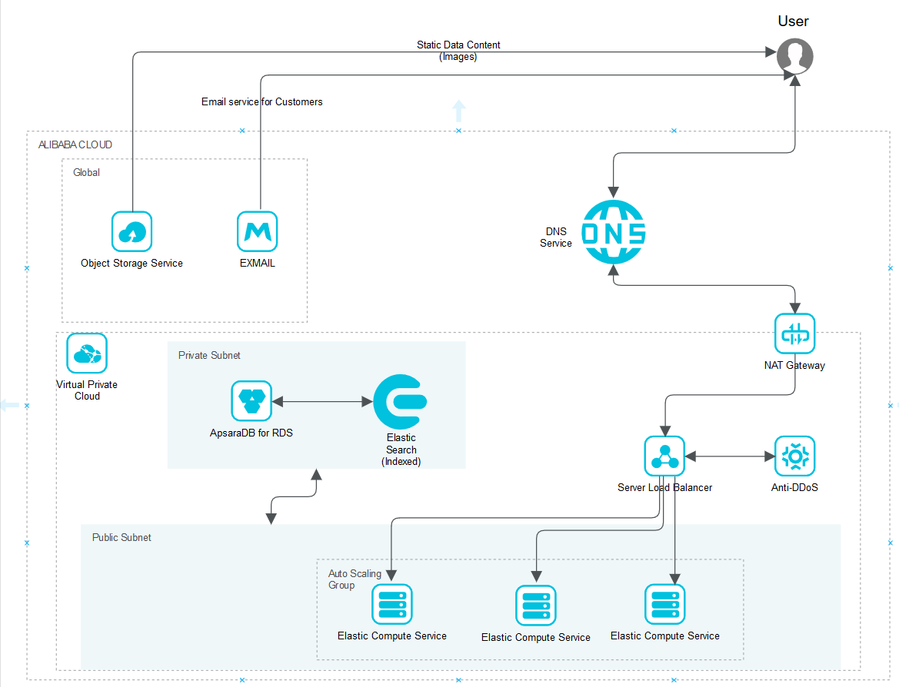
Architecture Diagram:
Click on the image to go to the website!

Slide 5
Technology/Tool Stack Used:
Backend:
Django Framework(Python!)
Elastic Search
Database:
Relational database ApsaraDB for RDS is used for database backend.
Frontend:
HTML, CSS
JS
jQuery AJAX
Backend
Database
Frontend

Slide 6
Alibaba Cloud services used: Mandatory Services-
Elastic Container Service:
ECS is used to for hosting the Django application that was built.
ApsaraDB for Relational Database Service
RDS is used in a private subnet as a database service for the given instance. Only the specified instances can access the RDS to ensure security.
Object Storage Service:
OSS is used for providing the static content to the user. It is supposed to be used as a Content Delivery Network(As CDN isn’t included by default in the free trial).
Elastic Search Service:
ESS is used for localized searching of the products across the globe.
Multiple ECS instances are supposed to be used in the autoscaling group.
ECS
ApsaraDB for RDS
OSS
ESS

Slide 7
Alibaba Cloud services used: Additional Services-
Server Load Balancer:
SLB is used for the autoscaling group created earlier, to provide optimal throughput to the customer.
Auto Scaling:
Auto Scaling group is created for the ECS instances, where the number of instances increases according to the CPU utilization.
Virtual Private Cloud:
VPC is used in for the creation of an isolated environment for atoz ecommerce. The ECS instances and the RDS are launched in the VPC itself
Anti DDOS:
Anti DDOS was used for the instance as to protect it from DDOS Attacks.
But as this service is only available for some regions(excluding Mumbai, India) it was removed.
Enterprise Email Service:
This service is used for sending mails to the customers.
SLB
Auto Scaling
VPC
A-DDOS
EES

Slide 8
Brief summary of the application/website:
It is a fact that the load is very varying for a website like ecommerce.
To provide support for such scenarios, the following architecture is proposed, which provides all these basic needs.
Elastic search is used as an effective tool to get personalized as well as localized searching of products over the website.
For better and improved UX/UI static file fetching is done using OSS.

Slide 9
Source code in zip file/GitHub link:
GitHub Link for the project:
https://github.com/atharvakango/django-alibaba-ecommerce
YouTube Link:
https://youtu.be/8DCScAWc698
(Application is hosted on Alibaba ECS instance.)
The IP:- http://149.129.180.169:8000/can be used to access the application.

Slide 10
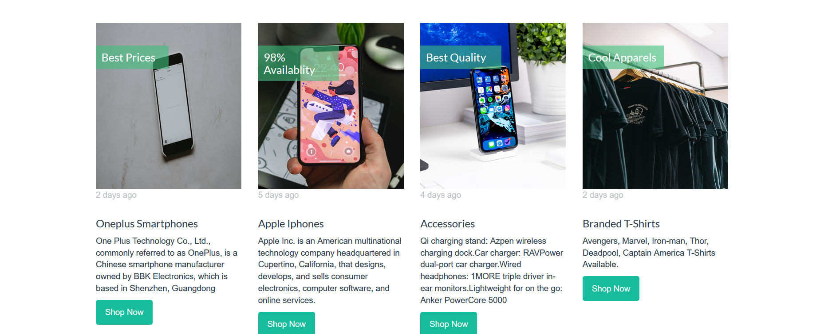
Prototype Demo(Video/Screenshots):

Slide 11
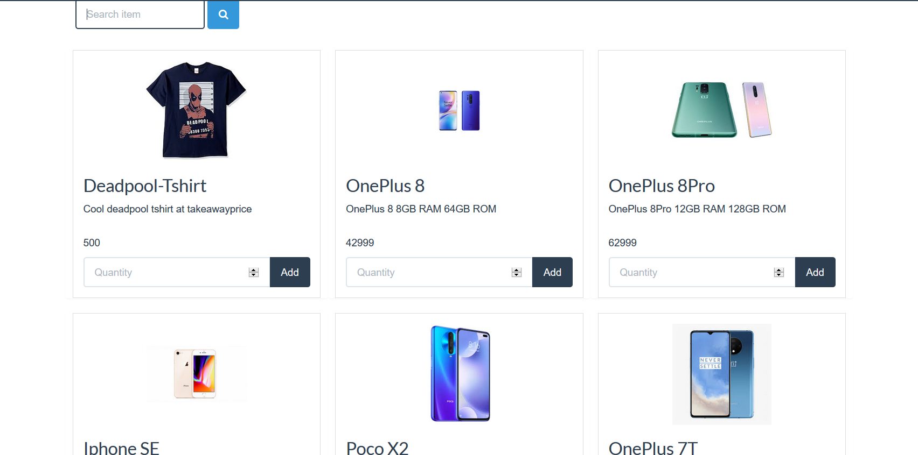
Prototype Demo(Video/Screenshots):

Slide 12
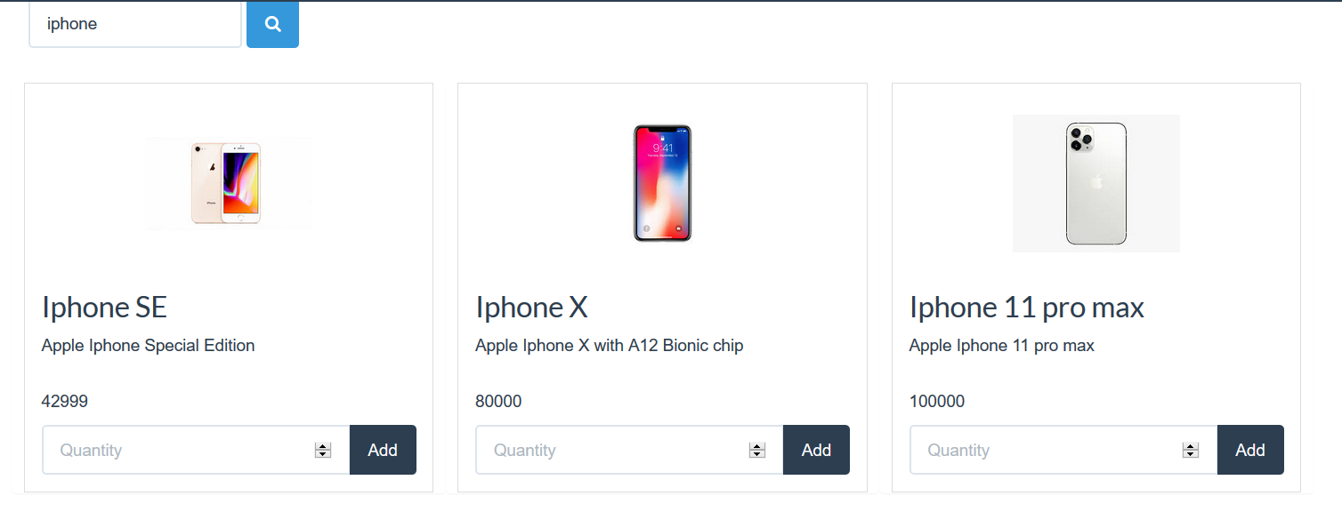
Prototype Demo(Video/Screenshots): Results after implementing Elastic-Searching:-

Slide 13
Proofs of Mandatory product Inclusions
As per the requirements, here is the proof that all the Mandatory services are used in the project.
Use of OSS is done to store static data and to fetch it.
https://github.com/atharvakango/django-alibaba-ecommerce/blob/6bc55f8ea05c749207c628c95b4114b10e59b692/ecommerce/settings.py
Elastic Search usage can be seen here:
https://github.com/atharvakango/django-alibaba-ecommerce/tree/master/search
Use of RDS and ECS instance (Screenshot in next slide):L

Slide 14
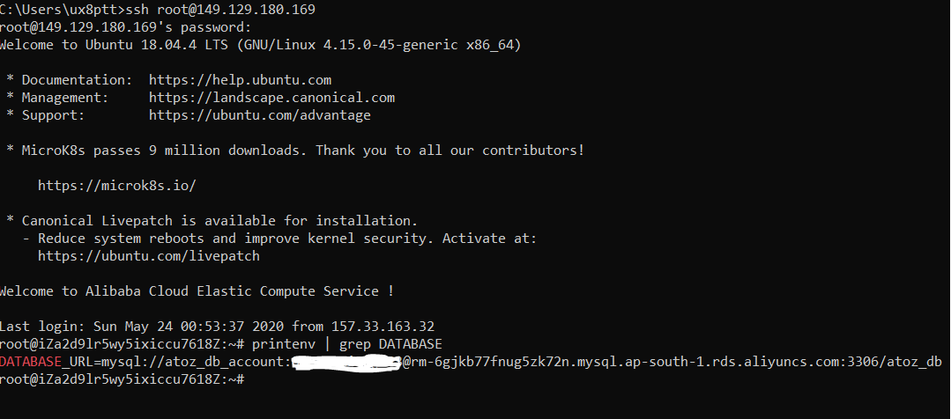

Slide 15
Thank You

