Slide 1
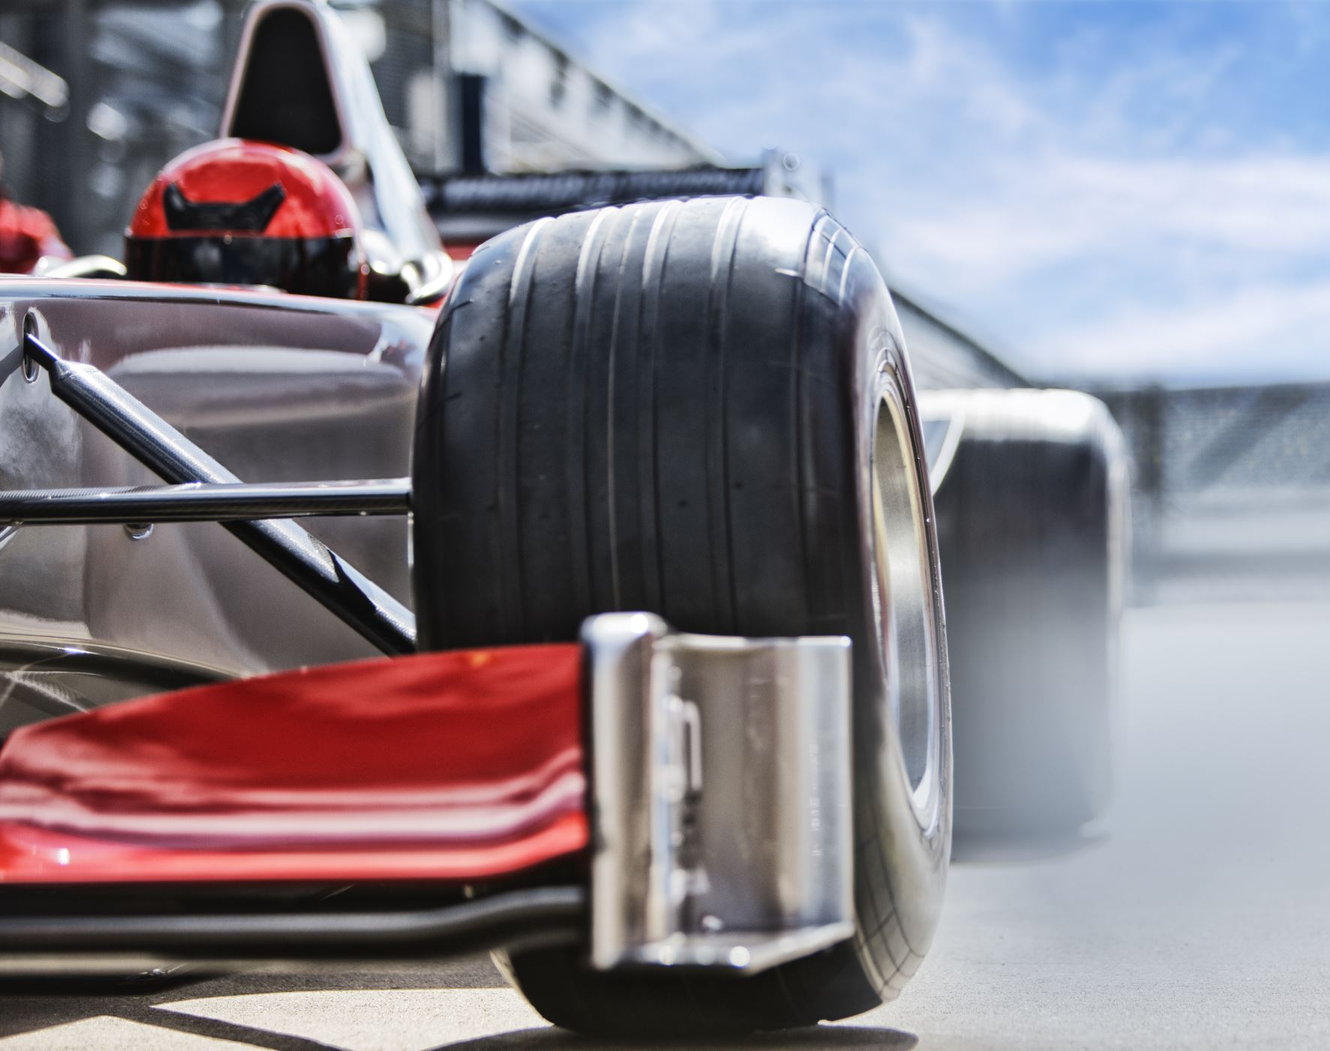
Analysis of Formula 1 Dataset(1950-2022)
Name: Atharva Khaire
BUID: U15258568
Course: Data Science with Python(CS677 A1)

Slide 2
What is Formula 1?
10 Constructors/Teams
20 Drivers (2 per team)
3-Day Race Weekend
1st day – FP1,FP2 (practice sessions)
2nd day – FP3, Qualifying(Q1,Q2,Q3)
3rd day – Race
Note: For some races FP3 is replaced by sprint race which sets up the grid for the main race on Sunday.

Slide 3
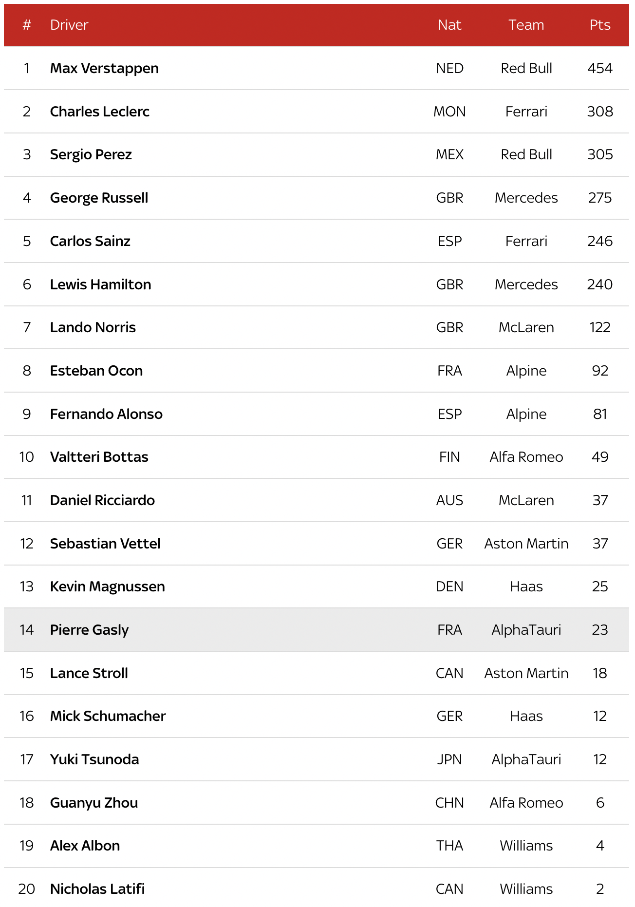
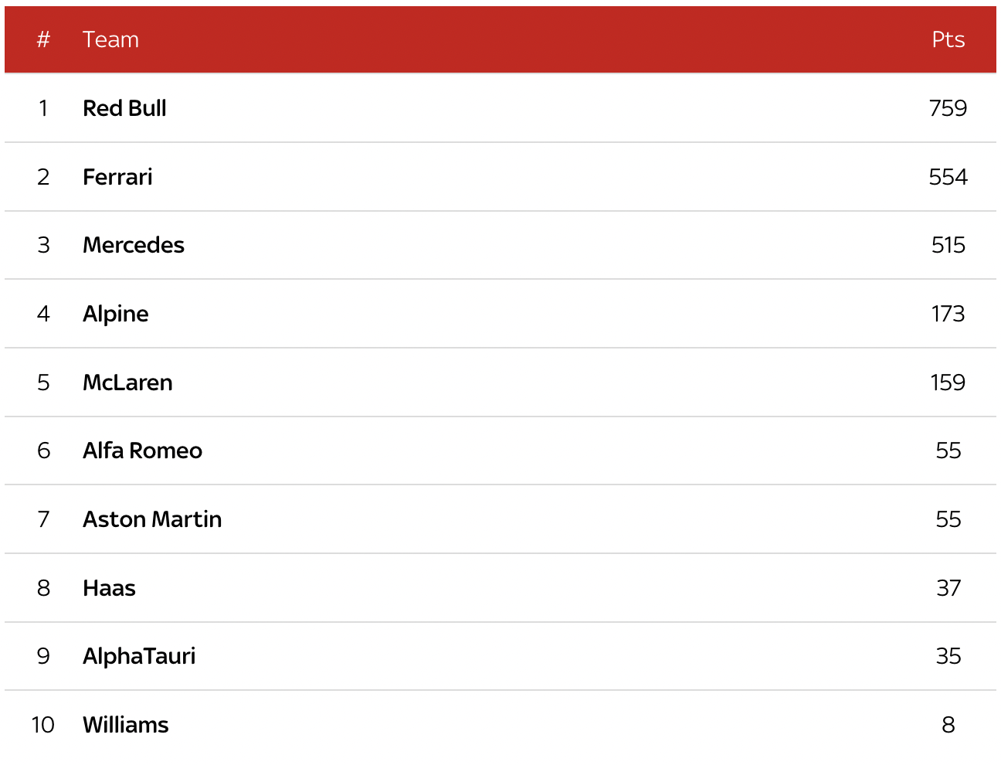
Constructors and Drivers

Slide 4
Datasets used
Circuits.csv
Lap_times.csv
Constructor_results.csv
Constructor_standings.csv
Constructors.csv
Driver_standing.csv
Drivers.csv
Pit_stops.csv
Qualifying.csv
Races.csv
Results.csv
Seasons.csv

Slide 5
Objectives
Car Performance over the years (Average net gain/loss in time on a track)
Lap Prediction (based on previous laps, the number of laps changing according to a certain window)
Lap Prediction (based on previous years data)
Constructor Comparison for the 2022 season
Driver Comparison for the 2022 season
Fastest Track (based on Lap time)
How error-prone each driver is?
Overtake Rate per race
Driver Ratings (based on Delta, Driver Error, Overtakes)

Slide 6
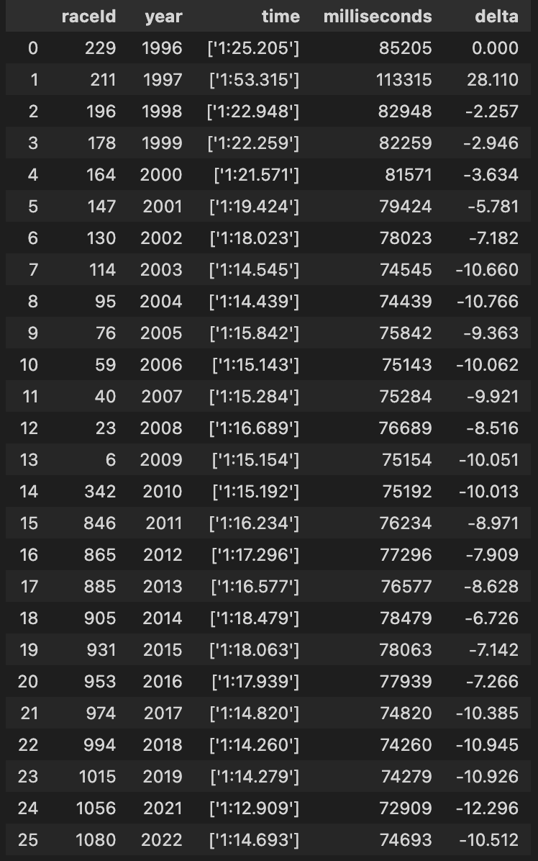
Car Perfomance over the years (Average net gain/loss in time on a track)
Track: Monaco
Monaco has the lowest number of straights and maximum number of turns.
Considering lap times affected by car downforce

Slide 7
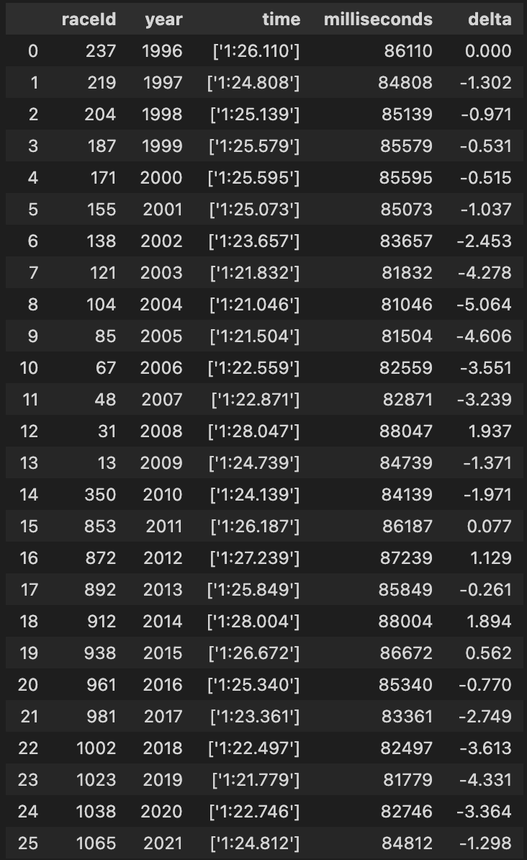
Car Perfomance over the years (Average net gain/loss in time on a track)
Track: Monza
Monza (also known as temple of speed) is majorly comprised of straights and only 5 turns.
Considering lap times affected by car’s straight line speed.

Slide 8
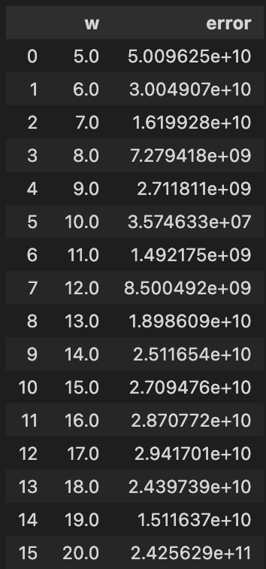
Lap Prediction (based on previous laps, the number of laps changing according to a certain window)
W – window of laps as training dataset
Error – Root Mean squared Error
Model – Linear Regression
Driver – Lewis Hamilton
Track – Nurburgring
Year - 2009

Slide 9
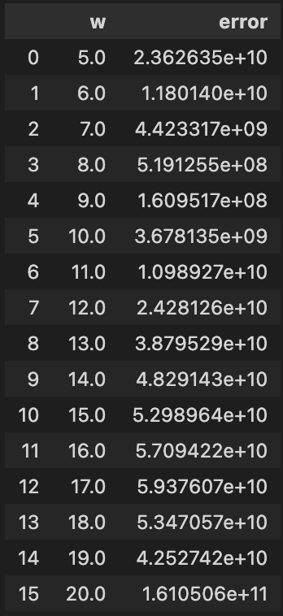
Lap Prediction (based on previous laps, the number of laps changing according to a certain window)
W – window of laps as training dataset
Error – Root Mean squared Error
Model – Polyfit with Log
Driver – Lewis Hamilton
Track – Nurburgring
Year - 2009

Slide 10
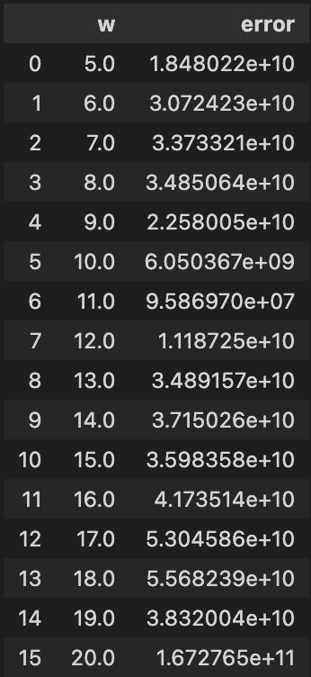
Lap Prediction (based on previous laps, the number of laps changing according to a certain window)
W – window of laps as training dataset
Error – Root Mean squared Error
Model – Polyfit with degree 3
Driver – Lewis Hamilton
Track – Nurburgring
Year - 2009

Slide 11
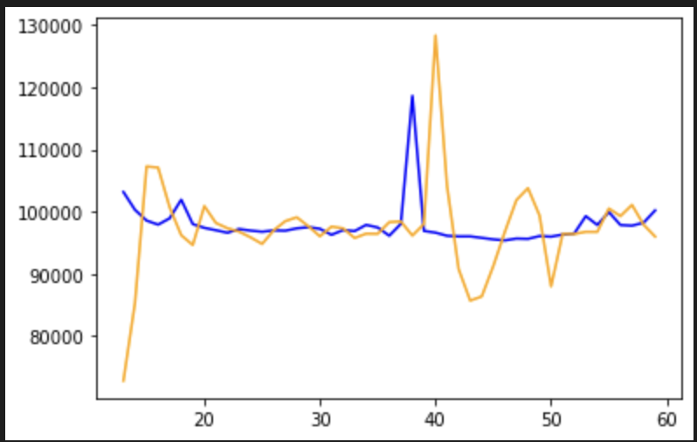
Lap Prediction (based on previous laps, the number of laps changing according to a certain window)
W_optimal – 11
Model – Polyfit with degree 3
Blue – actual
Orange – predicted
Driver – Lewis Hamilton
Track – Nurburgring
Year - 2009

Slide 12
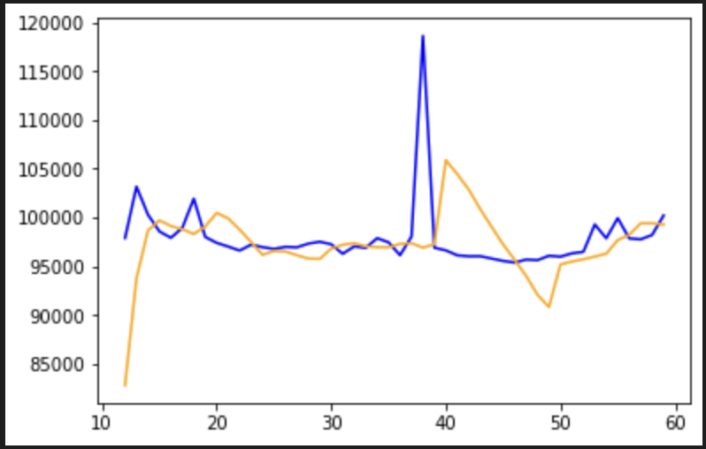
Lap Prediction (based on previous laps, the number of laps changing according to a certain window)
W_optimal – 10
Model – Linear Regression
Blue – actual
Orange – predicted
Driver – Lewis Hamilton
Track – Nurburgring
Year - 2009

Slide 13
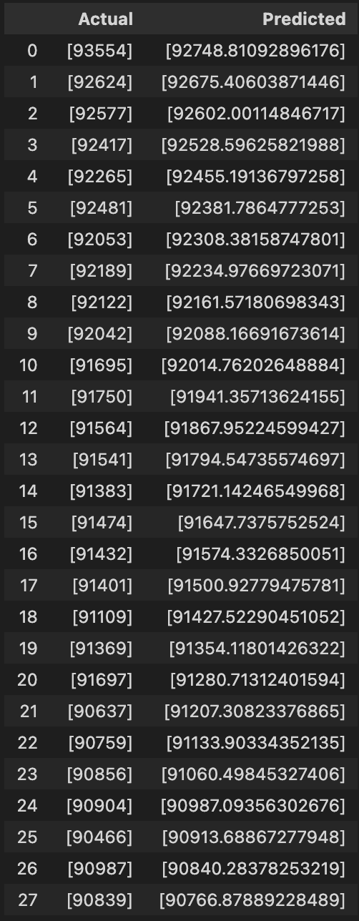
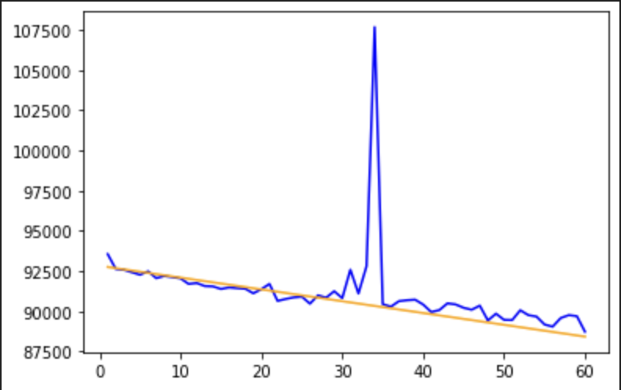
Lap Prediction (based on previous years data)
Driver – Sebastian Vettel
Track – Buddh International Circuit
Model – Lasso Regression
Avg_Delta_Error - -0.5956999999999961

Slide 14
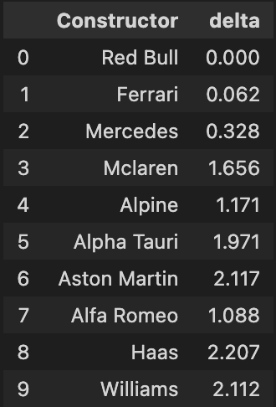
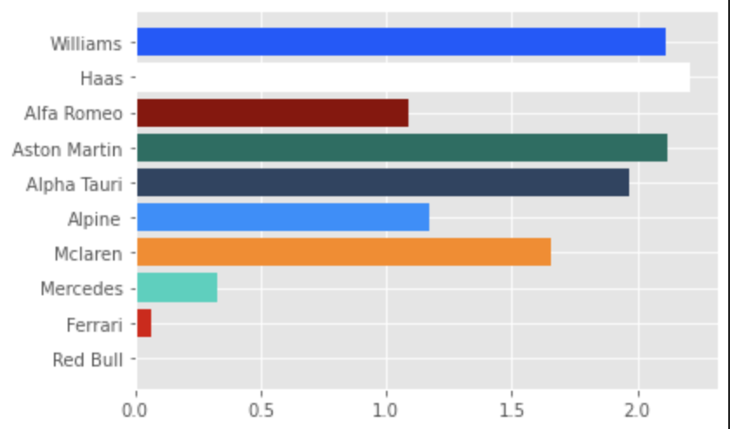
Constructor Comparison for the 2022 season
Delta is basically difference in time with the fastest car(in this case Red Bull)

Slide 15
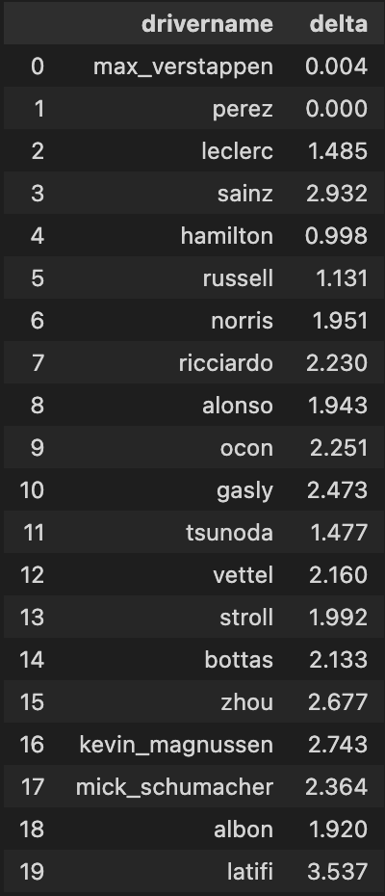
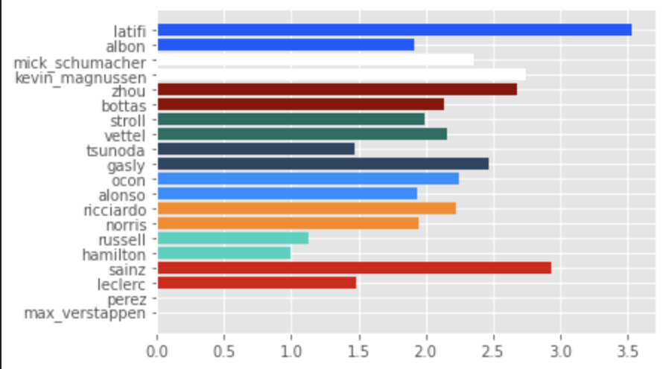
Driver Comparison for the 2022 season

Slide 16
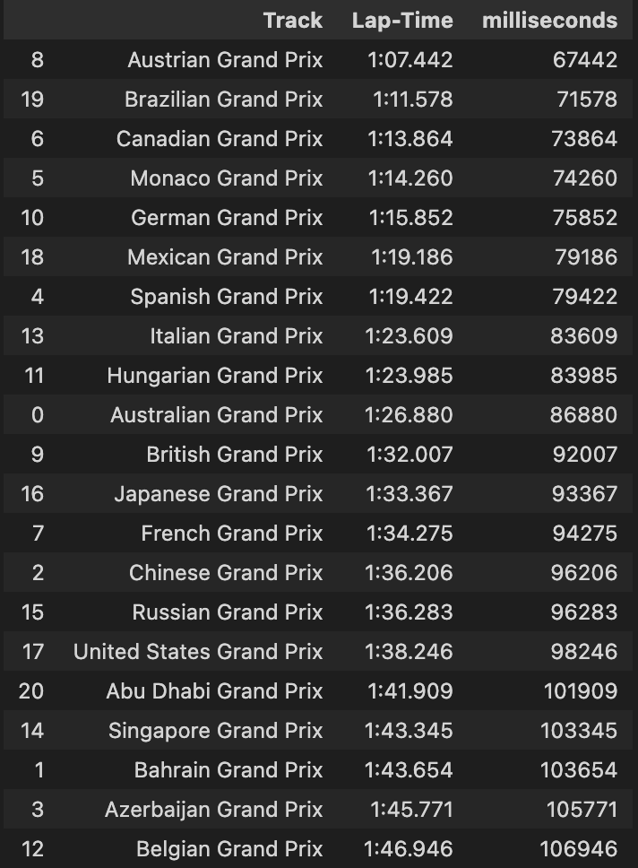
Fastest Track (based on Lap time)

Slide 17
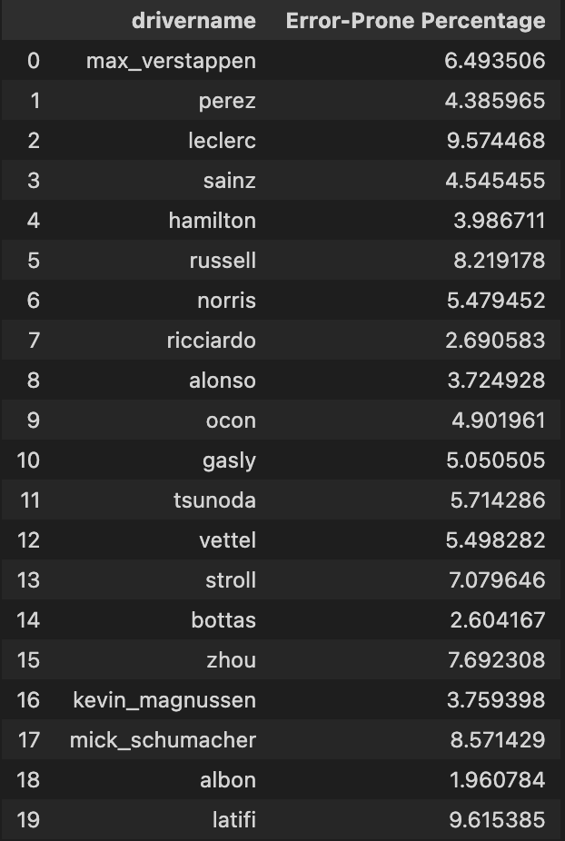
How error-prone each driver is?

Slide 18
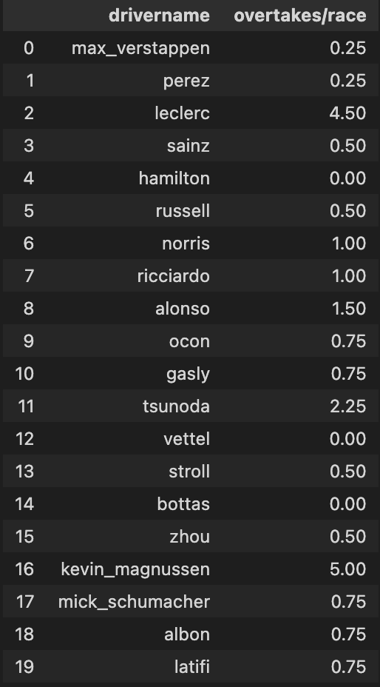
Overtake Rate per race

Slide 19
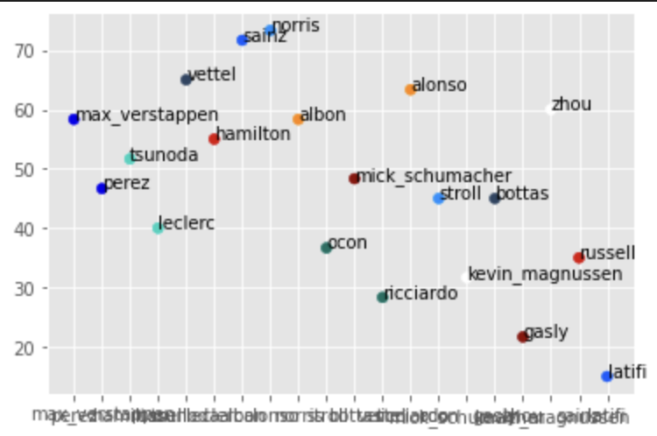
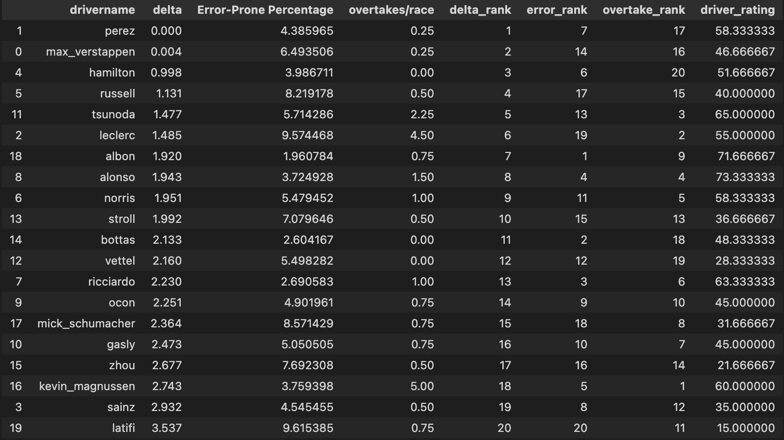
Driver Ratings(based on Delta, Driver Error, Overtakes)

Slide 20
Thank You

