Slide 1

PawsCare
Veterinary Hospital
Full-Stack Web Application for Modern Veterinary Management
Node.js
Express
MongoDB
HTML/CSS/JS

Slide 2






Problem Statement
Manual appointment booking via calls or in-person visits
Appointment slot conflicts and double bookings
No online presence or digital platform for services
No proper digital records management system
Time-consuming manual appointment handling for staff
Inconvenient experience for pet owners seeking care

Slide 3
Project Objectives
1
Create an attractive, responsive veterinary website
5
Improve user experience for pet owners
2
Provide seamless online appointment booking
6
Digitize records for efficient administration
3
Prevent duplicate & past date/time bookings
7
Ensure secure admin access & authentication
4
Build a secure admin dashboard for management

Slide 4




Technology Stack
Frontend
Backend
Database
Dev Tools
HTML5
Structure & Content
Node.js
Runtime Environment
MongoDB
NoSQL Database
VS Code
Code Editor
CSS3
Styling & Animations
Express.js
Web Framework
Mongoose
ODM Library
PowerShell
CLI Operations
JavaScript
Interactivity
REST API
Data Communication
MongoDB Compass
GUI Tool
Browser DevTools
Debugging

Slide 5







Website Modules
Home Page
Services
About
Contact
Hero section, navigation, intro & CTA button
Vaccination, Surgery, Grooming, Diagnostics, Emergency
Mission, vision, team details & why choose us
Phone, email, address, hours & contact form
Appointment
Admin Login
Admin Dashboard
Owner/pet info, date, time & service selection
Secure credential verification system
View & manage all appointments, logout

Slide 6








Project Workflow
1
2
3
4
5
6
7
8
User Visits
Explores Pages
Books Appt.
API Call
Validation
DB Storage
Admin Login
View Appts.
Browses website
Services/About/Contact
Fills appointment form
Fetch API → Backend
Backend validates data
Saved in MongoDB
Secure authentication
Admin manages data
👤 User Journey
🔑 Admin Journey

Slide 7










Key Features Implemented
Multi-page Website Navigation
Attractive UI & Background Images
Appointment Booking System
MongoDB Database Integration
Admin Login & Authentication
Admin Dashboard Management
Secure Logout Functionality
Duplicate Appointment Prevention
Past Date Booking Restriction
Responsive Frontend Design

Slide 8
Challenges & Solutions
⚠ Challenge
✔ Solution
Frontend Navigation Issues
→
Used proper anchor linking across pages
Backend Integration Issues
→
Used Fetch API for frontend-backend connection
Missing Express Module Error
→
Installed dependencies using npm install
Admin Redirect Loop
→
Fixed localStorage authentication logic
Duplicate CSS Conflicts
→
Audited & removed all duplicate styling code

Slide 9








Future Enhancements
Online Payment Integration
Email Notifications
SMS Appointment Reminders
Doctor Availability Tracking
Pet Medical Records System
AI Chatbot Support
Video Consultations
Online Prescription Management

Slide 10
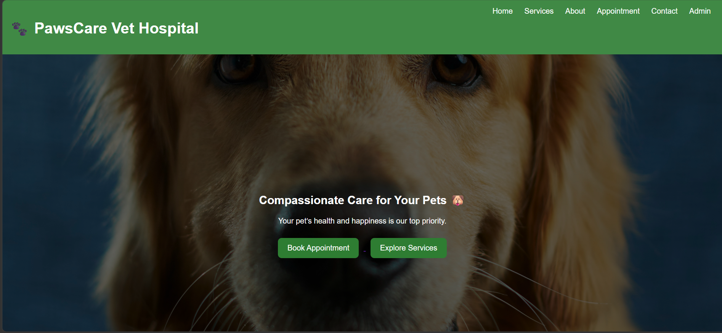

Slide 11
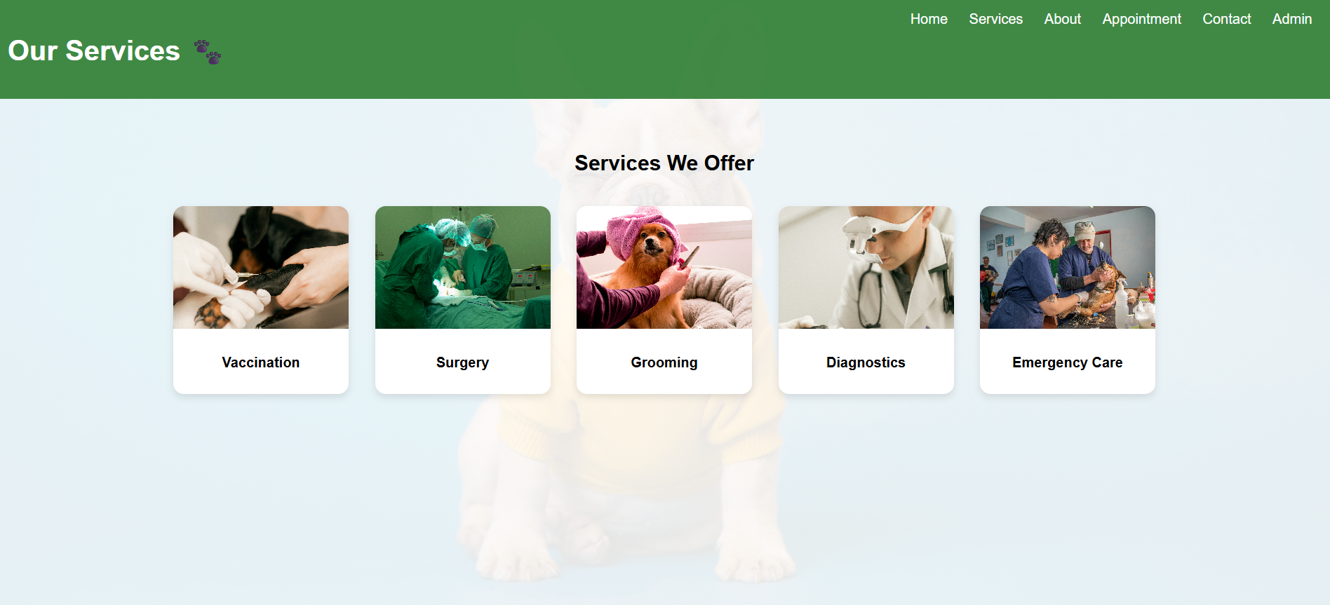

Slide 12
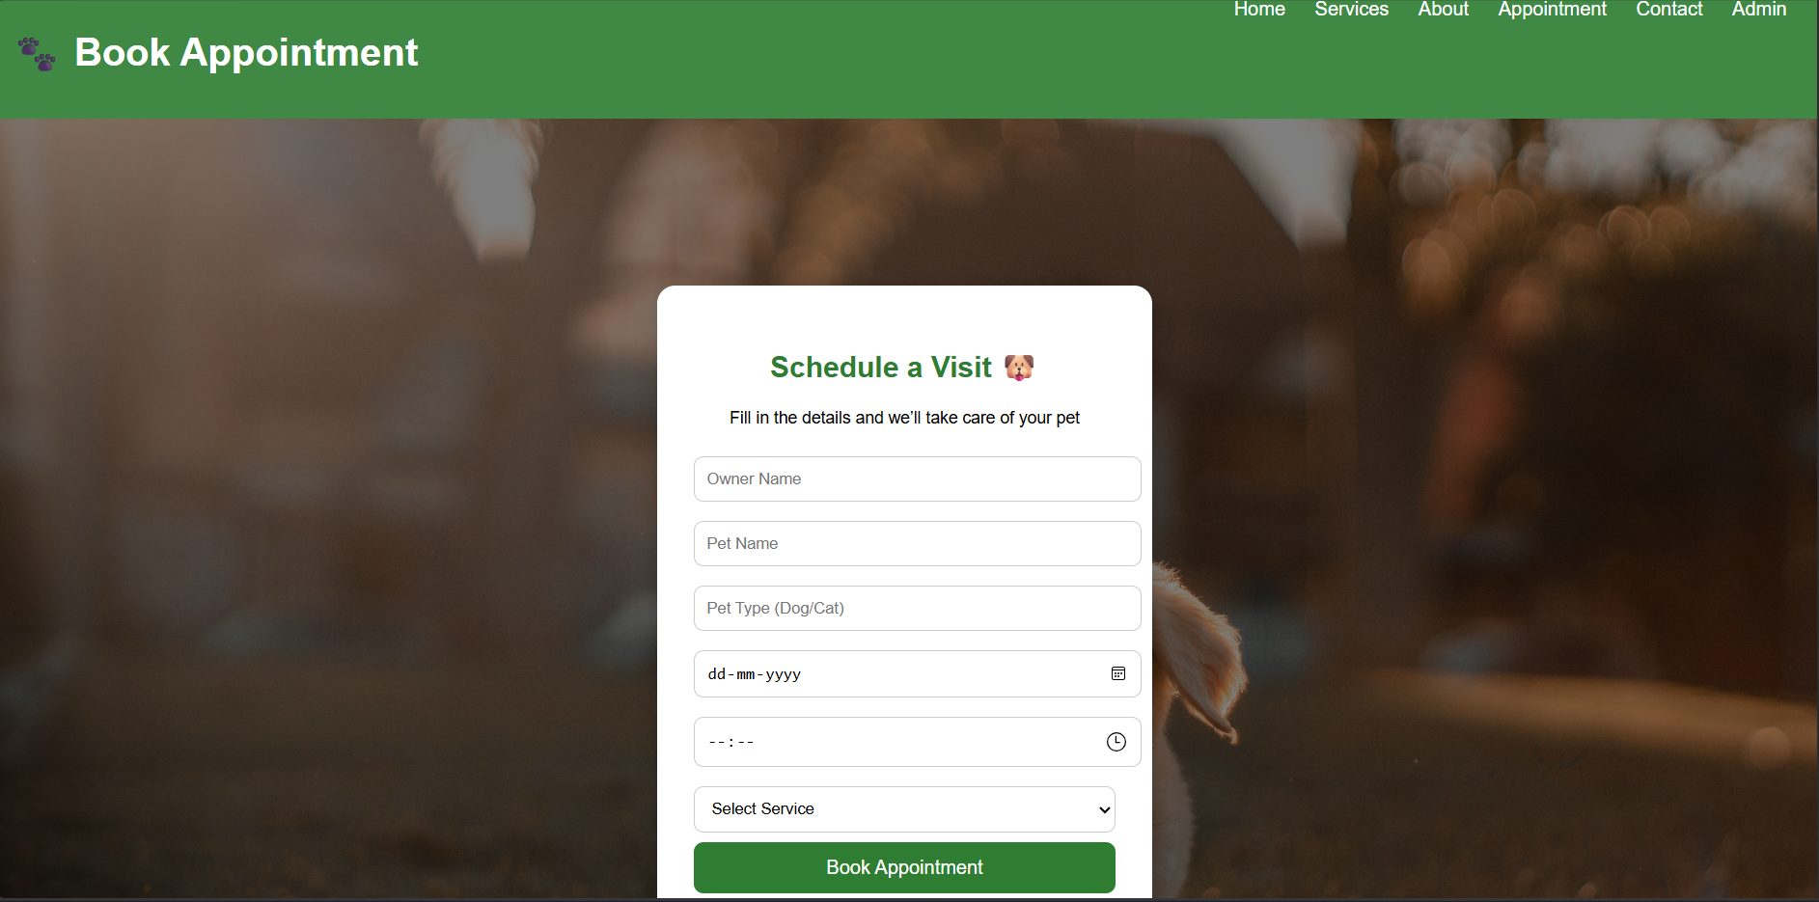

Slide 13
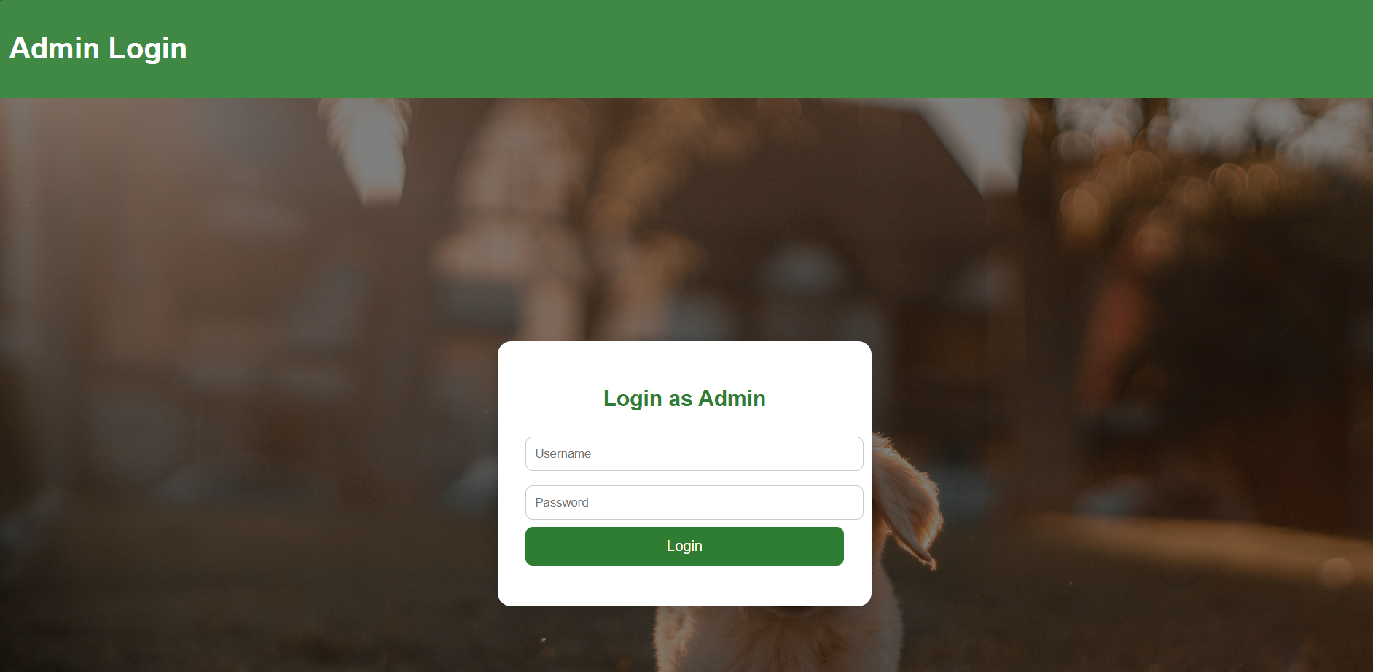

Slide 14
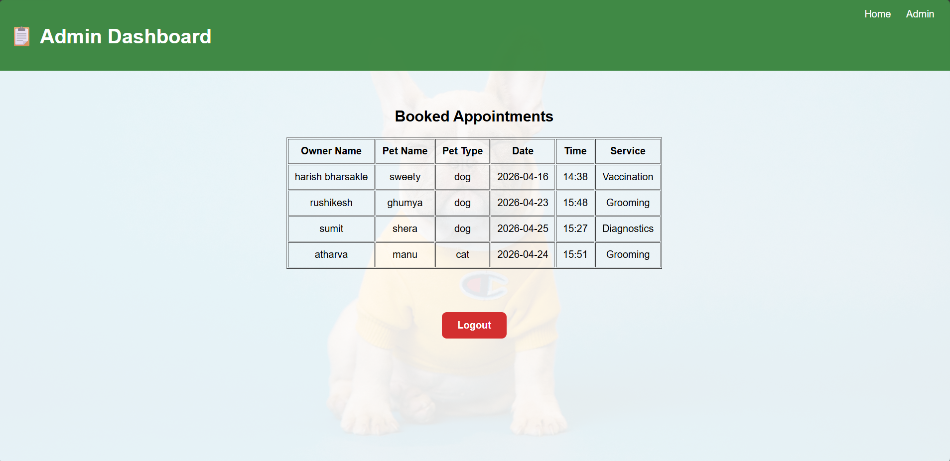

Slide 15
Conclusion
Successfully digitizes veterinary hospital management
Reduces manual effort and prevents appointment conflicts
Provides a professional online platform for pet owners
Demonstrates full-stack development across all layers
Built with Node.js · Express.js · MongoDB · HTML/CSS/JS

