Slide 1
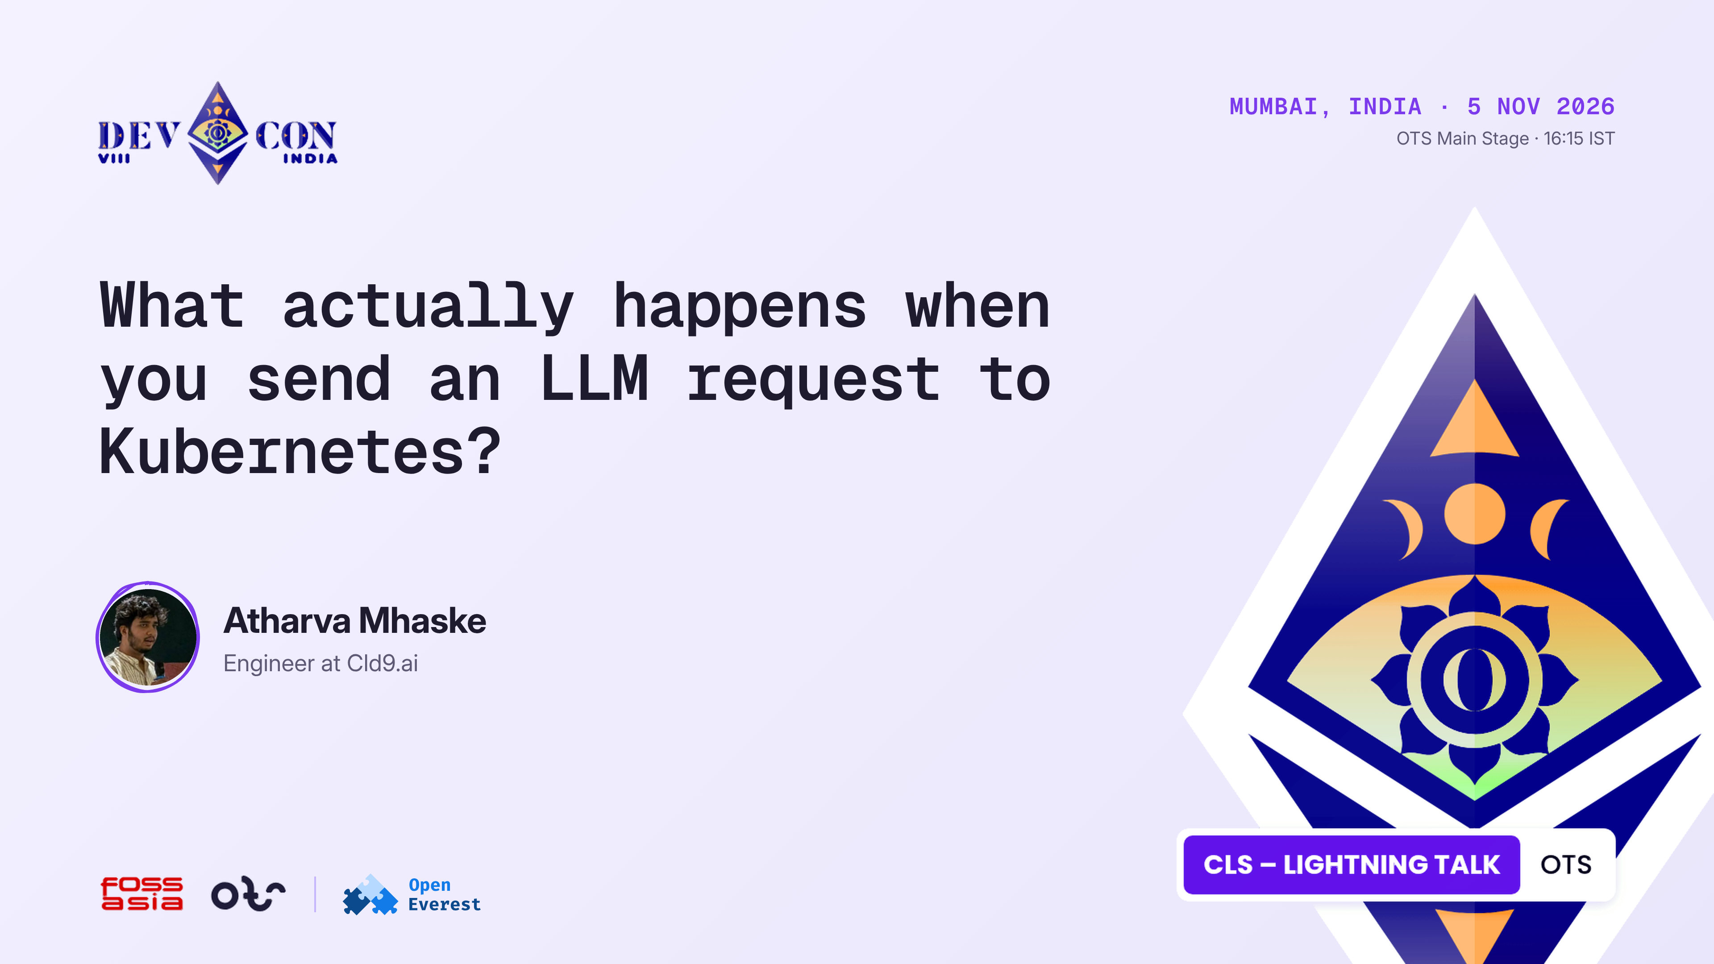
Notes:
0:00-0:15 · Title
Hi, I'm Atharva, an engineer at Cld9.ai. I work on provider-kserve at OpenEverest. In the next five minutes I'll follow one LLM request through a Kubernetes cluster.

Slide 2
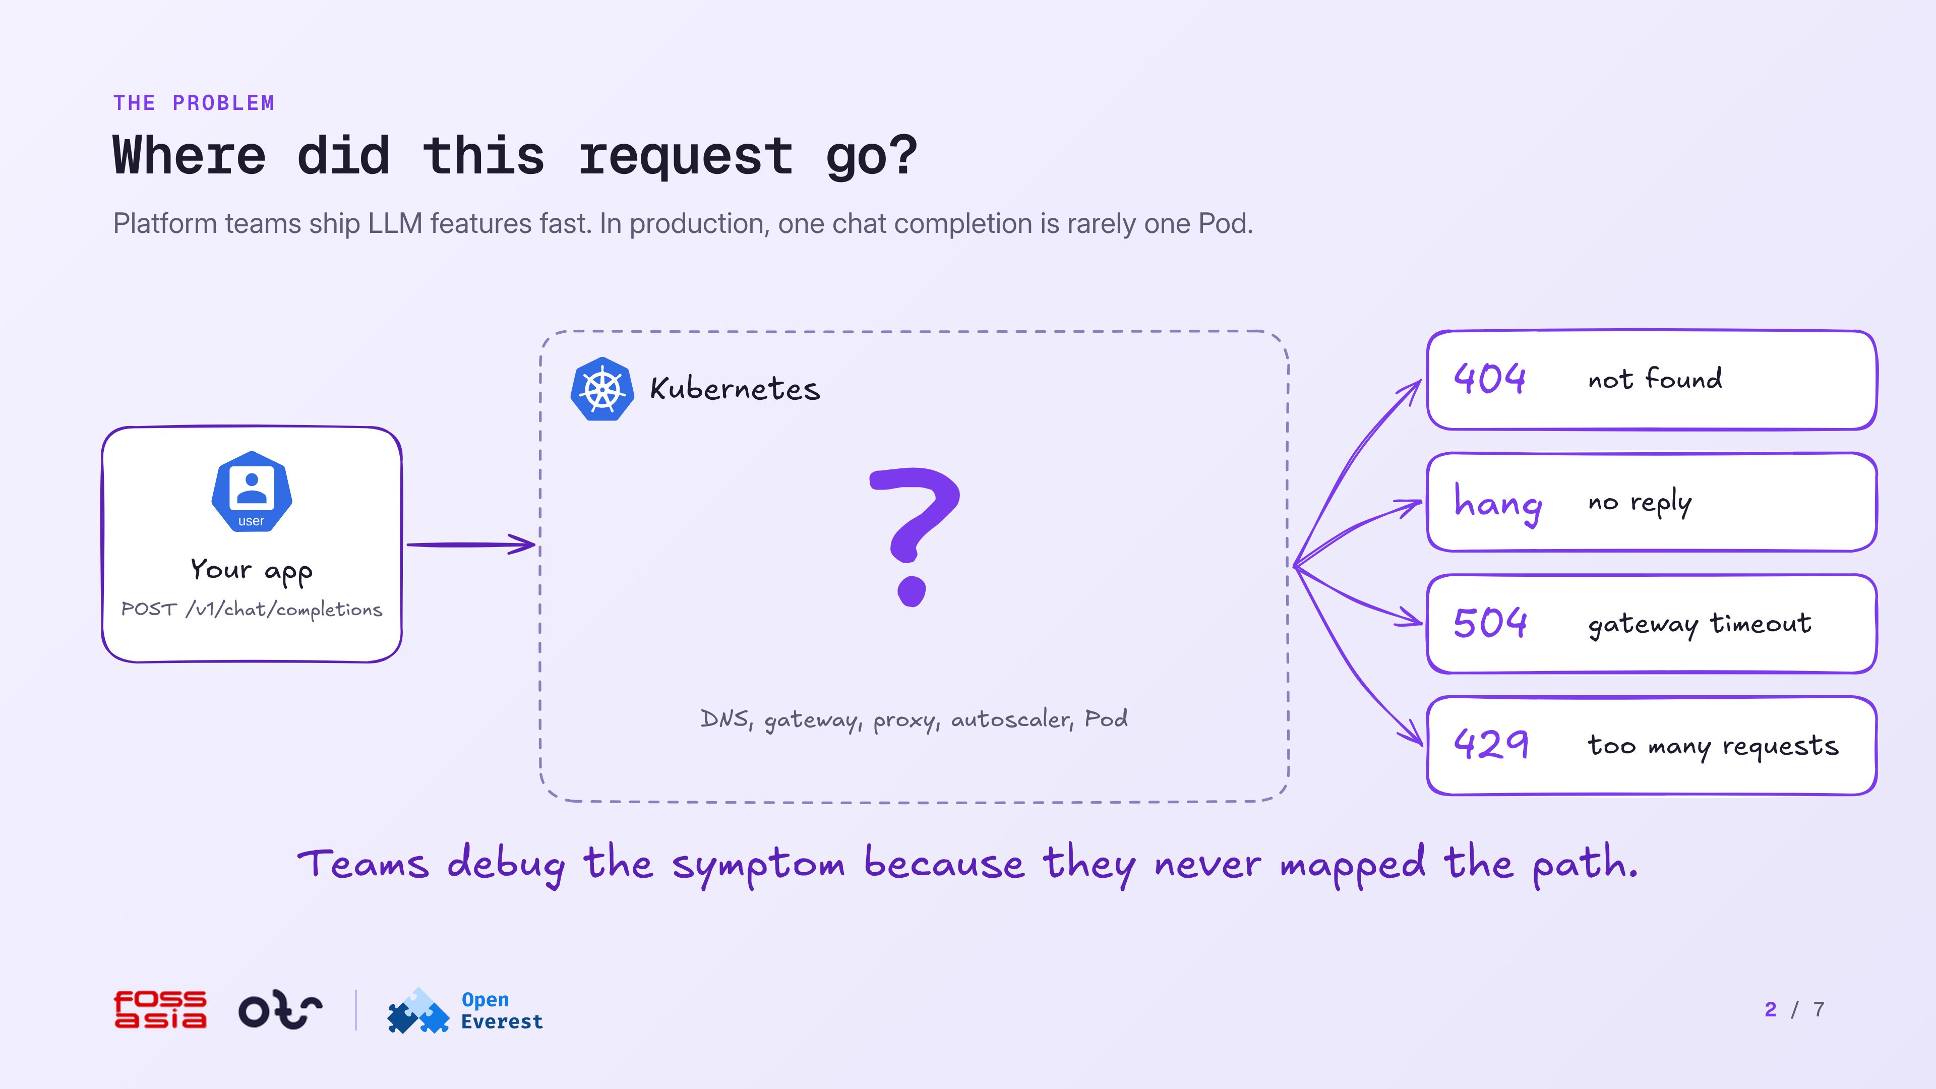
Notes:
0:15-0:55 · The problem
Platform teams ship LLM features fast. Then production asks a basic question: where did this request go? The answer is rarely one Pod. Your app calls /v1/chat/completions, and inside the cluster the request passes DNS, a gateway, a proxy, an autoscaler and a Pod. When a 404, a hang, a 504 or a 429 comes back, teams debug the symptom because they never mapped the path.

Slide 3
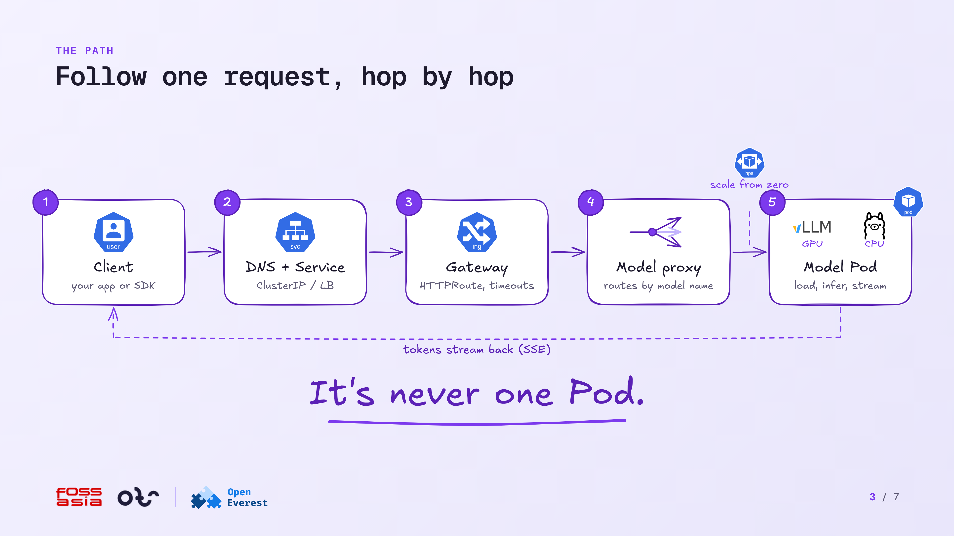
Notes:
0:55-1:50 · The path
The client sends an OpenAI-style request. DNS and a Service turn the name into an IP. The gateway applies TLS, auth, the HTTPRoute and its timeouts. The model proxy reads the model name and picks a backend. If no replica is running, the autoscaler starts one first. A vLLM Pod on a GPU, or an Ollama Pod on a CPU, loads the model, runs inference and streams tokens back as SSE chunks. It's never one Pod.

Slide 4
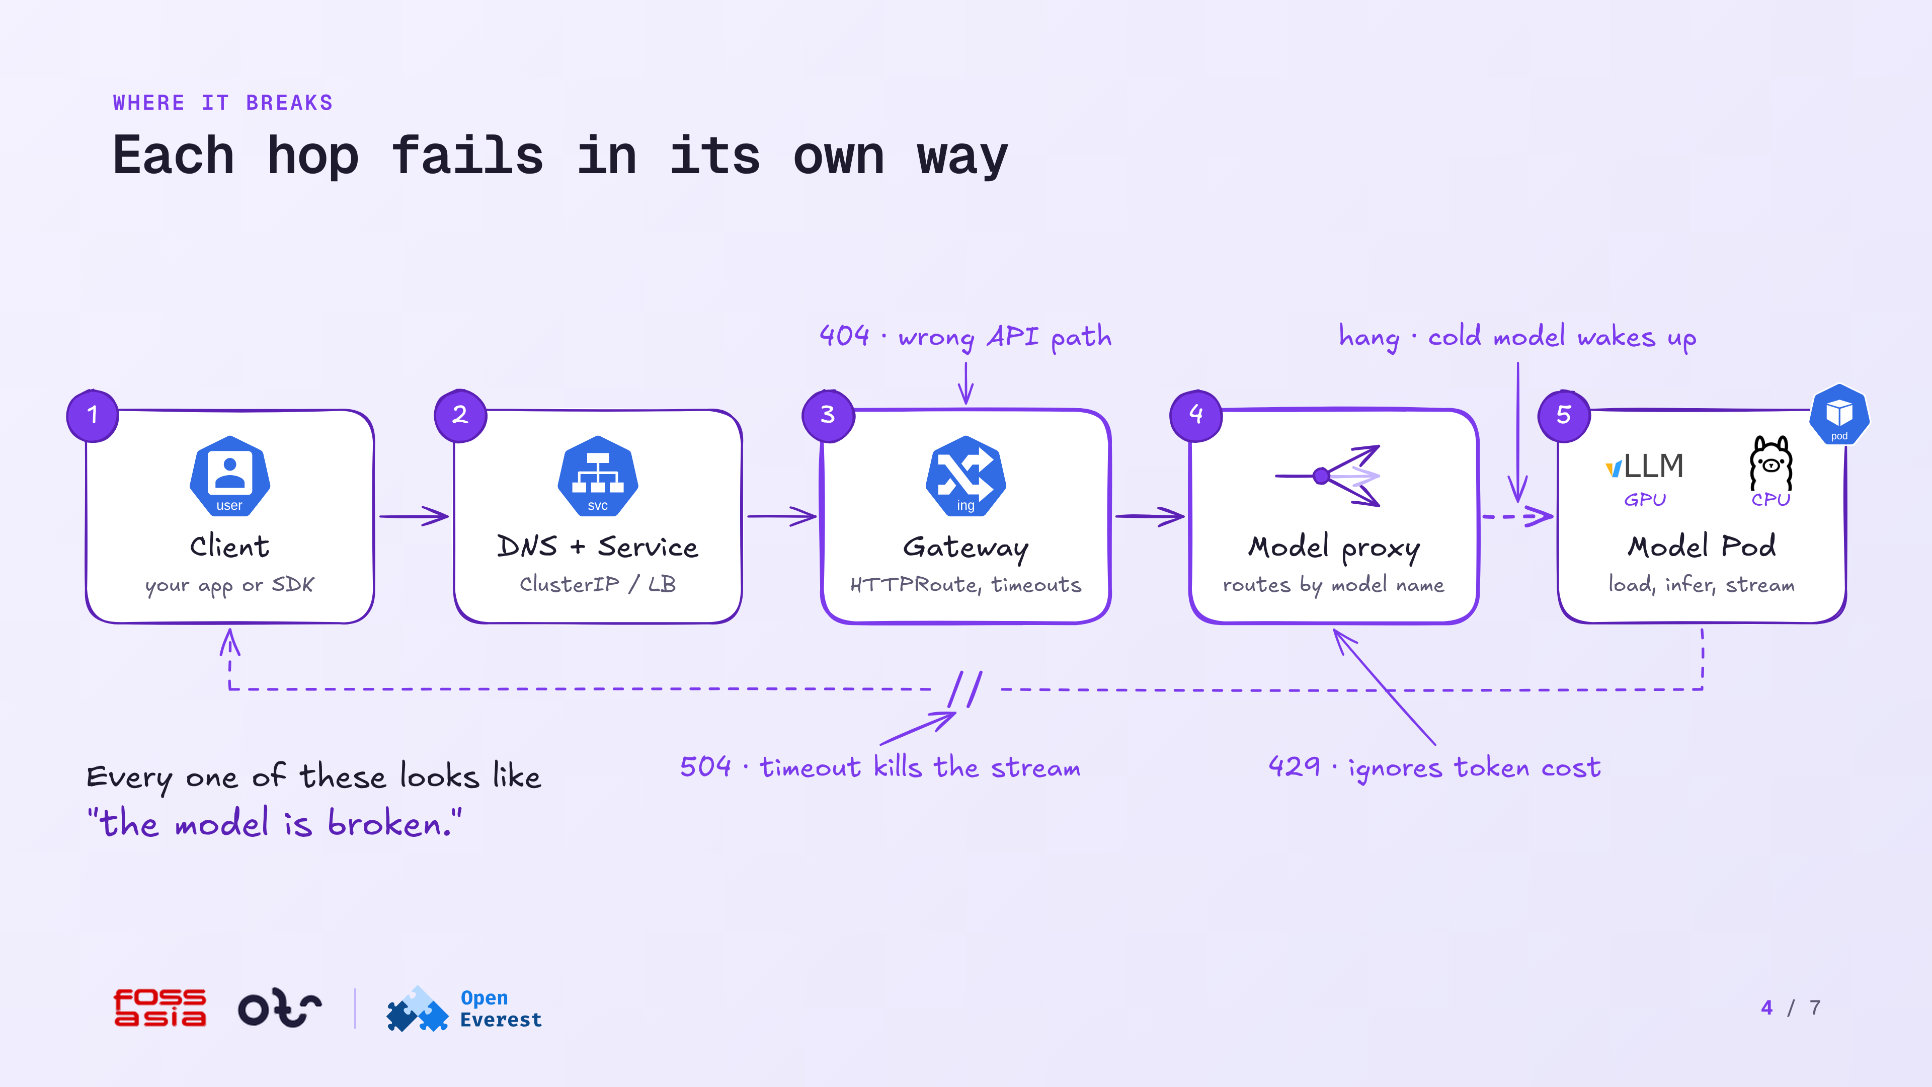
Notes:
1:50-2:50 · Where it breaks
A 404 means the client and the gateway disagree on the path, for example a missing /v1 prefix. A hang means the model is cold, so the request waits for an image pull, a weights download and a GPU load. A 504 means the gateway's idle timeout closed a long streaming answer. A 429 means the rate limit counts requests, so one huge prompt costs the same as a tiny one. Each of these looks like the model is broken.

Slide 5
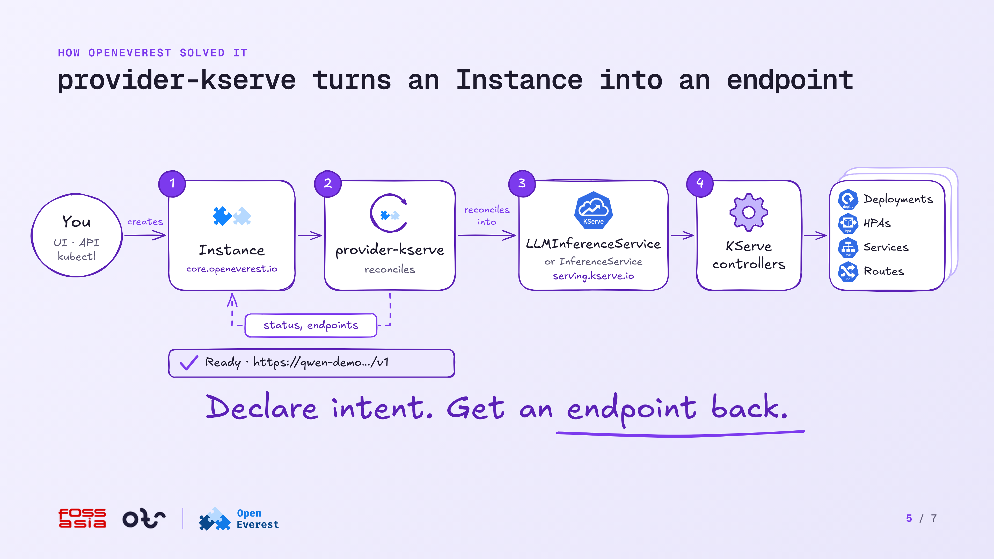
Notes:
2:50-3:55 · How OpenEverest solved it
You create a model as an Instance in core.openeverest.io, from the UI, the API or kubectl. provider-kserve reconciles it into a KServe LLMInferenceService or InferenceService. The KServe controllers create the Deployments, HPAs, Services and Routes. provider-kserve writes the status and the endpoint back to the Instance, so you get a ready URL. Declare intent. Get an endpoint back.

Slide 6
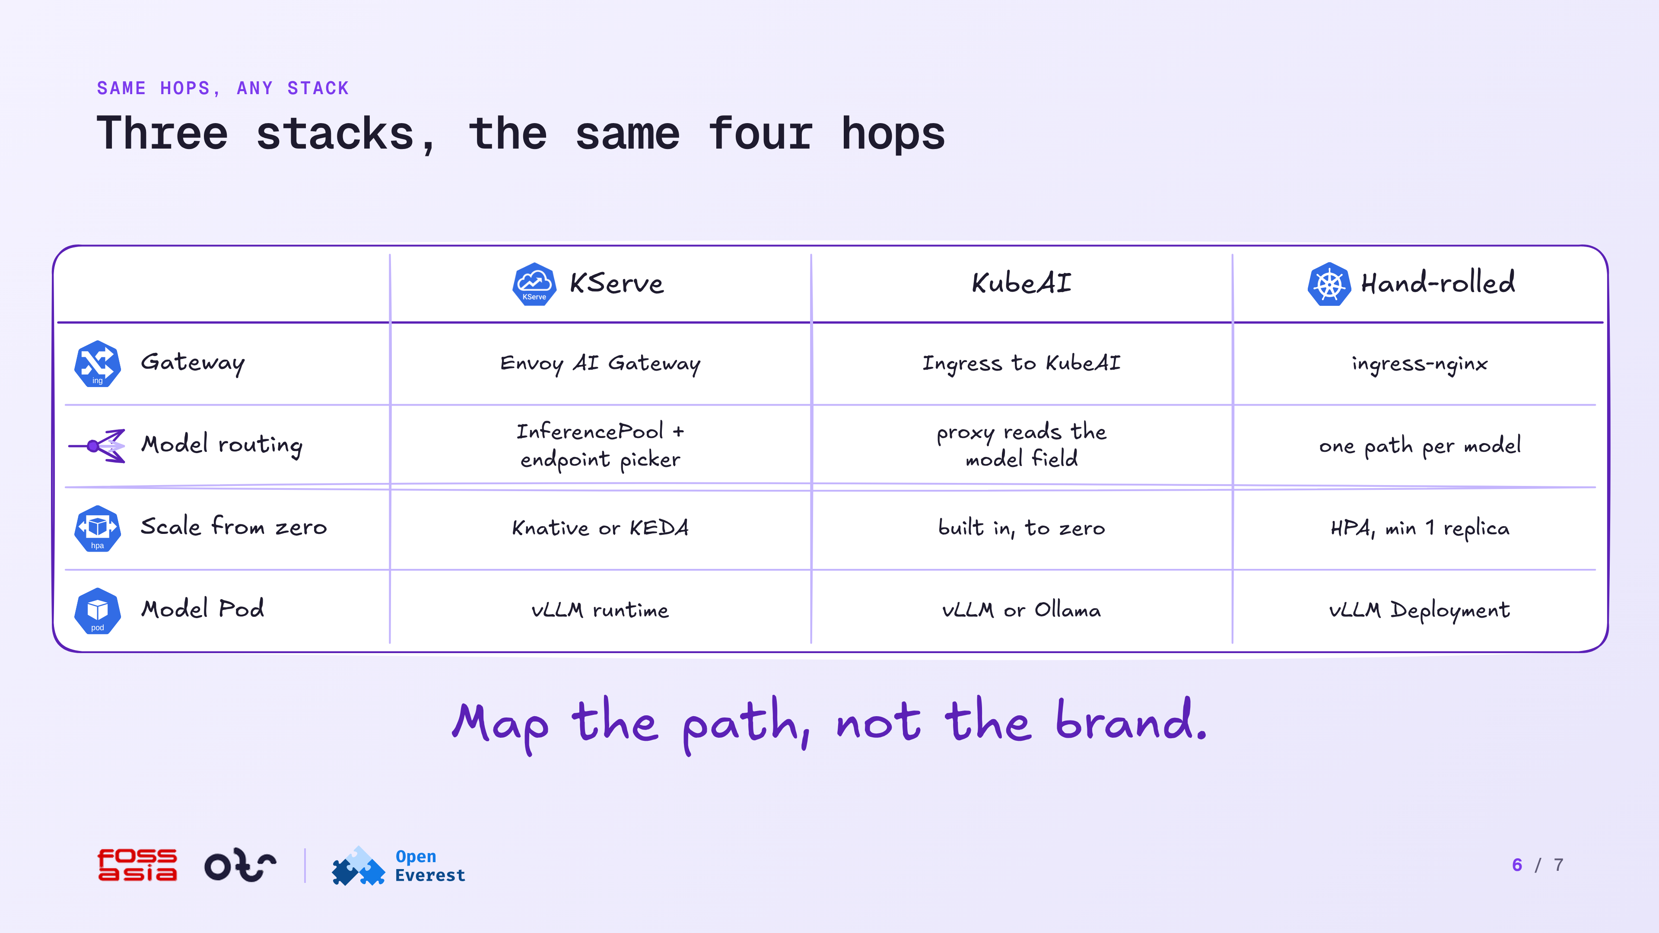
Notes:
3:55-4:40 · Same hops, any stack
KServe, KubeAI and a hand-rolled stack all have the same four hops. Each one has a gateway, model routing, scale from zero and a model Pod. Only the component names change. Map the path, not the brand.

Slide 7
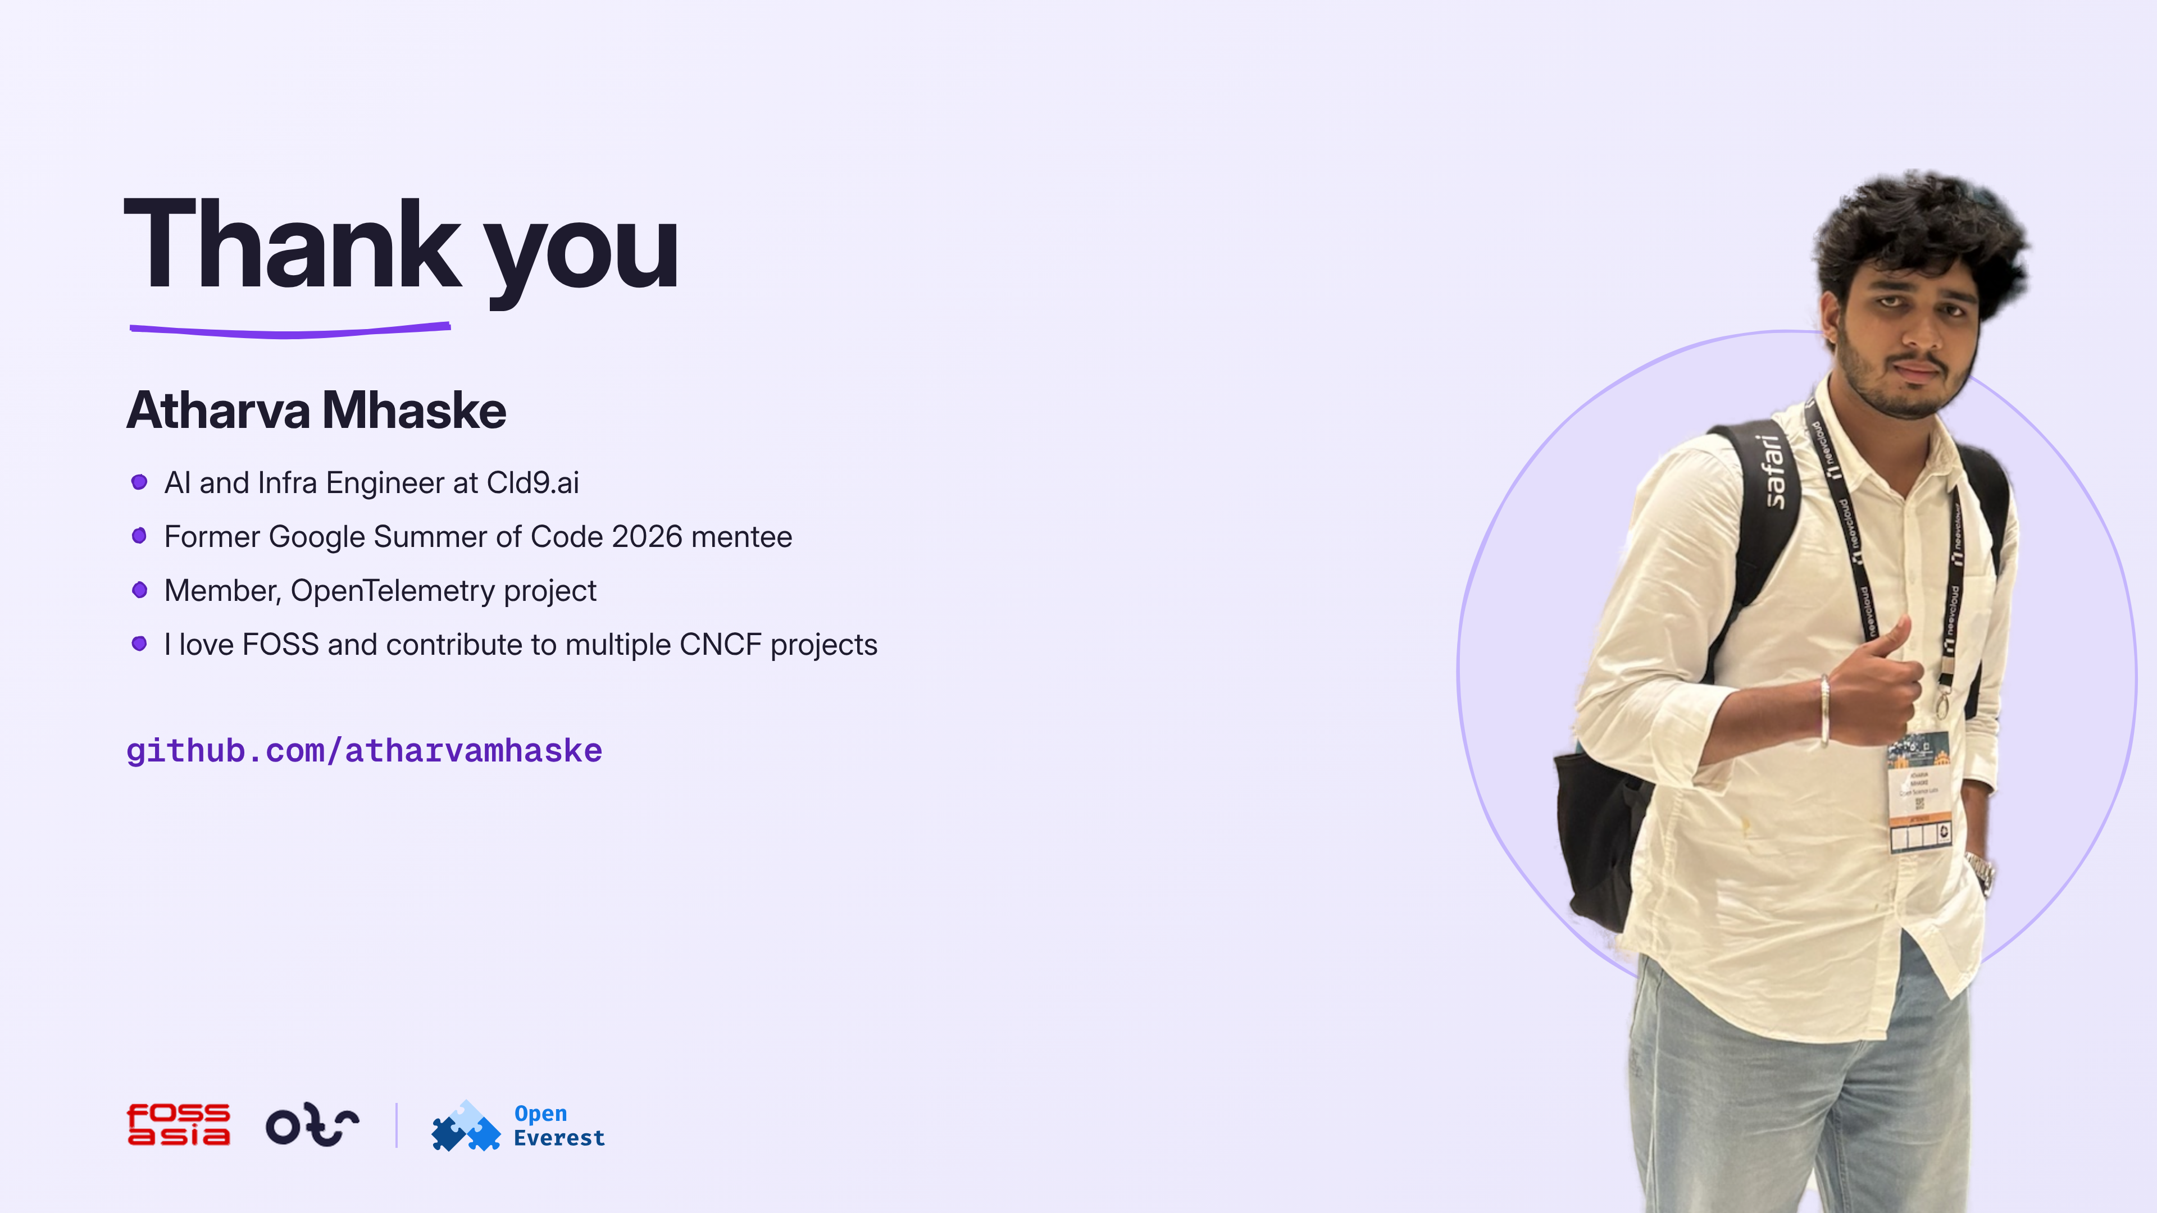
Notes:
4:40-5:00 · Thank you
I'm Atharva Mhaske, AI and Infra Engineer at Cld9.ai, a former GSoC 2026 mentee and an OpenTelemetry member. I'm github.com/atharvamhaske. Thank you.

