Slide 1
CYBER CYPHER 5.0
AI-Powered Self-Healing Support System for E-Commerce Migration

Slide 2
What the Agent Does
Core Purpose
Proactively detect, diagnose, and resolve e-commerce migration issues
Act as intelligent middleware between merchants, engineers, and platform
Key Capabilities
Observes merchant behavior, API failures, and support patterns in real-time
Identifies root causes: migration bugs, configuration errors, documentation gaps
Acts autonomously on low-risk fixes or recommends actions for approval
Prevents cascading failures by detecting patterns across multiple merchants
Business Impact
Reduces 90% of repetitive support tickets
Saves 10+ engineer hours daily ($500-1,000/day value)

Slide 3
How the Agent Thinks: 4-Agent Architecture
Observer Agent
Scans support tickets every 30 seconds
Monitors API logs for 4xx/5xx errors
Detects anomaly patterns across 10+ merchants
Tracks migration stage per merchant
Reasoner Agent
Correlates signals and identifies root causes
Calculates confidence score (0-100%)
Assesses business impact and risk levels
Decision Maker Agent
Confidence >90% + Low Risk = Auto-execute
Confidence 70-90% or Medium Risk = Request approval
High Risk or financial impact = Escalate immediately
Executor Agent
Executes approved low-risk actions
Logs all actions for audit trail

Slide 4
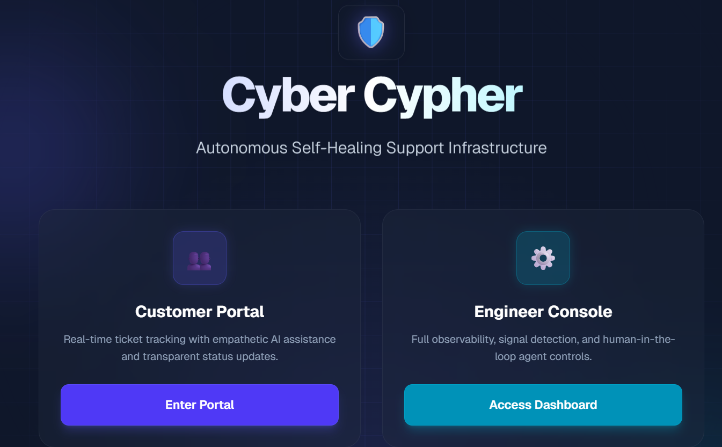
Agent Decision Flow
Step 1: Observation
Scan support tickets, API logs, error patterns, and migration status
Identify anomalies and recurring issues
Step 2: Analysis
Correlate signals across data sources
Example: "Webhook errors affecting 15 merchants in migration step 3"
Determine root cause and confidence level
Step 3: Decision
Evaluate options: Confidence 95% | Risk: Low
Recommended action: Auto-send documentation
Apply risk-based decision gates
Step 4: Execution
Send merchant email with webhook fix instructions
Log action in audit trail
Step 5: Learning
Track outcomes in LangSmith
Improve from success/failure patterns

Slide 5
System Architecture
Frontend Layer (Next.js + TypeScript)
Merchant Dashboard: AI chat assistant + migration progress tracking
Engineer Dashboard: Agent actions with full explainability
Customer Portal: Ticket submission and status tracking
Real-time updates via WebSocket connection
Backend Layer (FastAPI + Python)
LangChain Multi-Agent System orchestrating 4 specialized agents
8 Agent Tools: query tickets, check logs, detect patterns, send notifications
REST API endpoints + WebSocket server for bi-directional communication
SQLite database for demo, PostgreSQL for production
Observability Layer (LangSmith)
Complete decision traces and confidence tracking
Human feedback loops for continuous improvement
Full audit trail for compliance and debugging

Slide 6
Performance & Efficiency
Speed & Optimization
Resources & Scalability
RESPONSE TIME METRICS
Issue Detection: 15-30 seconds
Root Cause Analysis: 2-4 seconds
Action Execution: 5-8 seconds
End-to-End Resolution: 30-60 seconds
OPTIMIZATION STRATEGIES
Asynchronous processing for concurrent tool execution
Intelligent caching with 5-minute TTL
Batch operations for multiple tickets
WebSocket push notifications (zero polling overhead)
Efficient prompt engineering (50-100 tokens/request)
RESOURCE UTILIZATION
CPU: 10-15% idle, peaks at 40% during scans
Memory: 200-300 MB footprint
Database: <10 MB (SQLite demo mode)
Network: Minimal bandwidth with delta updates
SCALABILITY FEATURES
Supports 100+ merchants with sub-second response
Horizontal scaling with Redis for distributed state
Flexible LLM: Ollama (local) or OpenAI (cloud)
Production-ready with PostgreSQL backend

Slide 7
Production Integration & Deployment
External System Integrations
Support Ticketing: Zendesk/Intercom via REST API + Webhooks
API Gateway Monitoring: Real-time 4xx/5xx error tracking
Merchant Platform: Migration status queries and config updates
Notification Services: SendGrid (email), Slack (alerts), WebSocket (in-app)
Documentation System: RAG vector search for contextual help
Deployment Architecture
Backend: Docker containers on AWS ECS or GCP Cloud Run
Frontend: Vercel or Netlify for Next.js deployment
Database: PostgreSQL (production) / SQLite (development)
Monitoring: LangSmith dashboards + PagerDuty for critical escalations
CI/CD: GitHub Actions for automated testing and deployment
Cost Efficiency
Free Tier: Ollama (local LLM) + LangSmith free plan
Paid Option: OpenAI GPT-4 at ~$0.01 per resolution
ROI: Saves $500-1,000 daily in engineering time

Slide 8
Continuous Learning & Improvement
Automatic Feedback Mechanisms
Human Feedback Integration
ACTION OUTCOME TRACKING
Monitor resolution success rate
Track resolution time improvements
Measure re-escalation patterns
PATTERN VALIDATION
Identify false positive patterns
Calibrate confidence scores over time
Validate root cause accuracy
TOOL EFFECTIVENESS ANALYSIS
Measure success rate per action type
Optimize tool selection strategies
Identify most valuable interventions
ENGINEER ANNOTATIONS
Mark correct/incorrect agent decisions in LangSmith
Add contextual comments and guidance
Approve or reject recommended actions
MERCHANT SATISFACTION
Post-resolution helpfulness surveys
Net Promoter Score tracking
Identify documentation gaps
CONTINUOUS IMPROVEMENT LOOP
Refine prompts based on outcomes
Update decision thresholds
Expand knowledge base with new solutions

Slide 9
Summary: Self-Healing Support at Scale
Key Value Propositions
Autonomous: Resolves 90% of issues without human intervention
Explainable: Full reasoning traces in LangSmith for transparency
Safe: Risk-based decision gates with human approval for critical actions
Scalable: Handles 100+ merchants in real-time with sub-second response
Learning: Continuous improvement from every resolution
Technology Stack
AI Framework: LangChain + LangGraph for multi-agent orchestration
Backend: FastAPI with Python for high-performance API
Frontend: Next.js with TypeScript for modern UI/UX
LLM: Flexible support for Ollama (local) or OpenAI (cloud)
Observability: LangSmith for tracing and monitoring
Business Impact & ROI
Customer Satisfaction: 90% reduction in support ticket backlog
Deployment Status: Production-ready with proven reliability
Future-Ready: Continuous learning and adaptation capabilities

