Slide 1
Bluetooth based Microcontroller Programmer/Debugger Preliminary Design Review
Project Deliverables
Block Diagram
New Hardware Elements
New Software Elements
Milestones and Fallback Plan

Slide 2
Project Deliverables
Developing an embedded system using AVR microcontroller
Developing a programmer for the embedded system
Developing a wireless command device to download the program
Incorporating debugging capabilities

Slide 3
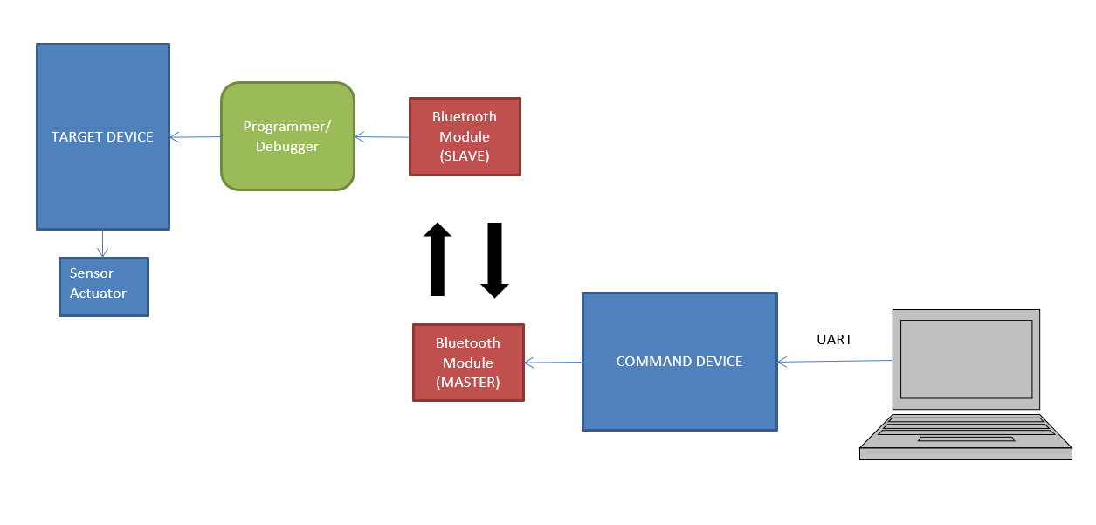
Block Diagram

Slide 4
New Hardware Elements
Bluetooth interfacing
AVR Embedded System
AVR programmer using on-chip self-programming
Using AVR debugWire for debugging

Slide 5
New Software Elements
AT Commands
AT+ORGL reset module
AT+NAME = DEVICENAME
AT+ROLE=1 ; change role of module to master
Bluetooth Protocol to Serial conversion (SPI or UART)
SPM (Store Program Memory) Instructions
AVR Assembly

Slide 6
Milestones
1 November: Complete initial design plan
5 November: Initial Hardware Bring up
10 November: Finish target embedded system
15 November: Bluetooth Interface
20 November: Finish Programmer
30 November: Complete integration
5 December: Debugging complete

Slide 7
Fallback Plan
Build only a wireless programmer for target embedded system

