Slide 1
RMS Titanic Survival Prediction
- Atharva Joshi

Slide 2
In this we try to analyze the data of the passengers aboard the famous RMS Titanic and try to gain insights on the factors that contribute to their chances of survival and then predict their rate of survival accordingly.

Slide 3
Variable Identification

Slide 4
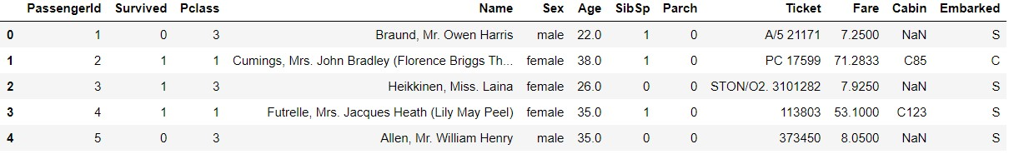
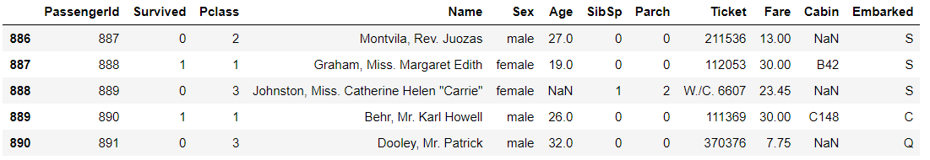
Initial Look into Data gives us an idea of what the dataset contains, what the data types of individual columns are and we can then try to gain insights as to what columns are suitable, how to make them more suitable, etc.

Slide 5
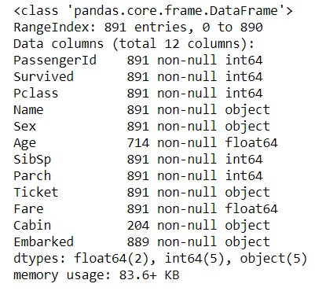
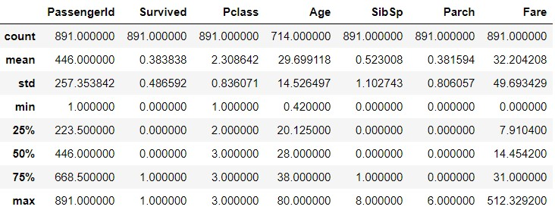
We then try to get values for Measure of Central Tendency, Measures of Dispersion and Measures of Shape to initialize our initial analysis. We also get information on actual data types of columns, number of values, etc.

Slide 6
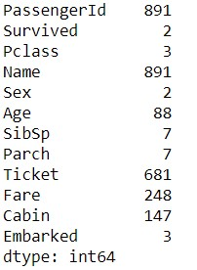
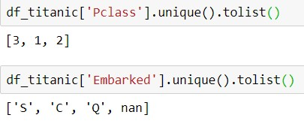

This forms the last few stages of understanding data like shape and understanding the various unique values of categorical variables.

Slide 7
Univariate Analysis

Slide 8
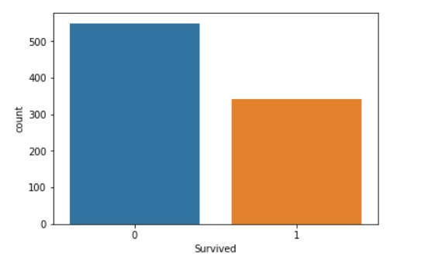
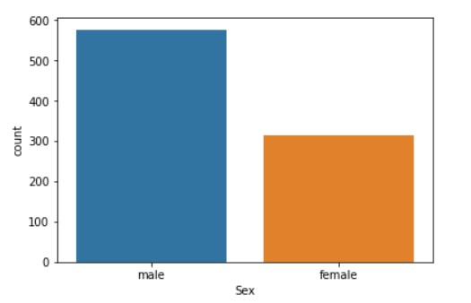
Here we start with analyzing each individual variable. We can first see that the number of people who did not survive is much greater than the people who survived. Hence the Probability of surviving is quite less.
This is just a count of the number of males and females aboard the titanic. Males were significantly higher than females

Slide 9
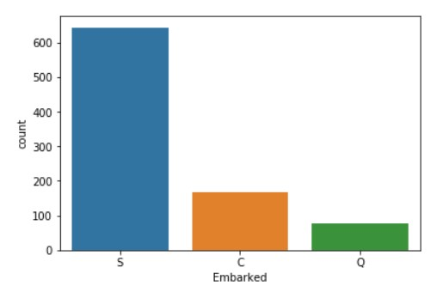
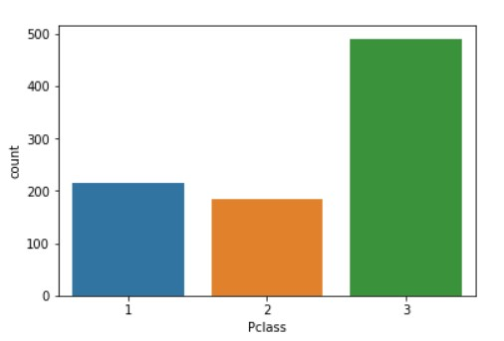
People climbed the titanic from three locations- Cherbourg, Queenstown and Southampton. Southampton saw the highest number of people while queens was the lowest. This won’t have much effect on survival since it is independent of the ability of a person to survive.
There were three types of ticket classes- first, second and third. Third, being the cheapest was highest while second, which was relatively cheaper was lowest.

Slide 10
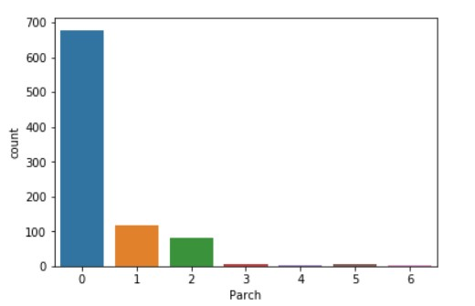
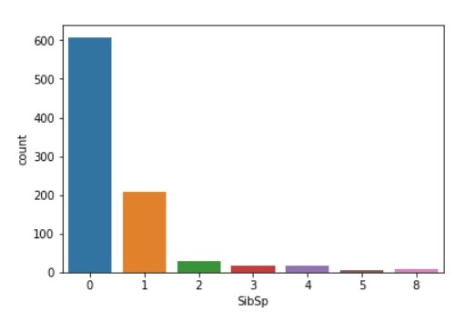
Most of the people on the titanic came without parents or children. This will increase their probability of surviving since they only have to look after themselves and make sure of their own safety
Similar pattern was observed when it came to siblings and spouses. Most preferred travelling solo thus increasing their chances of survival.

Slide 11
Bivariate Analysis

Slide 12
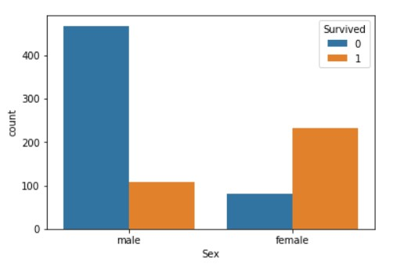
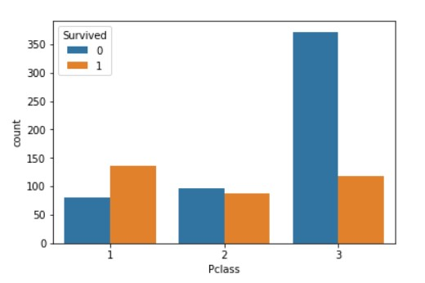
It is evident that more females have survived than males from the graph. This is due to the possibility that we tend to let ladies and children to safety first and then assist ourselves.
This graph shows more First class people survived probably since they asked for special treatment during the survival routine and has special access and privileges for such situations.

Slide 13
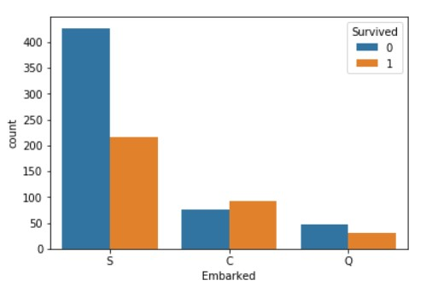
People climbed the titanic from three locations- Cherbourg, Queenstown and Southampton. Southampton saw the highest number of people survived while queens was the lowest. But this is since Southampton also had considerably large number of people climbing aboard. As previously stated, This won’t have much effect on survival since it is independent of the ability of a person to survive.
There were three types of ticket classes- first, second and third. Third, being the cheapest was highest while second, which was relatively cheaper was lowest.

Slide 14
Most of the people on the titanic came without parents or children. This will increase their probability of surviving since they only have to look after themselves and make sure of their own safety
Similar pattern was observed when it came to siblings and spouses. Most preferred travelling solo thus increasing their chances of survival.

Slide 15
Correlation between variables

Slide 16
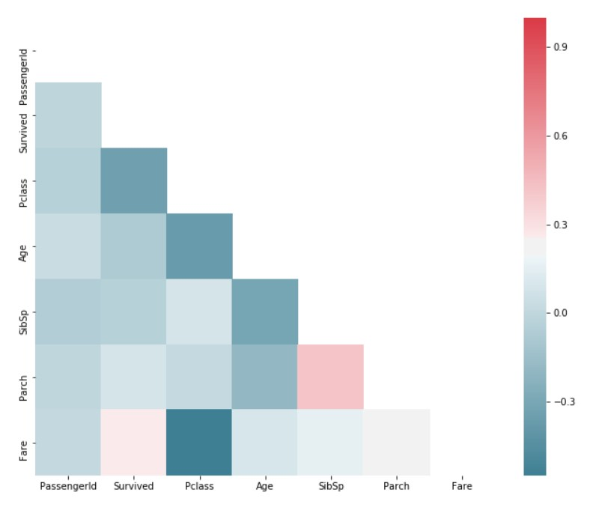
This Heat Map shows us various correlations between variables. As we can see the Pclass and Fare are highly dependent on each other.

Slide 17
Outlier Treatment

Slide 18
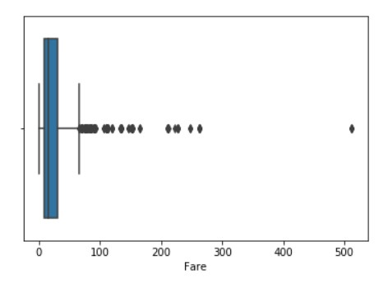
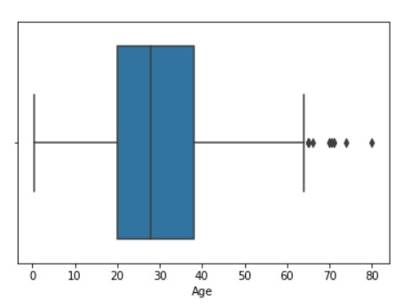
Here we can observe that the fare and age have some outliers. We can include both since there are a lot of people in third class. Hence, the fares are mostly distributed on the lower side and there are only a few people with higher class fares compared to other fares. Also, there are a lot of young people onboard with very few people above the age of 60.

Slide 19
Missing Value Treatment

Slide 20
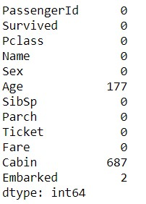
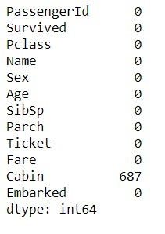
There were three variables with null values. We replaced the null values in Age column with the mean of that column. Similarly we replaced the null values in Embarked with the mode of the column. Note: Cabin has a lot of null values which makes it become difficult to impute the null values. Also it doesn’t affect the survival in any way. So we can ignore that column.

Slide 21
Applying Prediction Algorithms

Slide 22
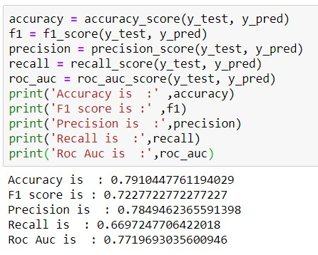

Logistic Regression
We got the accuracy of approximately 79% which is quite good.

Slide 23
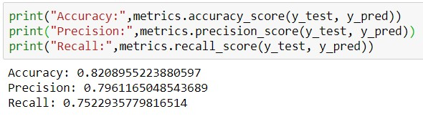

Random Forest
We got the accuracy of approximately 82% which is excellent.

Slide 24
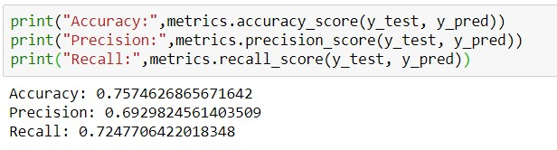

Decision Tree
We got the accuracy of approximately 75% which is good.

Slide 25
Conclusion

Slide 26
We applied three algorithms and got the following results:
Logistic Regression : 79% Accuracy
Random Forest : 82% Accuracy
Decision Tree: 75% Accuracy
While all three algorithms gave us excellent results, Random Forest stands out with highest accuracy of 82%. Thus it is the most suitable algorithm for prediction of our model.

Slide 27
Thank You

