Slide 1

TrustVote
Blockchain Based E-Voting System
Vishal Adhav
Gaurav Jethwani
Rishabh Kanojiya
Atharva Patil

Slide 2
Why E-Voting necessary ?
Low Voter Turnout
Slow and inefficient process
Inefficient elections - The Florida Effect
Direct democracy

Slide 3
Who’s in the game?
Direct-Recording Electronic (DRE) System
Optical Scan Voting System
Electronics Ballot Delivery
Internet Voting

Slide 4
Existing System Limitations
Security Vulnerability - Cyber attacks, Malware
Lack of Verifiability - Voters cannot verify their vote was recorded
System Failures - Hardware malfunctions leads to lost vote or incorrect vote tallies
Accessibility Issues - Overseas, disabilities
Privacy Concerns - Ensuring voter anonymity

Slide 5
Unique about TrustVote
Enhanced Security - Blockchain based system
Faster Results - Live tracking and verification
Environmental Friendly - Reduce voting ballot and paper based system
Innovation & Modernization - Trend Analysis
Reduced Cost
Increased accessibility

Slide 6
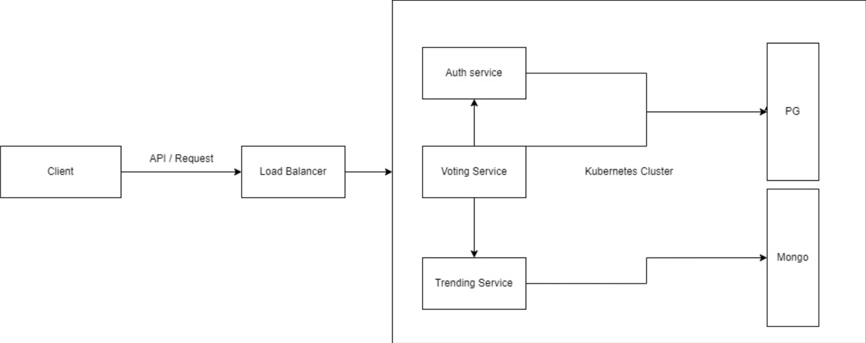
System Design

Slide 7
Impact
Time Efficient and Location Independence
Increased Voter Participation - Strong democracy
Empowerment and Equality
Long term social change
Trust in Electoral System

Slide 8
Tech Stack
Frontend - React Framework
Backend - Flask Framework, Node.js, Python
Cloud - Kubernetes, Docker
Database - Postgres, MongoDB
Blockchain

Slide 9
Execution Demo

