Slide 1

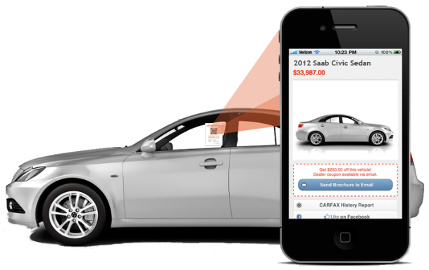
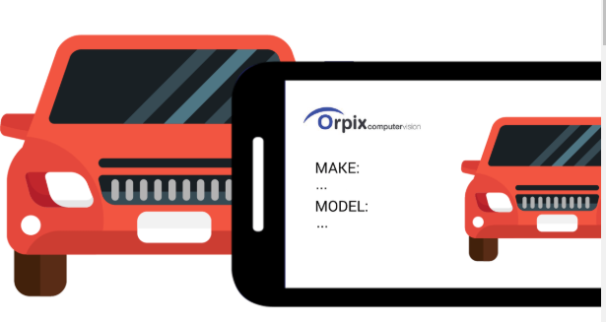
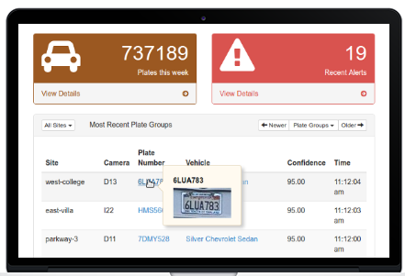

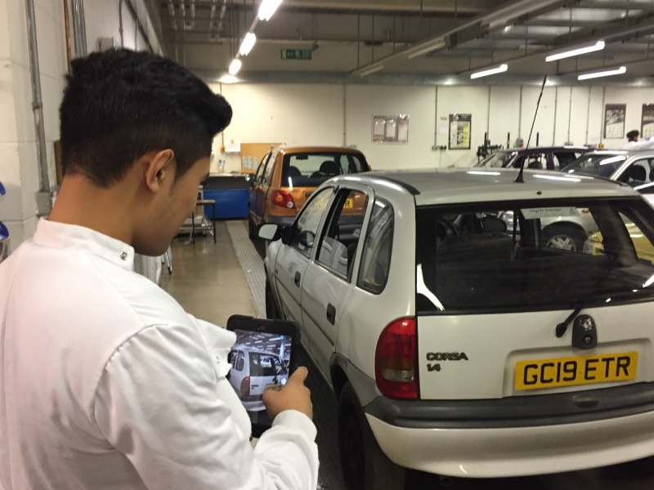
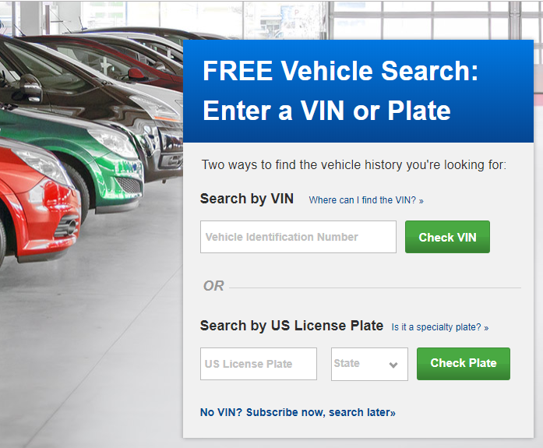
Leveraging AI to reimagine the Quote & Buy Process
Instant Auto Insurance Renewal Premium based on Car number plate and First year premium based on image of car
One tap retrieval of vehicle history for premium calculation using AutoCheck, DMV service
Instant premium calculation in Guidewire PolicyCenter. Quote time reduces from few minutes to seconds
9

Slide 2


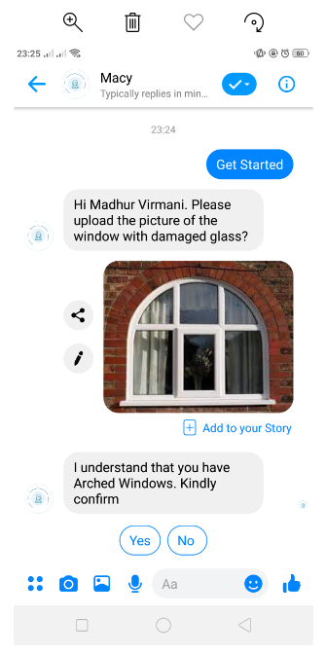


Developed using Guidewire Digital Portal
Using Virtual Assistant to deliver an efficient & frictionless customer experience in a claims process
Instant settlement of Home Insurance Glass Claim based on picture of damaged window and glass
Claim settlement timeframe reduced from an average of 10 days to few minutes
Instant verification of policy and claims intake in Guidewire Insurance Suite
Hello!!
I’m Macy and I can help you with your Home Insurance Glass Claim settlement
I have a damaged window glass for which I want to make a Claim

