Slide 1
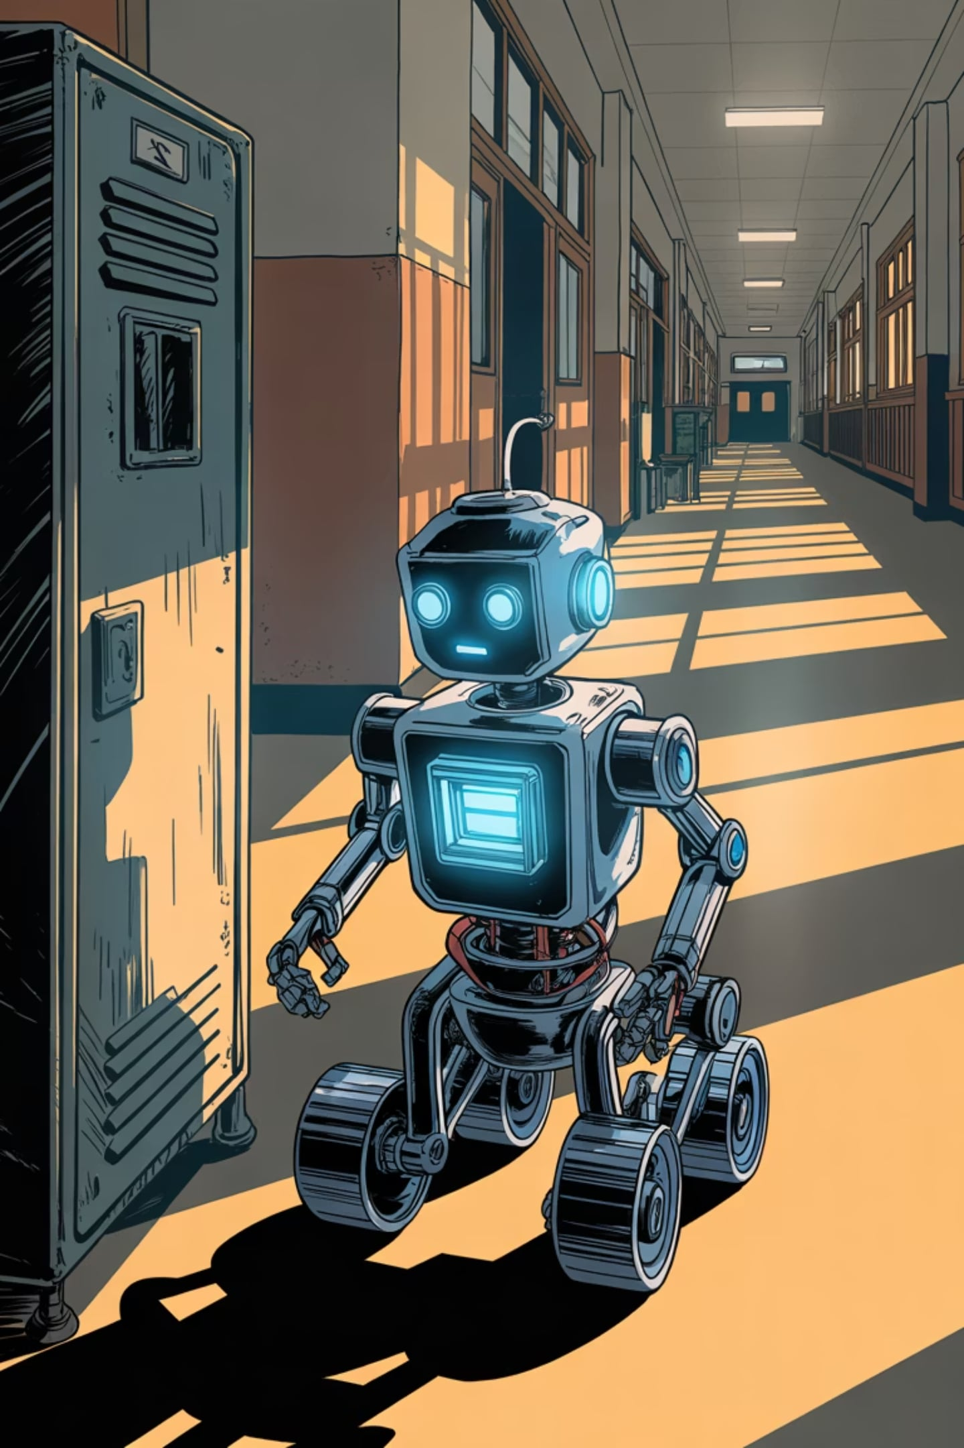
Autonomous Environmental Survey Rover (AESR)
SCIENCE FAIR PROJECT · CLASS 8C
Designed and fabricated by Atharva Phadnis, Vimala Kulkarni Memorial School. This project combines robotics, electronics, and data science to build a small moving robot that autonomously monitors temperature and humidity, avoids obstacles, logs data to a memory card, and compares weather patterns across days using a custom-built app.

Slide 2
How the Robot Works
The AESR runs two jobs simultaneously — moving safely and monitoring the environment — without ever getting stuck.
Job 1 — Moving Safely
Job 2 — Checking the Weather
IR sensors act as "electronic eyes," detecting objects in the robot's path. When an obstacle is found, the Arduino signals the wheels to reverse and turn away — all in real time.
The DHT22 sensor measures temperature and humidity. The Arduino processes the data and does three things:
Displays readings on the OLED screen
Saves data with a timestamp to the SD card
Transmits data via serial for wireless use

Slide 3






All the Parts Used
Six key components work together to make the AESR functional and reliable.
Arduino Uno R3 — The Brain
DHT22 — Weather Sensor
Runs all logic, stores the program, and processes sensor data in real time.
Measures temperature (±0.5°C precision) and humidity. Uses a 4.7kΩ resistor for clean signals.
IR Obstacle Sensor — Electronic Eyes
OLED Display — The Screen
Emits infrared light to detect objects from 5–30 cm. Adjustable detection range via a small screw.
128×64 pixel display using I²C (two wires). Shows live temperature, humidity, and obstacle status.
Micro SD Card Module — Memory
L298N Motor Driver — The Muscle
Saves timestamped readings via SPI connection. Built-in voltage regulator protects the card.
Amplifies low-power Arduino signals to drive both motors forward, backward, or stop.

Slide 4

How Everything is Connected
Each component connects to specific Arduino pins. This wiring ensures all parts communicate without conflicts.
Component
Pin
Arduino Pin
Function
DHT22 Sensor
VCC / GND / DATA
5V / GND / D4
Power and weather data
IR Sensor
VCC / GND / OUT
5V / GND / D7
Obstacle detection signal
OLED Display
VCC / GND / SDA / SCL
5V / GND / A4 / A5
I²C display communication
SD Card Module
CS / MOSI / MISO / SCK
D10 / D11 / D12 / D13
SPI data storage
Motor Driver
IN1–IN4
D5, D6, D8, D9
Left and right motor control
Pin 10 is reserved for the SD card. Motor control pins avoid this to prevent conflicts.

Slide 5
Step-by-Step: How the Program Works
When powered on, the Arduino follows a precise routine — checking for obstacles while logging weather data every 2.5 seconds.
01
02
03
Startup (Setup)
Check for Obstacles
Wait for the Right Time
Initialises the SD card, OLED screen, and DHT22 sensor.
Constantly monitors the IR sensor. If an obstacle is detected, stops, reverses, and turns away.
Waits 2.5 seconds without pausing obstacle detection — the robot stays responsive.
04
05
06
Read the Weather
Show on Screen
Save on Memory Card
Requests data from the DHT22. Receives 40 bits and verifies the checksum for accuracy.
Converts readings to text and displays them on the OLED screen.
Writes a line with timestamp, temperature, and humidity to the SD card — data is safe even if power is lost.
07
Repeat
The loop continues until power is switched off.

Slide 6





The Special App for Comparing Temperatures
After the robot runs, Atharva plugs the SD card into a computer. A custom-built app reads the data and draws a comparison chart.
Read the File
Separate the Days
Match the Times
Opens the saved CSV data file from the SD card.
Groups readings into "Today" and "Yesterday" based on timestamps.
Aligns readings by time — e.g., 8:00 AM today vs. 8:00 AM yesterday.
Draw the Chart
Show the Numbers
Plots two lines — one for each day — showing temperature changes hour by hour.
Calculates and displays average, highest, and lowest temperatures for both days.

Slide 7
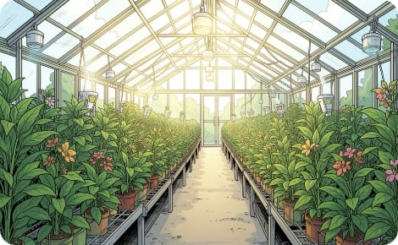
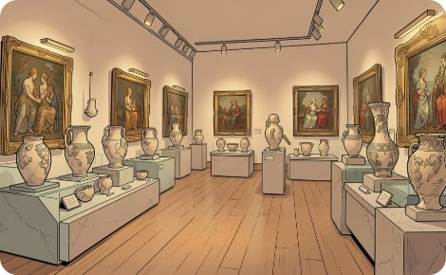
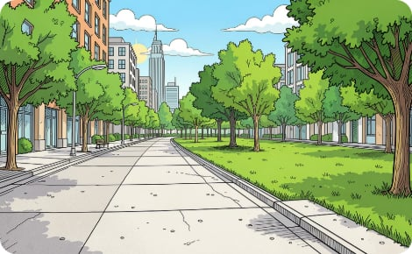
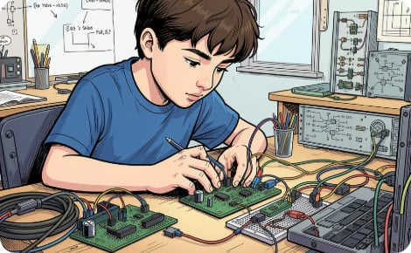
Real-Life Applications
The AESR is more than a school project — it solves real problems in farming, conservation, and urban science.
🌿 Greenhouse Farming
🏛 Museum Conservation
🌡 Urban Heat Studies
🔬 STEM Learning
Drives between plant rows to check humidity levels. Farmers use the comparison chart to decide when to water.
Measures temperatures on roads versus grassy areas, proving that concrete surfaces get much hotter.
Teaches mechanical assembly, circuit wiring, programming, and data analysis — all in one project.
Patrols galleries to detect areas that are too hot or dry, protecting sensitive paintings and artifacts.

Slide 8
Conclusion
The AESR is not just a toy — it is a serious, autonomous data-collecting machine that demonstrates real engineering thinking.
What Makes This Project Stand Out
A True Hands-On STEM Achievement
Simultaneous obstacle avoidance and environmental sensing
Reliable data logging to SD card with timestamps
Custom-built app for day-to-day temperature comparison
Practical applications in farming, museums, and urban science
Integrates electronics, programming, and data analysis
Atharva designed, built, programmed, and tested every part of this system independently. The AESR reflects a deep understanding of how hardware and software work together to solve real-world problems — a wonderful example of what a Class 8 student can achieve with curiosity and dedication.
ATHARVA PHADNIS · CLASS 8C
VIMALA KULKARNI MEMORIAL SCHOOL

