Slide 1
OPINION SPAM: DETECTION OF FAKE OnLINE REVIEWs
Group Members: Atharva Shrikant (10400114042)
Deboleena Chanda (10400114057)
Mentor: Prof. Sukanya Mukherjee

Slide 2
OBJECTIVE
The major aim of the project is to detect the fake reviews on E-Commerce sites using concepts of opinion mining and machine learning.
Our objective is to build classifiers using semi supervised learning methods and devise a self training mechanism for identifying fake reviews and evaluate the performance of classifier.
The main goal of our project is to test the hypothesis that when the number of labeled data is less, semi-supervised learning methods could improve upon the performance of supervised learning methods in the presence of unlabeled data.

Slide 3
MOTIVATION
Online reviews provide valuable information about products and services to consumers.
These reviews play a major role in decision making of consumer whether to buy the product or not.
Opinion Spammers can post unwarranted positive or unjustified negative reviews to promote or harm the reputation of a product and brand.
Spamming fake reviews has become a business and a big threat.
Since anyone can post reviews, It is not very easy to detect the spam reviews.
In this paper we will study and compare the performance of semi-supervised classifier against supervised learning classifiers.

Slide 4
BACKGROUND
The opinion spam problem was ﬁrst formulated by in 2008 by Jindal in context of product reviews on Amazon.com
Extensive studies have been done by Mukherjee and Liu to use supervised learning methods in detecting spam reviews.
Research has also been done (Jafar et al., 2015) in the application of semi supervised learning to a pool of unlabeled data and augmenting performance of supervised learning algorithm. They have studied the semi-supervised self-training algorithm with decision trees as base learners.

Slide 5
INTRODUCTION
Semi-supervised learning is a class of supervised learning tasks and techniques that also make use of unlabeled data along with labeled data for training.
For implementing our opinion spam detection model we use the various classifiers to identify the fake restaurant reviews posted by yelp.com. The classifiers being:
Naïve Bayes
Decision Trees
We applied the self training algorithm to predict the results. We then compared the accuracy of each of the semi-supervised self training model with its respective base learner accuracy.
In this project, we are assuming the yelp classification as pseudo ground truth.

Slide 6
COLLECTION OF DATA
Web Crawling is a technique employed to extract large amounts of data from websites whereby the data is extracted and saved to a local file in your computer or to a database in table (spreadsheet) format.
We collected both recommended and non recommended reviews as classified by yelp.
The dataset consists of approximately 40k unique reviews, 30k users and 140 restaurants. The following attributes were extracted:
Restaurant Name
Average Rating
User Name
Review Text
Rating
Date of Review
Classification by Yelp (Recommended / Not Recommended)

Slide 7
PREPROCESSING OF DATA
The preprocessing of data is done in R programming language which involved
Cleaning of data
removing duplicates
Processing of text reviews
removing punctuation, special characters, numbers and common word endings
removing stop words
covert text to lower case.
Making the word cloud of reviews
Calculating the behavioral dimension
Maximum number of reviews
Review length
Rating deviation
Maximum content similarity

Slide 8
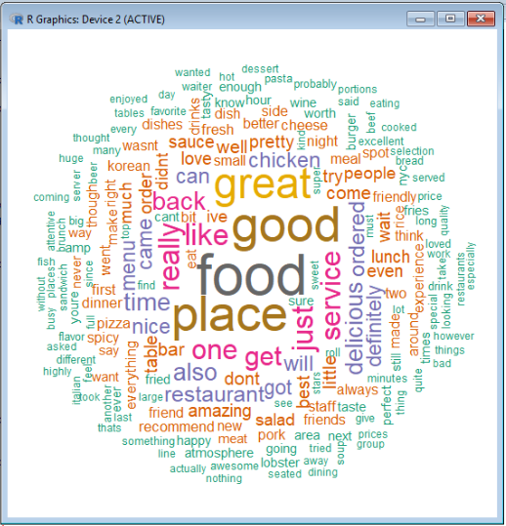
WORD CLOUD

Slide 9
SAMPLING
Using random sampling, we split our data set into training and testing sets in the ratio of 70:30 respectively.
Then we divided the training set such that approximately 60 % of the records were unlabeled and the remaining were labeled.
Following this, we used subsets of increasing sizes from the labeled data to train the base learner (Naive Bayes and Decision Tree).
To generate the subsets of labeled data, we used both simple random sampling and stratified sampling approaches.

Slide 10
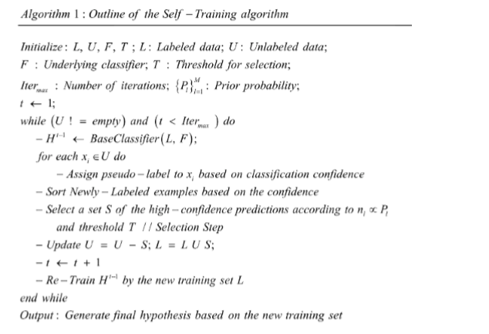
SELF - TRAINING ALGORITHM

Slide 11
PROPOSED FRAMEWORK
We split the available data set into training and testing sets in the ratio of 70:30.
On the training set, we created labeled data of varying sizes (from 50 to 2000). For the remaining data, we removed the labels and considered it to be the unlabeled data set.
We then trained the base learners individually on these sets of labeled data and tested it on the test set noting the accuracy.
Using these base learners, we built the semi-supervised self-training model individually on the sets of labeled data and again tested it on the test set noting the accuracy.
Finally, we compared the accuracy for the base learners alone and its corresponding semi supervised self-training model and plotted graphs.

Slide 12
NAÏVE BAYES RESULT
As the size of the labeled data set increases, accuracy of both the models converged to a stable value . Thus, Naive Bayes performed well for both the supervised and semi-supervised training model.
When number of labeled data was low, Naive Bayes with simple random sampling performed better with the semi-supervised model than the supervised approach. For stratified sampling, both the models gave similar accuracy. This is in agreement to our initial hypothesis.
As we increased the number of labeled data, accuracy for the semi-supervised approach was not always better than the supervised approach. This is a deviation from our initial hypothesis. This might be because Naive Bayes has the strong assumption that the features are conditionally independent.

Slide 13
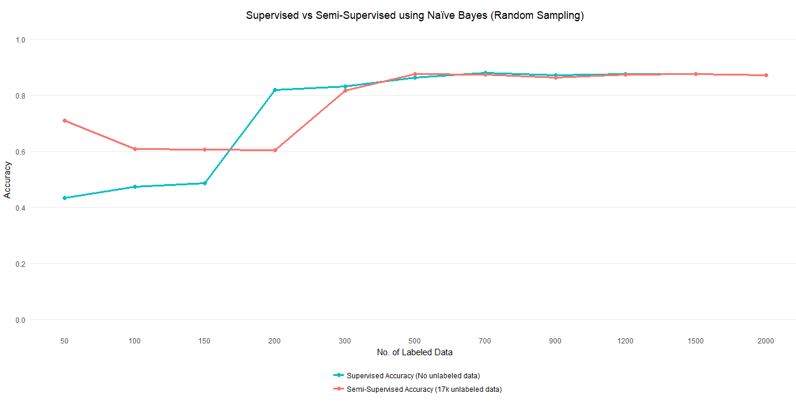
Simple Random Sampling

Slide 14
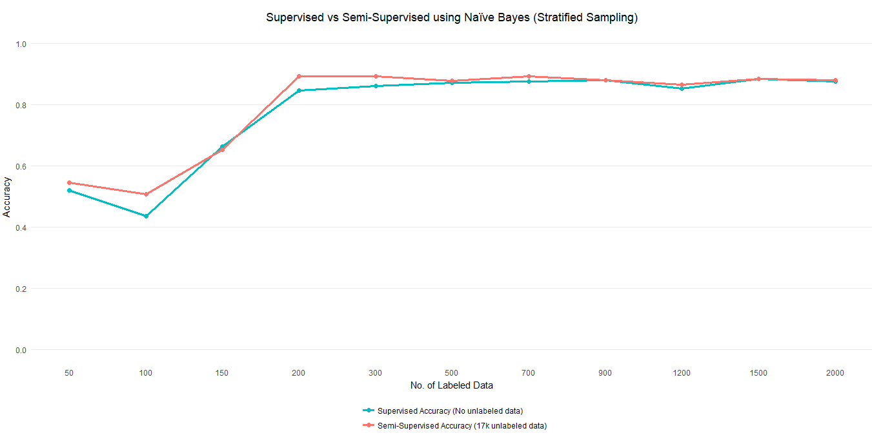
Stratified Sampling

Slide 15
DECISION TREE RESULT
As the size of the labeled data set increases, accuracy of both the models converged to a stable value (Approximately 89%). Thus, Decision Tree performed well for both the supervised and semi-supervised training model.
For both simple random and stratified sampling, Decision Tree performed better with the semi-supervised model than the supervised approach. This is in agreement to our initial hypothesis.

Slide 16
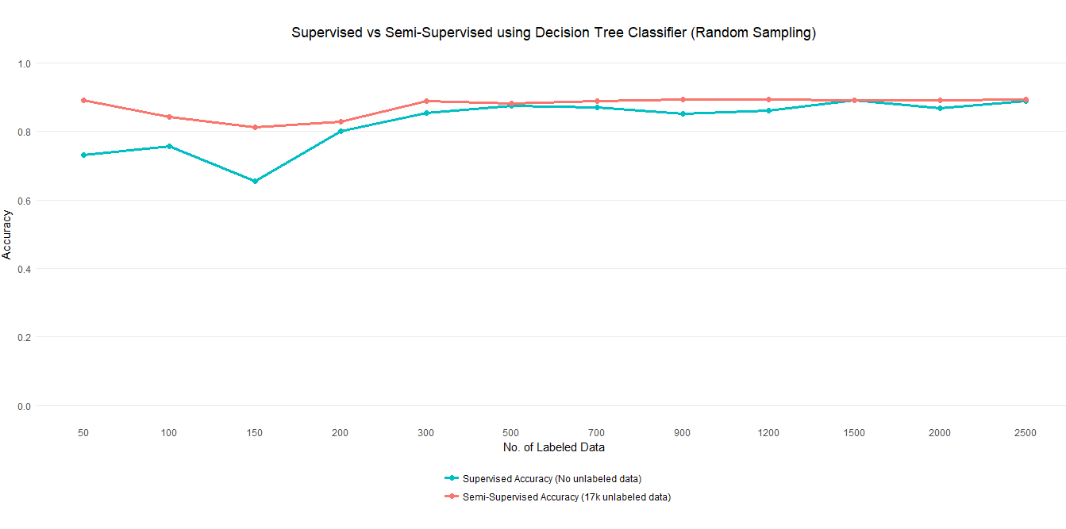
Simple Random Sampling

Slide 17
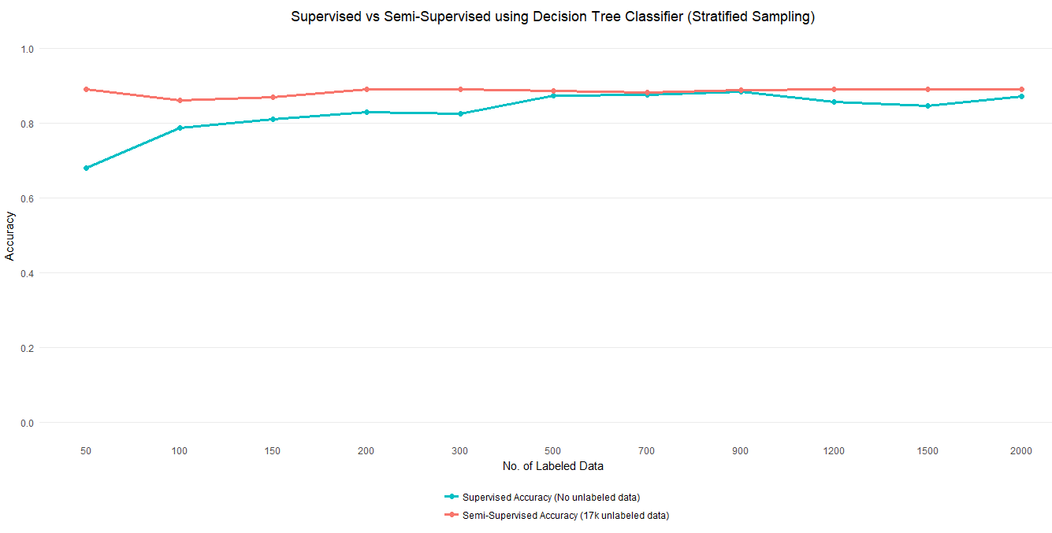
Stratified Sampling

Slide 18
CONCLUSION
Through this project, we learnt that self-training works well when the base learner is able to predict the class probabilities of unlabeled data with high confidence.
Based on the experiments that we performed, we found that in general semi-supervised learning using self-training does improve the performance of supervised learning methods in the presence of unlabeled data.
From the approaches that we tried, we found that semi-supervised self-training using Decision Tree as classifier leads to better selection metric for the self-training algorithm than the Naive Bayes base learners. Thus, Decision tree works as a better classification model for our project.

Slide 19
FUTURE WORK
Since the Decision Tree worked well, we had the idea of implementing Naïve Bayes Tree which is a hybrid of Decision Tree and Naïve Bayes on our data set. Tanha et al., (2015) have conducted a series of experiments which show that Naïve Bayes trees produce better probability estimation in tree classifiers and hence would work well with the self-training algorithm.

Slide 20
THANK YOU

