Slide 1


AtliQ
Hardware
AtliQ Business Insights Report
Presented by Atharva Sutar

Slide 2


Report Objective
This report aims to analyze and extract valuable insights from a MySQL database containing information about sales, products, customers and regions for AtliQ Hardware.
Who Am I?
I am Peter Pandey, Junior Data Analyst and my goal is to create a stakeholder-friendly dashboard that is easy to use and presents important insights, trends, and patterns to facilitate quick and clear decision-making.
AtliQ
Hardware

Slide 3

Company’s Background
AtliQ Hardware
Computer Hardware Manufacturer
India
Asia - Pacific Region
Latin America
Europe
North America

Slide 4






AtliQ Harware Business Model
Customer
Consumer
Retailers
Direct
e Store
Exclusive
Distributor
AtliQ
Hardware

Slide 5



Tools
MySQL
Microsoft Excel
Importing the Data
Data Validation
Microsoft Power BI
Building Dashboard

Slide 6
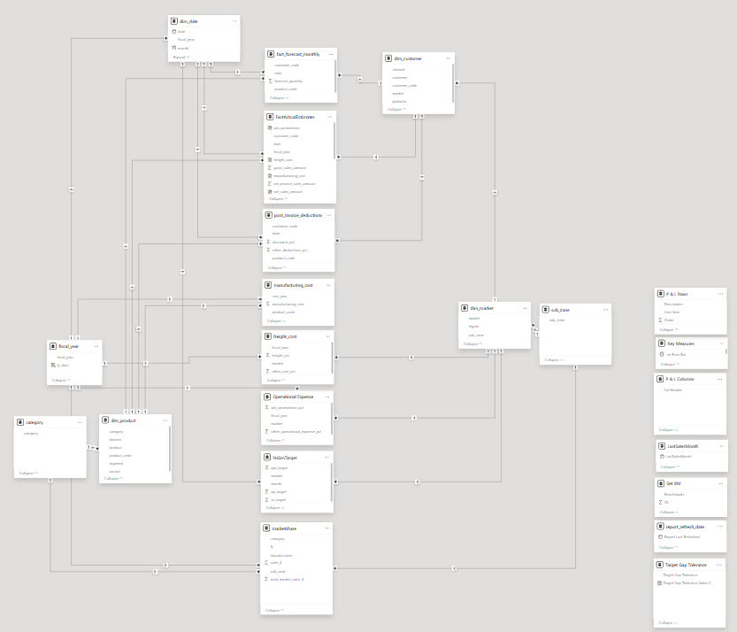
Database Modelling
AtliQ
Hardware

Slide 7
Some Major Insights
Net Sales in 2022 Fiscal Year is $ 3.74 Billion which is the most in all the years of AtliQ.
Dec 2021 recorded the highest Net Sales of the month in the history of AtliQ Hardware.
The Asia Pacific region contributed the most in the FY 2022.
Notebook were the most sold segment for FY 2022.
Net Sales is almost 50% of the revenue and Gross Margin is almost 36% of the Net Sales in FY 2022.
Marketing department need to focus on Networking, Storage segments and Latin America region.
Marketing Department need to lower the operational expense to increase the profit of the company.
Most of the customers are Out of Stock, Company needs to focus on manufacturing more products needed more by the particular customers.
Finally, the stakeholders need to focus on increasing the market share and then increase their profits.

Slide 8




AtliQ
Hardware
Thank you
Atharva Sutar
atharvasutar
atharvaz.at.work@gmail.com
atharvasutar28

