Slide 1
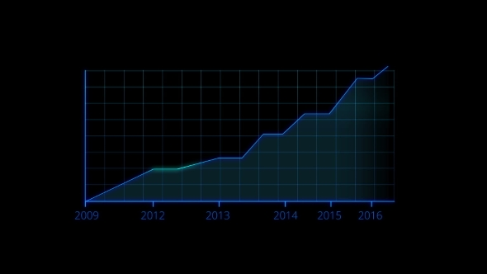
DA Project
Group 11
Covid 19 Analysis through visualizations and Hypothesis Testing

Slide 2
Group Members
SR. NO. | NAME | ROLL NUMBER
1. | Khushi Yagnik | 190030022
2. | Atharva Swami | 190010008
3. | Saloni Singh | 190010041
4. | Rishika Patel | 190030037
5. | Adarsh Mall | 190010003
6. | Dalpat Choudhary | 190030010

Slide 3
Objective
The objective of this project was to visualize the effect of COVID-19 worldwide through various plots and to make hypothesis and prove them using various statistical tests.

Slide 4
Procedure used for the project:
Collection of data from various sources
Plotting of appropriate graphs to visualize the effects of covid-19
Interpreting the graphs by making hypothesis
Testing the hypothesis using various statistical methods
Concluding the results from the project

Slide 5

COVID 19 in World
Some plots to show the various trends of the Covid 19 Virus in the world.All graphs were made either using python or excel.
A

Slide 6
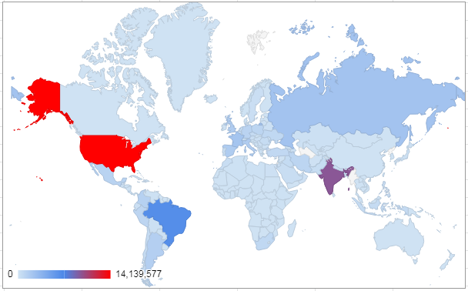
World heat map
From the heat map we can conclude that in the World, US had the highest number of covid 19 cases. Then comes India and Brazil.

Slide 7
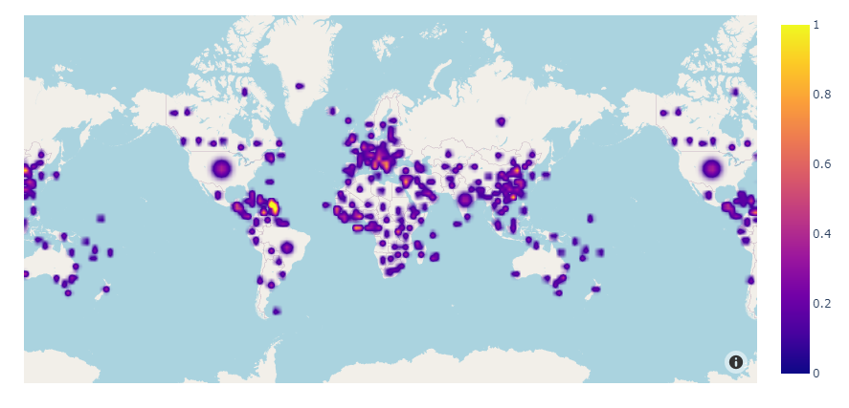
World heat map

Slide 8
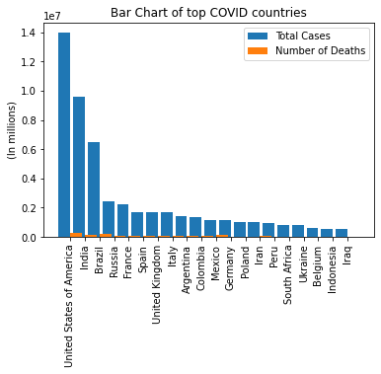
Bar Graph - top 20(cases)
Conclusion :
USA has the highest no. of cases.
Death rate is very low for all the countries.
Excluding the top 3 countries, all the countries have less than 0.5 million cases.

Slide 9
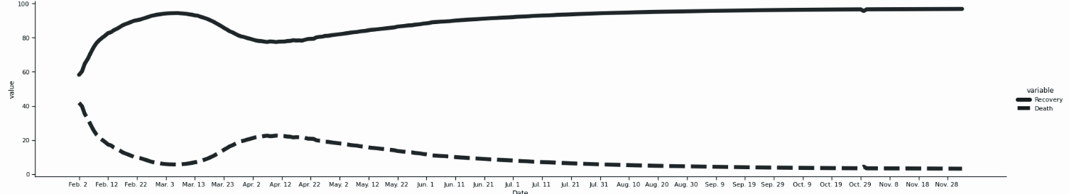
Recovery Rate vs Death Rate : Line graph
From the graph we can see that over time death rate has decreased and recovery rate has increased

Slide 10
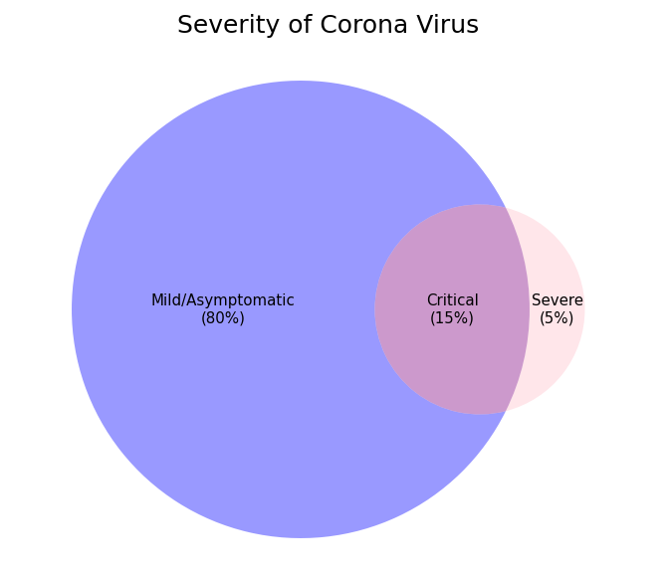
Severity of covid 19 : Venn Diagram
According to a generic figure given by WHO, around 80 % of cases were mild/asymptomatic, 15% were critical and needed to be hospitalized and 5% cases were severe where people needed ventilators.

Slide 11
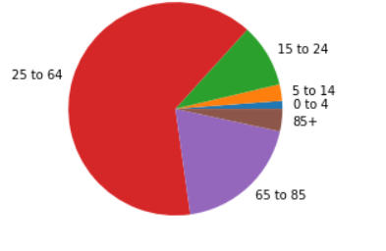
Pie chart age vs covid
CONCLUSIONS: 1. The deadly virus infects people between 25 to 64 the most worldwide.
2. Children between 0 to 4 are least affected however preventive measures should always be taken.

Slide 12
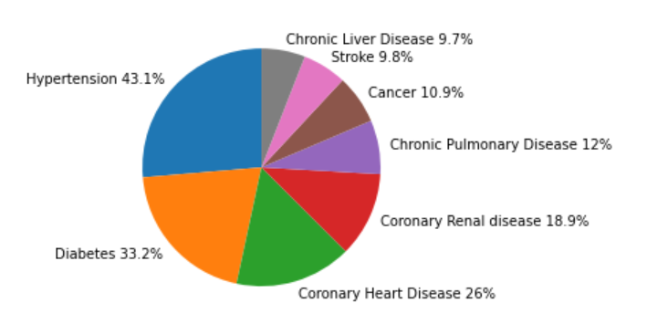
pie chart-disease wise
Conclusion:
Majority of deaths are caused in those with hypertension.
Least number of deaths are in those with chronic liver disease.

Slide 13
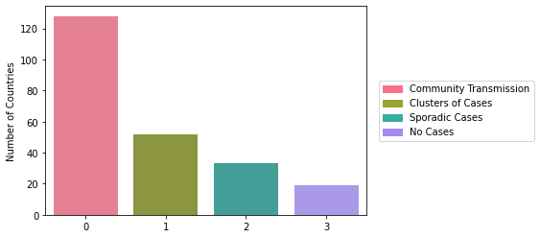
Bar plot for Method of transmission
Conclusion : The most common method of transmission is community transmission, and the least common is sporadic cases.

Slide 14
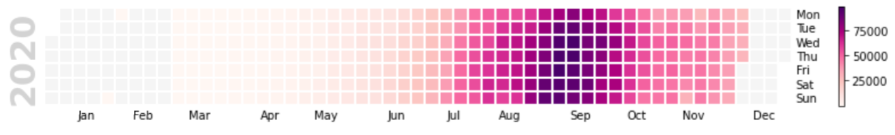
Daily cases India : Calendar plot
We can see from this calendar plot the rise of covid 19 in the year 2020. The intensity of colour is directly proportional to the number of cases. The maximum number of cases were reported in Aug-Sep.

Slide 15
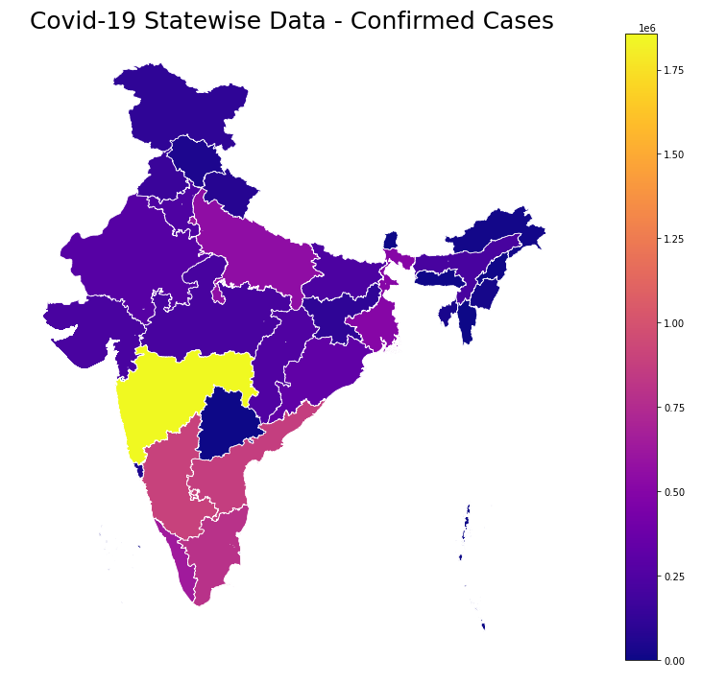
Cases in India State wise : Heat map
From the heat map we can conclude that in India, Maharashtra had the highest number of covid 19 cases.

Slide 16
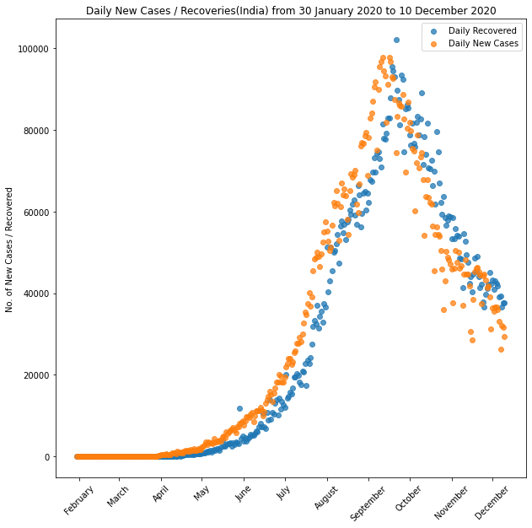
Scatter Plot for Daily Cases and Recoveries(India)
Conclusion :
Before October, most of the days, no. of new cases were greater than no. of daily recovered.
Since October, most of the days, no. of daily recovered became greater than no. of new cases.

Slide 17
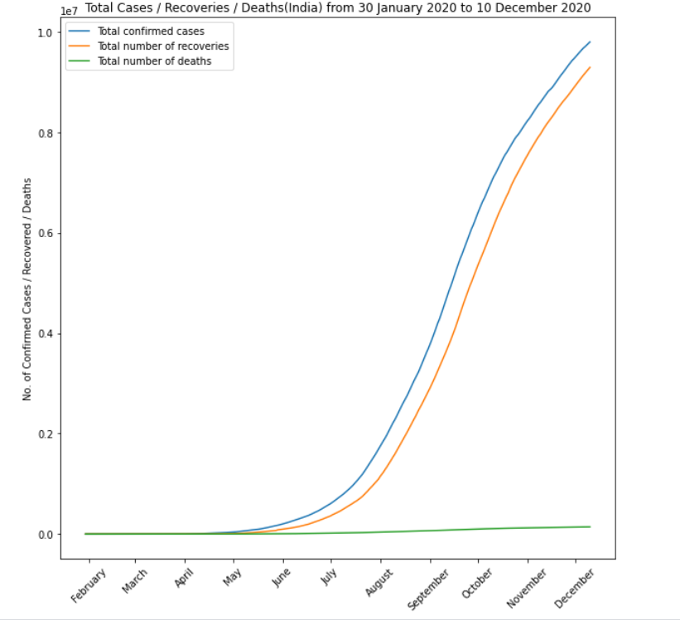
Line Graph for total cases vs recovery vs deaths in india
Conclusion:
The total number of deaths are very small
The recovery number follows the same pattern as total number with a small offset.
The total number of cases follow normal distribution.

Slide 18
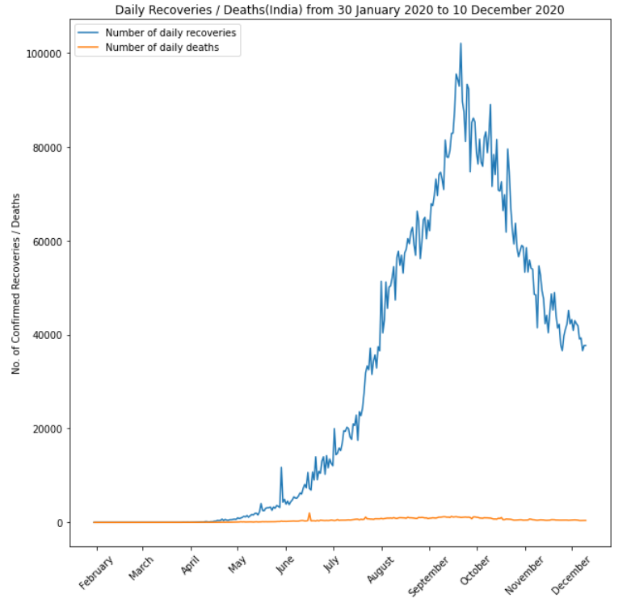
Line-graph of daily recoveries vs deaths
Conclusion:
The daily deaths are a small number as compared to number of recoveries.
The recovery pattern follows normal distribution.

Slide 19
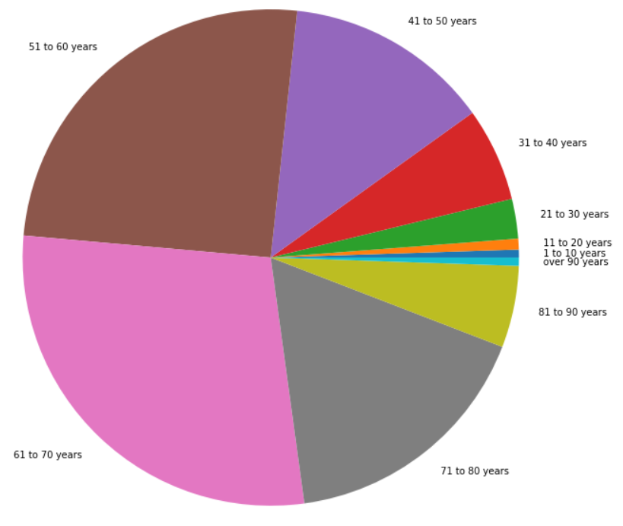
PIE CHART INDIA(AGE WISE)
CONCLUSIONS: 1. Corona virus affects the people of age 61-70 the most. Elder people should take utmost care by staying at homes.
2. The virus least affects small children from 1-10 years however preventive measures should always be taken.

Slide 20
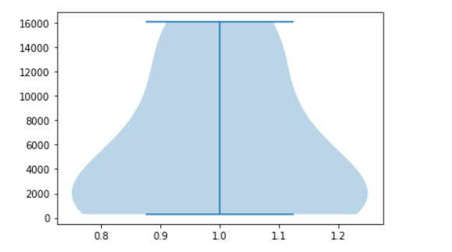
VIOLIN PLOT FOR INDIA(AGE WISE)
Conclusion:
The median number of cases is 2000

Slide 21
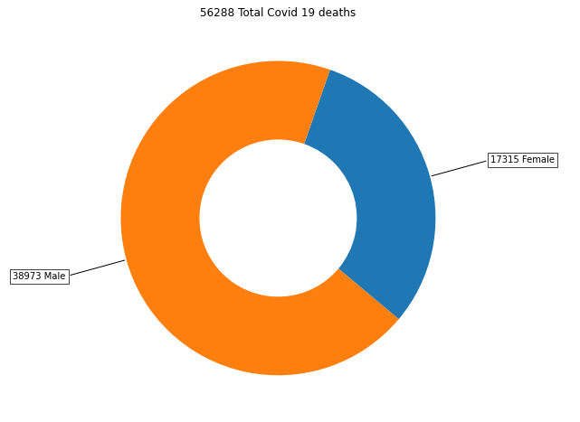
Gender vs death rate : Donut chart
In a sample of 56288 people who died due to covid 19, it was found that 38973 were male and 17315 were female.
The donut plot clearly shows the difference in death rate of males and females. Death rate of men is almost 2.5% more than women

Slide 22
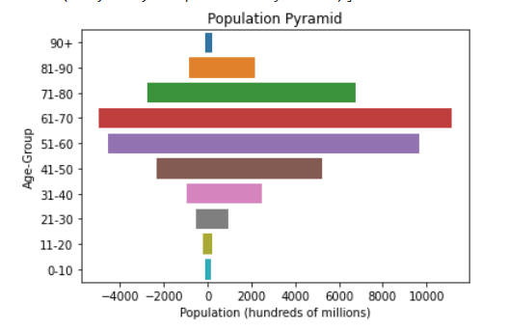
Population pyramid gender vs age
Conclusion:
The male deaths are more than female deaths.
Most deaths are in the age group 61 - 70.

Slide 23
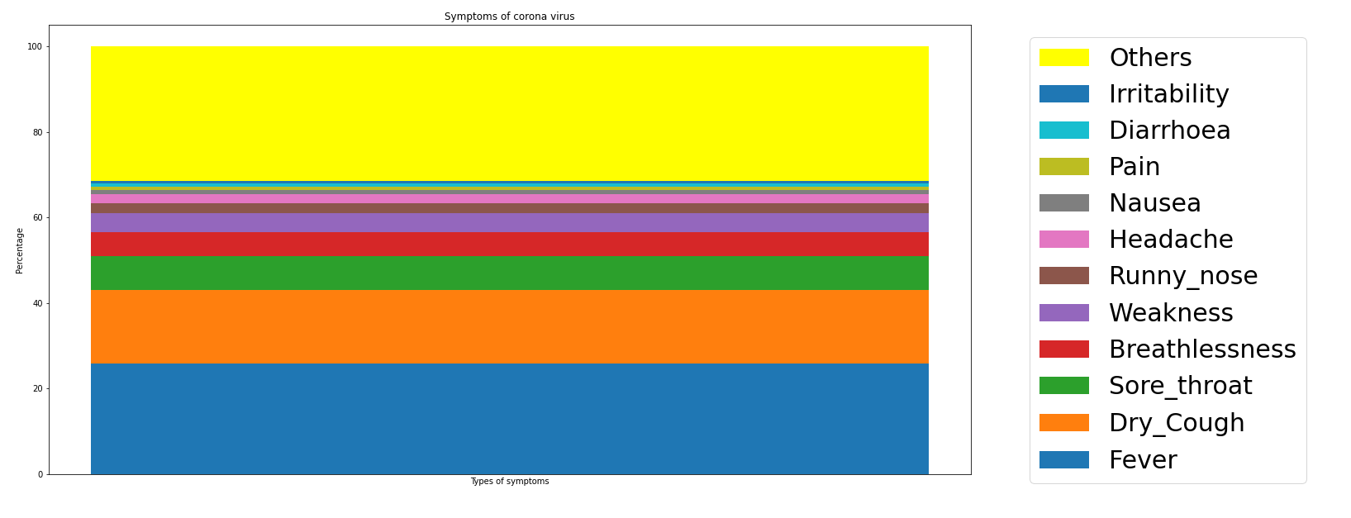
Symptoms of Covid 19-India : Stacked bar graph
The stacked bar graph shows the percentage of each symptom faced by people.

Slide 24
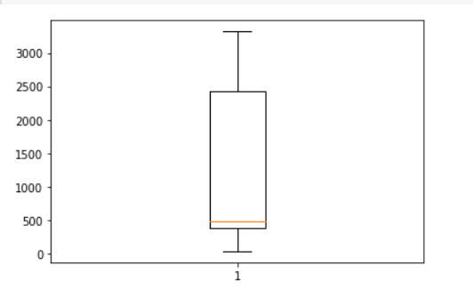
AGE VS CORONA DEATHS(MUMBAI)
CONCLUSIONS:
The median is 490.
The first quartile is 300
The third quartile is 2500
Minimum value is 35
Maximum value is 3321
There are no outliers

Slide 25
Hypothesis Testing
Hypothesis testing is an act in statistics whereby an analyst tests an assumption regarding a population parameter. The methodology employed by the analyst depends on the nature of the data used and the reason for the analysis.
In hypothesis testing, an analyst tests a statistical sample, with the goal of providing evidence on the plausibility of the null hypothesis.
Statistical analysts test a hypothesis by measuring and examining a random sample of the population being analyzed. All analysts use a random population sample to test two different hypotheses: the null hypothesis and the alternative hypothesis.
The null hypothesis is usually a hypothesis of equality between population parameters; e.g., a null hypothesis may state that the population mean return is equal to zero. The alternative hypothesis is effectively the opposite of a null hypothesis; e.g., the population mean return is not equal to zero. Thus, they are mutually exclusive, and only one can be true. However, one of the two hypotheses will always be true.

Slide 26
Growth of COVID-19 in INDIA
Here, the growth profile of COVID 19 has been analyzed in two segments i.e. one is for India and another is for the World consisting of all affected countries. For each of the segments, the analysis has been done in terms of two factors viz. i) total COVID 19 positive cases and ii) total COVID 19 death cases. The data was collected from the situation reports published by World Health Organization (WHO) in its website (www.who.int) from 30.01.2020 i.e. the day on which the first confirmed case of a COVID 19 positive was reported in India to 04.04.2020.
Firstly, it was statistically analyzed whether COVID 19 positive and death cases are significantly growing in India. Paired t tests (for two sample means) were done to assess whether the COVID 19 positive and death cases are significantly growing. The null hypothesis (H0) and alternate hypothesis (H1) were designed as follows:
H0: The COVID cases are not significantly growing week by week in India
H1: The COVID cases are significantly growing week by week in India
Let's analyze this data in a week wise manner for cases in India and the World. Do the tests with 5% level of significance. The P values obtained in the tests for paired two weeks mean COVID positive and death cases in India are given in the next slide.

Slide 27
P values of t tests- Paired two weeks mean COVID cases in India.
 | P value for COVID positive cases | P value for COVID death cases
1st week vs. 2nd week | 2.898 x 10-6 | 9.981 x 10-2
2nd week vs. 3rd week | 1.184x 10-5 | 7.215 x 10-6
3rd week vs. 4th week | 1.389 x 10-4 | 1.321 x 10-3
4th week vs. 5th week | 1.554 x 10-4 | 2.681 x 10-5

Slide 28
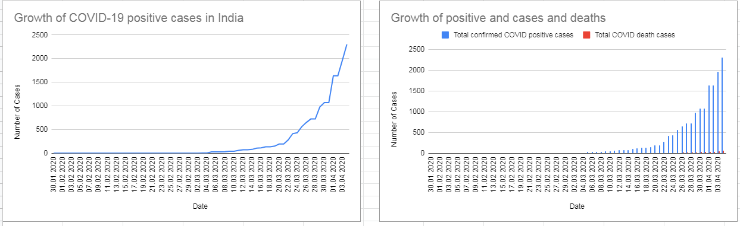

Slide 29


Growth of COVID-19 in WORLD
Similarly, it was statistically analyzed whether COVID positive and death cases are significantly increasing in the world for a test period of 01.03.2020 to 04.04.2020. The null hypothesis (H0) and alternate hypothesis (H1) were as under:
H0: The COVID cases are not significantly growing week by week in the World.
H1: The COVID cases are significantly growing week by week in the World.
The P values obtained in the tests for paired two weeks mean COVID positive and death cases in the World are presented in the next slide.
The t values and the Degree of Freedoms(DF) of the 2 samples were calculated using the formulas given below:

Slide 30
P values of t tests- Paired two weeks mean COVID cases in World.
 | P value for COVID positive cases | P value for COVID death cases
1st week vs. 2nd week | 4.988 x 10-5 | 2.758 x 10-4
2nd week vs. 3rd week | 1.046 x 10-4 | 9.220 x 10-5
3rd week vs. 4th week | 3.325 x 10-5 | 4.272 x 10-5
4th week vs. 5th week | 4.025 x 10-7 | 7.493 x 10-6

Slide 31
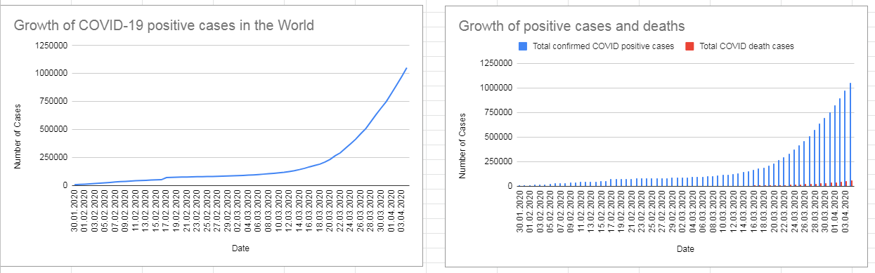

Slide 32
Results:
In case of India, since all the P values are much lesser than the level of significance (i.e. 0.05) for positive cases, it can be concluded that the COVID 19 positive cases are significantly growing week by week during test period (i.e. H1 accepted). In the same line, it can concluded from the P values of death cases in India that COVID death cases are significantly growing week by week (i.e. H1 accepted) except for 1st to 2nd week wherein H0 is accepted.
Similarly in case of the World, since all the P values are much lesser than the level of significance (i.e. 0.05) for positive as well as death cases, it can be concluded that the COVID 19 positive and death cases are significantly growing week by week during test period (i.e. H1 accepted).

Slide 33
Covid 19 Death Rate vs Gender
Is death rate of covid 19 independent of gender?
A survey was conducted and it was found that out 56288 total covid 19 deaths 38973 were male and 17315 were female. We want to prove at a 95% confidence interval that death rate of covid 19 is not independent of gender. In order to do this we have performed a chi square test for independence.
H₀ : Men and women are equally likely to die from covid-19.
H₁ : Death rate is not independent of gender.

Slide 34
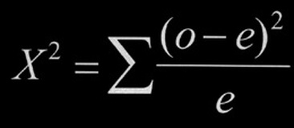
The data is represented in the table
CALCULATIONS
χ² = 8,333.38
Degree of Freedom = n-1 = 1
Critical value = 3.841
Since χ² > Critical Value
We can reject H₀ .
Therefore, death rate is not independent of gender.
Gender | Male | Female
Observed Deaths | 38973 | 17315
Expected Deaths | 28144 | 28144

Slide 35
Covid-19 deaths in australia vs germany:
Total deaths in australia=27676(ny)
Total deaths in germany=19314(nx)
Total deaths in australia of age above 60 years=6011(Y)
Total deaths in germany of age above 60 years= 18486(X)
Ho: proportion of people over 60 years who died due to covid in germany is equal to or greater than in australia
H1: proportion of people over 60 years who died due to covid in germany is less than in australia
We will use p test to check the hypothesis.

Slide 36
Covid Vs Diabetes
It is a widely stated hypothesis that the death due to Covid-19 is closely related to a person having diabetes.
In order to analyse this hypothesis we use a sample of 856 people who died due to covid. This group consisted of 64 people who had diabetes and 792 didn’t have diabetes. We make the following hypothesis.
H₀: A person with Diabetes is more likely to die than to survive
H₁: A person with Diabetes is equally likely to die and survive

Slide 37
Continued…..
Px cap=X/nx= 0.957129543
Py cap=Y/ny=0.217191791
P cap=(X+Y)/(nx+ny)=0.521324
Z score=157.9812522
P value=0.99997
Alpha =0.05
Since p value>>alpha, We fail to reject Ho.
CONCLUSION: proportion of people over 60 years who died due to covid in germany is equal to or greater than in australia

Slide 38
BIBLIOGRAPHY:
https://www.hindustantimes.com/india-news/90-of-those-killed-by-covid-in-india-are-older-than-40-69-are-men/story-glg0Ct4rHQ1YVvZgnckUcM.html
https://www.who.int/docs/default-source/coronaviruse/situation-reports/20200805-covid-19-sitrep-198.pdf?sfvrsn=f99d1754_2
https://timesofindia.indiatimes.com/city/mumbai/94-covid-deaths-in-mumbai-among-middle-aged-patients-senior-citizens/articleshow/77453775.cms
https://theprint.in/health/80-covid-patients-in-india-are-asymptomatic-health-ministry-analysis-finds/487761/
https://www.downtoearth.org.in/news/health/covid-19-are-80-cases-in-india-really-asymptomatic-70590
https://www.worldometers.info/coronavirus/
https://www.mohfw.gov.in/
https://coronavirus.jhu.edu/
https://www.tandfonline.com/doi/full/10.1080/00325481.2020.1786964
https://www.cdc.gov/nchs/nvss/vsrr/covid_weekly/index.htm#Comorbidities
https://covid19.who.int/table
https://api.covid19india.org/documentation/csv/
http://www.who.int
https://data.humdata.org/dataset/novel-coronavirus-2019-ncov-cases

Slide 39
CONTRIBUTIONS:
1.Khushi Yagnik
Line graph : Recovery rate vs Death rate
Venn Diagram : Severity of Covid cases
Heat map: Covid cases in India state wise
Donut chart : Gender wise cases of a population
Calendar plot : Daily cases in India
Stacked Bar graph : Symptoms of covid 19 in India
Hypothesis : Death rate of covid 19 is not independent of gender.
2.Atharva Swami
World Heat Map: Latest count of COVID cases and most affected countries
Growth Hypothesis of COVID cases and deaths in India
Line and Bar graphs of COVID cases and deaths in India
Growth Hypothesis of COVID cases and deaths in the World
Line and Bar graphs of COVID cases and deaths in the World

Slide 40
3. Saloni Singh
Pie chart for pre-existing condition vs covid
Line-graph for total cases vs recovery vs deaths in india
Line-graph of daily recoveries vs deaths
Daily cases India :Calendar plot
Population pyramid gender vs age
box-plot for age and number of deaths
4. Rishika Patel:
Pie chart of age vs corona deaths (INDIA)
Pie chart of age vs corona deaths (WORLDWIDE)
Violin plot for age vs corona deaths(INDIA)
Box plot for age vs corona deaths(MUMBAI)
Hypothesis for corona deaths in elder people(above 60 years) of germany vs australia

Slide 41
5. Adarsh Mall :
Bar Graph : Total cases of top 20 countries
Bar Graph : Methods of Transmission in various countries
Scatter Plot : Daily New Cases and Daily Recoveries
6. Dalpat Choudhary :
Data collection

