Slide 1
COMPUTER NETWORKS (CS212) LAB 1
Reference to assignment 1

Slide 2

Agenda
Network Utilities or Commands
Network Configuration Files
Examples on networking tools and files

Slide 3
System Requirements
We will be using linux platform during the entire lab sessions.
Preferably Ubuntu or Debian
If you are using windows,please ensure to have one of the following :
Partition the space and have linux operating system.
Install the virtual box and have ubuntu

Slide 4

Network Utilities Or Commands
1. Ifconfig
2. ping
3. traceroute
4. route
5. arp
6. ssh
7. ftp
8. smtp
Network utilities are basic software tools designed for analyzing and configuring various aspects of computer networks.
Network utilities help you keep your network functioning properly by allowing you to check the various aspects of your network, such as connections between devices, packet loss, and latency between connections. If a network issue arises, a network utility can help you pinpoint the problem

Slide 5

Network Configuration Files
1. /etc/hostname
2. /etc/hosts
3. /etc/network/interfaces
4. /etc/resolv.conf
5. /etc/protocols
6. /etc/services
There are many files under Linux where you can configure - define your Linux network.
The Linux network is configured by settings that are specified in configuration files that you can find in the /etc directory or in one of its subdirectories.

Slide 6
Examples On Network Utilities Or Commands

Slide 7
MAC (Media Access Control) address
A MAC (or Machine Access Control) address is best thought of as kind of serial number assigned to every network adapter. No two anywhere should have the same MAC address.
IP (Internet Protocol ) address
An IP address is assigned to every device on a network, so that device can be located on that network.

Slide 8
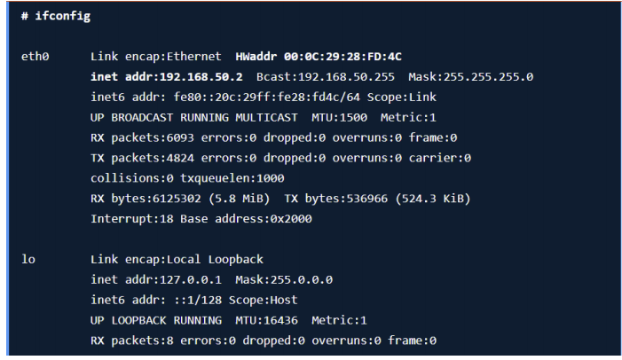
ifconfig
interface configurator (ifconfig) is use to initialize an interface, assign IP Address to interface and enable or disable interface on demand.
With this command you can view IP Address and Hardware / MAC address assign to interface

Slide 9
ip addr
ifconfig is deprecated in the latest versions of linux platforms.So ip addr command can be used as a replacement for the same.

Slide 10
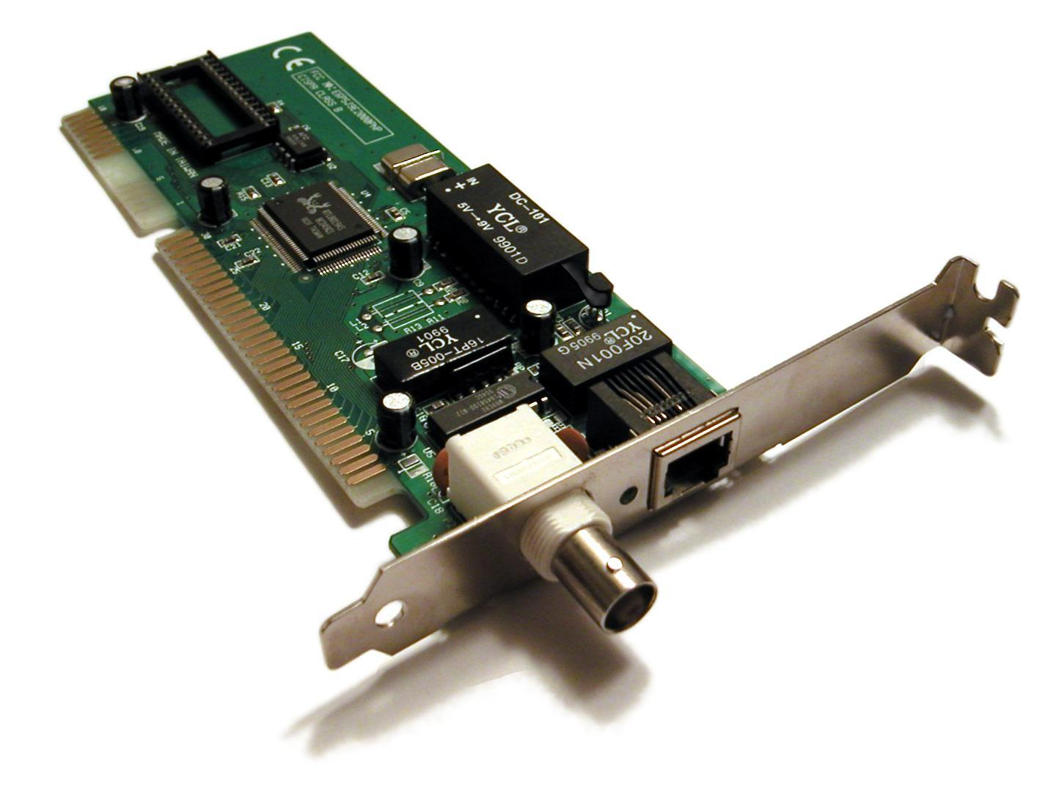
Network Interface:
• A network interface will usually have some form of network address (IP and MAC address, for instance)

Slide 11
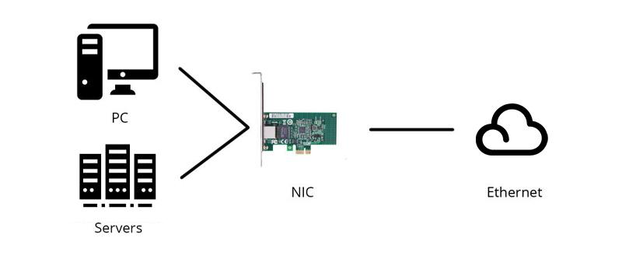
Network Interface ( Contd.)
One of the ways to access the internet is to connect a LAN cable(Ethernet Cable) to our computer. What happens when we connect this LAN cable to our computer? This LAN cable connects to a hardware device already present in our computer called Network Interface card. So, any computer in order to connect to the internet needs a Network Interface Card(NIC). These days almost all computers have built-in NIC.
Network Interface Card is a hardware device that is installed on the computer so that it can be connected to the internet. It is also called Ethernet Card or Network Adapter. Every NIC has a 48-bit unique serial number called a MAC address which is stored in ROM carried on the card. Every computer must have at least one NIC if it wants to connect to the internet.

Slide 12
Network Interface ( Contd.)
eth0, lo and wlan0 are the names of the active network interfaces on the system.
Additional Ethernet interfaces would be named eth1, eth2, etc..
lo is the loopback interface. This is a special network interface that the system uses to communicate with itself.
wlan0 is the name of the first wireless network interface on the system. Additional wireless interfaces would be named wlan1, wlan2, etc.

Slide 13
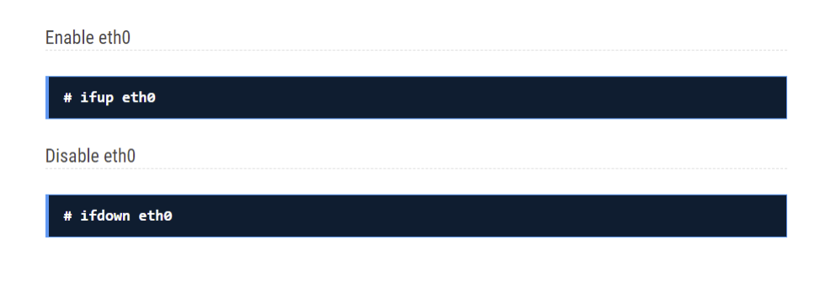
Enable/Disable interface

Slide 14
2. ping
A ping is a Command Prompt command that can be used to test a connection between one computer and another.
Ping measures the round-trip time for messages sent from the originating host to a destination computer that are echoed back to the source.
Round-trip time (RTT) is the duration in milliseconds (ms) it takes for a network request to go from a starting point to a destination and back again to the starting point.

Slide 15
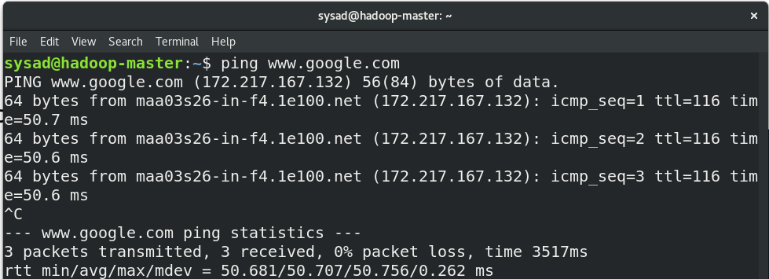
The terminal output includes a summary table that lists the corresponding response time, the packet size as well as the TTL per response packet. In addition, you receive statistical information on sent, received and lost packets, including packet loss in percentage terms as well as an analysis of the minimum, maximum and average response times.

Slide 16
3. route
shows and allows manipulation of IP routing table.
A routing table records the paths that packets should take to reach every destination that the router is responsible for. Think of train timetables, which train passengers consult to decide which train to catch. Routing tables are like that, but for network paths rather than trains.

Slide 17
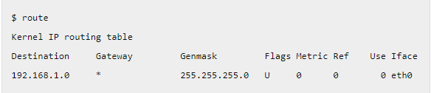
In this example, the ip-address of the system where the route command is being executed is 192.168.1.157
The above command shows that if the destination is within the network range 192.168.1.0 – 192.168.1.255, then the gateway is *, which is 0.0.0.0.
When packets are sent within this IP range, then the MAC address of the destination is found through ARP Protocol and the packet will be sent to the MAC address.In order to send packets to destination which is not within this ip range, the packets will be forwarded to a default gateway, which decides further routing for that packet.

Slide 18
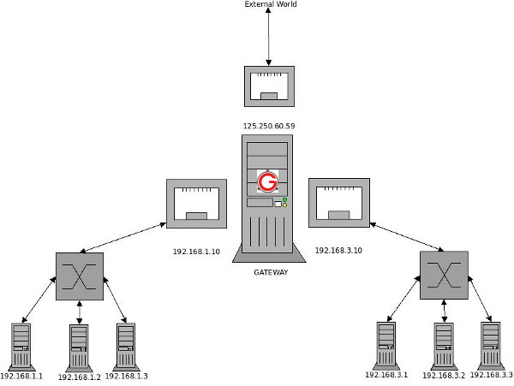

Slide 19
In the diagram, we have 2 individual networks ( 192.168.1.0 and 192.168.3.0, with subnet mask of 255.255.255.0 ).We also have a “GATEWAY” machine with 3 network cards. 1st card is connected to 192.168.1.0, 2nd card is connected to 192.168.3.0, and the 3rd card is connected to the external world
Make 192.168.3.* Accessible from 192.168.1.*
Now we need to add a routing entry such that we are able to ping 192.168.3. series ip-addresses from 192.168.1. series. The common point we have is the GATEWAY machine.So, on each machine in 192.168.1.* network a default gateway will be added as shown below.
$ route add default gw 192.168.1.10
Now when 192.168.1.1 pings 192.168.3.1, it will go to the GATEWAY via 192.168.1.10.
In GATEWAY, add the following routing entry.
$ route add -net 192.168.3.0 netmask 255.255.255.0 gw 192.168.3.10
Now all the packets addressed to 192.168.3.* network will be forwarded via the 192.168.3.10 interface, which then delivers the packets to the addressed machine.

Slide 20
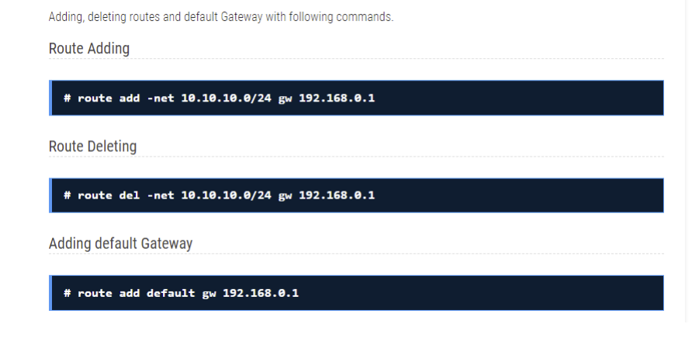

Slide 21
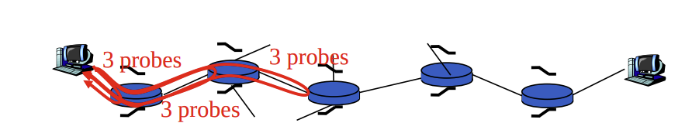
4. Traceroute
traceroute command in Linux prints the route that a packet takes to reach the host.
Traceroute is a useful tool for diagnosing network problems, most often speed issues. For example, if your website is slow to load pages then you might use Traceroute to discover the cause. Broadband customers might also use Traceroute if they are unable to connect to certain websites or their connection to the Internet is slow.

Slide 22
BASICS
Each IP packet that you send on the internet has got a field called as TTL. TTL stands for Time To Live.
TTL is not measured by the no of seconds but the no of hops. Its the maximum number of hops that a packet can travel through across the internet, before its discarded.
Hops are nothing but the computers, routers, or any devices that comes in between the source and the destination.

Slide 23
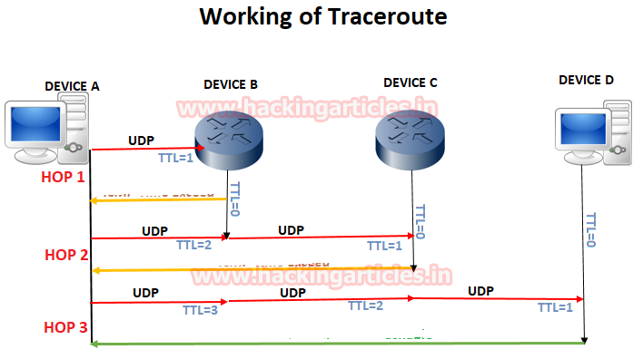

Slide 24
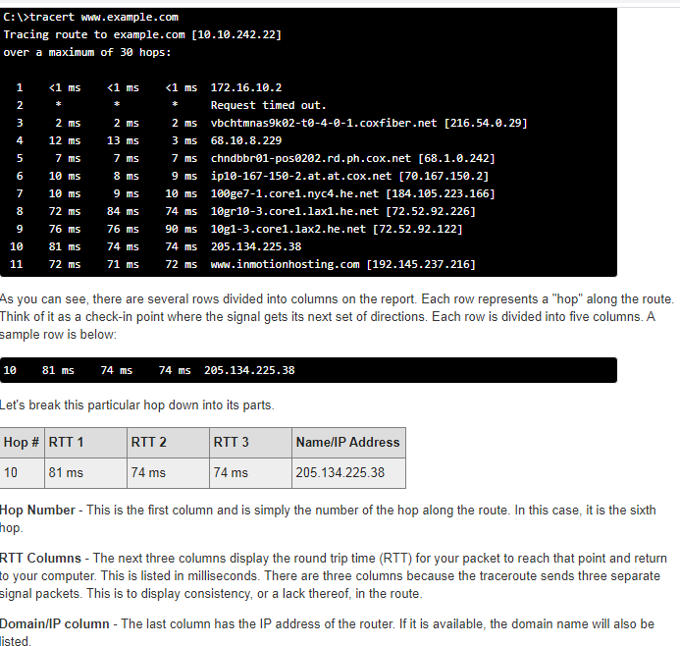

Slide 25
5. ARP
ARP Command is a TCP/IP utility and Microsoft Windows command for viewing and modifying the local Address Resolution Protocol (ARP) cache, which contains recently resolved MAC addresses of Internet Protocol (IP) hosts on the network.
You can use the arp command to view and modify the ARP table entries on the local computer.

Slide 26
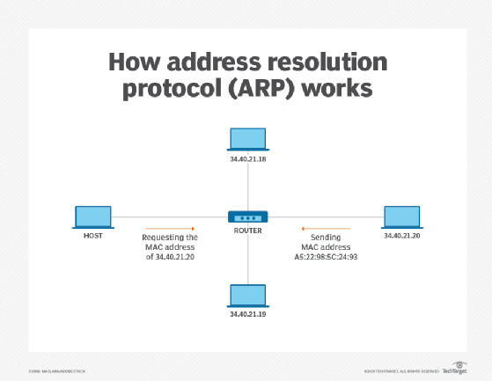

Slide 27
How ARP works?
Systems keep an ARP look-up table where they store information about what IP addresses are associated with what MAC addresses.
When trying to send a packet to an IP address, the system will first consult this table to see if it already knows the MAC address. If there is a value cached, ARP is not used.
If the IP address is not found in the ARP table, the system will then send a broadcast packet to the network using the ARP protocol to ask "who has 192.168.1.1".

Slide 28
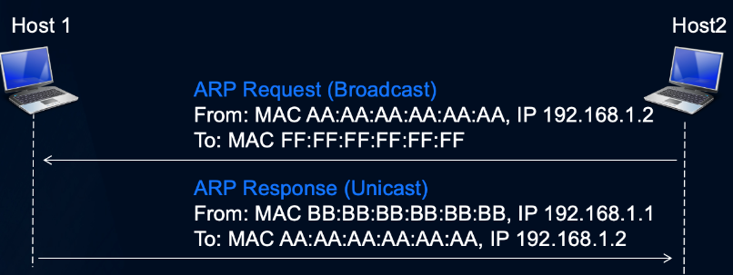
Process begins with caches being empty
Host 2 knows that it wants to send a packet to Host 1 (eg Default GW)
Host 2 has to send a broadcast ARP message (destination FF:FF:FF:FF:FF:FF) requesting an answer for 192.168.1.1.
Host 1 responds with its MAC address directly (unicast) to Host 2
Host 1 and 2 both insert this received information into their ARP caches for future use

Slide 29
6. SSH
SSH is typically used to log into a remote machine and execute commands.The ssh command provides a secure encrypted connection between two hosts over an insecure network. This connection can also be used for terminal access, file transfers, and for tunneling other applications

Slide 30
7. FTP
The FTP (File Transfer Protocol) utility program is commonly used for copying files to and from other computers. These computers may be at the same site or at different sites thousands of miles apart.

Slide 31
8. SMTP
Simple Mail Transfer Protocol (SMTP) is an Internet standard for sending emails.When you send an email, you are actually sending a bunch of commands to the SMTP server.

Slide 32
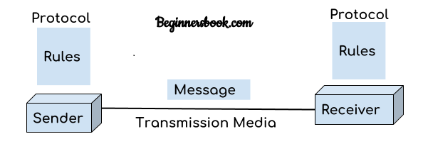
IMPORTANT TERMS
Protocols
In networking, a protocol is a set of rules for formatting and processing data. Network protocols are like a common language for computers. The computers within a network may use vastly different software and hardware; however, the use of protocols enables them to communicate with each other regardless.

Slide 33
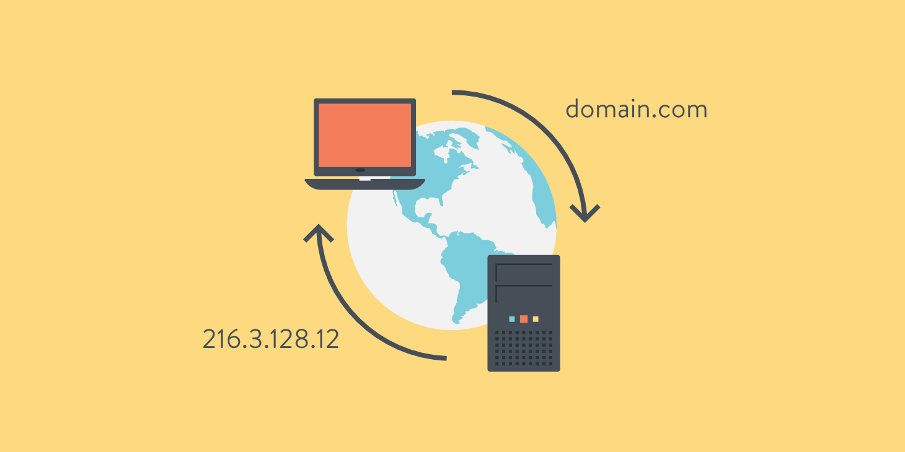
DNS
The Domain Name System (DNS) is the phonebook of the Internet.
When users type domain names such as ‘google.com’ or ‘nytimes.com’ into web browsers, DNS is responsible for finding the correct IP address for those sites., it takes a human-friendly request – a domain name like kinsta.com – and translates it into a computer-friendly server IP address – like 216.3.128.12.

Slide 34
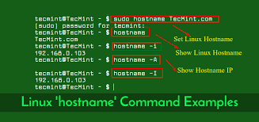
Hostname
A hostname is a unique name for a computer or network node in a network. Hostnames are specific names or character strings that refer to a host and make it usable for the network and people.

Slide 35
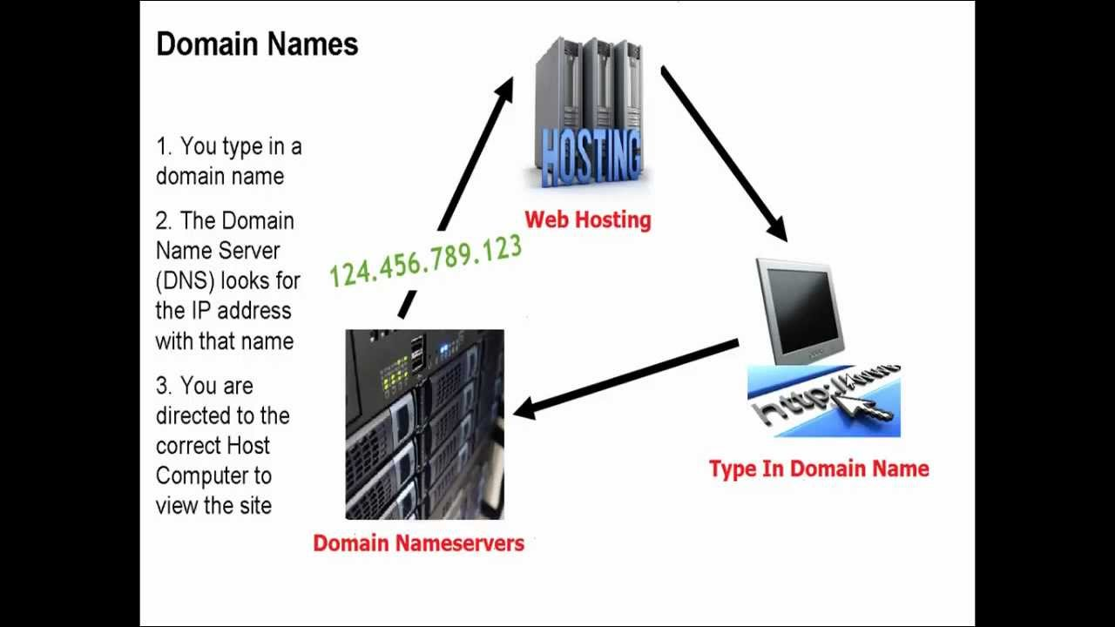
Nameserver
A name server is a specialized server on the Internet that handles queries or questions from your local computer, about the location of a domain name’s various services.

Slide 36
Examples On Network Configuration Files

Slide 37
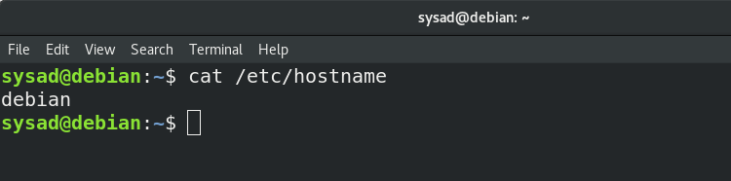
/etc/hostname
This file stores your system's host name, your system's fully qualified domain name

Slide 38
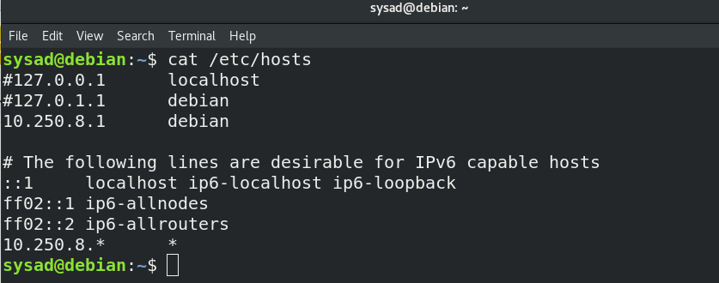
2. /etc/hosts
The /etc/hosts is an operating system file that translate hostnames or domain names to IP addresses

Slide 39
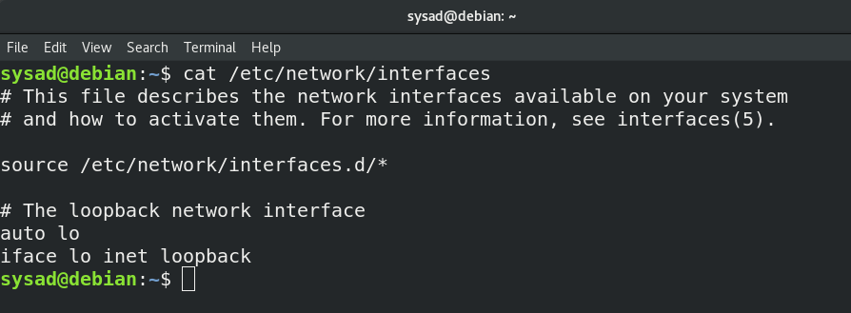
3. /etc/network/interfaces
/etc/network/interfaces file contains network interface configuration information for the both Ubuntu and Debian Linux. This is where you configure how your system is connected to the network.

Slide 40
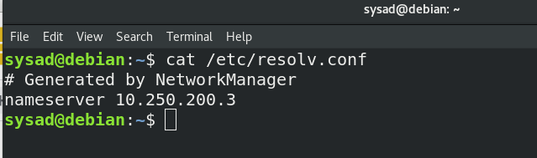
4. /etc/resolv.conf
Lists nameservers that are used by your host for DNS resolution. If you are using DHCP, this file is automatically populated with DNS record issued by DHCP server.

Slide 41
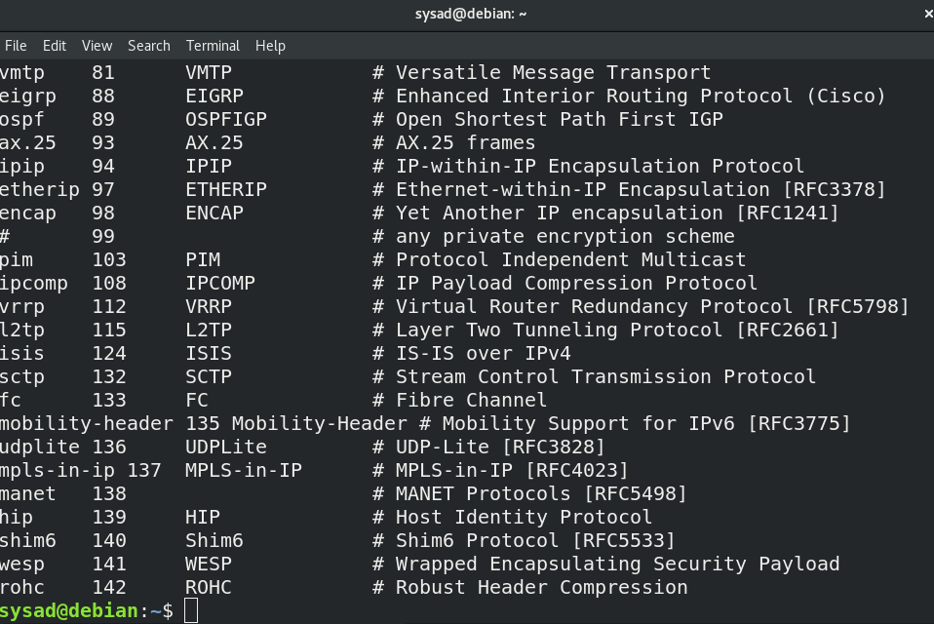
5. /etc/protocols
The /etc/protocols file contains information regarding the known protocol. For each protocol, a single line should be present with the following information:
official_protocol_name protocol_number aliases

Slide 42
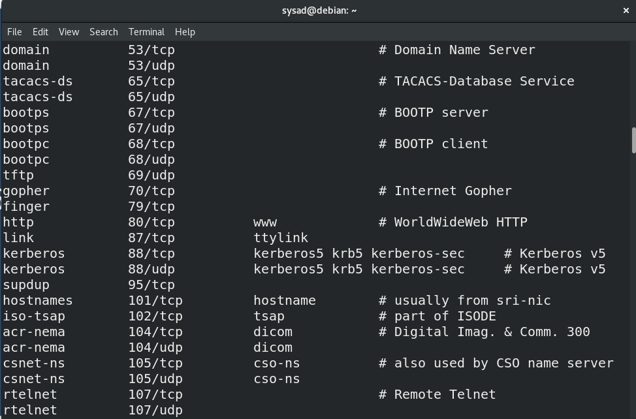
6. /etc/services
/etc/services file contains a list of network services and ports mapped to them

Slide 43
THANK YOU

