Slide 1


The 38th ACM/SIGAPP Symposium On Applied Computing
A Makespan and Energy-Aware Scheduling Algorithm for Workflows under Reliability Constraint on a Multiprocessor Platform
Atharva Tekawade
Undergraduate Research Fellow, Dept. of CSE
Indian Institute of Technology Jammu
Jammu and Kashmir, India
Suman Banerjee
Asst. Professor, Dept. of CSE
Indian Institute of Technology Jammu
Jammu and Kashmir, India
March 29, 2023

Slide 2
Outline
Introduction
Our Contributions
Systems Model
Problem Definition
Proposed Solution Approach
Results
Conclusion & Future work
References

Slide 3
Introduction
Many real-time embedded applications, in the domains of automotive [1], avionics [8], industrial automation [14], and communication networks [5] can be modeled as a directed acyclic graph and requires multiprocessor systems to execute.
As there are inherent dependency among the tasks, so failure of one task may leads to the failure of the entire workflow. Hence, reliability is a very important criteria that one scheduling algorithm needs to fulfill.
Another important criteria of a scheduling algorithm is to minimize the energy consumption. More importantly, this criteria become prevalent for battery operated devices where the availability of energy is limited such as mobile robots, drones etc.
Hence, developing energy efficient and reliable scheduling algorithms remains an important research directions.

Slide 4
Our Contributions
We study the problem of scheduling a workflow in a multi-processor system considering the energy consumption and makespan under a given reliability constraint.
We propose MERT, a scheduling algorithm that assigns each task to a processor taking energy consumption and makespan into consideration. If the constraint is higher, then we need to use more than one processor for a task to increase its reliability, and this is captured by the EAFTS algorithm.
Mathematically, we show that both MERT and EAFTS can achieve any reliability constraint in non-fault tolerant and fault-tolerant settings, respectively.
We perform an extensive set of experiments to evaluate the performance of the proposed scheduling algorithm and compare with many existing solutions on real world workflows.

Slide 5
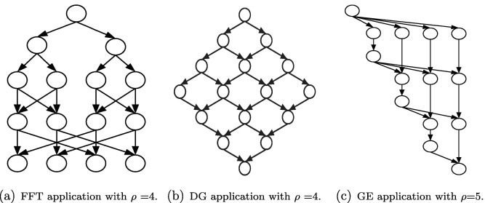
Scientific workflow
Many real-world workflows are modeled as a Directed acyclic graph (DAG) G(V, E).
V: Denotes the set of individual tasks of the workflow. V = {v₁, v₂,..., v_{n}}
E: Denotes the set of edges (v_{i}, v_{j}) indicating a data or control-flow dependency between the tasks i.e. v_{j} cannot start unless v_{i} finishes and transfers the output to it. The weight of edge w(v_{i}, v_{j}) denotes the communication overhead.

Slide 6
Multi-processor system
We consider a set of m heterogeneous processors, denoted by P = {u₁, u₂, . . . , u_{m}} and each connected with all the other processors resulting a complete graph.
Each processor runs for a given range of frequencies: [f_{uk,min}, f_{uk,max}].
For convenience, we normalize the maximum frequency to one i.e., f_{uk,max} = 1.

Slide 7
Notations and Timing Metrics
pred(v_{i}) (Predecessor set of v_{i}): Denotes the set of predecessor tasks of v_{i}.
succ(v_{i}) (Successor set of v_{i}): Denotes the set of successor tasks of v_{i}.
Tf [v_{i} , u_{k}] (Finish time of task v_{i}) = Ts[v_{i} , u_{k}] + T_{exec}[v_{i} , u_{k}]/f
Ts[v_{i} , u_{k}] (Start time of task v_{i}) = max{avail[u_{k}], max_{vj∈pred}(vi){Tf [v_{j} , u_{k’} ] + T_{comm}[v_{j} , v_{i} ]}}
makespan = T_{f} [v_{exit}, u_{k}] − T_{s}[v_{entry}, u_{k’} ] = T_{f} [v_{exit}, u_{k}]

Slide 8
Energy consumption
The power consumption of a processor consists of frequency dependent dynamic consumption, frequency independent dynamic consumption and static consumption components [6].
The frequency dependant dynamic component is the dominant one and can be written as: P = γ · c · v ² · f, Since f ∝ v, we see that P ∝ f ^{α}.
Energy consumed will be obtained by taking the product of power and execution time
E ^{f} _{vi,uk} = P ^{f} _{uk} · T_{exec}[v_{i} , u_{k}]/f

Slide 9
Reliability analysis
As in many other works [6], [12] we study dominant transient faults related to processor frequency which can be modeled by exponential distribution: λ_{uk} (f) = λ_{uk} · 10 ^{duk (1−f) / 1−fuk,min}.
The reliability is modeled using a Poisson distribution, with parameter λuk (f): R^{f} _{vi,uk} = e ^{−λuk (f)· Texec[vi ,uk]/f}
which can be easily observed to be an increasing function of f.
If a task vi is executed on multiple processors {uij : j ∈ [ik]} with frequencies {fij : j ∈ [ik]}, then the reliability in this case will be given by: 1 − 𝚷 (1 - R^{fij} _{vi,uij} )
Assuming each task is allocated to a single processor, the maximum reliability for any task vi will be when it is executed on the processor uk with min. value of λuk · Texec[vi ,uk], and run with maximum frequency denoted by R^{non-fault tolerant} _{vi,max} . The overall max. reliability is obtained as:
R^{non-fault tolerant} = 𝚷 R^{non-fault tolerant} _{vi,max}
If a task can be allocated to multiple processors, the maximum reliability here will be when each task is executed on each processor, and the overall max. reliability is: R^{fault tolerant} = 𝚷 R^{fault tolerant} _{vi,max .}

Slide 10
Achieveing the reliability constraint
Given a reliability constraint R_{req} we will distribute it among the tasks, s.t. each task has to satisfy a target value R^{non-fault tolerant} _{vi, target} s.t. 𝚷 R^{non-fault tolerant} _{vi, target} >= R_{req}. Effectively, if we ensure that each unassigned task can satisfy its respective target value then the overall constraint can be satisfied.
The target value for each task will be decided on two factors: R_{req} and R _{vi,max} .as shown below
R^{non-fault tolerant} _{vi, target} = R_{req} ^{log Rmax R vi,max} where R _{vi,max} , R _{max} denote the maximum values for either the non-fault tolerant or fault-tolerant case. It is easy to verify that 𝚷 R^{non-fault tolerant} _{vi, target} = R_{req}.
Basically, the target is set in proportional to its max value of R_{req} .
The formal proof is based on induction on the number of tasks.

Slide 11
Problem Formulation
Depending on the reliability constraint, we use the appropriate algorithm.
If R_{req} <= R^{non-fault tolerant} _{max} : In this case, we focus on non-fault tolerant scheduling by assigning each task to a unique processor. The problem we study here is to minimize makespan and energy consumption, and the algorithm is known as MERT.
Else if R^{non-fault tolerant} _{max} < R_{req} <= R^{fault tolerant} _{max} : In this case, we focus on fault-tolerant scheduling by assigning each task to multiple processors. The problem we study here is that of minimizing energy consumption, and the algorithm is known as EAFTS.
Else No possible allocation can satisfy the given constraint in this case.

Slide 12
Task Wait Time
Given a workflow G(V, E), the wait time of a task is defined as the amount of time for which a task is allocated to a processor:
W(v_{i}) = max _{vj∈pred(vi)} {w(v_{j} , v_{i})} + TE(v_{i})
The first part of the above equation gives an idea of how much time a task has to remain idle on a processor till all the output(s) from all its predecessor task(s) are received.
The second part is the average execution time over all the processors.
Naturally, tasks having longer waiting time are prone to be on their allocated processor for longer durations. Thus, to make the makespan shorter, better idea is to allocate these tasks to the processors with lower finish time.

Slide 13
MERT
We follow a list-scheduling approach which is known to be an effective and efficient method to solve DAG scheduling problems.
It occurs two phases:
Task Ordering: The tasks are ordered based on rank. The rank of a task is calculated recursively by travelling the DAG in a bottom-up fashion: Rank(v_{i}) = max_{vj in succ(vi)} {Rank(v_{j}) + w(vi, vj)} + TE(v_{i})where TE(v_{i}) is the mean time of executing v_{i} over all processors Basically the rank gives an estimate of the time to execute tasks from v_{i} to v_{n}. The tasks are ordered are in decreasing order of rank values. This ensures that a task always occurs before any of its successors.
Processor allocation: We sort the tasks based on decreasing order of their waiting time in an array W[]. Then, we allocate the first (0 ≤ l ≤ n) tasks based on a weighted normalized linear combination of task’s finish time with weight α and execution time with weight (1 − α), where the normalization is done using min-max normalization. The remaining tasks are allocated on the basis of their energy consumption.
Lastly we use the SOEA method [5] for assigning frequencies to processors. This method that gives the optimum energy consumption under a given reliability constraint and processor allocation.

Slide 14
EAFTS & FA
Task Ordering: Remains same as before.
Processor allocation: Sort the processors in increasing order of their energy consumption for task vi . And then, pick the processors one-by-one until the reliability target is achieved.
Frequency Allocation: For assigning frequencies to processors, we propose a new method FA because SOEA only works for the case when a single processor is allocated to each task. The procedure is as follows: For a processor uij running at some frequency fij , we try to find the frequency f ′ ij s.t. the overall reliability is brought down to exactly R_{req} by keeping all the other frequencies the same. Then the processor bringing max. drop in energy is selected and its frequency is reduced. The new freq. f ′ ij can be effectively found by binary search as R is an increasing function of f.

Slide 15
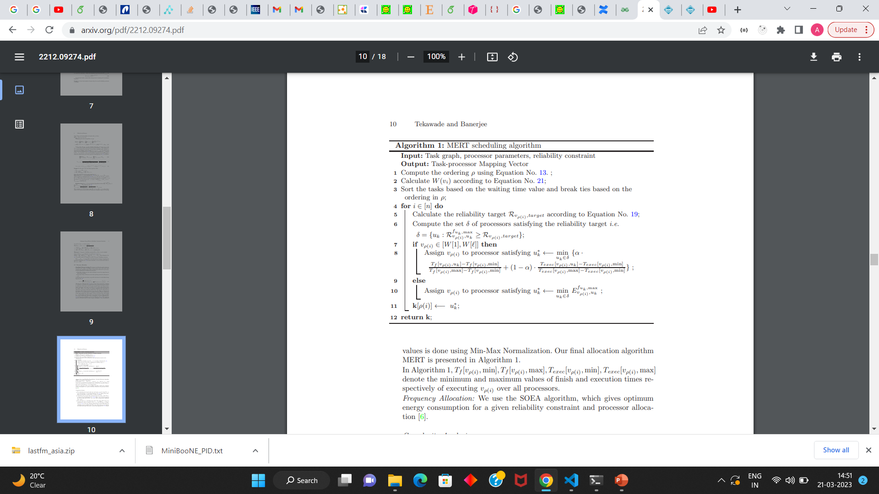
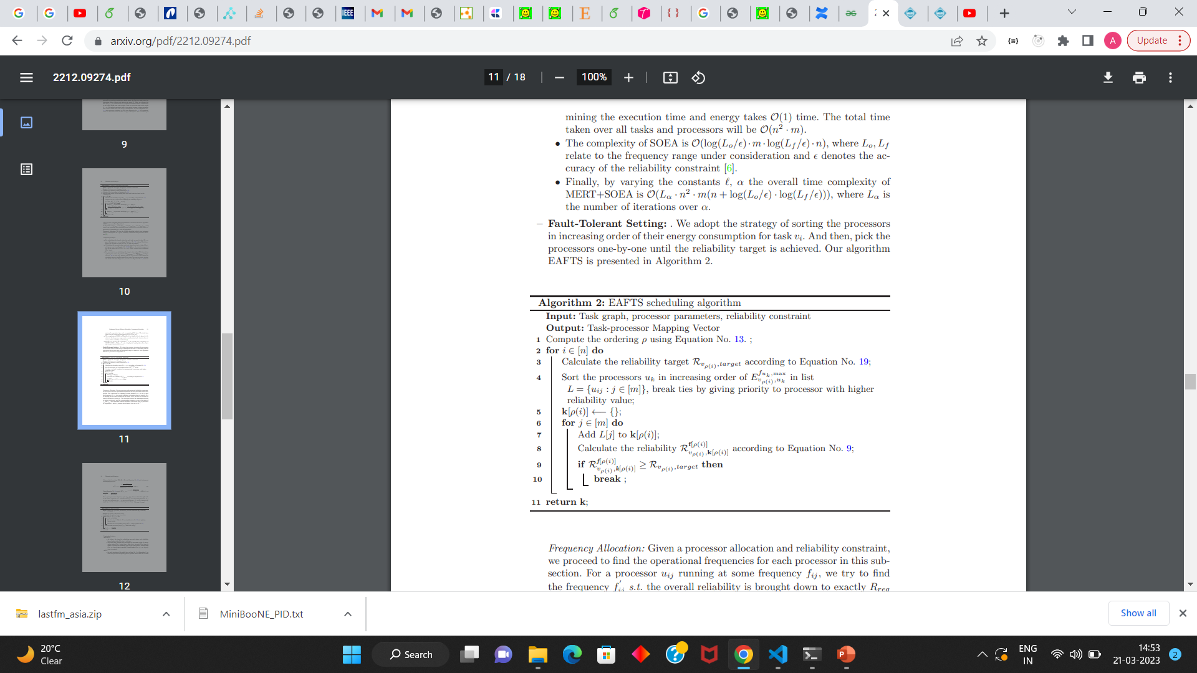
Pseudocode

Slide 16
Baseline Methods
Out Degree Scheduling (ODS) [6]: This is one of the state-of-the-art algorithm for workflow scheduling in multiprocessor system that takes makespan, energy and reliability into consideration by allocating task nodes based on their out-degree.
Energy Efficient Scheduling with Reliability Goal (ESRG) [12]: This is another state-of-the-art algorithm that minimizes for energy under reliability constraint. Many existing studies have also compared their results with this method. It determines both processor and frequency allocation together.
Minimizing Resource Consumption Cost with Reliability Goal (MRCRG) [11]: This is another state-of-the-art algorithm that minimizes resource cost under reliability constraint. As in [12] we can modify the algorithm to reduce energy consumption instead of resource cost.
Maximum Reliability (MR) [6], [13]: As the name suggests, this algorithm assigns each task to the processor that leads to the maximum reliability(R_{vi,max}) without considering makespan or energy consumption.
Other than ESRG, we use SOEA for all other methods to determine frequencies.

Slide 17
Baseline Methods
Energy-Efficient Fault-Tolerant Scheduling (EFSRG) [12]: This is a state-of-the-art algorithm that minimizes energy consumption under reliability constraint considering fault tolerance. It determines both processor and frequency allocation together.
MaxRe [17]: This is a state-of-the-art algorithm that minimizes the number of active replicas under a reliability constraint by assuming each task should have the same reliability target = R ^{1/n} _{req} .
RR [16]: This is a slight improvement of MaxRe that minimizes the number of active replicas under a reliability constraint by assuming all the unassigned tasks have the same reliability target
= R ^{1/n} _{req} .
Other than EFSRG, we use FA for all other methods to determine frequencies.

Slide 18
Experimental Description
We perform the experimental evaluation of our proposed scheduling algorithm on the FFT, and GE workflows which are widely used in literature for comparison [6], [11], [12].
We implement the proposed solution approach with on a workbench system with i5 10th generation processor and 32GB memory in Python 3.8.10.
System parameters are taken from [6] which reflect the real world characteristics, such as for Intel Mobile Pentium III and ARM Cortex-A9.
The reliability constraints for each experiment are set as η · R^{non-fault tolerant} _{max} ,
where η <= R^{fault tolerant} _{max} / R^{non-fault tolerant} _{max}

Slide 19
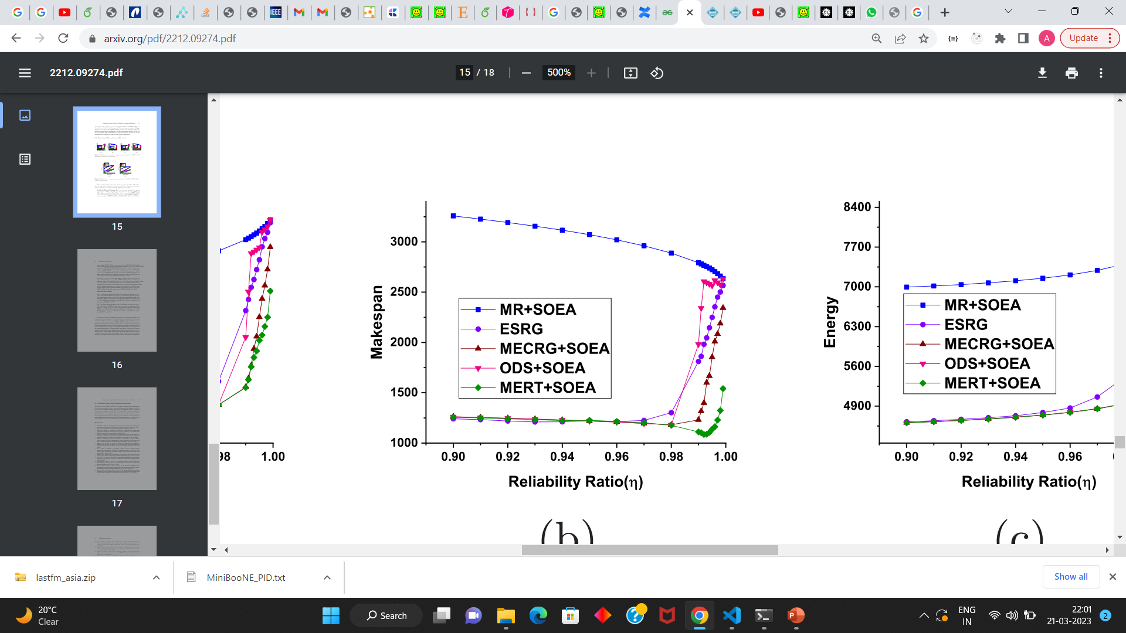

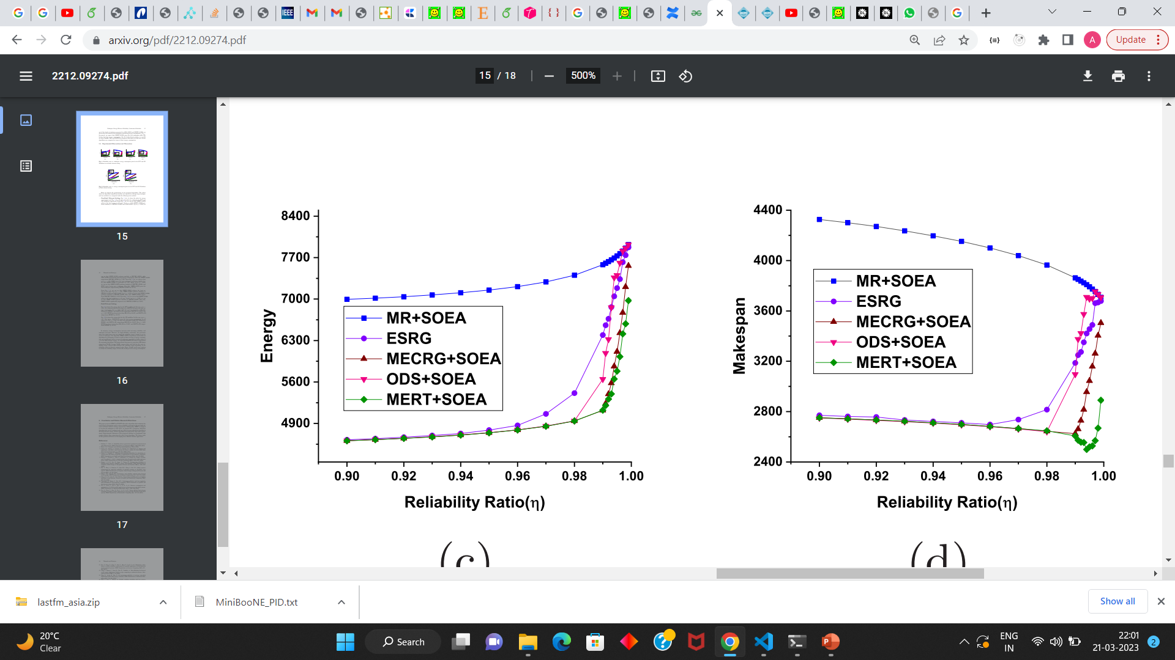
Results
(a) FFT: ‘Makespan’
(b) FFT: ‘Energy’
(a) GE: ‘Makespan’
(b) GE: ‘Energy’

Slide 20
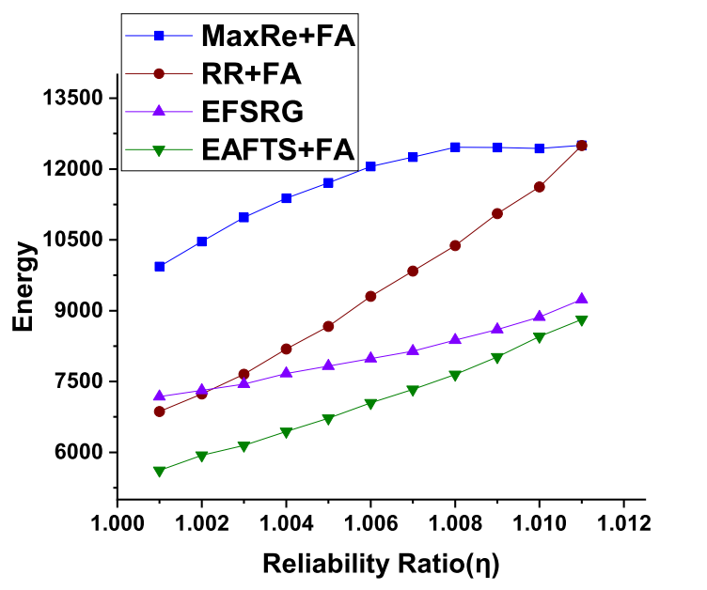
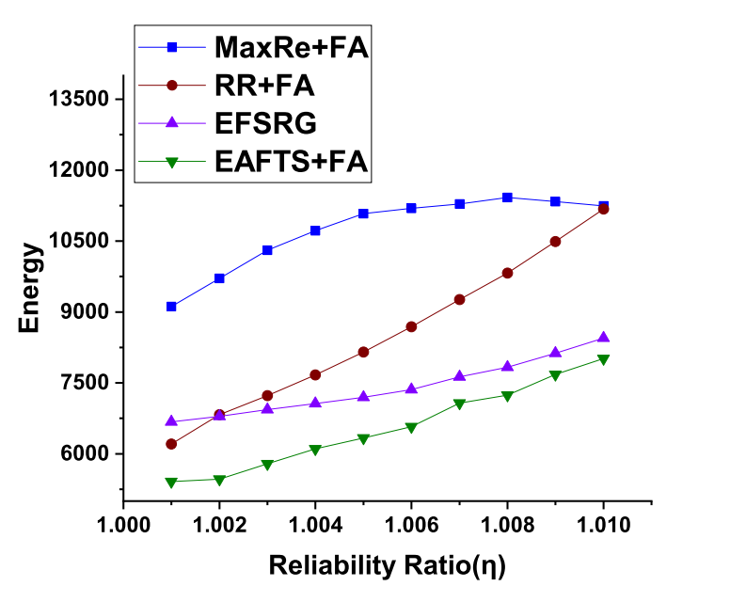
Results
(a) FFT
(b) GE

Slide 21
Conclusion & Future work
In this paper, we have proposed a scheduling algorithm for workflows in a multiprocessor system whose goal is to minimize makespan and energy consumption subject to reliability constraint.
We perform a number of experiments with real-world workflows to show the effectiveness of the proposed solution approach.
The future study on this problem will focus on developing more efficient solution approaches.

Slide 22
References
Bolchini, C., Miele, A.: Reliability-driven system-level synthesis for mixed-critical embedded systems. IEEE Transactions on Computers 62(12), 2489–2502 (2012)
Bruno, J.L.: Computer and job-shop scheduling theory. Wiley (1976).
Chang, W., Pr¨obstl, A., Goswami, D., Zamani, M., Chakraborty, S.: Battery-and aging-aware embedded control systems for electric vehicles. In: 2014 IEEE RealTime Systems Symposium. pp. 238–248. IEEE (2014).
Dogan, A., Ozguner, F.: Matching and scheduling algorithms for minimizing execution time and failure probability of applications in heterogeneous computing. IEEE Transactions on Parallel and Distributed Systems 13(3), 308–323 (2002) .
Hassija, V., Chamola, V., Han, G., Rodrigues, J.J., Guizani, M.: Dagiov: A framework for vehicle to vehicle communication using directed acyclic graph and game theory. IEEE Transactions on Vehicular Technology 69(4), 4182–4191 (2020).
Huang, J., Li, R., Jiao, X., Jiang, Y., Chang, W.: Dynamic dag scheduling on multiprocessor systems: reliability, energy, and makespan. IEEE Transactions on Computer-Aided Design of Integrated Circuits and Systems 39(11), 3336–3347 (2020) .
Ma, Y., Zhou, J., Chantem, T., Dick, R.P., Wang, S., Hu, X.S.: Online resource management for improving reliability of real-time systems on “big–little” type mpsocs. IEEE Transactions on Computer-Aided Design of Integrated Circuits and Systems 39(1), 88–100 (2018) .
Sahner, R.A., Trivedi, K.S.: Performance and reliability analysis using directed acyclic graphs. IEEE Transactions on Software Engineering (10), 1105–1114 (1987) .
Tang, X., Li, K., Qiu, M., Sha, E.H.M.: A hierarchical reliability-driven scheduling algorithm in grid systems. Journal of Parallel and Distributed Computing 72(4), 525–535 (2012).
Topcuoglu, H., Hariri, S., Wu, M.Y.: Performance-effective and low-complexity task scheduling for heterogeneous computing. IEEE transactions on parallel and distributed systems 13(3), 260–274 (2002).
Xie, G., Chen, Y., Liu, Y., Wei, Y., Li, R., Li, K.: Resource consumption cost minimization of reliable parallel applications on heterogeneous embedded systems. IEEE Transactions on Industrial Informatics 13(4), 1629–1640 (2016) .
Xie, G., Chen, Y., Xiao, X., Xu, C., Li, R., Li, K.: Energy-efficient fault-tolerant scheduling of reliable parallel applications on heterogeneous distributed embedded systems. IEEE Transactions on Sustainable Computing 3(3), 167–181 (2017) .
Xie, G., Zeng, G., Chen, Y., Bai, Y., Zhou, Z., Li, R., Li, K.: Minimizing redundancy to satisfy reliability requirement for a parallel application on heterogeneous service-oriented systems. IEEE Transactions on Services Computing 13(5), 871– 886 (2017) .

Slide 23
References
Yang, L., Zhong, C., Yang, Q., Zou, W., Fathalla, A.: Task offloading for directed acyclic graph applications based on edge computing in industrial internet. Information Sciences 540, 51–68 (2020).
Zhao, B., Aydin, H., Zhu, D.: On maximizing reliability of real-time embedded applications under hard energy constraint. IEEE Transactions on Industrial Informatics 6(3), 316–328 (2010).
Zhao, L., Ren, Y., Sakurai, K.: Reliable workflow scheduling with less resource redundancy. Parallel Computing 39(10), 567–585 (2013) .
Zhao, L., Ren, Y., Xiang, Y., Sakurai, K.: Fault-tolerant scheduling with dynamic number of replicas in heterogeneous systems. In: 2010 IEEE 12th International Conference on High Performance Computing and Communications (HPCC). pp. 434–441. IEEE (2010).

Slide 24
Thank You!!!

