Slide 1

SIX WEEKS SUMMER TRAINING
REPORT
on
C AND CPP
Submitted by
Atharva Santosh Todmal
Registration No.
12010145
Programme Name: B. Tech CSE
Under the Guidance of
School of Computer Science & Engineering
Lovely Professional University, Phagwara
(June-July, 2022)

Slide 2
INTRODUCTION
Python is a high-level, general-purpose and a very popular programming language. Python programming language (latest Python 3) is being used in web development, Machine Learning applications, along with all cutting-edge technology in Software Industry. Python Programming Language is very well suited for Beginners, also for experienced programmers with other programming languages like C++ and Java.
Scripting language
All scripting languages are programming languages. The scripting language is basically a language where instructions are written for a run time environment. They do not require the compilation step and are rather interpreted. It brings new functions to applications and glue complex system together. A scripting language is a programming language designed for integrating and communicating with other programming languages.
There are many scripting languages some of them are discussed below:
Bash: It is a scripting language to work in the Linux interface. It is a lot easier to use bash to create scripts than other programming languages. It describes the tools to use and code in the command line and create useful reusable scripts and conserve documentation for other people to work with.

Slide 3
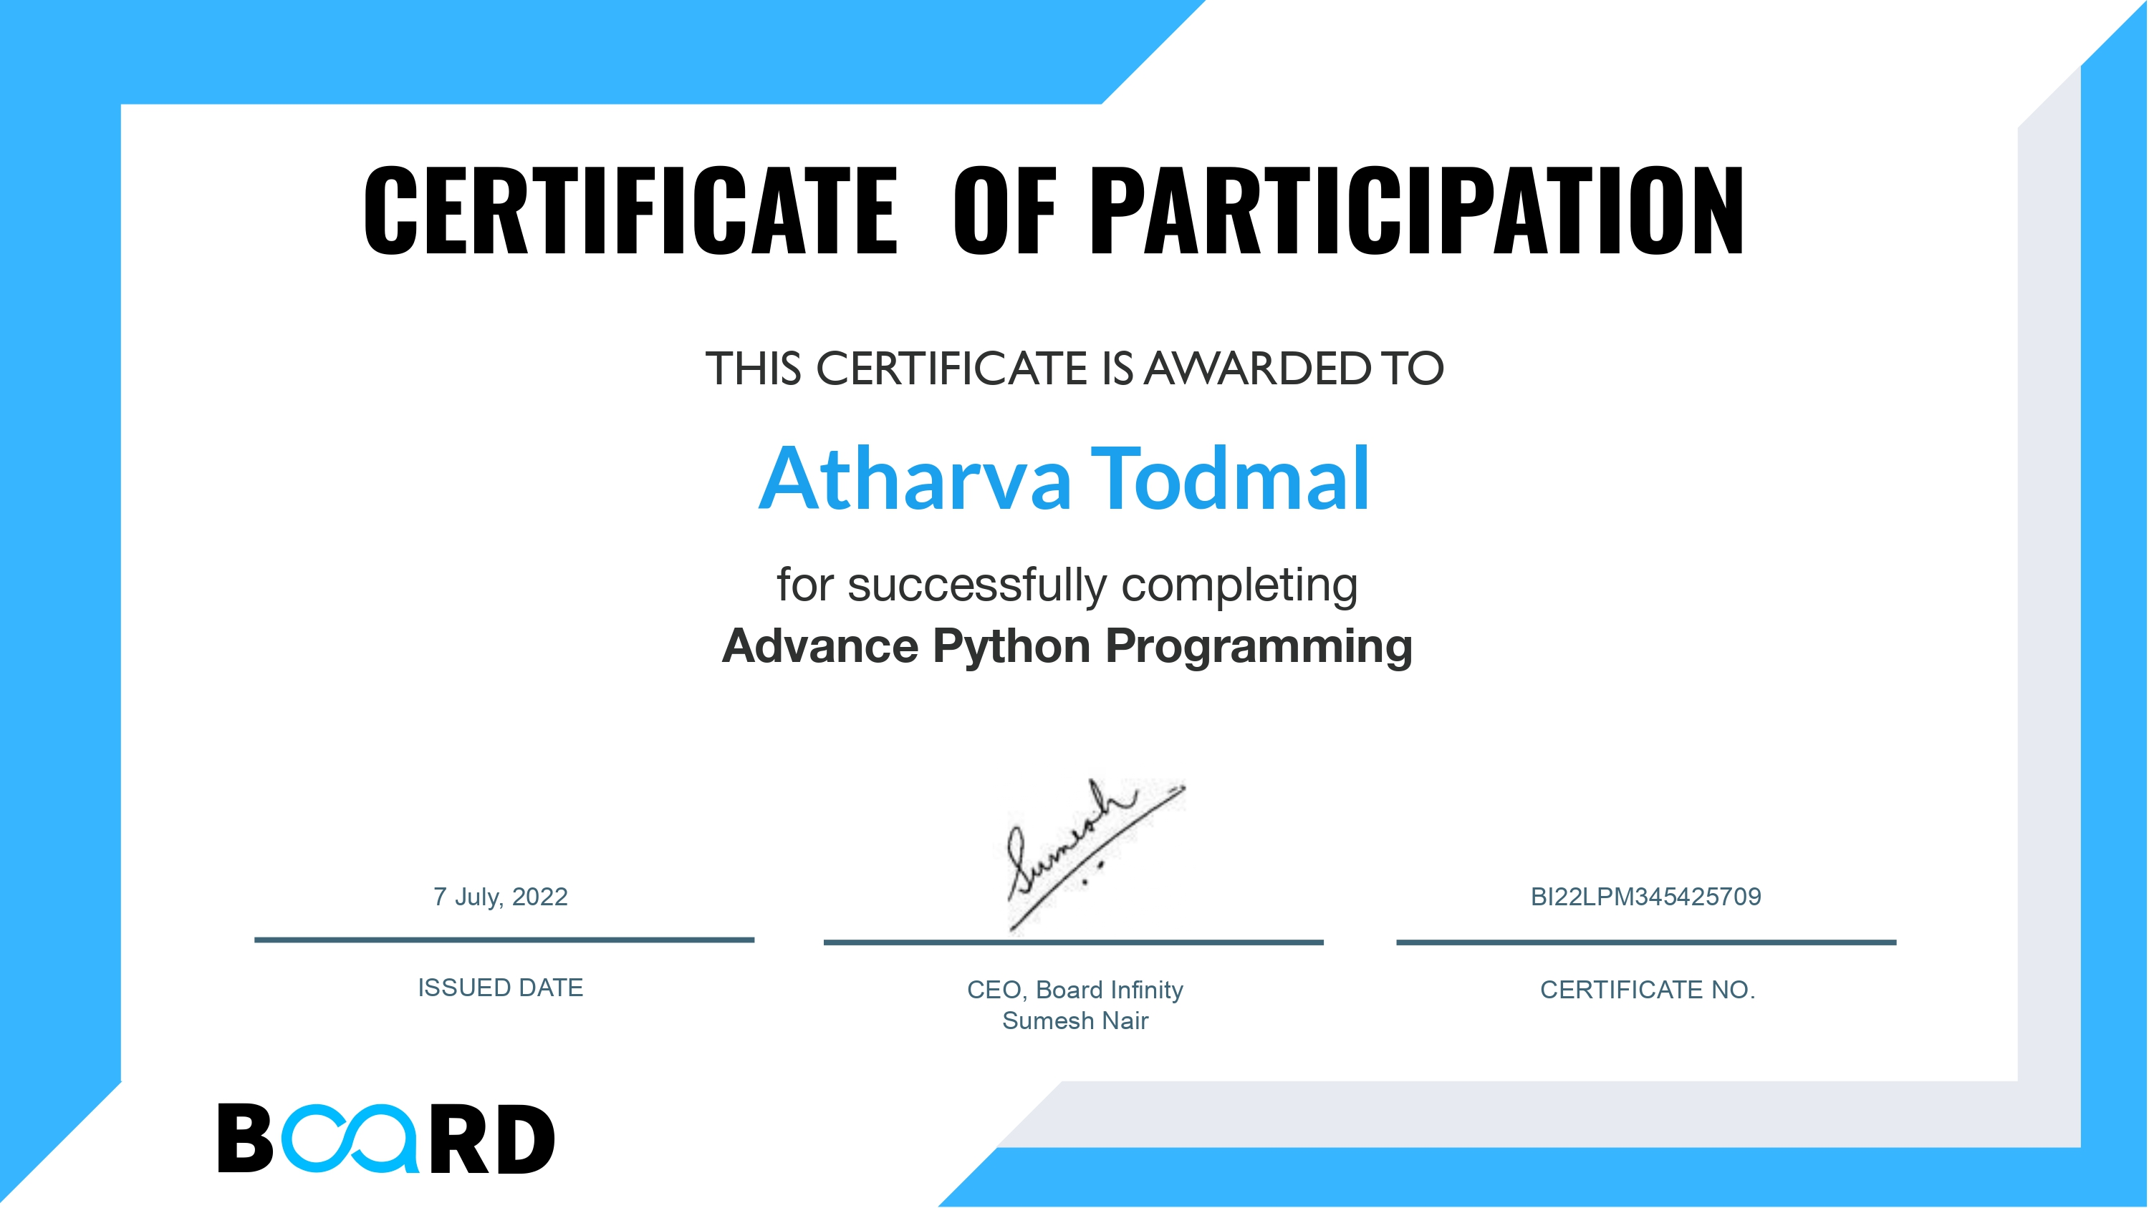
SUMMER TRAINING CERTIFICATE (FROM TRAINING INSTITUTE)

Slide 4
TECHNOLOGY LEARNT
Introduction to Python
Using Variables in Python
Basics of Programming in Python
Principles of Object-oriented Programming (OOP)
Connecting to SQLite Datab
Developing a GUI with PyQT
Application of Python in Various Disciplines
Pandas matplotlib

Slide 5
PROBLEM ANALYSIS
It would be wise to bear this in mind given the outcomes of the implementation phase, which were overall fairly neutral but still leaning towards Democratic Affiliation. So let's check whether grouping the data by population colour provides any more insight. The poll findings should, ideally, be a good depiction of the populations surveyed because other graphs have been produced that show a strong showing of potential voters and Registered Voters. Considering the uncertain component in particular, let's take a second, short look at the DataFrame that it provides after producing its graph to see how close these pools appear to be. As a consequence, we conducted a statistical analysis for the election outcomes and identified certain biassed and unbiased variables.
The suggested system or data visualization is quite simple and was just constructed to demonstrate a conceptual grasp of Python concept. It is also extremely viable because it does not call for any additional hardware or internet connectivity.

Slide 6
SOFTWARE REQUIREMENT ANALYSIS
VS Code
Windows 10,11

Slide 7
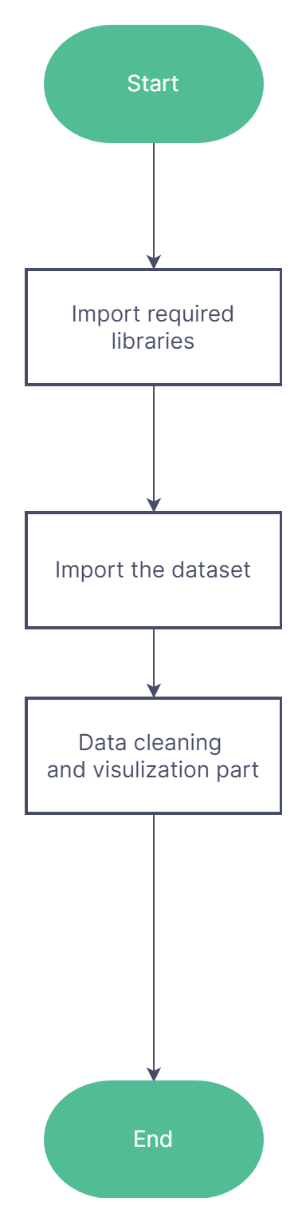
DESIGN

Slide 8
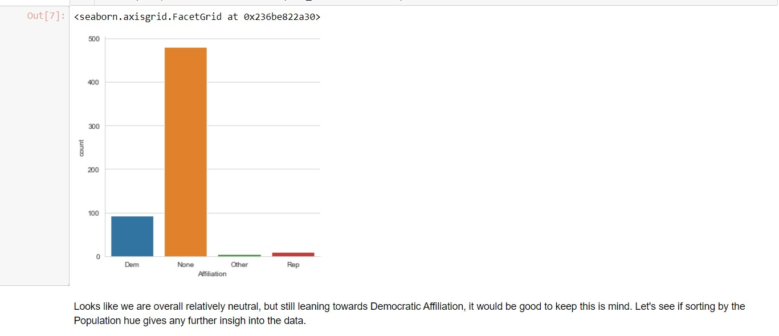
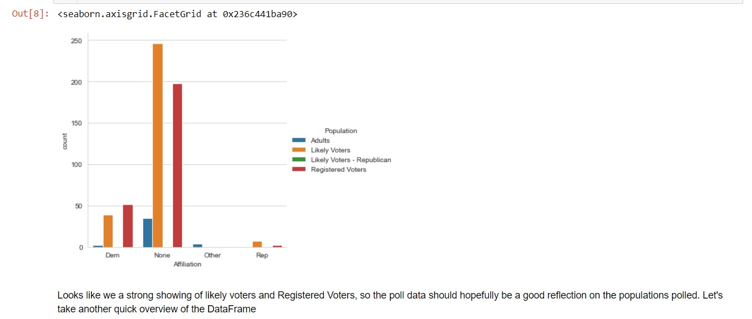
IMPLEMENTATION

Slide 9
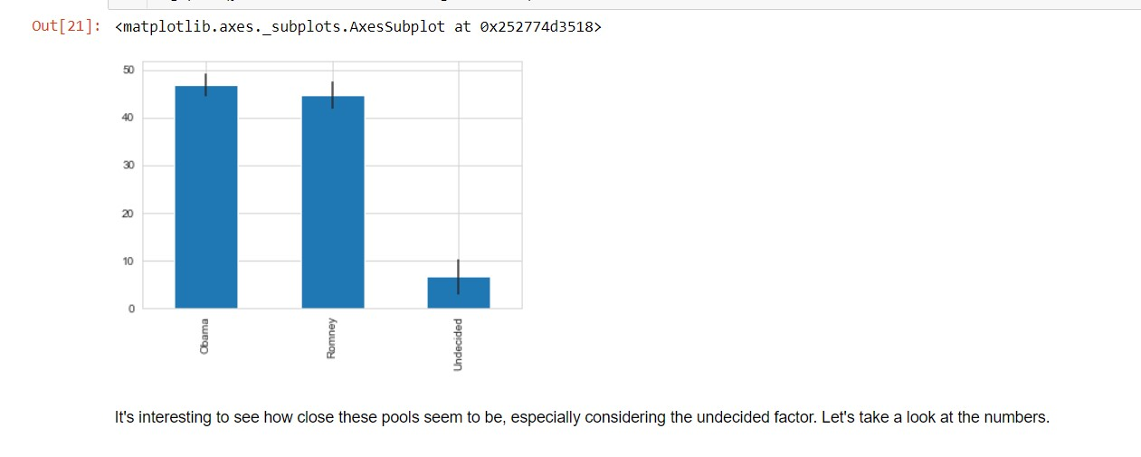

Slide 10
GANTT CHART

Slide 11
BIBLIOGRAPHY
https://en.wikipedia.org/wiki/Python_(programming_language)
https://docs.python.org/3/library/index.html
https://www.w3schools.com/python/
https://www.tutorialspoint.com/python/index.htm

Slide 12
Thank You

