Slide 1
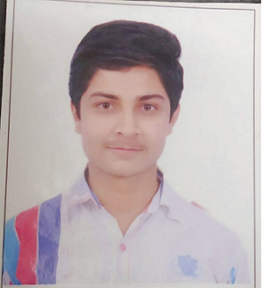
Atharv Vinod Dhirde
Bachelor of Engineering
Electronics and Telecommunication : 2018 - 2022
Analyst/Software Engineer
Skills
Java 11 /J2EE | Java Basics, OOPS, Generics, Collections, Arrays, Loops, Lambda Exp, Stream API Junit, Mockito, Servlets
Spring core | IOC & Dependency Injection, Autowire
Spring REST | REST controllers, Implementation of GET, POST, PUT & DELETE, Bean Validation & Exception Handling, Testing Services, Controller & Repository layer
Spring Data JPA | Implement DAO layer using spring Data repositories, Transaction Management
Spring Boot Microservices | Spring Boot Starters, annotations, Messaging Service, Sync/Async comms, Swagger API documents
Spring Cloud | Eureka, Netflix Ribbon, Feign Client, Netflix Hystrix, Netflix Zuul & Config Server
Angular | Components, Services, Modules, Routing, Forms & Validation, Testing using Jasmine & Karma
Database | MongoDB No SQL Basics, My SQL RDS Basics
UI Tech | HTML 5 & CSS 3,JavaScript, ES6 & TypeScript Reusable templates, Optimized UI Designed
Tools | Git, Postman, Maven, IDE
Add On skills | Communications, Team management. Peer learning
Mumbai
atharv.vinod-dhirde@capgemini.com
+91 8308839630
A4
Java Full Stack Developer with Angular
Hands on experience in creating microservices with Spring boot, Spring security, Eureka Server, Swagger, Logger, Junit testing.
Proficient in creating Single page Web Application in Angular with Authentication with route guards, Angular reactive forms, angular routing.
Hands on experience with HTML, CSS, JavaScript, ES6 and Angular.
Experience in creating documentation with swagger and in unit testing using Junit, Mockito including code quality using best practices.
Java Microservices Development knowledge using Spring boot and spring cloud framework on an intermediate level.
On Demand Car Wash System
Completed end to end case study of On demand car wash along with JWT authentication, Swagger, Junit testing and payment gateway using Razor pay. Angular is used for user interface.
backend (MongoDB), Midware (Spring Boot) and Frontend (Angular) at Capgemini Degreed Platform
Learned and recompiled all concepts of the backend, midware and frontend technologies to polish my skills to work on real time projects.

