Slide 1
BU CS 506 · Data Science · Final Project
AML Risk Detection
Ranking suspicious transactions on merged IBM + SAML-D data
Zukhriddin
Jaswanth
Atharv
Assylkhan
Problem & Goal
Data, Cleaning, Features
Visuals & Modeling
Results & Limitations
Final report · README.md
Recording · YouTube link in README
Datasets · IBM AML + SAML-D synthetic transaction monitoring data
Notes:
Speaker 1 opens. Introduce team, project, and the two datasets. Keep it short — full intro lasts ~25 seconds before moving to the problem slide.

Slide 2
BU CS 506 Data Science
Problem
02 / 13
AML detection is a rare-event triage problem
Banks process huge volumes of transactions, but investigators can only review a tiny fraction.
Extreme class imbalance
Asymmetric costs
Ranking matters
Laundering accounts for ~0.1% of transactions. Plain accuracy can ignore the positive class entirely and still look 'good'.
Missed laundering creates regulatory exposure. Excess false positives bury analysts and slow real cases.
The most useful model puts the riskiest transactions at the top of a finite review queue, not just labels them.
PROJECT GOAL
Build an AML risk-ranking pipeline that puts truly suspicious transactions at the top of a finite review queue.
Evaluation focuses on PR-AUC, PR lift, precision/recall/F1, and precision-at-k / lift-at-k.
Notes:
Speaker 1: explain why accuracy is the wrong success measure under extreme imbalance.

Slide 3
BU CS 506 Data Science
Approach
03 / 13
Our pipeline: raw transactions to ranked alerts
One reproducible notebook merges, cleans, engineers, models, and evaluates — chronologically split end-to-end.
1
2
3
4
5
COLLECT
HARMONIZE
ENGINEER
MODEL
RANK
IBM AML + SAML-D pulled via KaggleHub
One shared schema, leak-prone columns dropped
53 numeric + 5 categorical history features + Isolation Forest score
Benchmark 6 tree models + weighted ensemble
Tune threshold; report precision-at-k / lift-at-k
Reproducibility: the README runs `make all`, `make download`, and `make reproduce`.
PYTHON 3.10
JUPYTERLAB
MAKEFILE
GITHUB ACTIONS CI
PYTEST
XGBOOST
SCIKIT-LEARN
ISOLATION FOREST
Pipeline implemented in ds_final.ipynb · helpers in src/ · CI in .github/workflows/ci.yml
Notes:
Speaker 1: walk left to right through the 5 steps. Tie back to the rubric (collection, cleaning, features, modeling, results).

Slide 4
BU CS 506 Data Science
Data
04 / 13
Two complementary public AML datasets
Both are synthetic and labeled, which makes evaluation possible while we are realistic about generalization limits.
IBM TRANSACTIONS FOR AML
SAML-D · SYNTHETIC TRANSACTION MONITORING
IBM AML
SAML-D
Synthetic bank-style transaction stream with explicit laundering labels.
Strengths: rich structure across senders, receivers, banks, and currencies.
Used for: early time window of the chronological split.
Synthetic AML monitoring dataset with multiple laundering typologies.
Strengths: diverse payment formats and currencies, longer recent time range.
Used for: validation and held-out test windows.
WHY MERGE THEM
Combining both yields more behavior diversity, lets us standardize one schema, and makes the chronological split possible across two non-overlapping time ranges.
Sources: Kaggle (IBM AML, SAML-D) · downloaded via data/download.py with KaggleHub.
Notes:
Speaker 2: name the datasets, justify, and tee up the overview chart on the next slide.

Slide 5
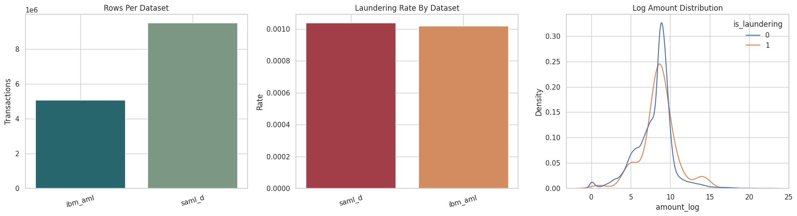
BU CS 506 Data Science
Data
05 / 13
What the merged dataset looks like
Sizes differ, laundering rate is tiny, and amounts span several orders of magnitude.
WHAT THE OVERVIEW SHOWS
Both sources contribute, but at different scales.
Laundering is rare — about 0.1% of transactions.
Amounts are heavily skewed, which is why we use a log axis and amount-shape features.
Figure: reports/figures/dataset_overview_final.png
Notes:
Speaker 2: point at the size + prevalence + amount-skew panels and tie each to a downstream design choice.

Slide 6
BU CS 506 Data Science
Processing
06 / 13
Cleaning produces one fair shared schema
Both sources standardized; leak-prone shortcuts excluded; rows ordered chronologically before any history feature.
1
Standardize the schema
2
Parse and coerce
Map both datasets to common timestamp, sender, receiver, banks, accounts, amount, currencies, and label fields.
Convert timestamps with errors="coerce"; coerce numeric amounts; drop rows without a usable amount.
3
Normalize text
4
Lock down leakage
Clean bank, account, currency, and payment-format strings so categorical encoders see the same value across both sources.
Keep `laundering_type` and `source_dataset` for auditing only — they are excluded from the model's feature set.
Chronological sort happens BEFORE any cumulative feature is computed — every row only sees its past.
Cleaning logic implemented in ds_final.ipynb (and mirrored in src/preprocessing.py for unit tests).
Notes:
Speaker 2: emphasize the leak-prone columns are kept for analysis, never given to the model.

Slide 7
BU CS 506 Data Science
Features
07 / 13
Features describe behavior around each transaction
Raw metadata becomes far more informative when each row is compared against its own history.
Amount context
FEATURE SET
raw amount, log amount, z-scores, pair amount-share
59 features
Time context
5 categorical · 53 numeric · 1 anomaly score
hour, weekday, weekend flag, gaps since prior related transactions
Categorical:
from_bank · to_bank · payment_currency · receiving_currency · payment_format
Plus an Isolation Forest anomaly score appended before supervised training.
Relationship context
sender, receiver, pair, and route counts (per-day and cumulative)
Novelty context
new counterparties, new banks, new currencies, first-seen flags
Behavioral history
prior mean / std of amounts and trajectory features
Leak guardrail: every cumulative feature is computed from prior rows only. Cached to parquet for repeat runs.
Notes:
Speaker 2: stress that the ranking power comes from BEHAVIOR features, not just raw amount or currency.

Slide 8
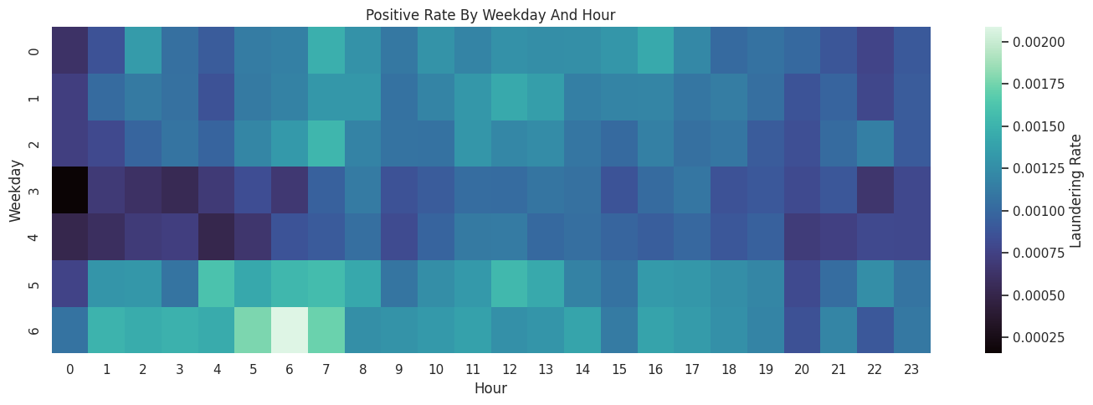
BU CS 506 Data Science
Visualization
08 / 13
Visualization 1 — Laundering rate is not uniform in time
The weekday × hour heatmap motivates calendar / time-window features in the model.
WHAT THE HEATMAP TELLS US
Positive rate moves with weekday and hour.
It does not prove timing causes laundering — it just gives the model useful context.
The heatmap also avoids overplotting millions of rows by aggregating to a clean grid.
Figure: reports/figures/temporal_patterns_final.png
Notes:
Speaker 3: open the visualization section. Focus on the takeaway, not every cell of the heatmap.

Slide 9
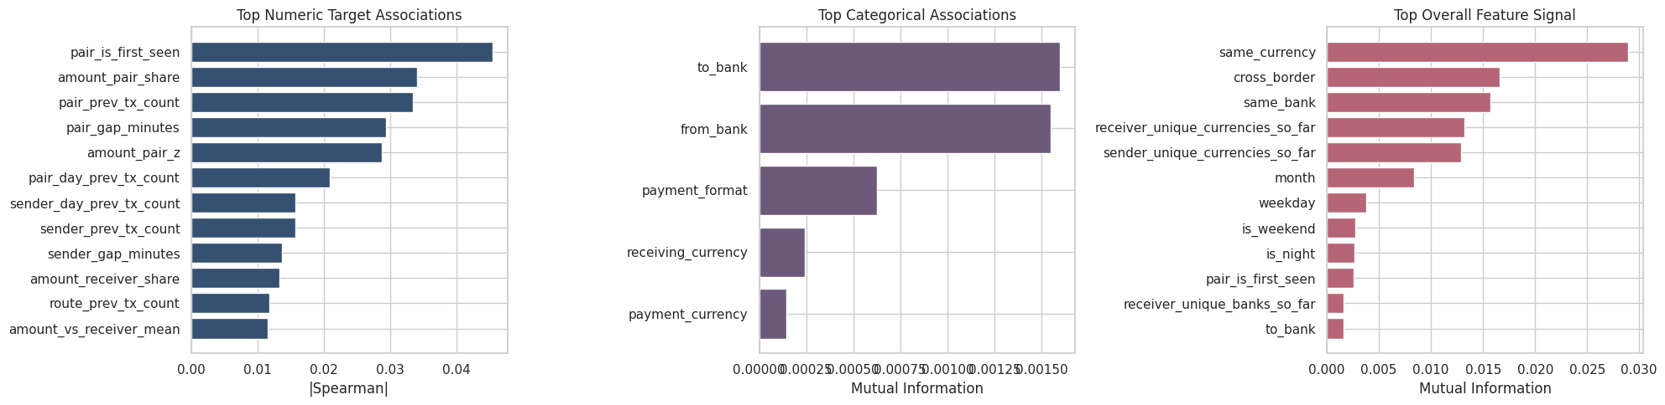
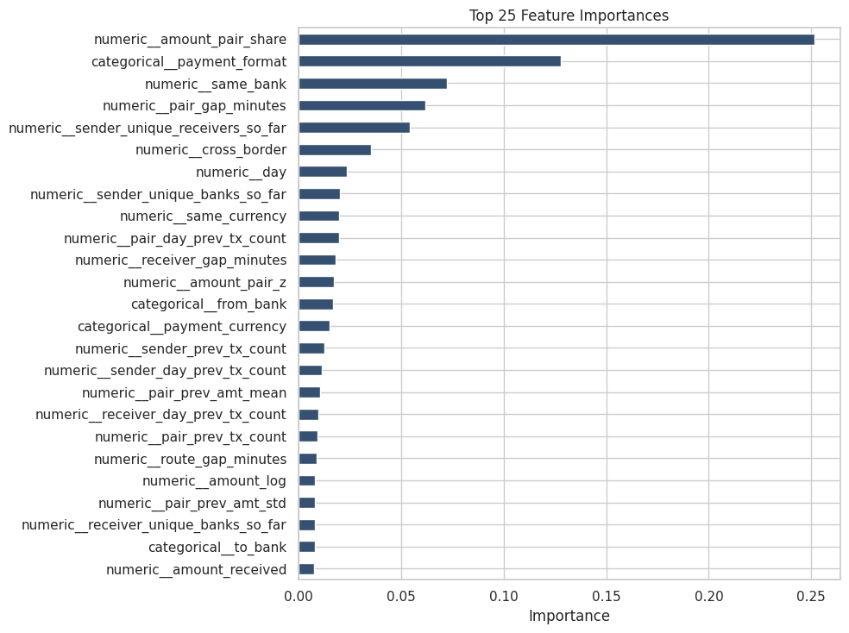
BU CS 506 Data Science
Visualization
09 / 13
Visualization 2 — History features carry the strongest signal
Association views and tree feature importance both rank behavior + relationship features above raw metadata.
Feature association — numeric & categorical signal
Tree-model feature importance
Takeaway: pair history, sender / receiver history, route patterns, and currency context outrank raw amount. Laundering is a pattern across transactions, not one isolated row.
Figures: reports/figures/feature_association_views_final.png · feature_importance_final.png
Notes:
Speaker 3: tie this back to the feature engineering slide — the signal validates the design choice.

Slide 10
BU CS 506 Data Science
Modeling
10 / 13
Six candidates benchmarked, one ensemble selected
Models compared on a chronological 64 / 16 / 20 split. Final pick is the validation winner — frozen before test.
Candidate | Validation PR-AUC | Best F1 | Threshold
★ weighted ensemble | 0.9763 | 0.9642 | 0.925
xgb recall focused | 0.9757 | 0.9608 | 0.950
xgb undersampled | 0.9748 | 0.9574 | 0.875
xgb regularized | 0.9720 | 0.9251 | 0.950
hist gradient boosting | 0.8978 | 0.2352 | 0.950
extra trees | 0.8946 | 0.8437 | 0.725
balanced random forest | 0.8766 | 0.8302 | 0.925
SELECTED MODEL
Weighted Ensemble
of regularized + recall-focused + undersampled XGBoost
VALIDATION THRESHOLD
0.925
best-F1 operating point on validation; reused for test.
Why tree ensembles? Tabular, mixed numeric / categorical, heavy class imbalance, non-linear interactions.
Source: reports/artifacts/candidate_results.csv · star marks the selected model.
Notes:
Speaker 3: explain why we benchmark, why ensemble wins, and why the threshold is locked from validation.

Slide 11
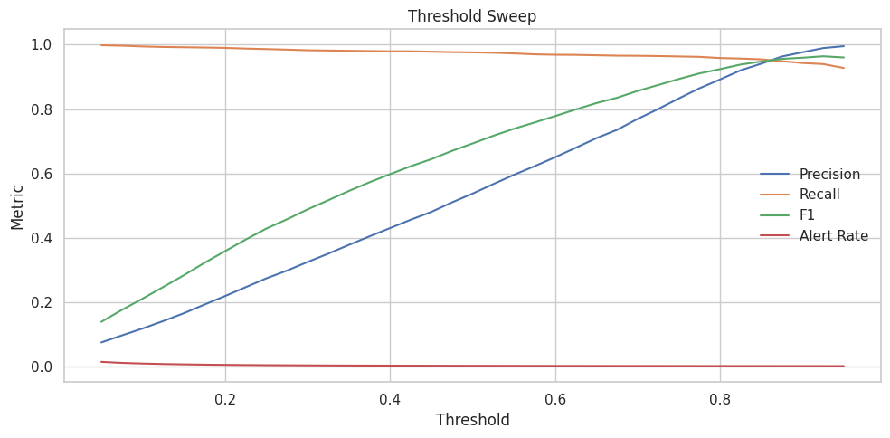
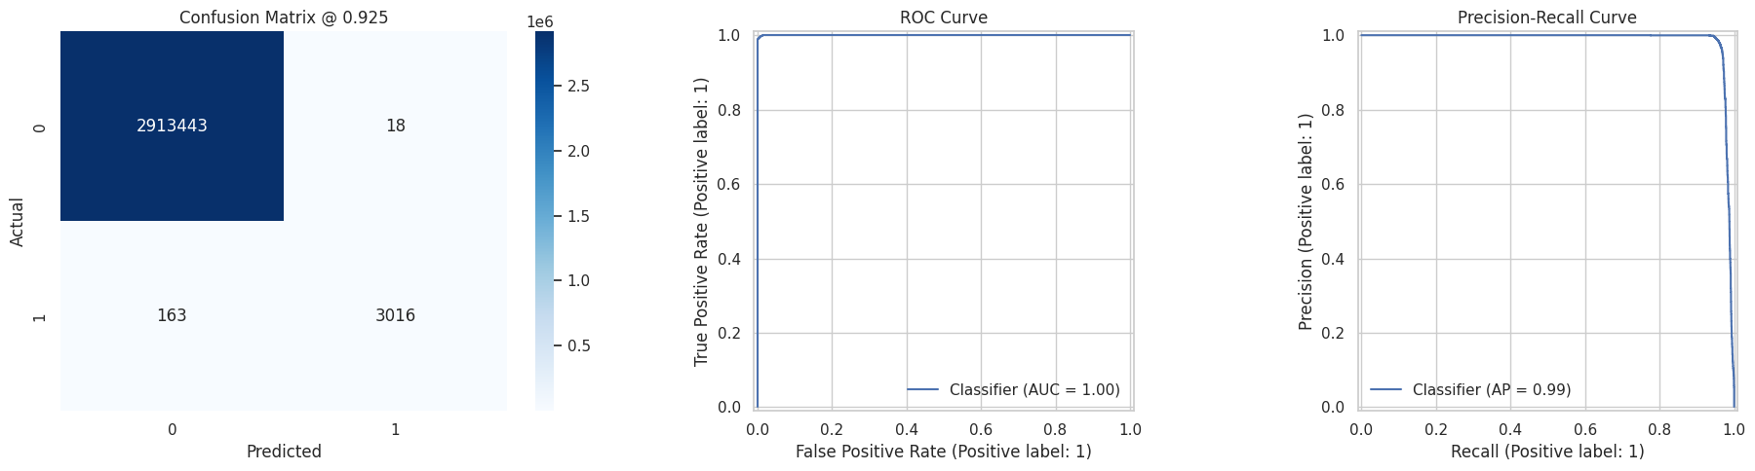
BU CS 506 Data Science
Diagnostics
11 / 13
Threshold and diagnostics — operating the model
Threshold choice is an operations decision. Diagnostics show strong score separation and PR behavior.
Threshold sweep — precision / recall / F1 / alert rate
Confusion matrix · ROC · Precision-Recall
Lower threshold → more alerts and recall. Higher threshold → fewer alerts but more misses. Operating point chosen at validation F1 peak (0.925).
Figures: threshold_sweep_final.png · model_diagnostics_final.png
Notes:
Speaker 4: open the results section by talking through how the threshold is chosen and why diagnostics matter.

Slide 12
BU CS 506 Data Science
Results
12 / 13
Held-out test results — strong on every imbalance metric
Reported on the chronological test window with the validation-frozen threshold of 0.925.
0.9851
0.9941
0.9487
0.9709
904×
TEST PR-AUC
PRECISION
RECALL
F1
PR LIFT vs BASELINE
Split | ROC-AUC | PR-AUC | PR lift | Precision | Recall | F1
TRAIN | 0.9995 | 0.7880 | 780.6× | 0.6316 | 0.7248 | 0.6750
VALID | 0.9999 | 0.9763 | 930.2× | 0.9897 | 0.9400 | 0.9642
TEST | 0.9999 | 0.9851 | 903.8× | 0.9941 | 0.9487 | 0.9709
Test row is highlighted — the model's PR-AUC stays at 0.985 with precision 0.994 / recall 0.949 on the unseen window.
Sources: reports/artifacts/metrics.json · split_metrics.csv
Notes:
Speaker 4: walk the row of big metrics, then point at the test row in the table to confirm consistency.

Slide 13
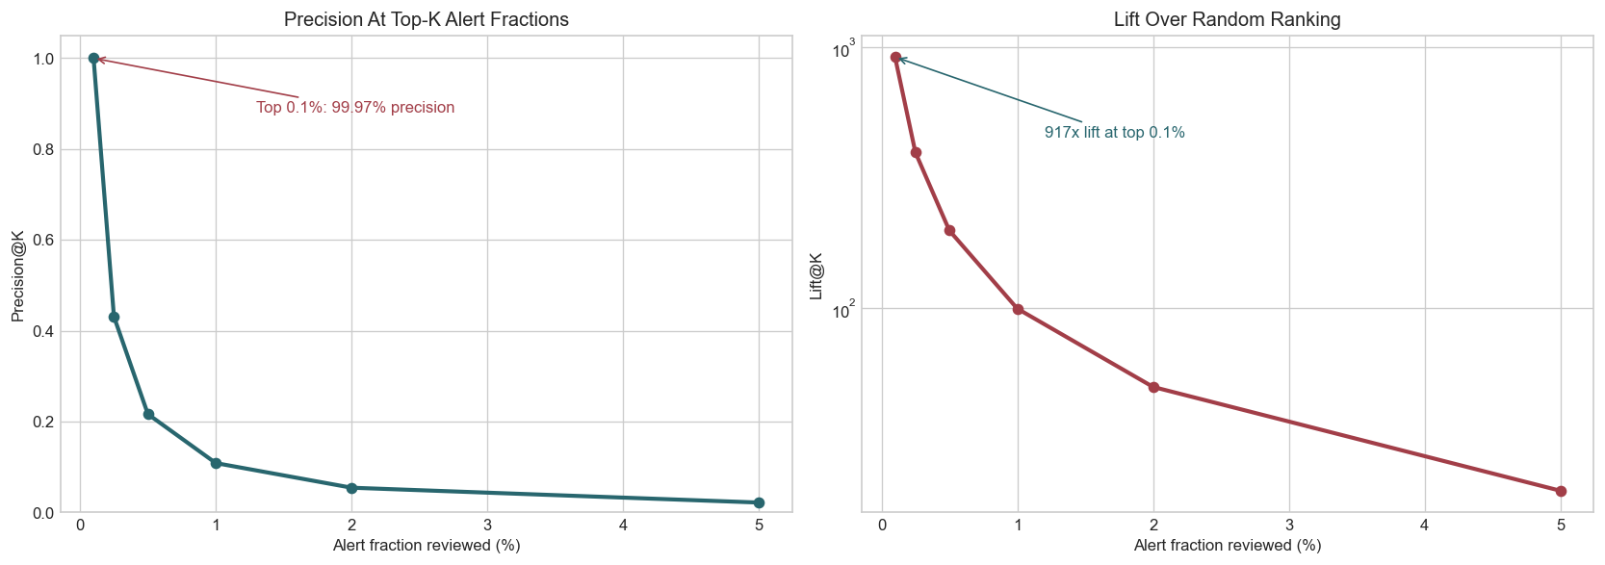
13 / 13 · CLOSE
What the ranking actually means
The top of the alert queue is dense with true positives — exactly where investigators look first.
LIMITATIONS
Both datasets are synthetic — these results should not be read as production performance.
Validation and test windows are effectively SAML-D-only.
Strong separability likely reflects the cleaner synthetic labels.
FUTURE WORK
Add transaction-graph features · validate on less synthetic data · calibrate threshold to investigator capacity · monitor drift across later windows.
99.97%
91.7%
precision in top 0.1% of ranked alerts
of all positives recovered in that same slice
README.md is the final report · Recording link at the top · make download → make reproduce

