Slide 1

Amity School of Engineering Technology NTCC (Term Paper)
Student Name: Atharv Gupta
Enrollment No: A2345921019
Programme Name: B.Tech CSE Evening

Slide 2

Topic: Machine Learning (Deep Learning)
Amity School of Engineering Technology

Slide 3
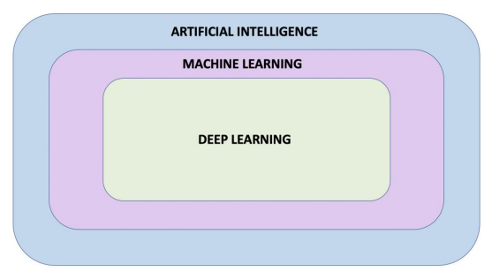
Introduction
Amity School of Engineering Technology
AIM: To learn deep learning in machine learning.
Deep Learning is an area of machine learning focused with artificial neural networks.
Here, we used Python as our default programming language.
Artificial intelligence - Branch of computer science that tries to imitate human intellect in machines.
Neural Network - A machine learning concept that takes its cues from the network of neurons in the human brain.

Slide 4
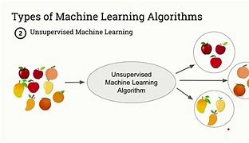
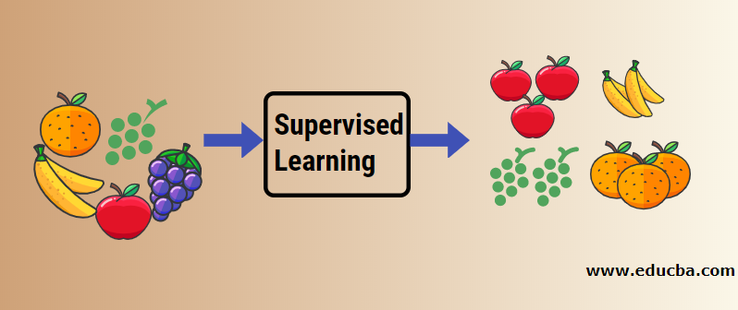
Amity School of Engineering Technology
Deep Learning - A branch of machine learning that makes use of multi-layered neural networks.
There are 2 types of learning patterns:
Supervised Learning
Unsupervised Learning

Slide 5

Purpose of the Study
Amity School of Engineering Technology
Every robot understands user's transformation with a significant amount of data. To get about the idea of ML, step by step basic method was used.
Using common language handling methods (NLP) to organise the instructive foundation and learn about how a robotic chip reacts to the data provided to it.

Slide 6

Objectives of The Study
Amity School of Engineering Technology
To learn about deep learning and areas where it can be used efficiently.

Slide 7
Review of Literature [ Tabular] Form
Amity School of Engineering Technology
Topic | Site URL | Methodology
Deep learning networks | https://www.liip.ch/en/blog/sentiment-detection-with-keras-word-embeddings-and-lstm-deep-learning-networks | Tensorflow
Arbitrage trade analysis | https://sites.google.com/site/mbawithfun/home/mba-projects/mba-projects/arbitrage-trade-analysis-of-stock-trading-in-nse-and-bse | Fashion MNIST

Slide 8
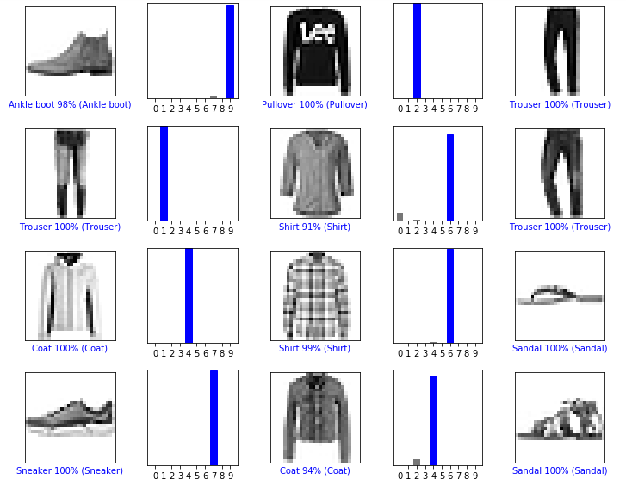
Research Methodology
Amity School of Engineering Technology
The following methods have been used for the research in analysis of the study-
Tensor Flow
Fashion-MNIST Dataset
The Rectified Linear Unit
(ReLU)

Slide 9
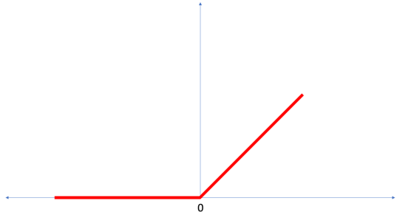
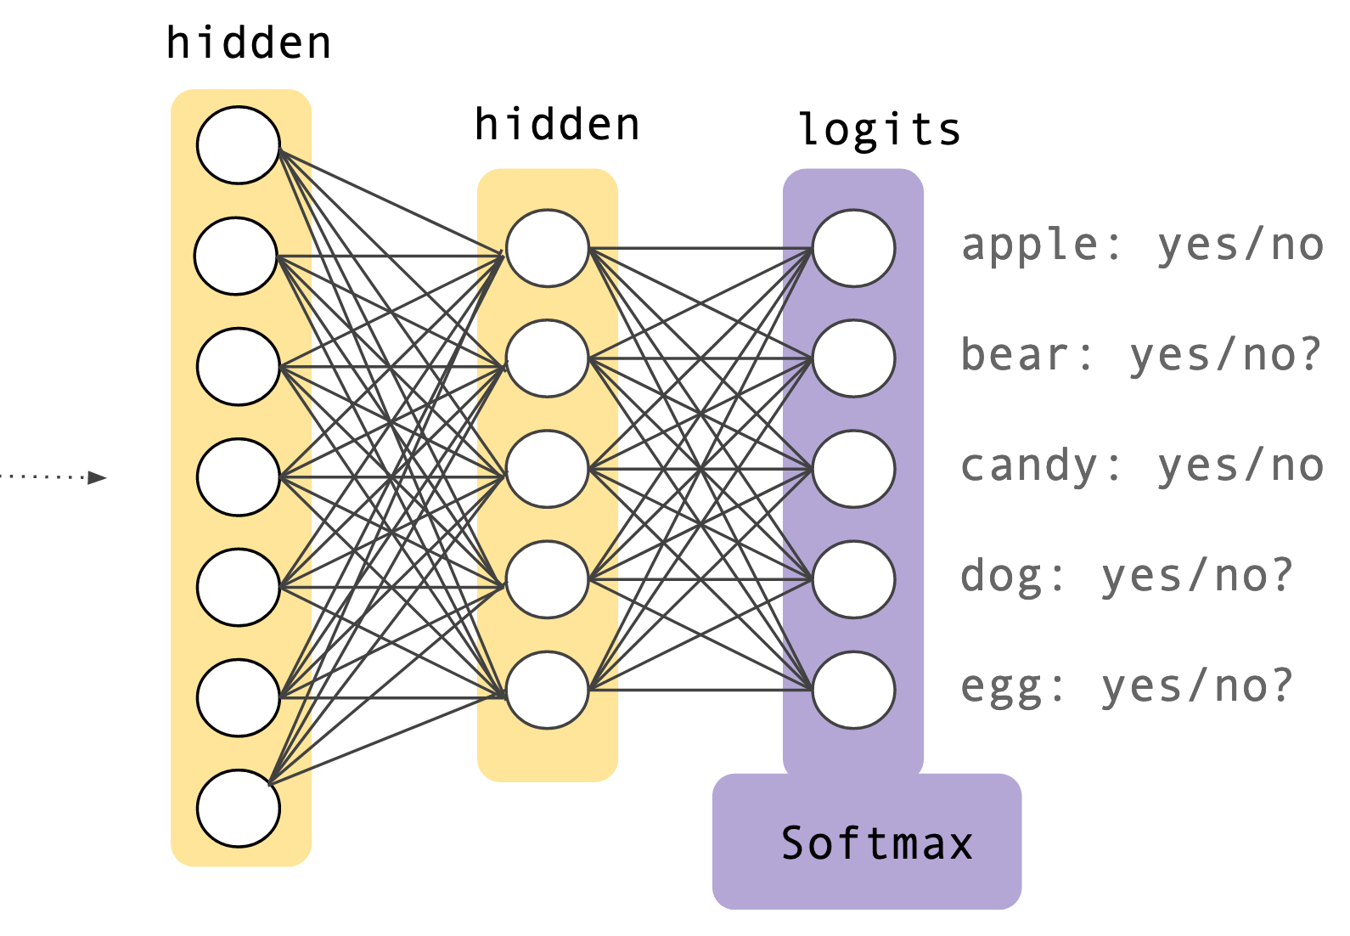
Analysis [Objective Wise]
Amity School of Engineering Technology
New Terms learnt:
Flattening
ReLU
Softmax
Classification

Slide 10
Findings of The Study
Amity School of Engineering Technology
A model with a dense layer was made.
To calculate the accurate Fahrenheit value for each Celsius number, our model had to fine-tune the variables in the Dense layer.
Training Set- The data used for training the neural network.
Test set- The data used for testing the performance of the neural network.

Slide 11
Conclusion
Amity School of Engineering Technology
For the purpose of classifying photos of apparel, we trained a neural network. The Fashion MNIST dataset, was utilised to do this.
10,000 of them were utilised to test the network's performance after we had used 60,000 of them to train it.
For each class, 10 outputs show the probability.
The probability distribution was generated using the softmax activation function.

