Slide 1
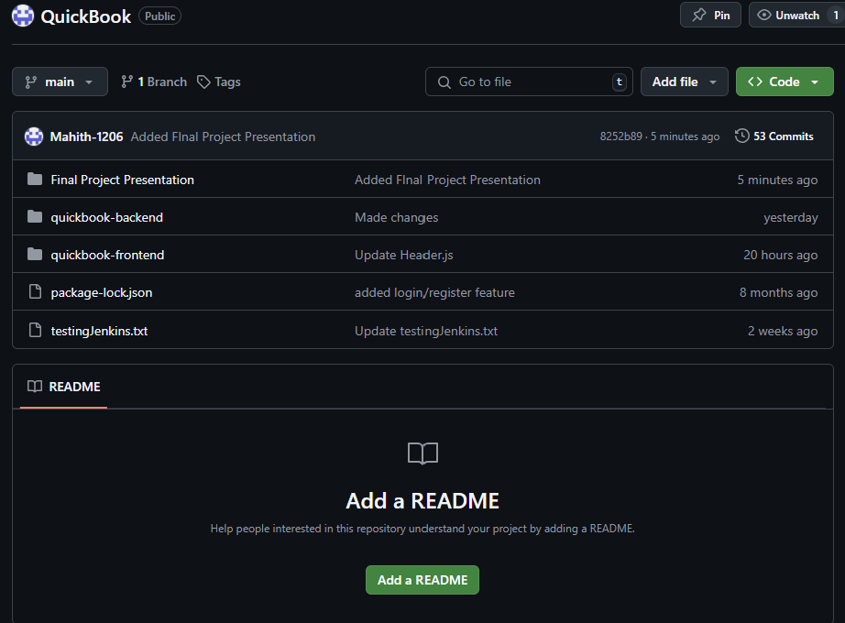
QuickBook - GIT
Folder Structure

Slide 2
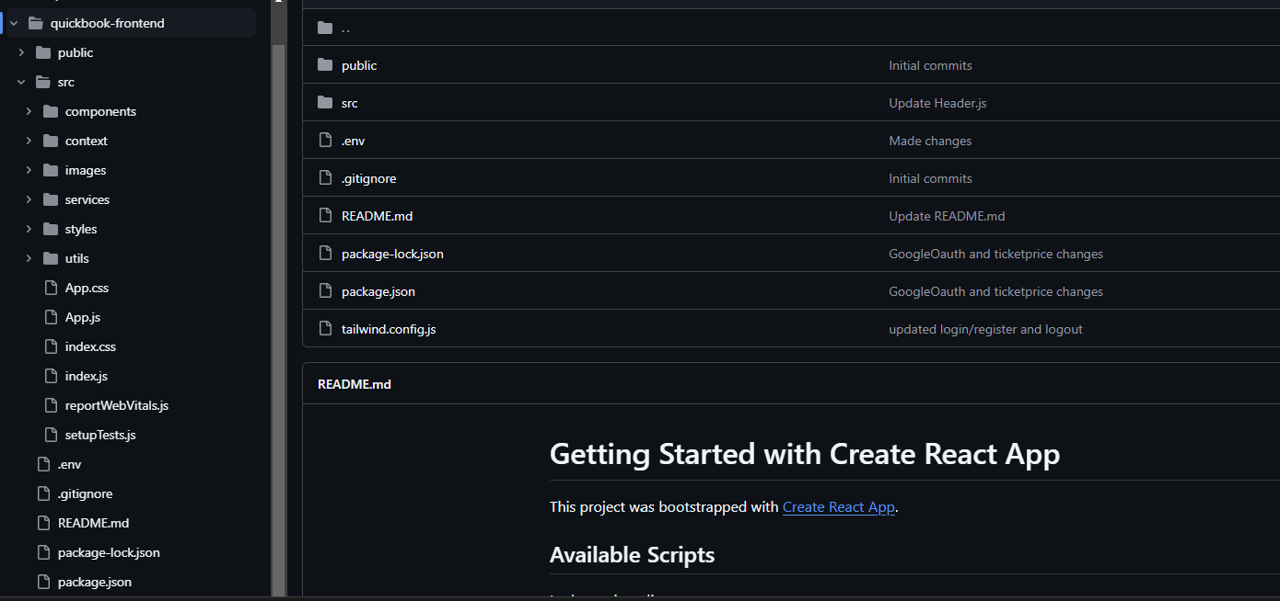
Frontend Structure

Slide 3
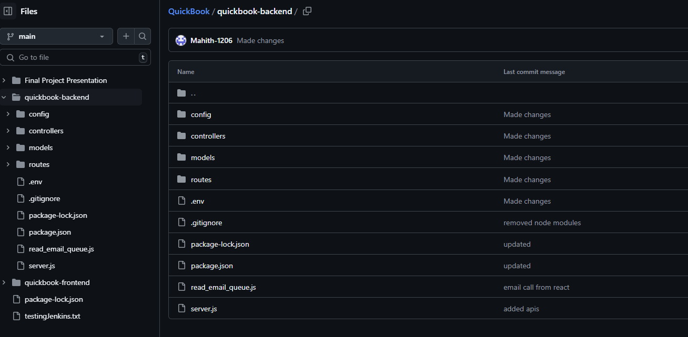
Backend Structure

