Slide 1
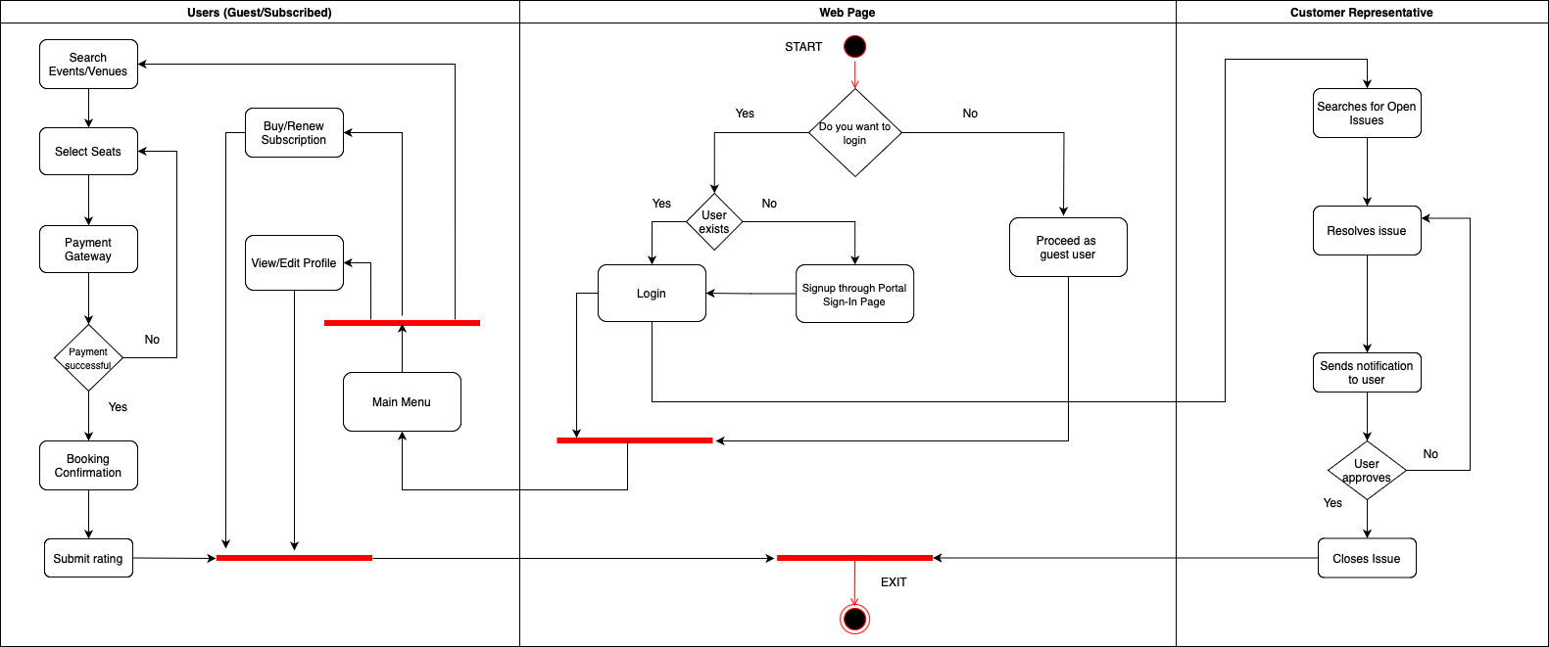
QuickBook- Activity Diagram

